Slide 1
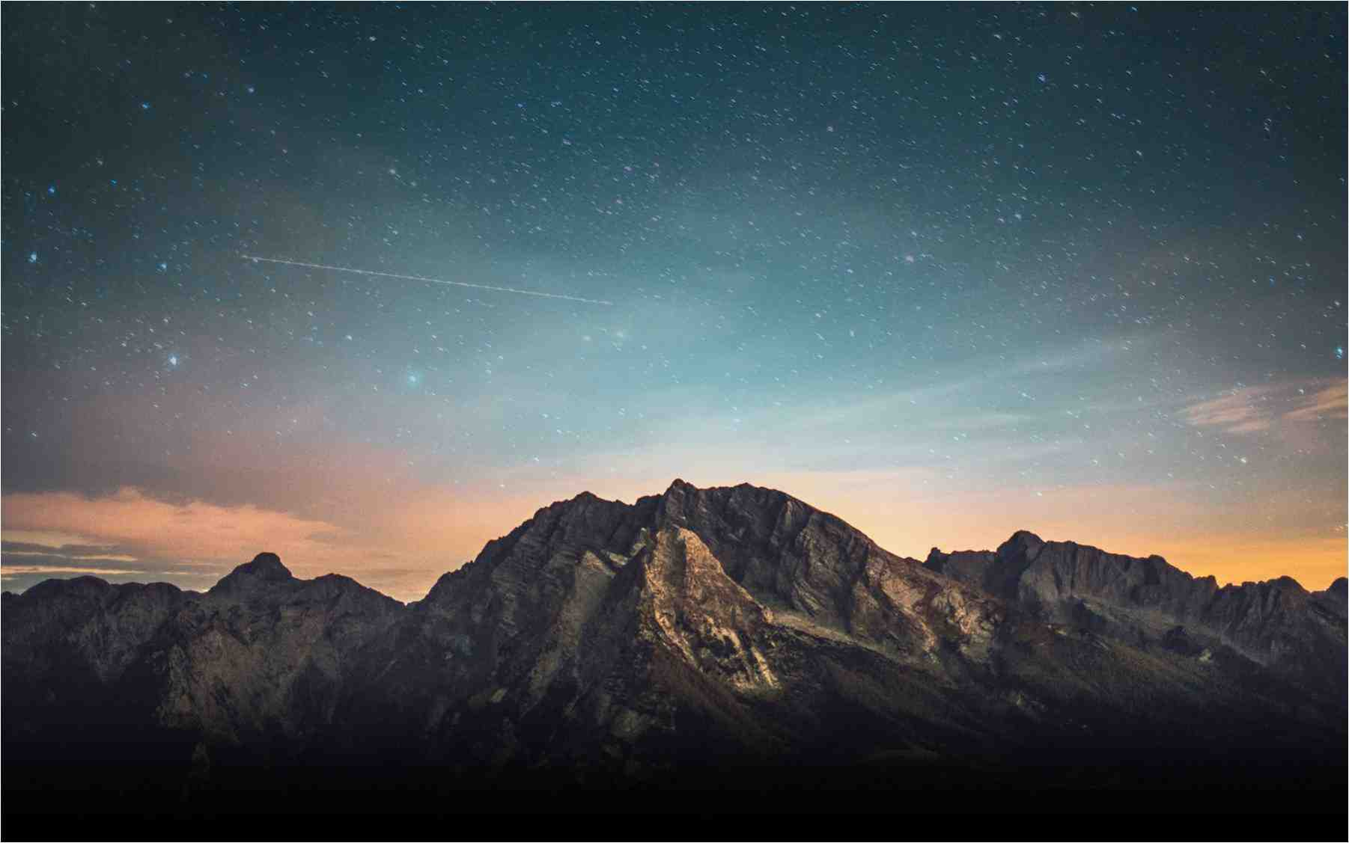

Slide 2
We need a solid foundation
1 Timothy 3:14-15 continue in what you have learned
The soundness of the foundation..evidence for the truth of Christ and His Word.
Understand that upon this Foundation are Built:
Godly Lives, Faithful Churches, Strong Marriages & Families, Unselfish Christians.
Notes:
Examine the Evidence….plenty of us can benefit from this examination. From students bombarded with questions to adults faith being tested. But in addition to edifying our members, these lessons will be GREAT for inviting non-believing friends and neighbors.

Slide 3
By Obeying His words
Matthew 7:24-25
²⁴ “Therefore whoever hears these sayings of Mine, and does them, I will liken him to a wise man who built his house on the rock: ²⁵ and the rain descended, the floods came, and the winds blew and beat on that house; and it did not fall, for it was founded on the rock.
²⁶ “But everyone who hears these sayings of Mine, and does not do them, will be like a foolish man who built his house on the sand: ²⁷ and the rain descended, the floods came, and the winds blew and beat on that house; and it fell. And great was its fall.”

Slide 4
The Foundation has been laid
1 Corinthians 3:11-15
¹¹ For no other foundation can anyone lay than that which is laid, which is Jesus Christ.
¹² Now if anyone builds on this foundation with gold, silver, precious stones, wood, hay, straw, ¹³ each one’s work will become clear; for the Day will declare it, because it will be revealed by fire; and the fire will test each one’s work, of what sort it is. ¹⁴ If anyone’s work which he has built on it endures, he will receive a reward. ¹⁵ If anyone’s work is burned, he will suffer loss; but he himself will be saved, yet so as through fire.

Slide 5
We are built into a holy temple
Ephesians 2:19-22
Now, therefore, you are no longer strangers and foreigners, but fellow citizens with the saints and members of the household of God,
²⁰ having been built on the foundation of the apostles and prophets, Jesus Christ Himself being the chief cornerstone, ²¹ in whom the whole building, being fitted together, grows into a holy temple in the Lord, ²² in whom you also are being built together for a dwelling place of God in the Spirit

Slide 6
The Stone chosen by God
1 Peter 2:4-8
Coming to Him as to a living stone, rejected indeed by men, but chosen by God and precious, ⁵ you also, as living stones, are being built up a spiritual house, a holy priesthood, to offer up spiritual sacrifices acceptable to God through Jesus Christ.
⁶ Therefore it is also contained in the Scripture, “Behold, I lay in Zion A chief cornerstone, elect, precious, And he who believes on Him will by no means be put to shame.”

Slide 7
The Stone chosen by God
1 Peter 2:4-8
Therefore, to you who believe, He is precious; but to those who are disobedient,“The stone which the builders rejected Has become the chief cornerstone,” and “A stone of stumbling And a rock of offense.” They stumble, being disobedient to the word, to which they also were appointed.

Slide 8
Jesus Is Our Rock
Rich Old Testament Connections To The Rock
Deuteronomy 32:15-18, Psalm 118:22
Jesus Describes Himself As Our Rock
Luke 20:17, Acts 4:8-12
Notes:
Rich Old Testament Meaning
Personal Description of His Role & Work
On-Going Gospel Preaching
Acts 4:11, 1 Peter 2:6
Mark 12:10
Luke 20:17
Acts 4:11

