Slide 1
Gospel by the Numbers
The Number of Perfection
7
Seven Churches

Slide 2
Significance of Seven
7 days creation..
7 pairs animials, birds
7 years
Naaman dipped 7 times
Babylonian captivity (70 years)
Gospel of John (7 signs, I Am’s)
Matt 18:28 (forgive 70 times 7)
2 Peter 1 (7 virtues)

Slide 3
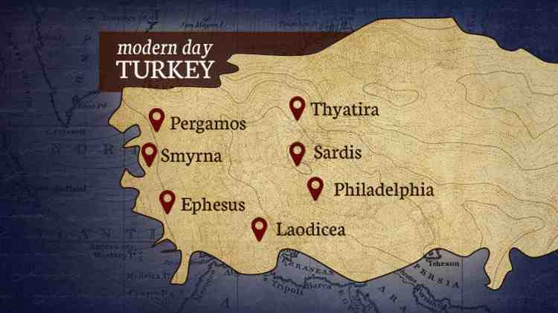
Letters to Seven Churches (Rev 2-3)

Slide 4
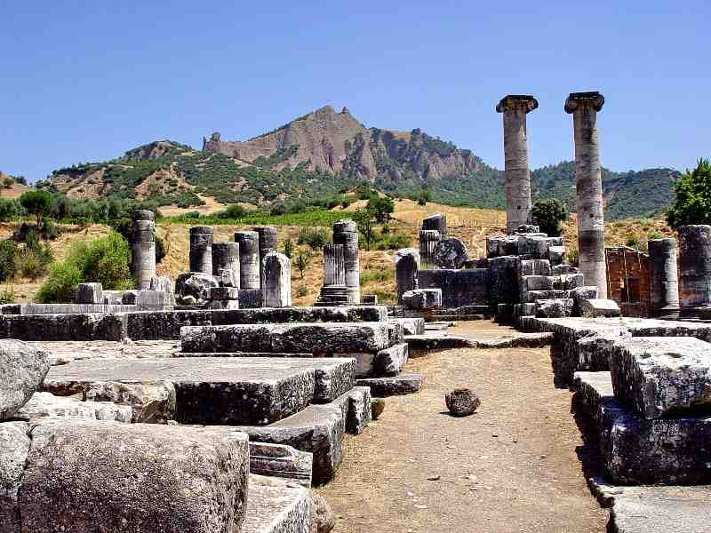
Message to the Churches
“I know your works”
Promises tribulation
Promises reward if overcome

Slide 5
Lessons for the church
Ephesus (2:4)..don’t forget your love for Christ
Smyrna (2:10)..don’t give up in difficult times
Pergamum (2:16)..don’t compromise
Thyatira (2:25)..hold to what you know is true
Sardis (3:1-2)..fan the dying flame
Philadelphia (3:11)..don’t drop the ball
Laodicea (3:17)..look at yourselves, hold fast

Slide 6
Lessons for us..
Jesus knows the conditions of the churches
Jesus says our destiny is conditional
Good in one area does not cancel sin in another
Must speak out against false teaching
Reputation with people does not count
Just doctrinally correct may not be enough
There is a reward for those who overcome

Slide 7
Gospel by the Numbers
7
The Number of Perfection
Seven Churches

