Slide 1
Hebrews 11:1-6

Slide 2
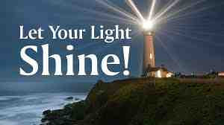

Slide 3
John 17:5 And now, Father, glorify me in your own presence with the glory that I had with you before the world existed.
Luke 24:44-45 that everything written about me in the Law of Moses and the Prophets and the Psalms must be fulfilled.” ⁴⁵ Then he opened their minds to understand the Scriptures,
True God
Christ
God’s Word
Notes:
Examine the Evidence….plenty of us can benefit from this examination. From students bombarded with questions to adults faith being tested. But in addition to edifying our members, these lessons will be GREAT for inviting non-believing friends and neighbors.

Slide 4
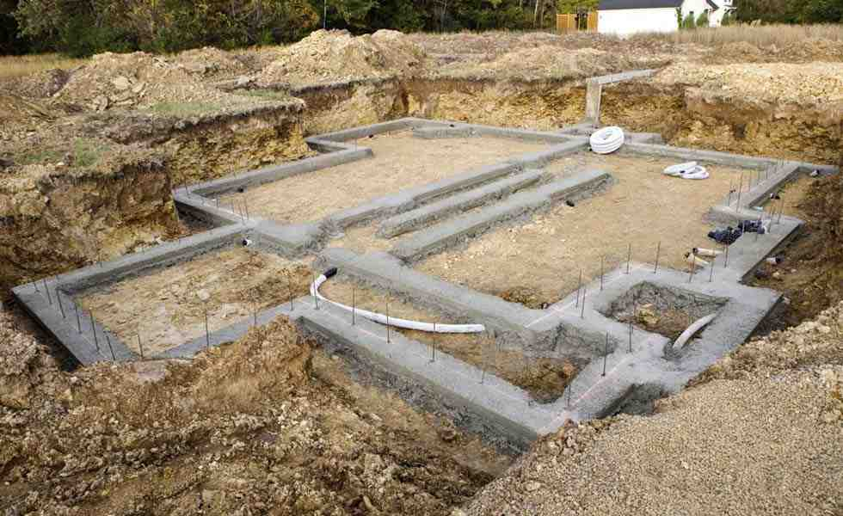

Slide 5
Matthew 7:24-27
²⁴ “Everyone then who hears these words of mine and does them will be like a wise man who built his house on the rock. ²⁵ And the rain fell, and the floods came, and the winds blew and beat on that house, but it did not fall, because it had been founded on the rock. ²⁶ And everyone who hears these words of mine and does not do them will be like a foolish man who built his house on the sand. ²⁷ And the rain fell, and the floods came, and the winds blew and beat against that house, and it fell, and great was the fall of it.”

Slide 6
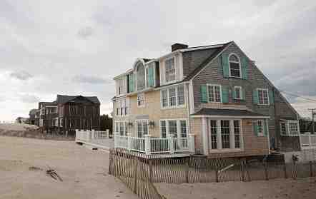
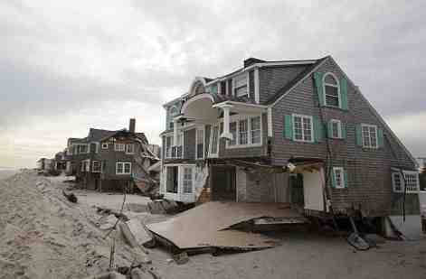

Slide 7
Hebrews 11
⁶ And without faith it is impossible to please Him, for he who comes to God must believe that He is and that He is a rewarder of those who seek Him.
³ By faith we understand that the universe was created by the word of God, so that what is seen was not made out of things that are visible.

Slide 8
Which is a more reasonable conclusion?
Order
Undirected Random Chance
Function
A Creator
Complexity
Notes:
Examine the Evidence….plenty of us can benefit from this examination. From students bombarded with questions to adults faith being tested. But in addition to edifying our members, these lessons will be GREAT for inviting non-believing friends and neighbors.

Slide 9
Acts 14:17
¹⁷ Yet he did not leave himself without witness, for he did good by giving you rains from heaven and fruitful seasons, satisfying your hearts with food and gladness.”
Romans 1:19-20
¹⁹ For what can be known about God is plain to them, because God has shown it to them. ²⁰ For his invisible attributes, namely, his eternal power and divine nature, have been clearly perceived, ever since the creation of the world, in the things that have been made. So they are without excuse.

Slide 10
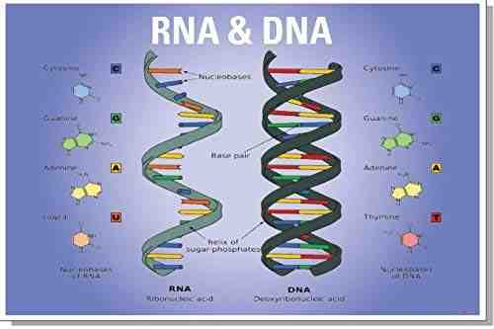
The Works of God
DNA – Code
RNA – Replicator
Proteins – Building Material
A Beginning
Life

Slide 11
The Works of God
A Beginning
Life
Mankind
Morality and Conscience
Sense of Humor, Laughter
Kindness
Self-Sacrifice
Intelligence
Communication
Inventiveness
Artistic Creativity
Imagination and Planning

Slide 12
Romans 1:28
²⁸ And just as they did not see fit to acknowledge God any longer, God gave them over to a depraved mind, to do those things which are not proper…

Slide 13
I Corinthians 2:10-13
¹⁰ these things God has revealed to us through the Spirit. For the Spirit searches everything, even the depths of God. ¹¹ For who knows a person's thoughts except the spirit of that person, which is in him? So also no one comprehends the thoughts of God except the Spirit of God.¹² Now we have received not the spirit of the world, but the Spirit who is from God, that we might understand the things freely given us by God.¹³ And we impart this in words not taught by human wisdom but taught by the Spirit, interpreting spiritual truths to those who are spiritual.

Slide 14
Building On The Rock
Hebrews 11:1-6

Slide 15
Building On The Rock
Hebrews 11:1-6

