Slide 1
How to Win at the Game of Life

Slide 2
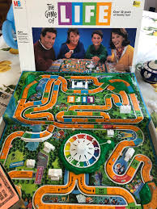

Slide 3
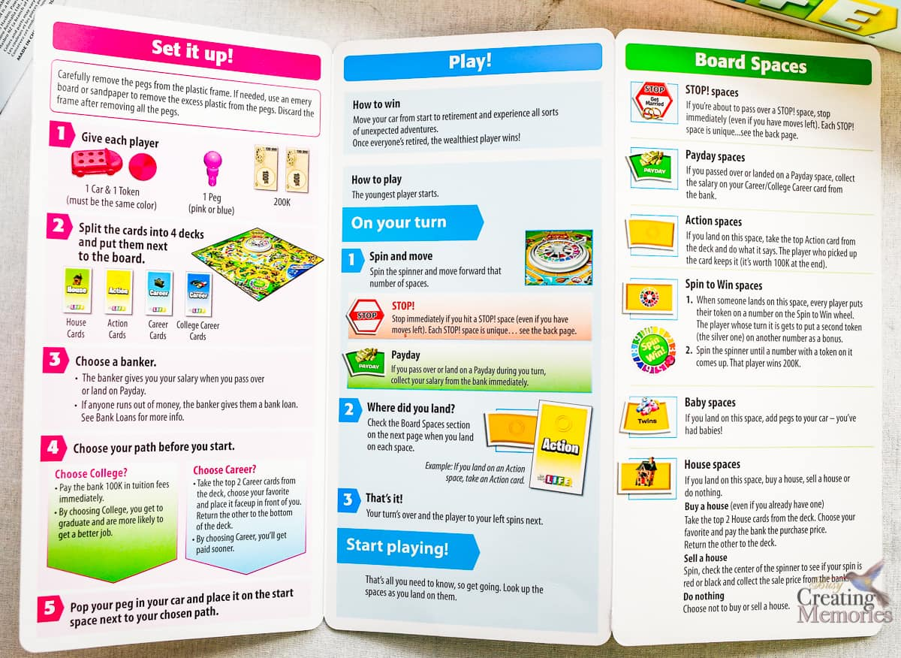

Slide 4
Knowing the rules of the game
We were never created to die.. Genesis 1-3
We are eternal souls with a body.. Eccl 12:7
Romans 5:12, 6:23
2 Cor 5:1-8

Slide 7
Living with Eternity in Mind
Our lives are like a vapor.. James 4:13-17
Make decisions based on eternity.. John 14:1-3
Invest in eternal virtues .. 1 Peter 4:7-11
Sober-minded and self control
Love others deeply
Use your spiritual talents
2 Corinthians 5:1-8
Matthew 6:19-21

Slide 8
How to Win at the Game of Life

