Slide 1
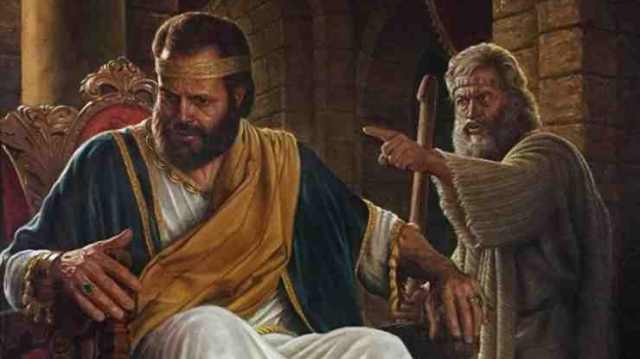
The Sins of David
2 Samuel 11-12

Slide 2
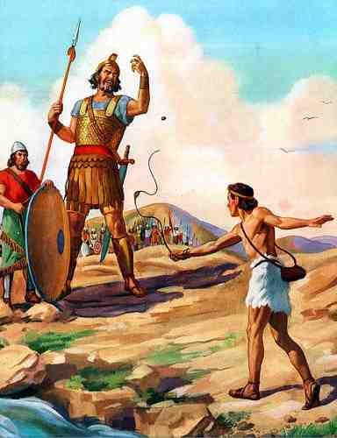
David the people’s hero..
David - one of the most popular people in the Bible.
We first meet him as a lowly shepherd boy — 1 Sam. 16
He defeats Goliath in the “name of the Lord” — 1 Sam. 17:45-51
He serves king Saul with honor — 1 Sam. 18-20
David is forced to flee from the king but retains his integrity, honor, & faith — 1 Sam 21-31
He even mourns king Saul’s death — 2 Sam. 1
David is anointed king and victoriously leads Israel in the ways of the Lord — 2 Sam. 2, 5-10

Slide 3
David the people’s hero..
God makes a covenant with David, — 2 Sam. 7:1-17
David praises & and in humility expresses thanks to God — 2 Sam. 7:18-28
However, even a man after God’s own heart (Acts 13:22) can sin and mess up his life.
David acted irresponsibly (2 Samuel 11:1), foolishly (11:2–5) and wickedly (11:6–27).
David broke half of the Ten Commandments (Exodus 20)
Sin has consequences - and NOT JUST for the sinner

Slide 4
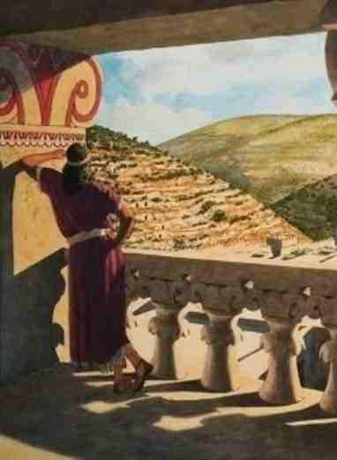
David let down his guard – 11:1-2
It happened in the spring of the year, at the time when kings go out to battle, that David sent Joab and his servants with him, and all Israel; and they destroyed the people of Ammon and besieged Rabbah. But David remained at Jerusalem.
² Then it happened one evening that David arose from his bed and walked on the roof of the king’s house. And from the roof he saw a woman bathing, and the woman was very beautiful to behold.

Slide 5
David let down his guard – 11:1-2
Stayed behind in Jer. – vs. 1
Saw & Beheld – vs. 2
Inquired & Committed Adultery – vs. 3,4
Bathsheba Conceives – vs. 5
Prideful Shame & Deceitful Cover Up – vs. 5-27
Deceitful scheme to get Uriah to go in to Bathsheba – vs. 6-13
Murders Uriah – vs. 14-25
Takes his prize - vs. 26-27

Slide 6
Coveted neighbor’s wife – 11:3
2 And from the roof he saw a woman bathing, and the woman was very beautiful to behold. ³ So David sent and inquired about the woman. And someone said, “Is this not [Bathsheba, the daughter of Eliam, the wife of Uriah the Hittite?”

Slide 7
Coveted neighbor’s wife – 11:3
“You shall not covet your neighbor’s … wife” — Ex. 20:17
David knew this was wrong — did it in secret & tried to cover it up — Rom. 12:12,13; Eph 5:11
David was guilty of sinning against God before he touched Bathsheba —Mat. 5:27,28
What David did in secret was known by God — Psalm 51:4
What made David better than king Ahab? — 1 Kings 21
All coveting is sin (a form of idolatry) — Lk. 12:15, Col. 3:5
We MUST learn to be content AND thankful for the blessings we have! — Heb. 13:5-6;

Slide 8
Committed adultery – 11:4
⁴ Then David sent messengers, and took her; and she came to him, and he lay with her, for she was cleansed from her impurity; and she returned to her house.
“You shall not commit adultery” (Exo. 20:14).
David KNEW who Bathsheba was - He knew she was married, yet he pursued her anyway — (2 Sam. 11:3,6)
David knew he had no right to lay with Bathsheba, thus he did this in secret, (2 Sam. 12:12).
David’s unlawful sexual encounter produced a lifetime of pain — (2 Sam 12:10-12)

Slide 9
Stole another man’s wife – 12:9
“You shall not steal” — Exo. 20:15
David took Bathsheba, knowing she did not belong to him but to another man — (2 Sam. 11:3,6)
How did David feel about the thief Nathan tells him about in the next chapter? (12:1-6)
Selfishness blinds the eyes of the selfish to the pain they cause others - David had his eyes opened — 12:7-13

Slide 10
He lied – 11:7-8
“You shall not bear false witness …” — Exo. 20:16
David misrepresented the reason for which he had summoned Uriah — 11:6-11
He went to great pains to cover up his sin — 11:12,13
He lied to Uriah when he sent him back to Joab — took advantage of Uriah’s honor — 11:14,15

Slide 11
He murdered Uriah – 11:17
“You shall not murder” — Exo. 20:13
To cover up his adultery, David had Uriah put to death: 11:14-17
Nearly everyone agrees that murder is a horrendous crime: Gal. 5:19-21; Rev. 21:8
How could David do such a terrible thing?
Murder always has been and still is a horrible crime — Those guilty were to be put to death — Gen. 9:6
The Law demanded those guilty of murder, (and other crimes), were to be put to death if there were two or more witnesses — Ex. 21:12–14; Lev. 24:17; Num. 35:33

Slide 12
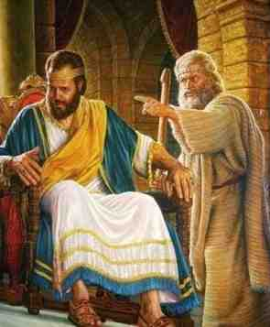
Nathan’s rebuke – 2 Samuel 12
Nathan was sent –- 1
Nathan’s Parable –- 1-4
David Saw The Guilt In Another That He Would Not See In Himself –- 5,6
Nathan Makes The Point Clear – “YOU ARE THE MAN" — 7-12
David Repents, Confesses & Is Pardoned –- 13
David’s Sin Had Earthly Consequences –- 14

Slide 13
What David did when confronted
David admitted/acknowledged his sin (2 Samuel 12:13). He took personal responsibility for his sin — He saw himself as God saw him - guilty! Wicked! Unholy! Condemned — (Psalm 51:1-4).
David turned to God for he was at God’s mercy — (Psalm 51:4).
David asked God for forgiveness (Psalm 51:1). He didn’t use elaborate or soft vocabulary. He said, “I have sinned.”

Slide 14
Lessons we need to learn
Our NEED to ALWAYS be on GUARD — 2 Peter 1:5-9
Sin will take us further than we ever DREAMED possible — Jn 8:34; Rom. 7:13-24; James 1:13-15
Sin is DESTRUCTIVE — it hurts me — it hurts others — causes death — Rom. 6:23; 14:15
Our need to take responsibility for our sins — to be honest and humble — (2 Sam. 12:13; Ps. 51:1-12; Acts 2:36,37)

Slide 15
The Sins of David
2 Samuel 11-12

