Slide 1
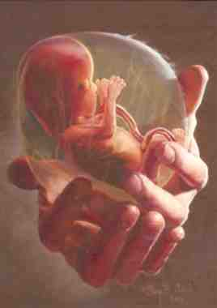
The Value of Life
Psalm 139:13-16

Slide 2
Fearfully and wonderfully made
13 For You formed my inward parts; You covered me in my mother’s womb.¹⁴ I will praise You, for I am fearfully and wonderfully made..
18 days heart is forming
21 heartbeat
30 days size multiplied 10,000
40 days brainwaves

Slide 3
Biblical respect for life
Gen 9:5-6 I will demand a reckoning
Lev 17:10-14 Animal life
Gen 1:26-27 Human life
Acts 17:24-28 He gives life to all

Slide 4
When does life begin?
Exodus 21:22-24 injury to a woman with child
Gen 25:21-23 the children struggled within her
Job 3:3 the night a male child was conceived
Isa 49:1 the Lord called me from the womb
Luke 1:36-44 the babe leaped in the womb

Slide 5
End of life issues
Job 3:20-22 longing for death
1 Kings 19:4 Lord, take my life
Jonah 4:3 please take my life
Romans 1:28-32 without natural affection

Slide 6
The Value of Life
Psalm 139:13-16

