Slide 1
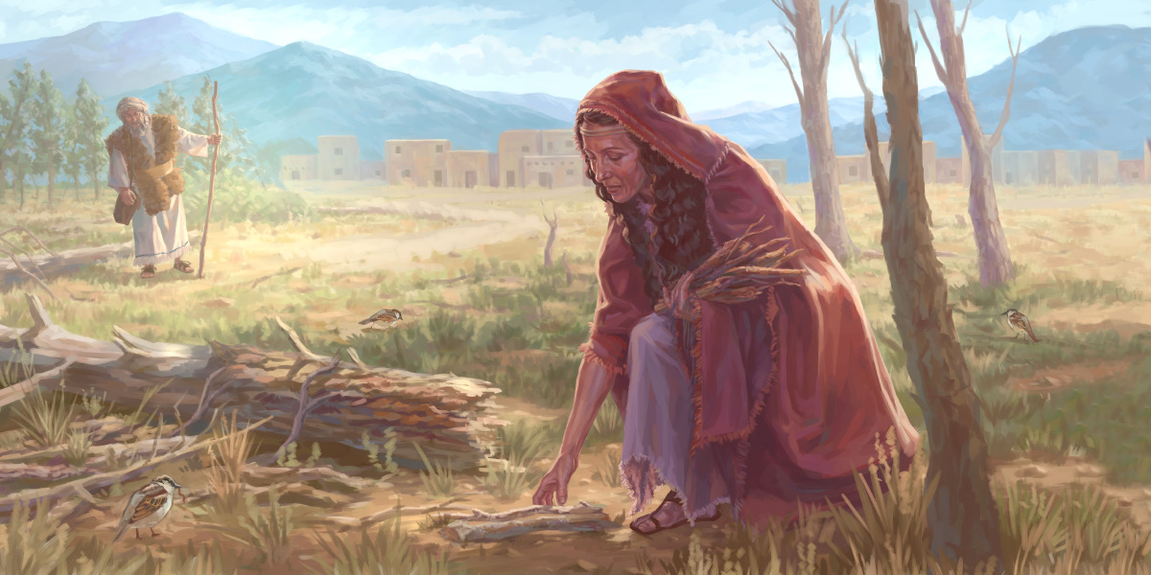
A Little Cake for the Prophet
1 Kings 17:10-16

Slide 2
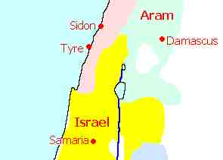
Background
1 Kings 16:30-33 Now Ahab the son of Omri did evil in the sight of the Lord, more than all who were before him. ³¹ And it came to pass, as though it had been a trivial thing for him to walk in the sins of Jeroboam the son of Nebat, that he took as wife Jezebel the daughter of Ethbaal, king of the Sidonians; and he went and served Baal and worshiped him. ³² Then he set up an altar for Baal in the temple of Baal, which he had built in Samaria. ³³ And Ahab made a wooden image (Asherah) . Ahab did more to provoke the Lord God of Israel to anger than all the kings of Israel who were before him.

Slide 3
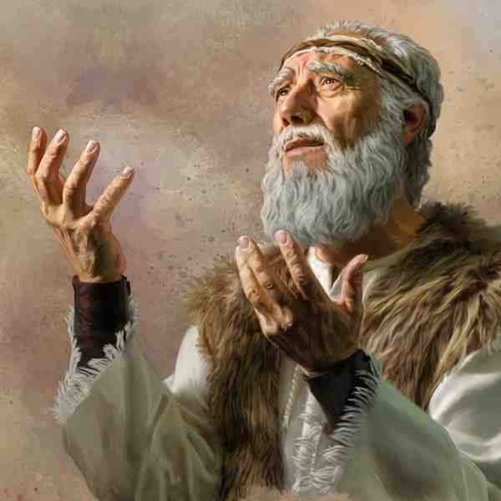
The Prophet
1 Kings 17:1 And Elijah the Tishbite, of the inhabitants of Gilead, said to Ahab, “As the Lord God of Israel lives, before whom I stand, there shall not be dew nor rain these years, except at my word.”

Slide 4
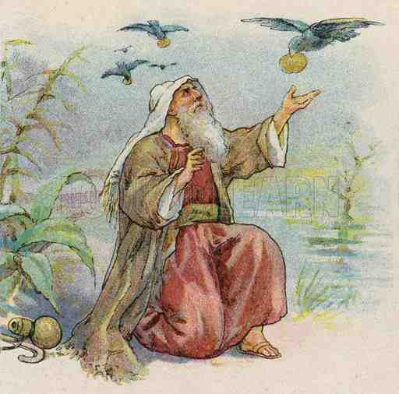
Fed by Ravens
1 Kings 17:2-7 Then the word of the Lord came to him, saying, ³ “Get away from here and turn eastward, and hide by the Brook Cherith, which flows into the Jordan. ⁴ And it will be that you shall drink from the brook, and I have commanded the ravens to feed you there.”
7 And it happened after a while that the brook dried up, because there had been no rain in the land.

Slide 5
A Widow in Sidon
1 Kings 17:8-16 Then the word of the Lord came to him, saying, ⁹ “Arise, go to Zarephath, which belongs to Sidon, and dwell there. See, I have commanded a widow there to provide for you.” ¹⁰ So he arose and went to Zarephath. And when he came to the gate of the city, indeed a widow was there gathering sticks. And he called to her and said, “Please bring me a little water in a cup, that I may drink.” ¹¹ And as she was going to get it, he called to her and said, “Please bring me a morsel of bread in your hand.”

Slide 6
A Widow in Sidon
12 So she said, “As the Lord your God lives, I do not have bread, only a handful of flour in a bin, and a little oil in a jar; and see, I am gathering a couple of sticks that I may go in and prepare it for myself and my son, that we may eat it, and die.”
13 And Elijah said to her, “Do not fear; go and do as you have said, but make me a small cake from it first, and bring it to me; and afterward make some for yourself and your son. ¹⁴ For thus says the Lord God of Israel: ‘The bin of flour shall not be used up, nor shall the jar of oil run dry, until the day the Lord sends rain on the earth.’ ”

Slide 7
The Promise of God to Provide
And Elijah said to her, “Do not fear; go and do as you have said, but make me a small cake from it first, and bring it to me; and afterward make some for yourself and your son. ¹⁴ For thus says the Lord God of Israel: ‘The bin of flour shall not be used up, nor shall the jar of oil run dry, until the day the Lord sends rain on the earth.’ ”

Slide 8
The Promise of God to Provide
Matthew 6:33 Seek first the kingdom of God and His righteousness, and all these things shall be added to you.
Luke 21:1-4 poor widow put her two copper coins in the treasury
2 Corinthians 8:5 the Macedonians gave beyond their ability.. But they first gave themselves to the Lord and then to us by the will of God

Slide 9
The Widow’s Son
1 Kings 17:17-24 Now it happened after these things that the son of the woman who owned the house became sick. And his sickness was so serious that there was no breath left in him. ¹⁸ So she said to Elijah, “What have I to do with you, O man of God? Have you come to me to bring my sin to remembrance, and to kill my son?”
19 And he said to her, “Give me your son.” So he took him out of her arms and carried him to the upper room where he was staying, and laid him on his own bed. 20 Then he cried out to the Lord and said, “O Lord my God, have You also brought tragedy on the widow with whom I lodge, by killing her son?”

Slide 10
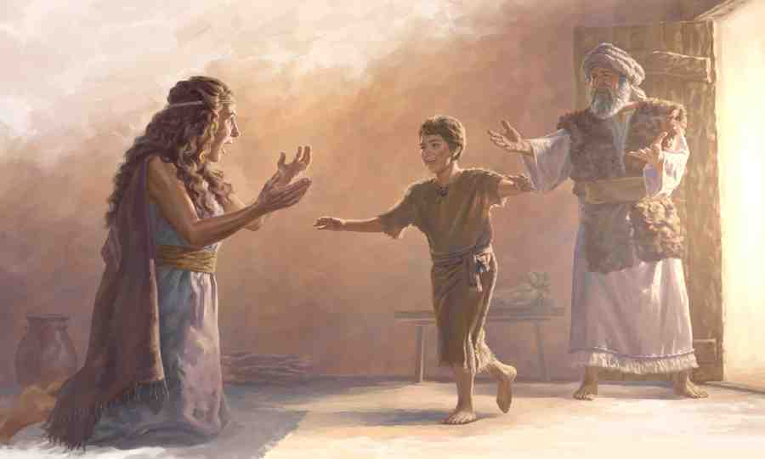
God Raised Her Son
²¹ And he stretched himself out on the child three times, and cried out to the Lord and said, “O Lord my God, I pray, let this child’s soul come back to him.” ²² Then the Lord heard the voice of Elijah; and the soul of the child came back to him, and he revived.
²³ And Elijah took the child and brought him down from the upper room into the house, and gave him to his mother. And Elijah said, “See, your son lives!”
²⁴ Then the woman said to Elijah, “Now by this I know that you are a man of God, and that the word of the Lord in your mouth is the truth.”

Slide 11
Resurrection Power
Genesis 2:8 And the Lord God formed man of the dust of the ground, and breathed into his nostrils the breath of life; and man became a living being.
1 Peter 1:3 Blessed be the God and Father of our Lord Jesus Christ, who according to His abundant mercy has begotten us again to a living hope through the resurrection of Jesus Christ from the dead,

Slide 12
God’s Mercy to All
Luke 4:16 So He came to Nazareth, where He had been brought up. And as His custom was, He went into the synagogue on the Sabbath day, and stood up to read.
24 Then He said, “Assuredly, I say to you, no prophet is accepted in his own country. ²⁵ But I tell you truly, many widows were in Israel in the days of Elijah, when the heaven was shut up three years and six months, and there was a great famine throughout all the land; ²⁶ but to none of them was Elijah sent except to ^{[l]}Zarephath, in the region of Sidon, to a woman who was a widow. ²⁷ And many lepers were in Israel in the time of Elisha the prophet, and none of them was cleansed except Naaman the Syrian.”

Slide 13
A Little Cake for the Prophet
1 Kings 17:10-16

