Slide 1
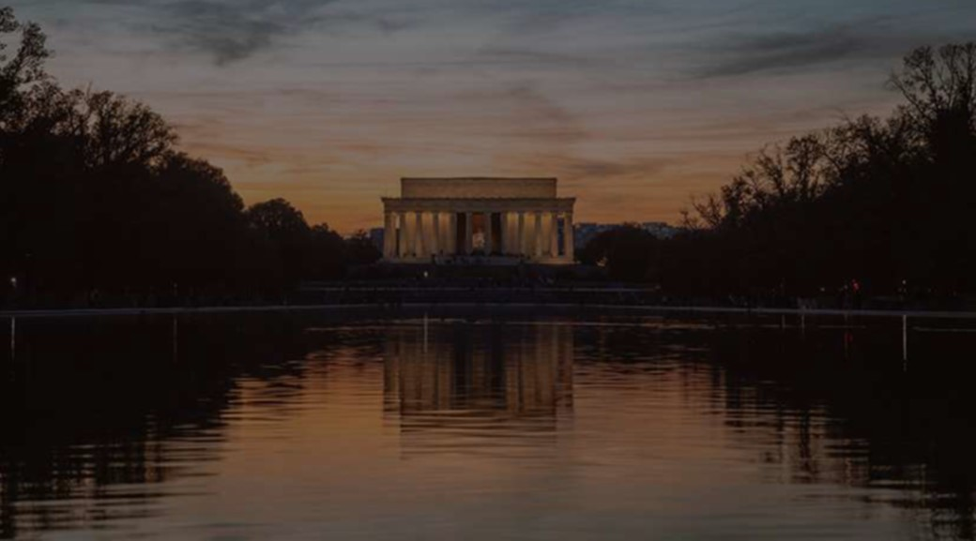
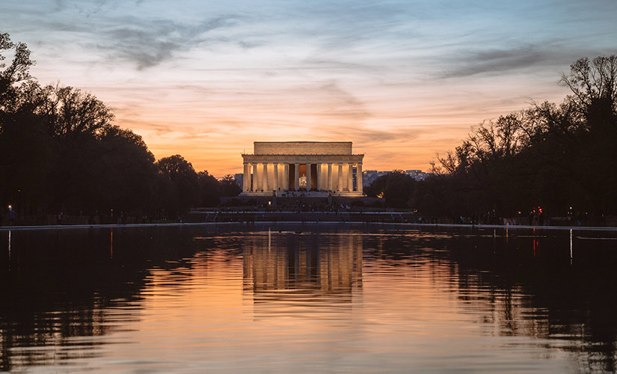
Ezra Prays for His Nation
Ezra 9:1-15

Slide 2
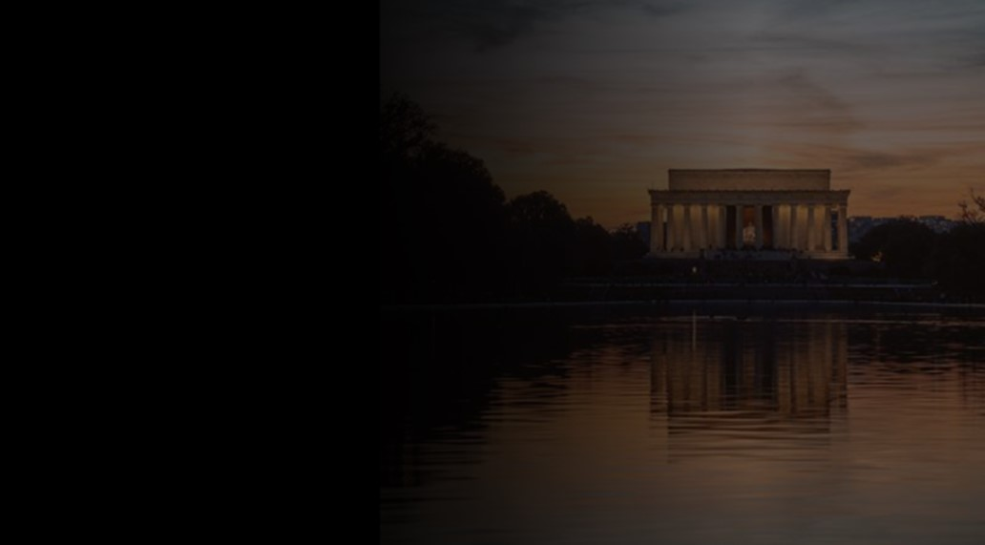
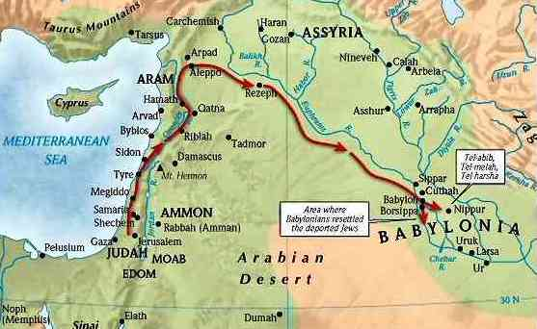
The Returns
1st Group 538 to rebuild temple (Zerubbabel) 49,897 people
2nd Group 458 to restore people (Ezra leads) 1754 people
3rd Group 444 to rebuild walls (Nehemiah leads)

Slide 3
Ezra – a godly devoted Jew (“Help”)
A devoted student of the scriptures; skilled scribe
He helped to restore the Law to the nation
A man of prayer deeply burdened for the spiritual welfare of his people

Slide 4
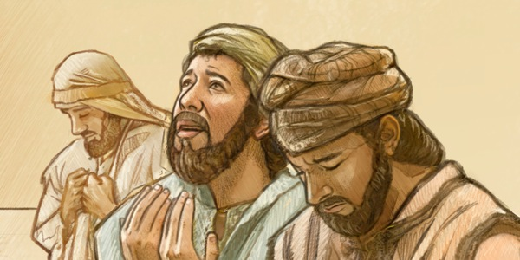
Ezra is Chosen
7:1-10 King Artaxerxes permitted Ezra to return to Jerusalem to assist the spiritual needs of the people
7:6 A scribe skilled in the law of Moses – the hand of God was upon him (v 6, 9, 28)
7:10 For Ezra had set his heart to study the Law of the Lord, and to do it and to teach his statutes and rules in Israel.

Slide 5
Ezra given permission by the King 7:12-26
Letter written in Aramaic language
Any Jew could go up with Ezra (13)
Large free will offering (16)
Even given expense account (20-22)

Slide 6
Ezra’s Task (7:25-28)
To establish order and religious worship in the land
His appreciation and praise (27-28)
Blessed be the Lord, the God of our fathers, who put such a thing as this into the heart of the king, to beautify the house of the Lord that is in Jerusalem, ²⁸ and who extended to me his steadfast love. I took courage, for the hand of the Lord my God was on me,

Slide 7
Making the Journey Ch 8
Assembling companions (1-14)
Finding and enlisting Levites (15-20)
Fasting for Prayer and Courage (21-23)
Journey to Jerusalem (8:31-36)

Slide 8
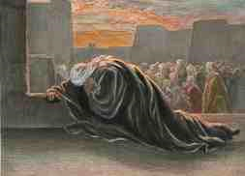
Ezra’s Reaction to Sin
9:1-4 Ezra hears many people in Israel have sinned by taking foreign wives).. Ezra’s reaction
9:3-4 As soon as I heard this, I tore my garment and my cloak and pulled hair from my head and beard and sat appalled. ⁴ Then all who trembled at the words of the God of Israel, because of the faithlessness of the returned exiles, gathered around me while I sat appalled until the evening sacrifice.

Slide 9
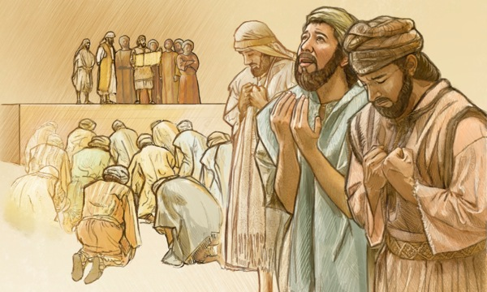
Godly Reaction to Sin Ch 9
Their sin is reported 9:1-2 Marriages with foreign wives, Exodus 34:11-16; Deut 7:1-4
Ezra’s prayer of confession (9:5-15)
Confess it without excuse to the God of mercy

Slide 10
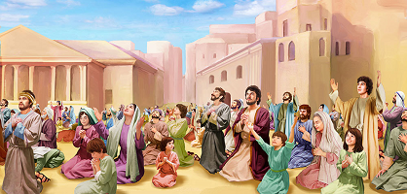
Shechaniah’s Challenge Ch 10
Shechaniah listens and admits their sin (1-2)
Challenges the people to face their responsibility (4)
Public Oath and Call for Repentance
Their sin put away (10:18-44)

Slide 11
Ezra Prays for His Nation
Ezra 9:1-15

