Slide 1
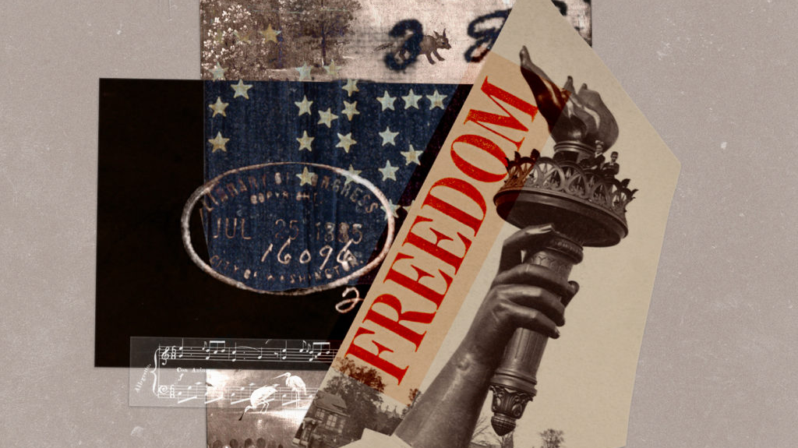
Using Freedom Properly
1 Peter 2:16

Slide 2
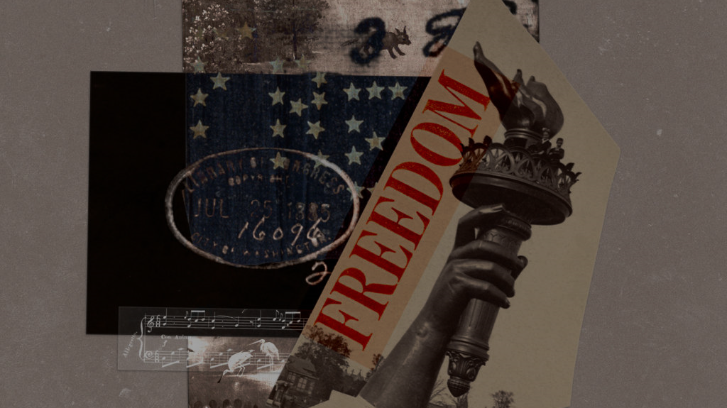
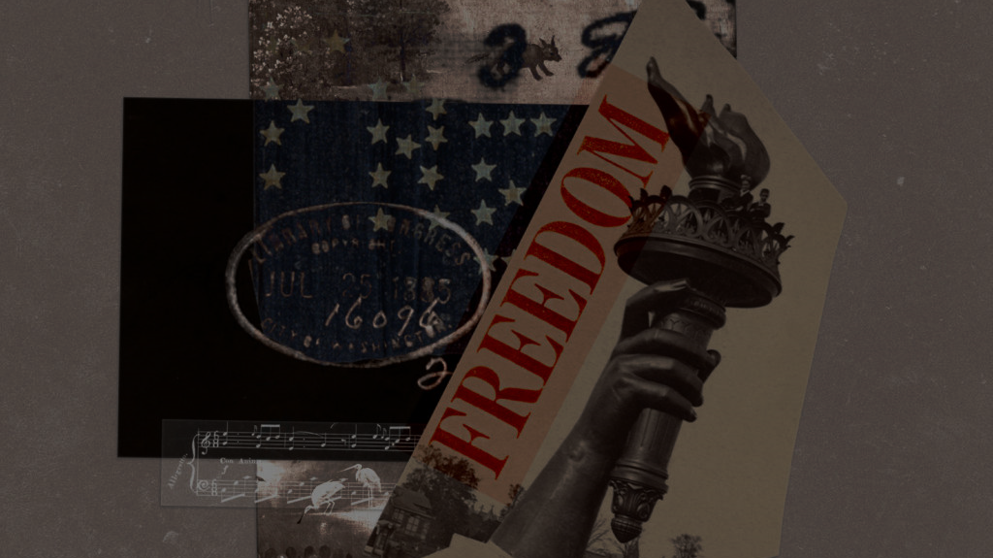
Peter speaks about freedom
1 Peter 2:16 Live as people who are free, not using your freedom as a cover-up for evil, but living as servants of God.
Ch 2-3 in 1st Century
Living faithfully in the Roman world
In view of eternity with living hope
To honor God to attract others to Him

Slide 3
“Freedom is destroyed not only by its retraction, but it is also devastated by its abuse” – Ravi Zacharias
Radical moral relativism – individual can define their own morality
There is nothing left to constrain us – the tragedy of our culture celebrating the new definition of individual freedom is that it has also destroyed what protected us from tyranny.

Slide 4
Our New Life in Christ
1:3-5 Blessed be the God and Father of our Lord Jesus Christ! According to his great mercy, he has caused us to be born again to a living hope through the resurrection of Jesus Christ from the dead, 4 to an inheritance that is imperishable, undefiled, and unfading, kept in heaven for you..
1:22-24 Having purified your souls by your obedience to the truth for a sincere brotherly love, love one another earnestly from a pure heart, 23 since you have been born again, not of perishable seed but of imperishable, through the living and abiding word of God

Slide 5
Continue Desiring to Grow..
2:1-3 Therefore, laying aside all malice, all deceit, hypocrisy, envy, and all evil speaking, ² as newborn babes, desire the pure milk of the word, that you may grow ^{[a]}thereby, ³ if indeed you have tasted that the Lord is gracious.
Spiritual growth begins and continues through the Word of God
Spiritual growth is motivated by appreciation of God’s grace

Slide 6
Beginning to grow together
2:4-5 As you come to him, a living stone rejected by men but in the sight of God chosen and precious, 5 you yourselves like living stones are being built up as a spiritual house, to be a holy priesthood, to offer spiritual sacrifices acceptable to God through Jesus Christ..
2:6-8 For it stands in Scripture: “Behold, I am laying in Zion a stone, a cornerstone chosen and precious, and whoever believes in him will not be put to shame.” ⁷ So the honor is for you who believe, but for those who do not believe, “The stone that the builders rejected has become the cornerstone,” ⁸ and “A stone of stumbling, and a rock of offense.”

Slide 7
People who proclaim His excellency
2:9-10 But you are a chosen generation, a royal priesthood, a holy nation, His own special people, that you may proclaim the praises of Him who called you out of darkness into His marvelous light;
2:11-12 Beloved, I beg you as sojourners and pilgrims, abstain from fleshly lusts which war against the soul, ¹² having your conduct honorable among the Gentiles, that when they speak against you as evildoers, they may, by your good works which they observe, glorify God in the day of visitation.

Slide 8
Keep your conduct honorable..
2:12 Keep your conduct among the Gentiles honorable, so that when they speak against you as evildoers, they may see your good deeds and glorify God on the day of visitation.
How we respond to this world will impact how others respond to God..
If people are hostile to you for your faith and you respond hostile to them, they won’t be impressed with your faith
John 13:34-35, 17:20-21 the world notices our conduct

Slide 9
Living out His praises in the world..
2:13-15 Therefore submit yourselves to every ordinance of man for the Lord’s sake, whether to the king as supreme, 14 or to governors, as to those who are sent by him for the punishment of evildoers and for the praise of those who do good. 15 For this is the will of God, that by doing good you may put to silence the ignorance of foolish men—
2:16-17 Live as people who are free, not using your freedom as a cover-up for evil, but living as servants of God. ¹⁷ Honor everyone. Love the brotherhood. Fear God. Honor the emperor.
2:18-25 Live honorably, even if you are treated unjustly, for Christ

Slide 10
Using Our Freedom properly..
The Freedom of the NT is not political but spiritual freedom
Freedom from guilt because our sins have been forgiven
John 8:31-36 “If you abide in my word, you are truly my disciples, 32 and you will know the truth, and the truth will set you free.”
Freedom from the ruling power of sin in our lives
Romans 8:1-3 There is therefore now no condemnation for those who are in Christ Jesus. ² For the law of the Spirit of life has set you free in Christ Jesus from the law of sin and death.
Freedom from the demand of the law to earn favor with God
Gal 5:1 or freedom Christ has set us free; stand firm therefore, and do not submit again to a yoke of slavery.

Slide 11
Using Our Freedom properly..
The Freedom of the NT is not political but spiritual freedom
God does not give us freedom so we can do whatever we want and please ourselves
Freedom means we have responsibility
To submit to proper authority in our lives, even though we may be treated unjustly
We are to use our freedom to glorify God and proclaim His excellencies by doing good

Slide 12
Using Freedom Properly
1 Peter 2:16

Slide 13
1 – When the Roll Is Called Up Yonder
755
1.
When the trumpet of the Lord shall sound
and time shall be no more,
And the morning breaks eternal, bright and fair;
When the saved of earth shall gather over on the other shore,
And the roll is called up yonder, I'll be there.
Words & Music: James M. Black
© 2005 The Paperless Hymnal™

Slide 14
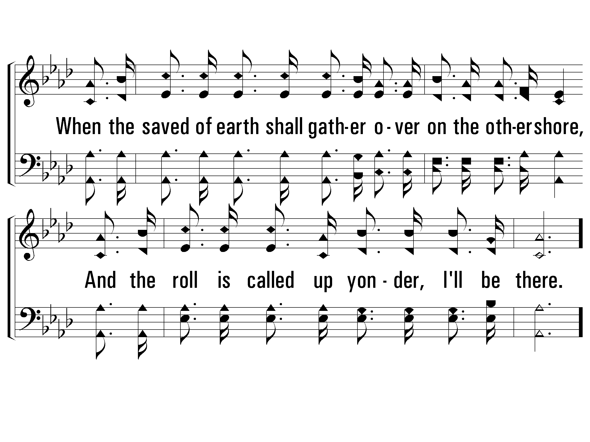
1 – When the Roll Is Called Up Yonder
755
© 2005 The Paperless Hymnal™

Slide 15
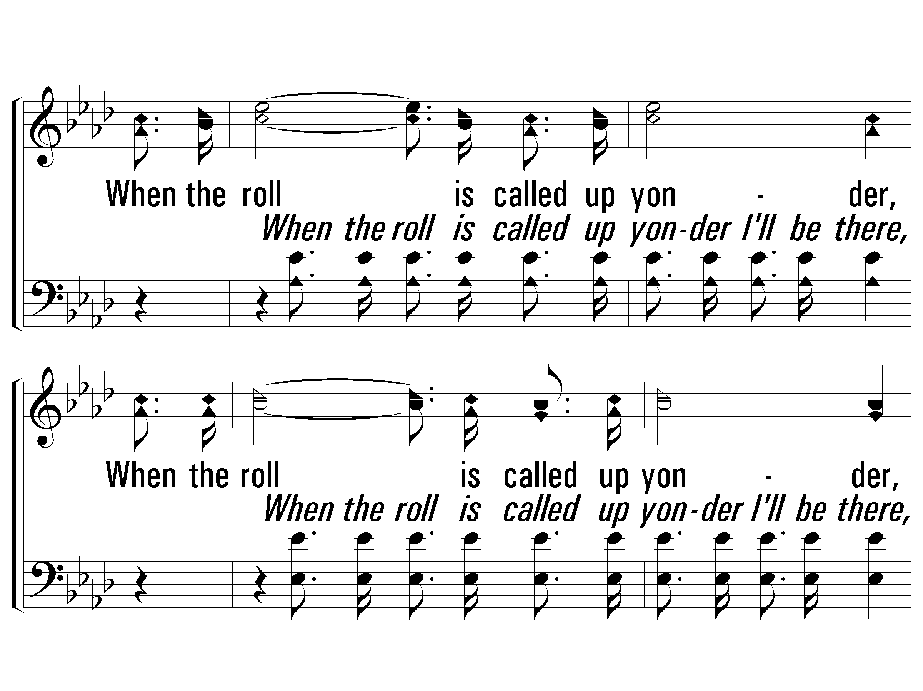
c – When the Roll Is Called Up Yonder
755
When the roll is called up yonder,
When the roll is called up yonder,
When the roll is called up yonder,
When the roll is called up yonder, I'll be there.
© 2005 The Paperless Hymnal™

Slide 16
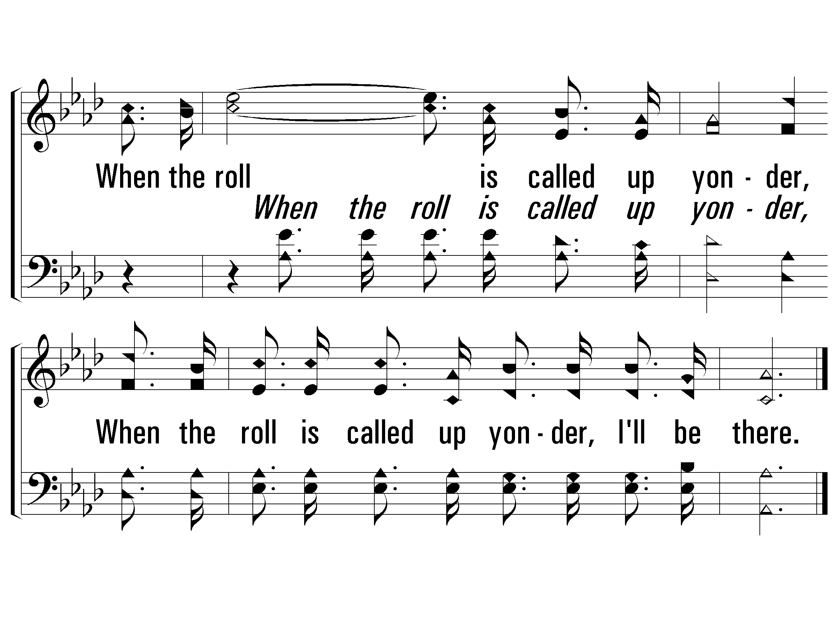
c – When the Roll Is Called Up Yonder
755
© 2005 The Paperless Hymnal™

Slide 17
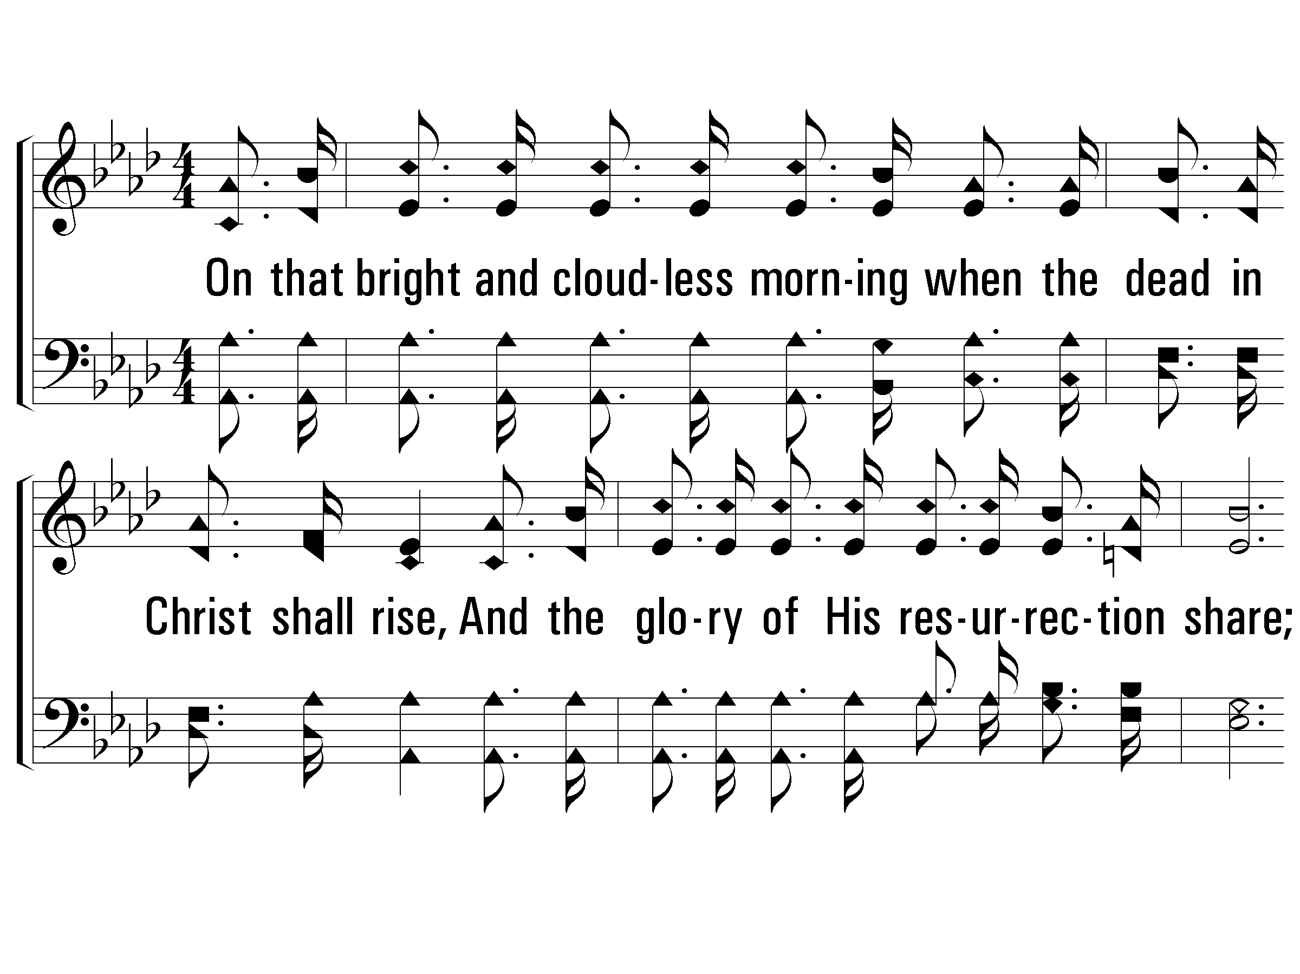
2 – When the Roll Is Called Up Yonder
755
2.
On that bright and cloudless morning
when the dead in Christ shall rise,
And the glory of His resurrection share;
When His chosen ones shall gather to their home beyond the skies,
And the roll is called up yonder, I'll be there.
Words & Music: James M. Black
© 2005 The Paperless Hymnal™

Slide 18
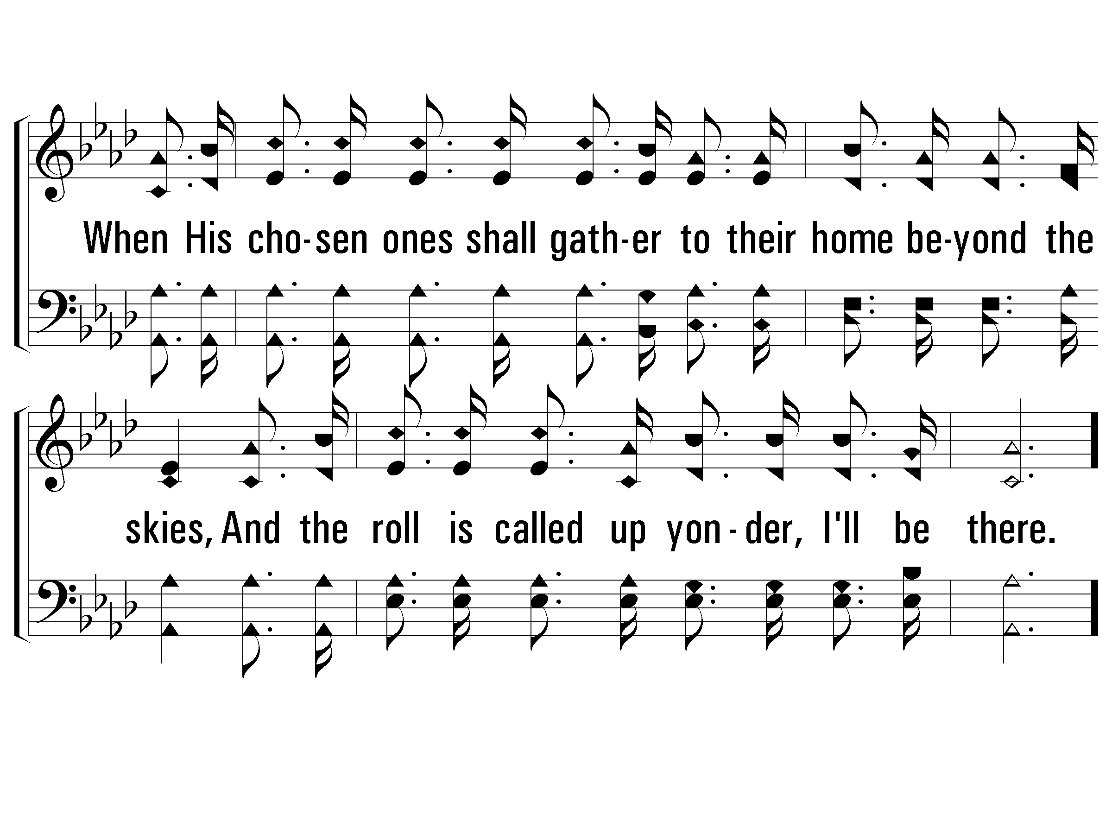
2 – When the Roll Is Called Up Yonder
755
© 2005 The Paperless Hymnal™

Slide 19
c – When the Roll Is Called Up Yonder
755
When the roll is called up yonder,
When the roll is called up yonder,
When the roll is called up yonder,
When the roll is called up yonder, I'll be there.
© 2005 The Paperless Hymnal™

Slide 20
c – When the Roll Is Called Up Yonder
755
© 2005 The Paperless Hymnal™

Slide 21
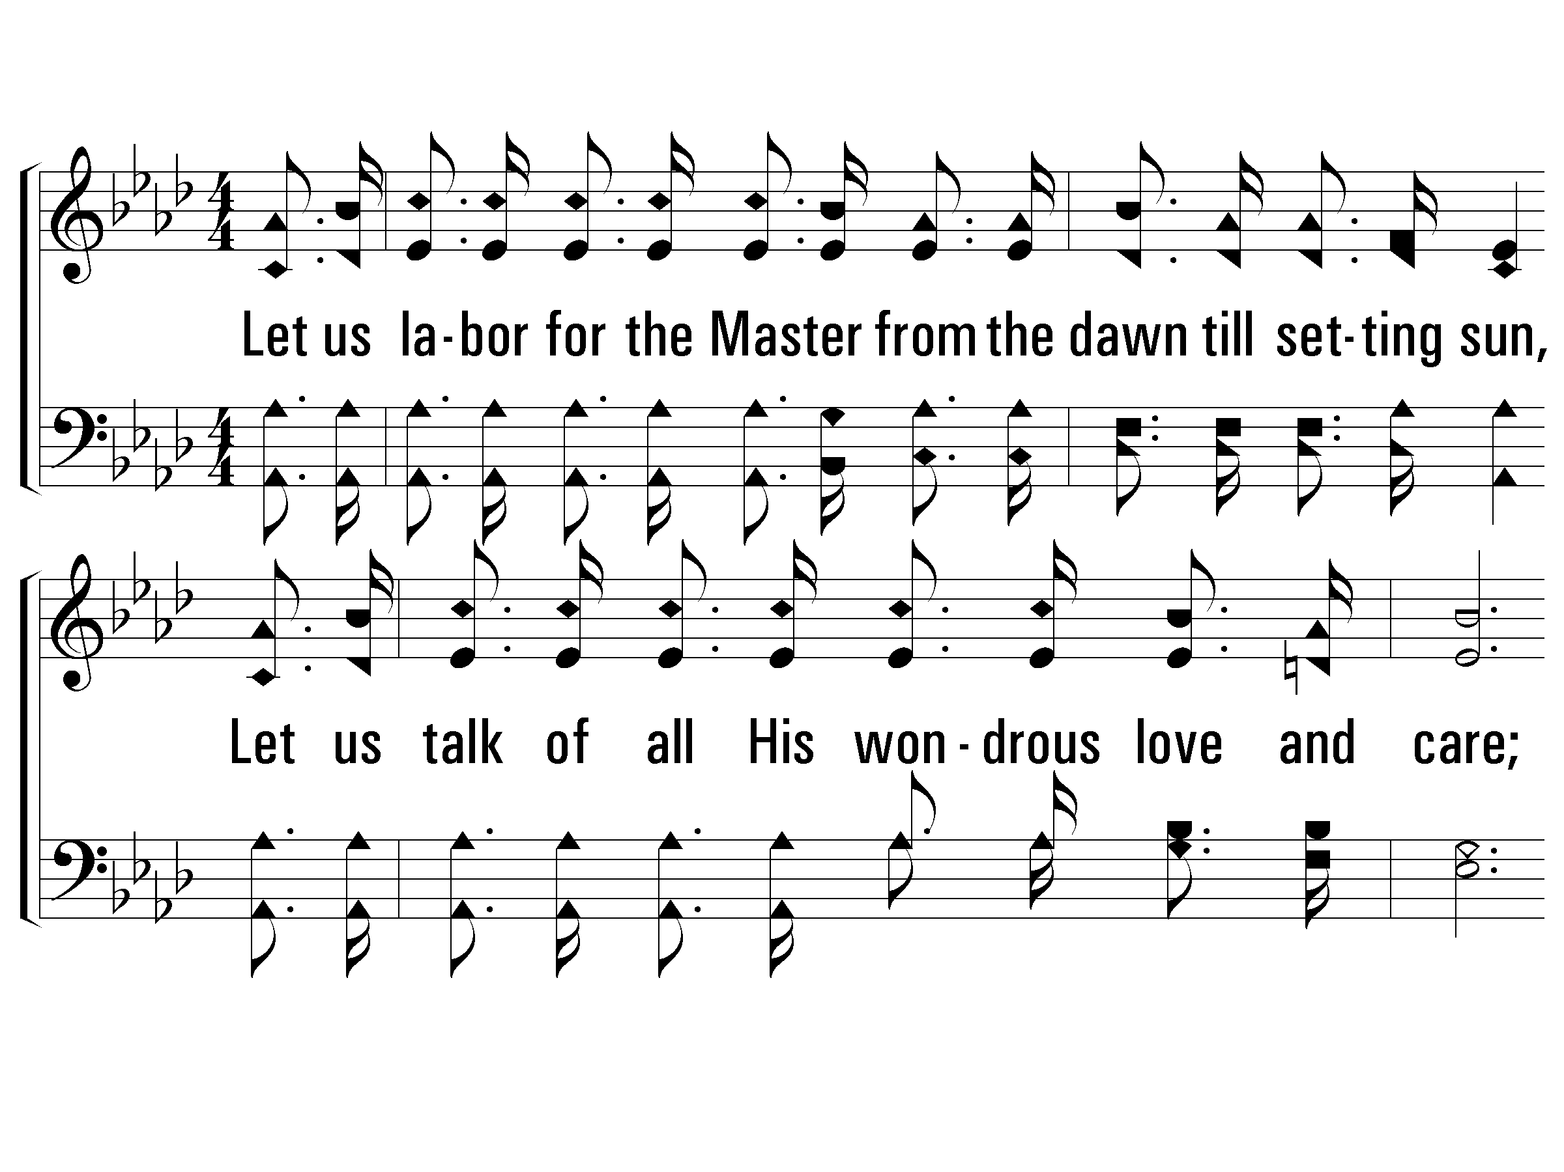
3 – When the Roll Is Called Up Yonder
755
3.
Let us labor for the Master from the dawn till setting sun,
Let us talk of all His wondrous love and care;
Then when all of life is over and our work on earth is done,
And the roll is called up yonder, I'll be there.
Words & Music: James M. Black
© 2005 The Paperless Hymnal™

Slide 22
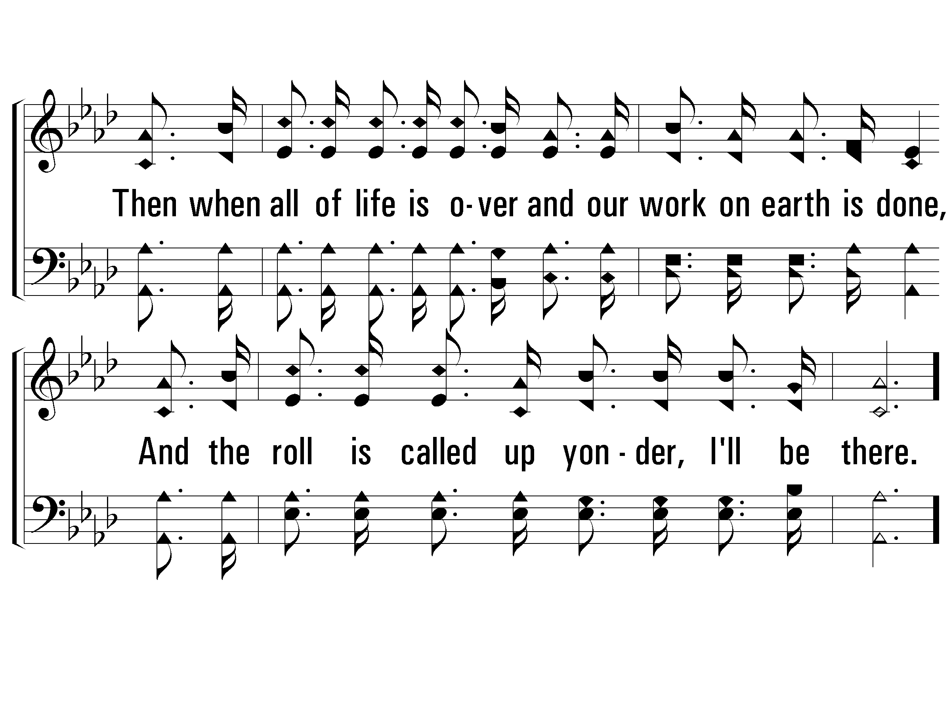
3 – When the Roll Is Called Up Yonder
755
© 2005 The Paperless Hymnal™

Slide 23
c – When the Roll Is Called Up Yonder
755
When the roll is called up yonder,
When the roll is called up yonder,
When the roll is called up yonder,
When the roll is called up yonder, I'll be there.
© 2005 The Paperless Hymnal™

Slide 24
c – When the Roll Is Called Up Yonder
755
© 2005 The Paperless Hymnal™

Slide 25
Using Freedom Properly
1 Peter 2:16

