Slide 1
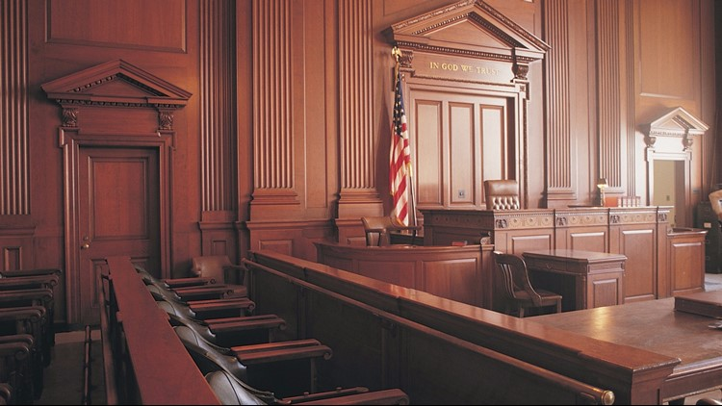
The Right to Religious Freedom
Leviticus 25:1-10

Slide 2
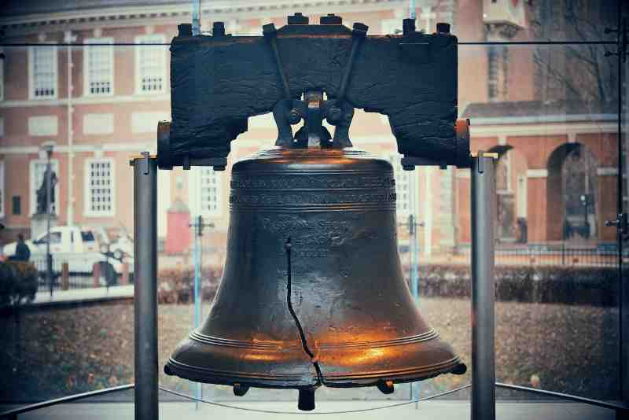
Liberty Bell
“Proclaim liberty throughout the land” Leviticus 25:10

Slide 3
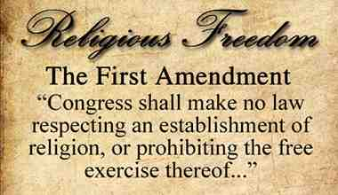
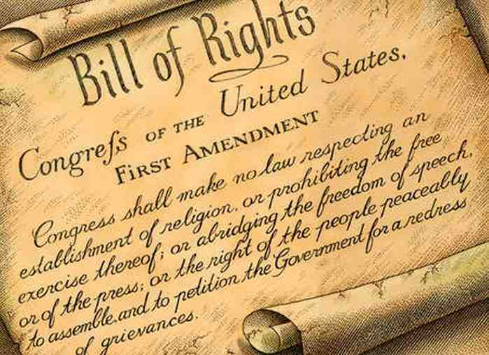

Slide 4
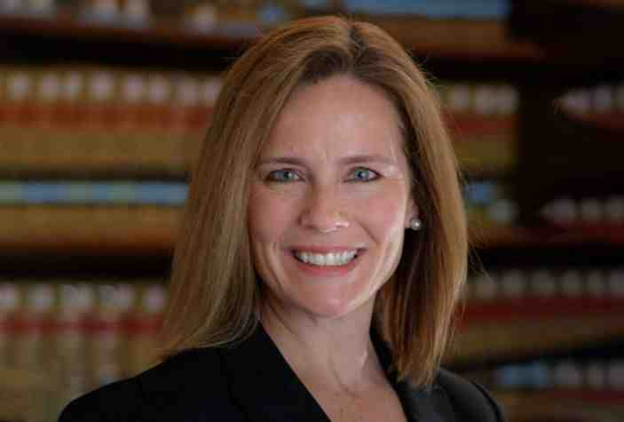
Judge Amy Coney Barrett

Slide 5
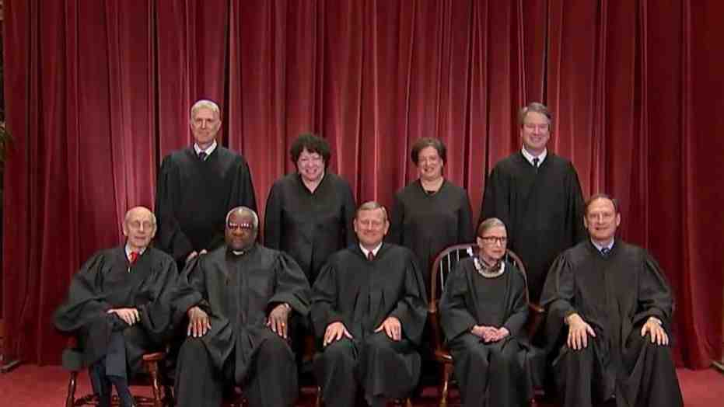

Slide 6
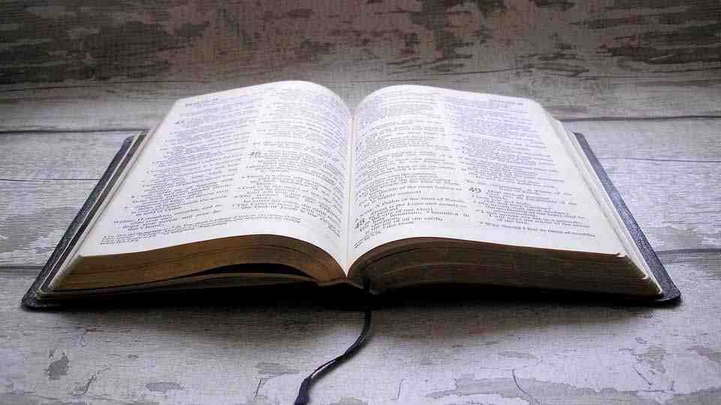
Our foremost right..
Declaration of Independence “We hold these truths to be self evident that all men are endowed by their creator with certain inalienable rights”
Religious liberty is the freedom for all people to live out their faith according to their deepest convictions.
Religious freedom is more than the freedom to worship. It means people shouldn’t have to go against their core values and beliefs to conform to culture or government.
Removing authoritarian control from religion is a founding principle of American society, traditionally seen as a God-given right.

Slide 7
God-given rights
These ideals of religious liberty have their roots in the Bible
God respects our choices .. Genesis 13:8-12, Joshua 24:15
God Himself extends a freedom to people to choose or to reject Him.. Luke 18:18-25 Matt 13:18-41
God establishes human governments (home, government, church) to protect, preserve, uphold the good..
Because of sin, only God can redeem fallen man.. John 3:16
God is over all and gives man the right of conscience to obey God rather than men.. Acts 4:19-20; 5:28-30

Slide 8
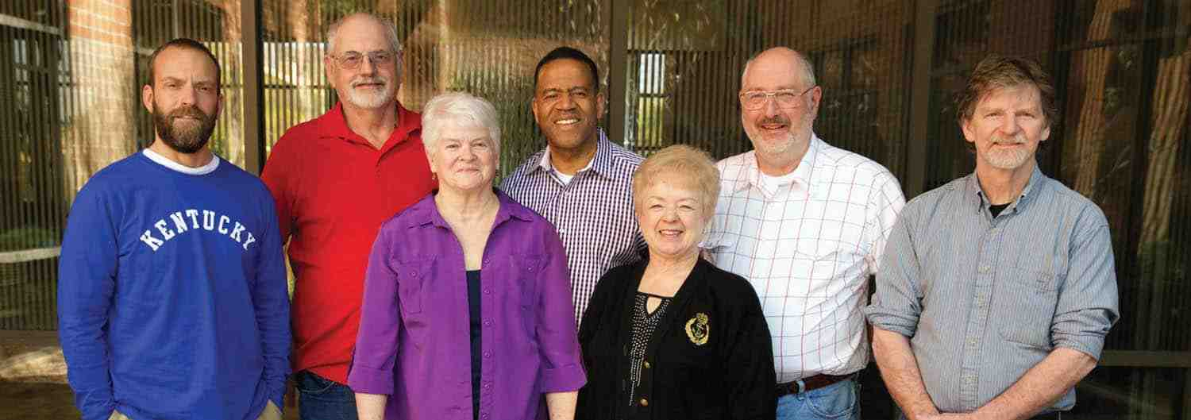
Religious freedom and discrimination cases

Slide 9
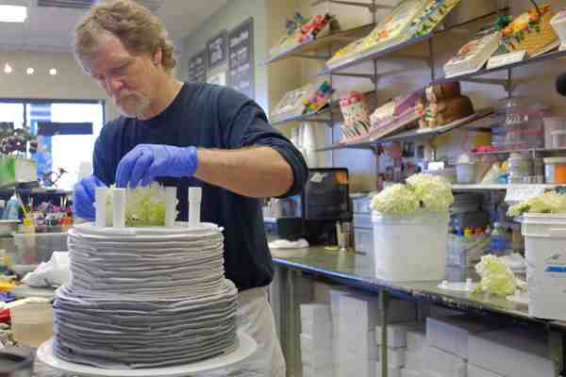
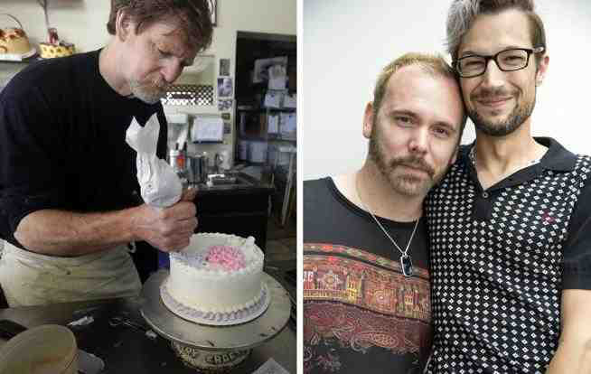
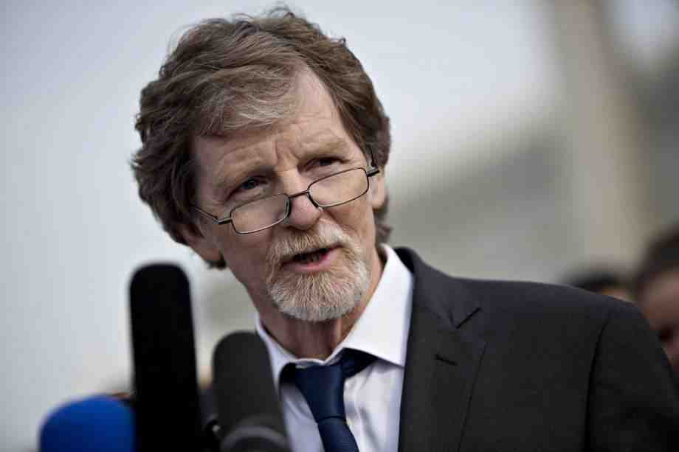
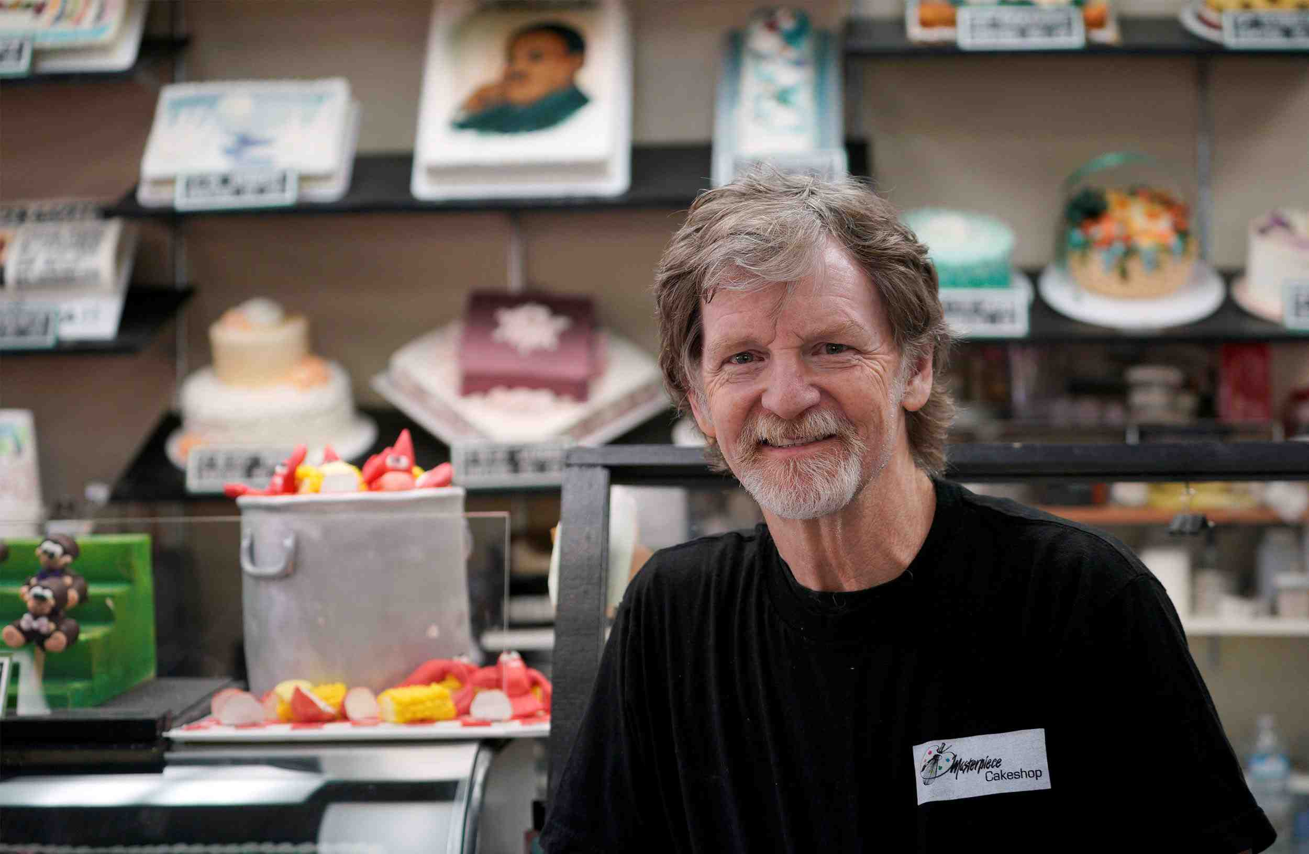

Slide 10
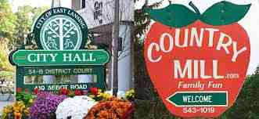
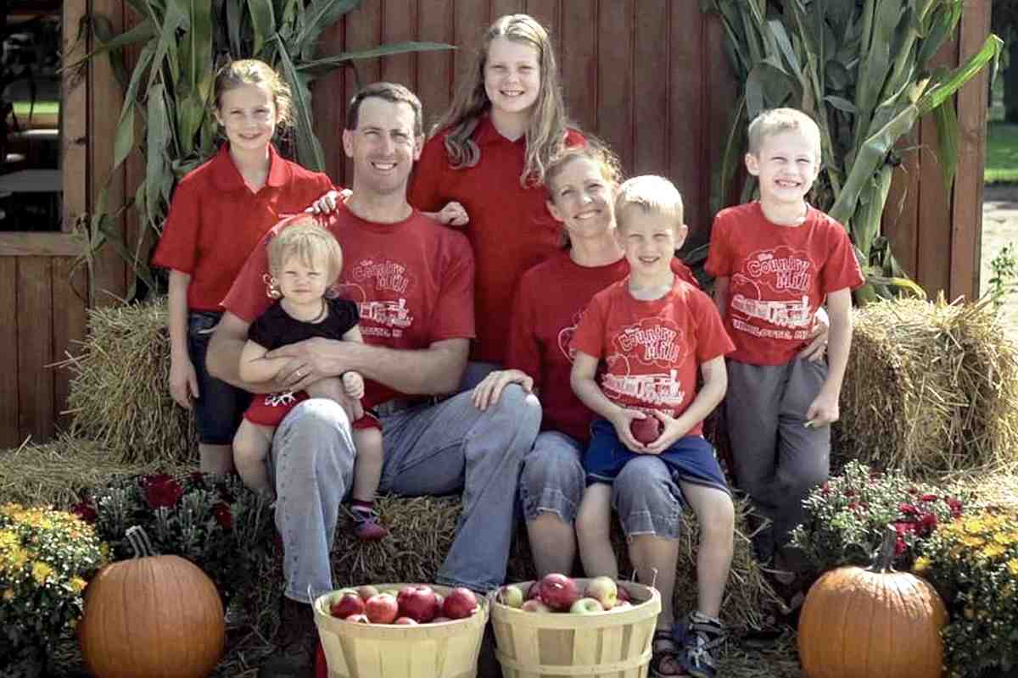
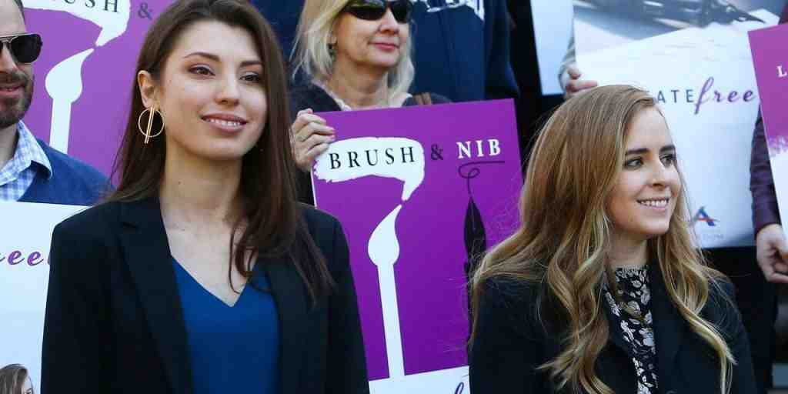

Slide 11
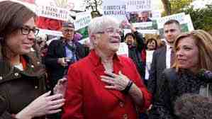
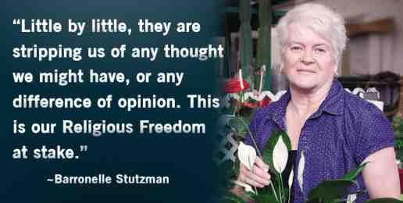

Slide 12
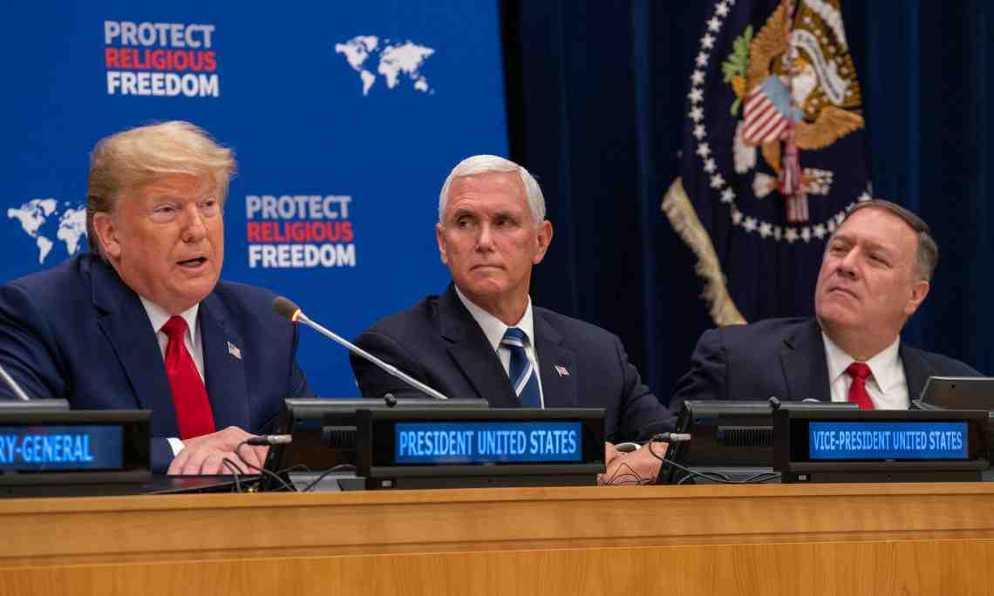

Slide 13
The Right to Religious Freedom
Leviticus 25:1-10

