Slide 1
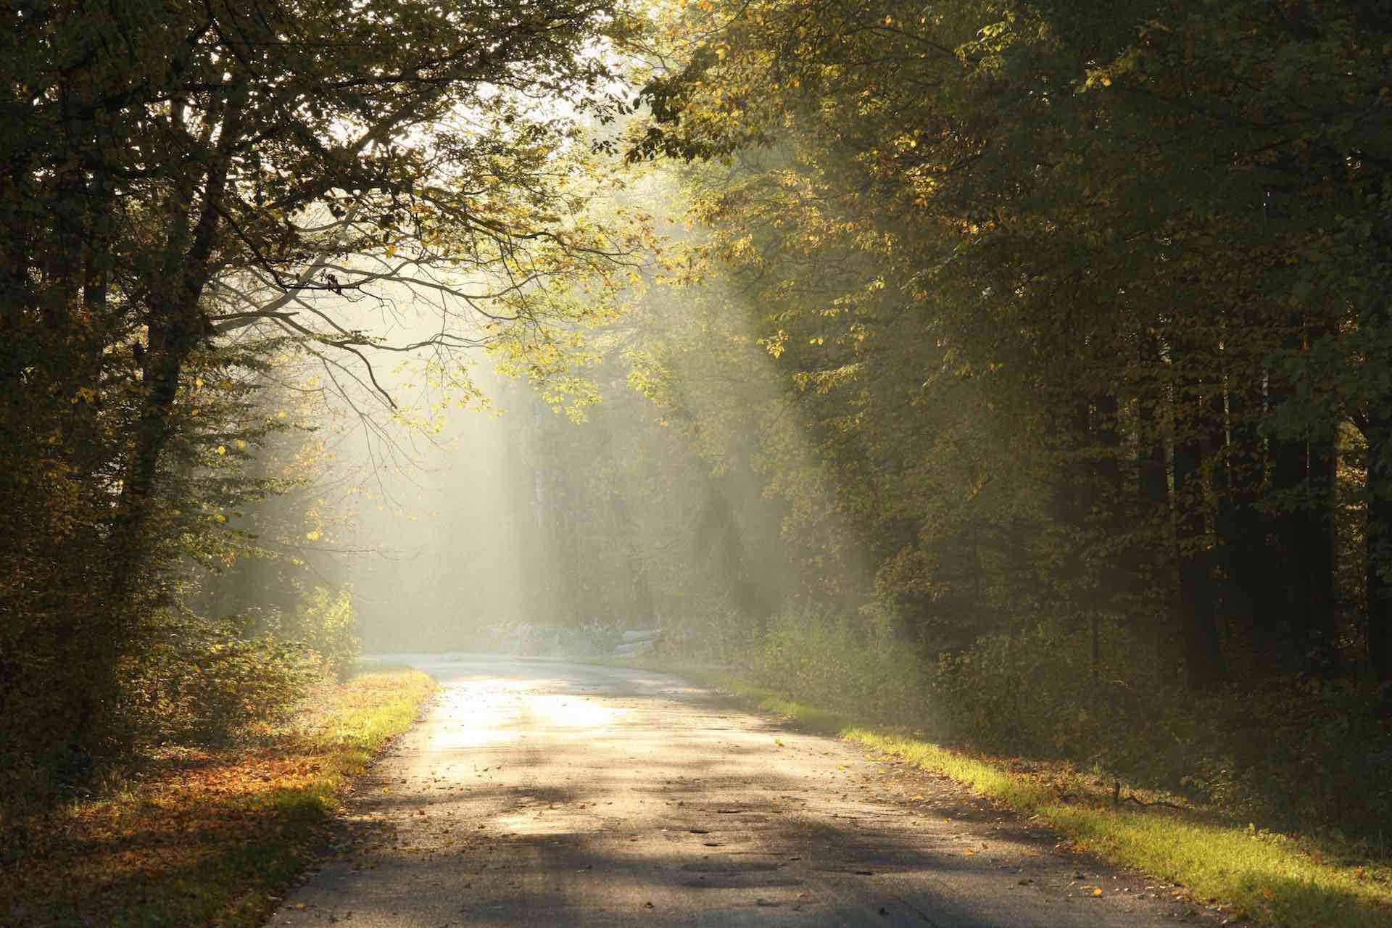
A Life that Prospers Spiritually
3rd John 1-11

Slide 2
Our reputation..
The estimation others have of you..
What do you think of yourself?
What do others think about you?
What does God think about you?

Slide 3
John’s letter to Gaius
A unique look at two very different men..
Gaius – a righteous man
Filled with good works
Known for love for the truth
Loves his brethren, hospitality
Diotrophes – loves himself
Wants to have preeminence
Refuses faithful brethren

Slide 4
Gaius..
3 John 1-2 The Elder, To the beloved Gaius, whom I love in truth: ² Beloved, I pray that you may prosper in all things and be in health, just as your soul prospers.
John loves him in truth
John prays for him physically
Doesn’t need to pray for him spiritually

Slide 5
Gaius life of truth..
3 John 3-4 For I rejoiced greatly when brethren came and testified of the truth that is in you, just as you walk in the truth. ⁴ I have no greater joy than to hear that my children walk in truth.
The truth was in him
He was walking in the truth
No greater joy for John

Slide 6
Gaius and the brethren..
3 John 5-6 Beloved, you do faithfully whatever you do for the brethren and for strangers, ⁶ who have borne witness of your love before the church. If you send them forward on their journey in a manner worthy of God, you will do well,
Gaius was known for his hospitality
To his brethren, even to strangers
He taught and practiced the truth

Slide 7
Gaius and the brethren..
3 John 7-8 because they went forth for His name’s sake, taking nothing from the Gentiles. ⁸ We therefore ought to receive such, that we may become fellow workers for the truth.
These men went out for Jesus’ name
At their own expense
These men are worthy of support

Slide 8
The opposite character..
3 John 9-10 I wrote to the church, but Diotrephes, who loves to have the preeminence among them, does not receive us. ¹⁰ Therefore, if I come, I will call to mind his deeds which he does, prating against us with malicious words. And not content with that, he himself does not receive the brethren, and forbids those who wish to, putting them out of the church.

Slide 9
The Choice for us..
3 John 11 Beloved, do not imitate what is evil, but what is good. He who does good is of God, but he who does evil has not seen God.

Slide 10
A Life that Prospers Spiritually
3rd John 1-11

