Slide 1

Romans 12:1-2
Romans 12:1-2

Slide 2

Paul’s appeal to us..
Romans 12:1-2 I beseech^{[a]} you therefore, brethren, by the mercies of God, that you present your bodies a living sacrifice, holy, acceptable to God, which is your ^{[b]}reasonable service. ² And do not be conformed to this world, but be transformed by the renewing of your mind, that you may prove what is that good and acceptable and perfect will of God.

Slide 3
By the mercies of God..
Based on previous teaching (Rom 1-11)
All have sinned Rom 3:9-23
God’s mercy to all who believe 3:21-26
Apart from law/because of Christ 5:1-2
Emphasis on unity

Slide 4
Present your bodies..
As living sacrifices.. Holy, acceptable to God
Rom 6:19 slaves to righteousness
OT sacrifices (blood)/Jesus once for all
Your bodies living sacrifices (vital/alive)
1 Cor 6:19-20; 2 Cor 5:10

Slide 5
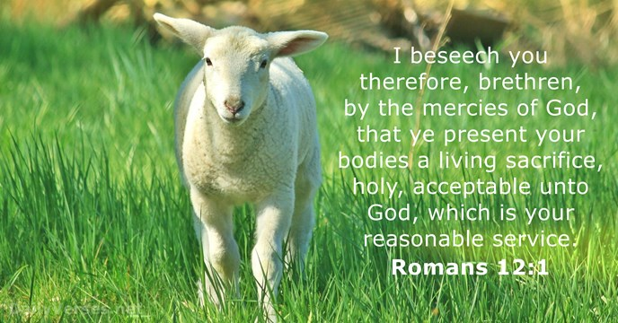

Slide 6
Be not conformed to this world..
Negative: Don’t let the world squeeze you into its mold
The world is able to conform us
Conform (become the same or similar)
Schematizo (to conform to same pattern)
Vine: To fashion or shape one thing like another

Slide 7

“Aggressively Uncool”

Slide 8
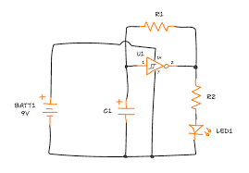
Schematic

Slide 9
Don’t be conformed to this world..
1 John 2:15-17 Do not love the world or the things in the world. If anyone loves the world, the love of the Father is not in him. ¹⁶ For all that is in the world—the lust of the flesh, the lust of the eyes, and the pride of life—is not of the Father but is of the world. ¹⁷ And the world is passing away, and the lust of it; but he who does the will of God abides forever.

Slide 10


Slide 11
Be Transformed by the renewing of your minds..
Positive: Allow to be transformed
Be transformed/conformed
Metamorphoo (metamorphosis) change one’s form
As Jesus was transformed
We too can be transformed

Slide 12


Slide 13
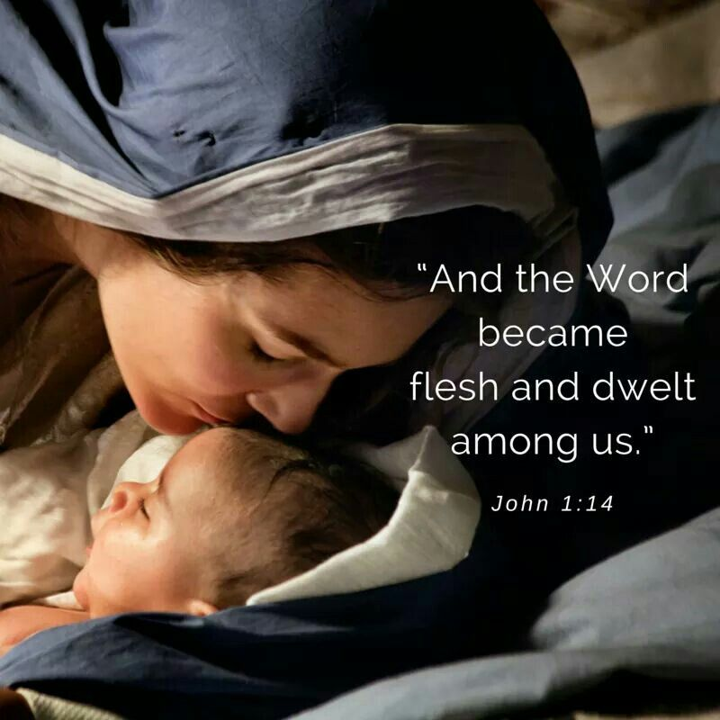

Slide 14
Jesus emptied himself..
Philippians 2:5-8 Let this mind be in you which was also in Christ Jesus, ⁶ who, being in the form of God, did not consider it ^{[a]}robbery to be equal with God, ⁷ but ^{[b]}made Himself of no reputation, taking the form of a bondservant, and coming in the likeness of men. ⁸ And being found in appearance as a man, He humbled Himself and became obedient to the point of death, even the death of the cross.

Slide 15


Slide 16
Romans 12:1-2
Romans 12:1-2

