Slide 1
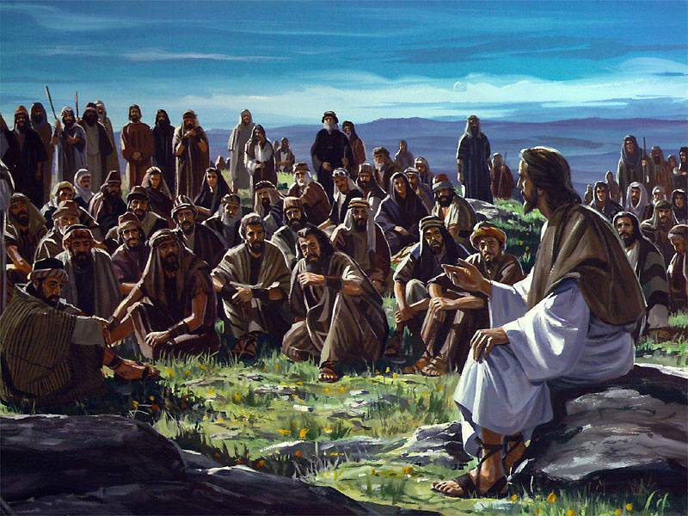
Jesus Taught them in Parables
Matthew 13:1-17

Slide 2
Jesus was a teacher
He went about teaching Matt 4:24
He came to reveal His Father’s will
This had to be achieved by instruction
His teaching was a simple approach
He told simple stories from people’s lives
Used these to teach spiritual lessons

Slide 3
He told many parables
Parable (parabole) to throw alongside
Place one thing beside another
Earthly story with a heavenly meaning
Proverbs (short saying/clear truth)
Parable (longer story/meaning drawn out)
Didn’t begin using parables until later

Slide 4
Why did Jesus begin using parables?
Matt 13:10-14 And the disciples came and said to Him, “Why do You speak to them in parables?” ¹¹ He answered and said to them, “Because it has been given to you to know the ^{[a]}mysteries of the kingdom of heaven, but to them it has not been given.
¹² For whoever has, to him more will be given, and he will have abundance; but whoever does not have, even what he has will be taken away from him. ¹³ Therefore I speak to them in parables, because seeing they do not see, and hearing they do not hear, nor do they understand.

Slide 5
Why did Jesus begin using parables?
Matt 13:34-35 All these things Jesus spoke to the multitude in parables; and without a parable He did not speak to them, ³⁵ that it might be fulfilled which was spoken by the prophet, saying: “I will open My mouth in parables; I will utter things kept secret from the foundation of the world.
God reveals His will to humble Isa 57:15; 66:2
Kingdom revealed to those willing to receive

Slide 6
Why did Jesus begin using parables?
Matt 13:13-16 Therefore I speak to them in parables, because seeing they do not see, and hearing they do not hear, nor do they understand. ¹⁴ And in them the prophecy of Isaiah is fulfilled, which says: ‘Hearing you will hear and shall not understand, And seeing you will see and not perceive; ¹⁵ For the hearts of this people have grown dull. Their ears are hard of hearing, And their eyes they have closed, Lest they should see with their eyes and hear with their ears, Lest they should understand with their hearts and turn, So that I ^{[b]}should heal them.’

Slide 7
What made the difference?
Many saw and heard, but refused to accept
The disciples asked questions, seeking to understand
Matt 13:17-18 But blessed are your eyes for they see, and your ears for they hear; ¹⁷ for assuredly, I say to you that many prophets and righteous men desired to see what you see, and did not see it, and to hear what you hear, and did not hear it.
Parables were designed to turn some away
He who has ears to hear, let him hear

Slide 8
Jesus Taught them in Parables
Matthew 13:1-17

