Slide 1
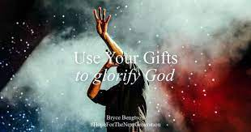
Using Our Gifts
Romans 12:3-8

Slide 2
Living sacrifices (vs 1-2)
Not conformed, but transformed
Devotion and worship (1-2)
Active obedience, ministry (3-8)
Spiritual service using our gifts
Proper attitude
Proper relationship
Proper activity

Slide 3
Proper Attitude: Humble
Humility (vs 3)
Through the grace given to me
To everyone who is among you
Not to think more highly of himself
But to think soberly (clear thinking)
As God has dealt to each a measure of faith
Humility a prerequisite
Moses, Isaiah, Peter, Paul

Slide 4
The Proper Relationship
Many members in One Body (vs 4-5)
The body of Christ (Eph 1:22-23)
Many members (diversity, but practical unity)
Each member does their part (Eph 4:13-16)
Individually members of one another
Compared to our human bodies (1 Cor 12:21-27)
But all members do not have same function

Slide 5
The Proper Activity
Using our gifts (6-8)
Having then gifts (charismata – charis)
Differing according to grace (functions)
In the body (different but complementary)
Spiritual gifts (1 Cor 12; Rom 12; 1 Peter 4)
Let us use them (prophecy, ministry, teaching, exhorting, giving, leads, showing mercy)

Slide 6
Using our Gifts
Proper Attitude – Humility
Proper Relationship – Many members, One body
Proper Activity – Let us use them
The Body of Christ (humble servants)
100% of members/100% of gifts
1 Peter 4:10 As each one has received a gift, minister it to one another, as good stewards of the manifold grace of God.

Slide 7
Using Our Gifts
Romans 12:3-8

