Slide 1
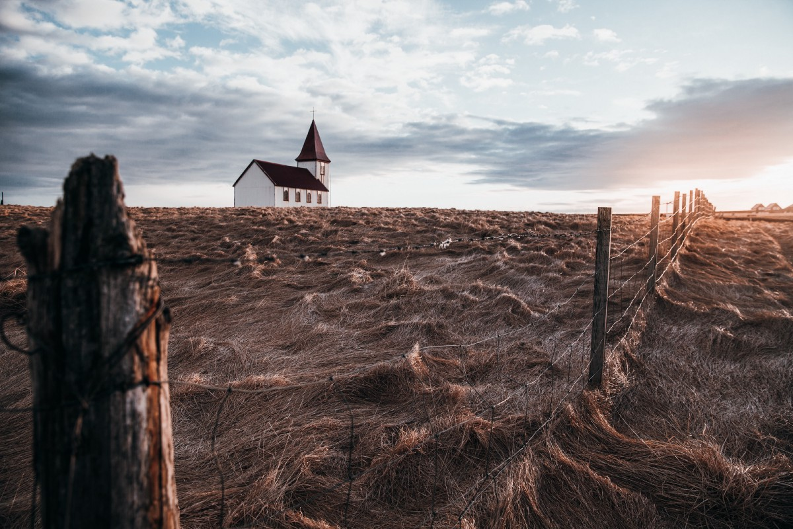
A Famine of the Word
Amos 8:11-14

Slide 2
How God deals with nations
In OT God dealt with Israel and other nations to fulfill His purposes to send a Savior
GOD
OTHER
NATIONS
ISRAEL

Slide 3
Background of Amos
History of the Jews
Joshua (1400 BC) – Israel settled in Promised Land
Israel ruled by tribal leaders (Judges)
Israel under United Kingdom (Saul, David, Solomon)
After Solomon’s death – divided two kingdoms 930 BC
Amos 750 BC – reign of Jeroboam II (786-746)
Time of great prosperity – booming economy
Rich and poor – injustice in legal system
Secularization of society – Baal worship mixed with Jehovah

Slide 4
Amos the prophet
Amos 7:14-15 Then Amos answered, and said to Amaziah: “I was no prophet, Nor was I a son of a prophet, But I was a sheepbreeder And a tender of sycamore fruit. ¹⁵ Then the Lord took me as I followed the flock, And the Lord said to me, ‘Go, prophesy to My people Israel.’
Not a prophet but a sheepbreeder
Sent from Judah to northern Israel
No-nonsense outsider from country

Slide 5
Amos’ warnings
Ch 1-2 Sins of the pagan nations surrounding Israel
Damascus, Gaza, Edom, Tyre, Ammon, Moab
Judah… despised law of the Lord
Israel.. Decay in society, excesses of rich
Ch 3-4 God’s message to northern kingdom
3:1-8 Two cannot walk together
3:15, 6:1-4 Woes pronounced

Slide 6
Five visions impending judgment
7:1-3 Locusts
7:4-6 Fire
7:7-9 Plumbline
8:1-3 Basket of summer fruit
9:1-10 The Lord beside the altar

Slide 7
Amos opposed by the priest
7:10-17 Amaziah opposes Amos
12 Then Amaziah said to Amos: “Go, you seer! Flee to the land of Judah. There eat bread, And there prophesy. ¹³ But never again prophesy at Bethel, For it is the king’s sanctuary, And it is the royal ^{[i]}residence.”
7:14-18 Amos responds..

Slide 8
A different famine
8:11-12 “Behold, the days are coming,” says the Lord God, “That I will send a famine on the land, Not a famine of bread, Nor a thirst for water, But of hearing the words of the Lord. ¹² They shall wander from sea to sea, And from north to east; They shall run to and fro, seeking the word of the Lord, But shall not find it.

Slide 9
A Famine of the Word
Amos 8:11-14

