Slide 1
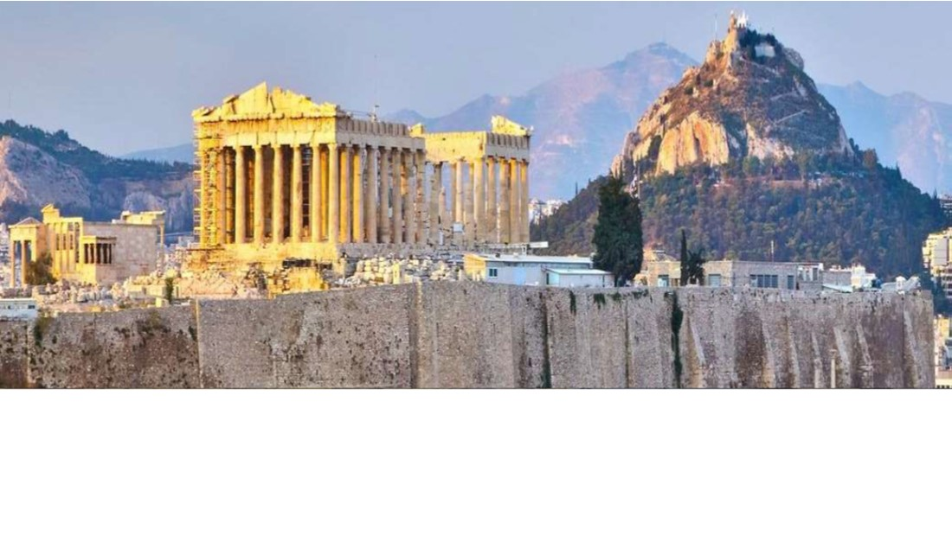
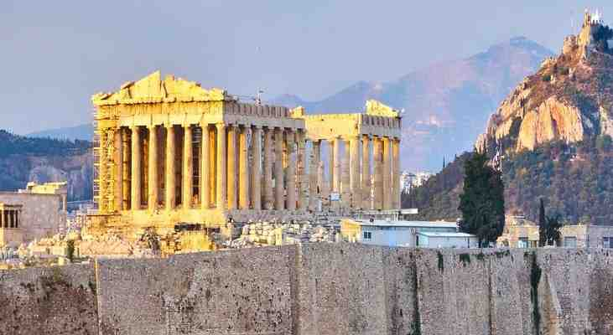
Paul’s Approach with People
Acts 17:16-34

Slide 2
How did Paul talk with people?
1 Corinthians 9:19-22 I have become all things to all men, that I might by all means save some.
Acts 17:1-3 Then Paul, as his custom was, went in to them, and for three Sabbaths reasoned with them from the Scriptures, ³ explaining that the Christ had to suffer and rise again from the dead, and saying, “This Jesus whom I preach to you is the Christ.”
Acts 17:16-17 Therefore he reasoned in the synagogue with the Jews and with the Gentile worshipers, and in the marketplace daily with those who happened to be there.
“Dialegomai” – to dialogue, talk with, reason, dispute

Slide 3
What Paul saw in Athens..
Acts 17:16 Now while Paul waited for them at Athens, his spirit was provoked within him when he saw that the city was given over to idols.
He was bothered by the sin..
He cared about the people..
John 3:16; Matt 22:35-40
Genesis 1:26-27; Matt 16:26

Slide 4
He listened to their beliefs..
Acts 17:18-21 Then certain Epicurean and Stoic philosophers encountered him. And some said, “What does this babbler want to say?” Others said, “He seems to be a proclaimer of foreign gods,” because he preached to them Jesus and the resurrection.
Idols – religious superstition (Acts 14:14-17)
Epicureans – pleasure lovers
Stoics – fate controls life
We need to sympathize (Heb 4:14-15)

Slide 5
He started with common ground..
Acts 17:18-21 Then Paul stood in the midst of the ^{[i]}Areopagus and said, “Men of Athens, I perceive that in all things you are very religious; ²³ for as I was passing through and considering the objects of your worship, I even found an altar with this inscription: TO THE UNKNOWN GOD. Therefore, the One whom you worship without knowing, Him I proclaim to you:
Complimentary… You’re religious – so am I
Don’t talk down.. Phil 2:3-5; Romans 3:23

Slide 6
He said what needed to be said..
Acts 17:23 What you worship as unknown I proclaim to you..
17:24-25 God is the maker of all things (Creation account); does not live in temples made by hands
17:25-27 All nations of one blood; God is near and desires us to seek Him
17:28-29 God and man are related (His offspring.. )
17:30-31 Abandon your ignorant rituals and repent.. God raised His Son; day of judgment is appointed (Jesus is the solution)

Slide 7
The Reaction was mixed..
Acts 17:32-34 And when they heard of the resurrection of the dead, some mocked, while others said, “We will hear you again on this matter.” ³³ So Paul departed from among them. ³⁴ However, some men joined him and believed, among them Dionysius the Areopagite, a woman named Damaris, and others with them.
Plant the seed..God will give the increase (1 Cor 3:6)
Let your light shine.. (Matt 5:16)

Slide 8
Paul’s Approach with People
Acts 17:16-34

