Slide 1
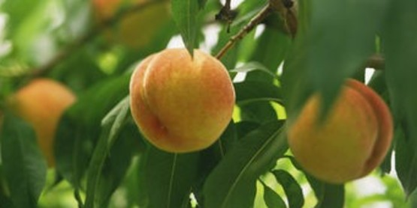
The Fruit of the Spirit
Galatians 5:16-26

Slide 2
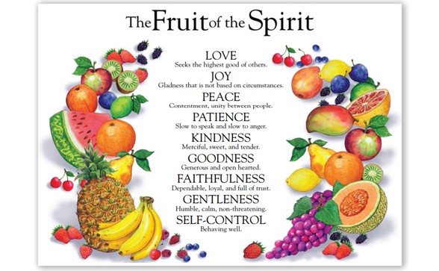
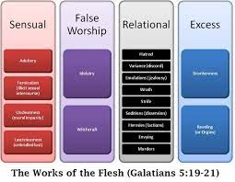
How can we walk by the Spirit..
Galatians 5:16-17 I say then: Walk by the Spirit, and you shall not fulfill the lust of the flesh. ¹⁷ For the flesh lusts against the Spirit, and the Spirit against the flesh; and these are contrary to one another, so that you do not do the things that you wish.

Slide 3
Christ has set us free..
Galatians 5:1 Stand fast therefore in the liberty by which Christ has made us free, and do not be entangled again with a yoke of bondage.
John 8:31-36 Jesus sets us free in the truth
Sin following our desires enslaves us

Slide 4
Do not be enslaved again
Jewish law showed we cannot live God’s standard in our own strength
We need a Savior (Jesus Christ – he fulfilled the law)
The Gospel: what God did by sending His Son
Jewish Christians had difficulty changing their mindset
To follow God, you had to live by certain rules
You had to be circumcised

Slide 5
Paul’s response: free in Christ
Gal 5:2-4 if you seek to be justified by circumcision
Christ will not benefit you
Obligated to keep the whole law
Separated from Christ and grace
Gal 5:5-6 What counts with God..
We wait for the hope of righteousness
What matters: faith working through love

Slide 6
Does that mean we can live however we want?
Galatians 5:13-15 For you, brethren, have been called to liberty; only do not use liberty as an opportunity for the flesh, but through love serve one another. ¹⁴ For all the law is fulfilled in one word, even in this: “You shall love your neighbor as yourself.” ¹⁵ But if you bite and devour one another, beware lest you be consumed by one another!
Jesus the two greatest commandments
These ultimately fulfill the whole law

Slide 7
We are not saved in our own strength..
Galatians 5:16 I say then: Walk in the Spirit, and you shall not fulfill the lust of the flesh.
Romans 8:5 set your minds on the things of the Spirit
Our actions reflect what is in our heart
Different mindset: not about following a set of rules
Our God given desire to follow Him keeps us from fulfilling fleshly desires

Slide 8
Desires of flesh..
Galatians 5:19-21 Now the works of the flesh are evident, which are: adultery, fornication, uncleanness, lewdness, ²⁰ idolatry, sorcery, hatred, contentions, jealousies, outbursts of wrath, selfish ambitions, dissensions, heresies, ²¹ envy, ^{[f]}murders, drunkenness, revelries, and the like; of which I tell you beforehand, just as I also told you in time past, that those who practice such things will not inherit the kingdom of God.

Slide 9
Fruit of the Spirit..
Galatians 5:22-23 But the fruit of the Spirit is love, joy, peace, longsuffering, kindness, goodness, faithfulness, ^{23 [g]}gentleness, self-control. Against such there is no law.

Slide 10
The Fruit of the Spirit
Galatians 5:16-26

