Slide 1
The Truth/Freedom Connection
John 8:32-36

Slide 2
Truth/freedom are under attack
John 8:31-32 Then Jesus said to those Jews who believed Him, “If you abide in My word, you are My disciples indeed. ³² And you shall know the truth, and the truth shall make you free.
Connection between truth/freedom
Today both truth/freedom under attack
We are in a spiritual warfare
1 Chronicles 12:32 the sons of Issachar who had understanding of the times, to know what Israel ought to do

Slide 3
Context: Jesus and Pharisees
John 8:31-32 Then Jesus said to those Jews who believed Him, “If you abide in My word, you are My disciples indeed. ³² And you shall know the truth, and the truth shall make you free.
To whom: those who believed in Him
Condition: If you continue in my Word
Promise: know the truth/make you free
2 Corinthians 13:5 Examine yourselves as to whether you are in the faith. Test yourselves. Do you not know yourselves, that Jesus Christ is in you?—unless indeed you are disqualified.

Slide 4
Choice of truth or lies
John 8:33-36 They answered Him, “We are Abraham’s descendants, and have never been in bondage to anyone. How can You say, ‘You will be made free’?”³⁴ Jesus answered them, “Most assuredly, I say to you, whoever commits sin is a slave of sin.
Rejecting truth will cause us to believe lies
If truth sets us free, believing lies brings bondage
God sets us free with truth/Satan brings bondage with a lie (sin)
Proverbs 14:34 Righteousness exalts a nation, But sin is a reproach to any people.

Slide 5
Believing lies will bring bondage
2 Thess 2:9-12 the coming of the lawless one is according to the working of Satan, with all power, signs, and lying wonders, ¹⁰ and with all unrighteous deception among those who perish, because they did not receive the love of the truth, that they might be saved. ¹¹ And for this reason God will send them strong delusion, that they should believe the lie, ¹² that they all may be condemned who did not believe the truth but had pleasure in unrighteousness.
Man’s fall from freedom into sin was by believing a lie
Satan robs our freedom by getting us to believe a lie
Evil leaders use lies to bring entire nations into bondage

Slide 6
Believing Satan’s lie brought the human race into bondage
Genesis 3:1-5 Now the serpent was more cunning than any beast of the field which the Lord God had made. And he said to the woman, “Has God indeed said, ‘You shall not eat of every tree of the garden’?”
⁴ Then the serpent said to the woman, “You will not surely die. ⁵ For God knows that in the day you eat of it your eyes will be opened, and you will be like God, knowing good and evil.”
“Has God said?” (begins by getting us to question God’s word)
“You shall not surely die” (moves on to outright denial of God’s word)
“You shall be like God, knowing good and evil” (we can be independent)

Slide 7
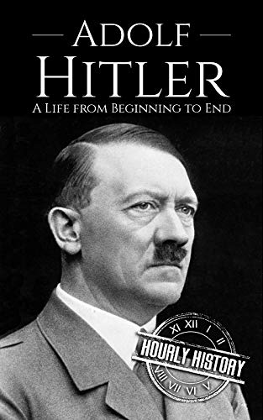
Evil leaders use lies to bring entire nations into bondage..
“The great masses of the people will more easily fall victims to a big lie than to a small one. Make the lie big, make it simple, keep saying it, and eventually they will believe it”
Convinced people Germans a superior race
That all their problems caused by the Jews
Took control of national media propanda

Slide 8
The lies Americans are believing..
Socialism is good; it is even Christian
The government has the right to redistribute wealth
The nuclear family is outdated (the Bible also)
Gay marriage is just as legitimate as traditional marriage
Homosexuality is a legitimate alternate lifestyle
A woman has the right to her own body (abortion)
Gender is determined by choice (not by biology)

Slide 9
The lies Americans are believing..
The climate will kill us within 15 years
The character of America requires open borders
America is and always has been systematically racist
America was founded in 1619 not 1776
Critical race theory explains what’s wrong with our country
The greatest problem in America is white supremacy
Mass murders will end if we have greater gun control

Slide 10
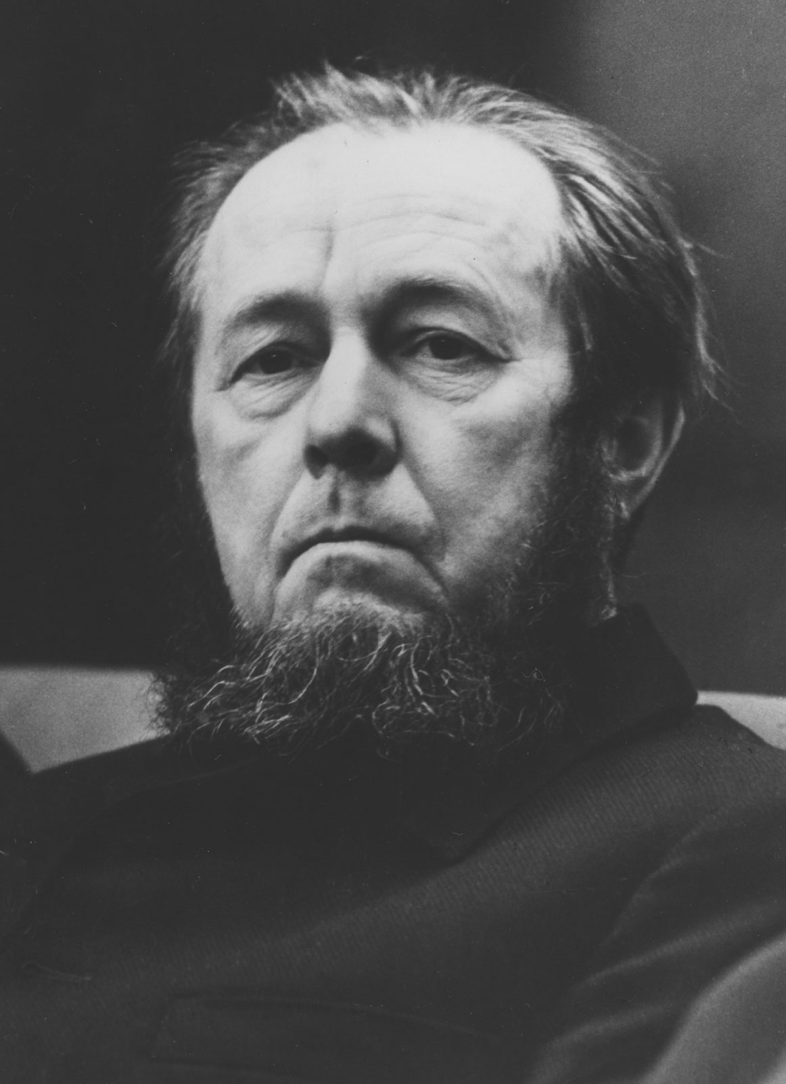
Solzhentisyn: Live not by lies
“Lies can only persist by violence. The bolder and falser the lie, the more insistent the calls to conformity, and the elimination of dissent,”
“Therein we find the simplest, the most accessible key to our liberation: a personal nonparticipation in lies! Even if all is covered by lies: Let their rule hold not through me!”
To Solzhenitsyn, to live by lies meant accepting all the falsehoods and propaganda that the state compelled its citizens to affirm to get along peaceably under totalitarianism.

Slide 11
Application
Jesus taught connection between truth and freedom
Freedom for the true disciple by knowing the truth
Enemies of freedom will always attack the truth with a lie
Knowing the truth will set us free
We must accept a life outside the mainstream as we live and defend the truth
1 Timothy 3:15 but if I am delayed, I write so that you may know how you ought to conduct yourself in the house of God, which is the church of the living God, the pillar and ground of the truth.

Slide 12
The Truth/Freedom Connection
John 8:32-36

