Slide 1
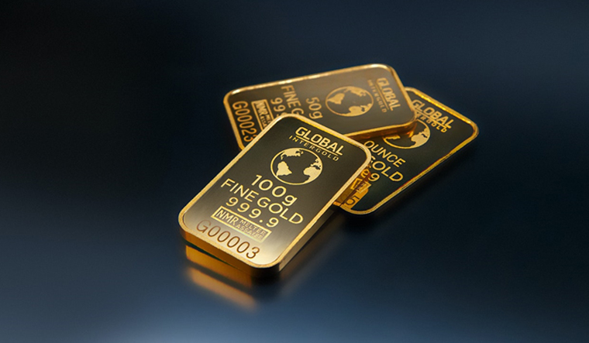
Living the Golden Rule
Matthew 7:7-12

Slide 2
“The Golden Rule”
Matt 7:12 Therefore, whatever you want men to do to you, do also to them, for this is the Law and the Prophets.
Luke 6:31 And just as you want men to do to you, you also do to them likewise.
Rabbi Hillel: “What is hateful to you, do not do to your fellow creatures”
Jesus: “Do unto others as you would have them do unto you”

Slide 3
The Context of Matthew 7
Matt 7:1-6 how not to treat others (critically)
Don’t judge others differently than ourselves
Matt 7:7-12 how to act toward others (lovingly)
God promises to answer our prayers
God challenges us to live by golden rule

Slide 4
A Golden Promise
Matt 7:7-8 “Ask, and it will be given to you; seek, and you will find; knock, and it will be opened to you. ⁸ For everyone who asks receives, and he who seeks finds, and to him who knocks it will be opened.
Context of seeking the kingdom of God
Matt 6:9-15 Our Father in heaven, Your will be done
Matt 6:25-33 don’t worry/seek first His kingdom
First Seek God, ask for His righteous desires for us
Then look toward others, live out the Golden Rule

Slide 5
Ask Persistently
Matt 7:7-8 Ask, and it will be given to you; seek, and you will find; knock, and it will be opened to you. ⁸ For everyone who asks receives, and he who seeks finds, and to him who knocks it will be opened.
Ask God.. Seek God, righteousness.. Knock on his door
Everyone who asks this way will receive
Our Dependence on God

Slide 6
Encouragement to Ask
Matt 7:9-11 Or what man is there among you who, if his son asks for bread, will give him a stone? ¹⁰ Or if he asks for a fish, will he give him a serpent?
Parents want to give our children good things
We don’t always give what they ask, but what they need
11 If you then, being evil, know how to give good gifts to your children, how much more will your Father who is in heaven give good things to those who ask Him!

Slide 7
The Golden Rule
Matt 7:12 Therefore, whatever you want men to do to you, do also to them, for this is the Law and the Prophets.
“Therefore” connects to previous promise
Because of what God has done for us as a loving Father
Problem: we want to think only of ourselves, our needs
Solution: because God meets our needs frees us
We don’t do unto others so they will do unto us

Slide 8
Our motivation is from God
Key word: “Therefore”..
God is a loving Father who invites us to approach His throne
We can be confident He will give us what we need
Now go and give others what they need
God’s love is to motivate your love for others
Don’t give to others what they deserve
Ask: what would we want?

Slide 9
This is the law and the prophets
The very heart of the Law and the Prophets
Leviticus 19:18 You shall love your neighbor as yourself
God has increased this through giving His own Son
Look what God has done for you through the cross
He tells us to ask of Him and expect to receive
He give good gifts to His children..
Now do the same.. Change the world

Slide 10
Living the Golden Rule
Matthew 7:7-12

