Slide 1
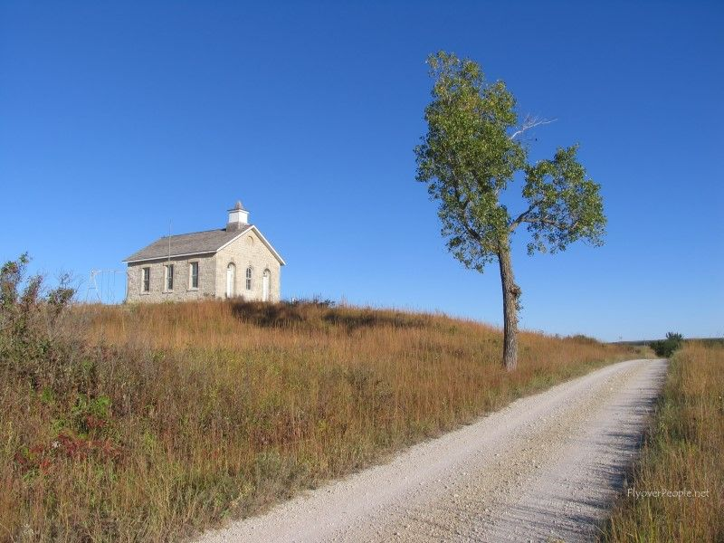
Wisdom is Good and Profitable
Ecclesiastes 6:1 – 7:14

Slide 2
Without God, life is empty
Eccl 6:1-5 There is an evil which I have seen under the sun, and it is common among men: ² A man to whom God has given riches and wealth and honor, so that he lacks nothing for himself of all he desires; yet God does not give him power to eat of it, but a foreigner consumes it. This is vanity, and it is an evil affliction.
Gaining riches/Power to enjoy = Both are Given by God
No matter how great the blessings, can’t be enjoyed alone

Slide 3
Without God we can’t be satisfied
6:7-9 All the labor of man is for his mouth, And yet the soul is not satisfied. ⁸ For what more has the wise man than the fool? What does the poor man have, Who knows how to walk before the living? ⁹ Better is the sight of the eyes than the wandering of desire. This also is vanity and grasping for the wind.
All work is to fill earthly needs, yet appetite is never satisfied
Apart from God, what advantage is the wise over the fool

Slide 4
Only God can explain life
6:10-12 Whatever one is, he has been named already, For it is known that he is man; And he cannot contend with Him who is mightier than he. ¹¹ Since there are many things that increase vanity, How is man the better? ¹² For who knows what is good for man in life, all the days of his vain life which he passes like a shadow? Who can tell a man what will happen after him under the sun?
We cannot change that we are “man” contending with God
We can’t escape limitations of our ability and knowledge

Slide 5
The Value of Wisdom in Life
Eccl 7 :1-6 A good name is better than precious ointment, And the day of death than the day of one’s birth; ² Better to go to the house of mourning Than to go to the house of feasting, For that is the end of all men; And the living will take it to heart. ³ Sorrow is better than laughter, For by a sad countenance the heart is made better. ⁴ The heart of the wise is in the house of mourning, But the heart of fools is in the house of mirth.
There is more benefit in sobering things than frivolous things
To become wise we must experience suffering, hard lessons

Slide 6
Wisdom comes by patiently waiting
7:7-10 Surely oppression destroys a wise man’s reason, And a bribe debases the heart. ⁸ The end of a thing is better than its beginning; The patient in spirit is better than the proud in spirit. ⁹ Do not hasten in your spirit to be angry, For anger rests in the bosom of fools. ¹⁰ Do not say, “Why were the former days better than these?” For you do not inquire wisely concerning this.
A mark of wisdom is patience, waiting to end to see purpose
Patiently live in the present; wait for God to work things out

Slide 7
Wisdom gives life and shelter
7:11-12 Wisdom is good with an inheritance, And profitable to those who see the sun. ¹² For wisdom is a defense as money is a defense, But the excellence of knowledge is that wisdom gives life to those who have it.
Wisdom should be our goal..can be a defense (shelter)
Very beneficial.. Can give life, joy, happiness, contentment

Slide 8
Consider God’s purpose in adversity
7:13-14 Consider the work of God; For who can make straight what He has made crooked? ¹⁴ In the day of prosperity be joyful, But in the day of adversity consider: Surely God has appointed the one as well as the other, So that man can find out nothing that will come after him.
Consider the purpose of God.. accept our circumstances
God’s providence is working in both good and bad times
What is God teaching us in our present difficult time?

Slide 9
Wisdom is Good and Profitable
Ecclesiastes 6:1 – 7:14

