Slide 1
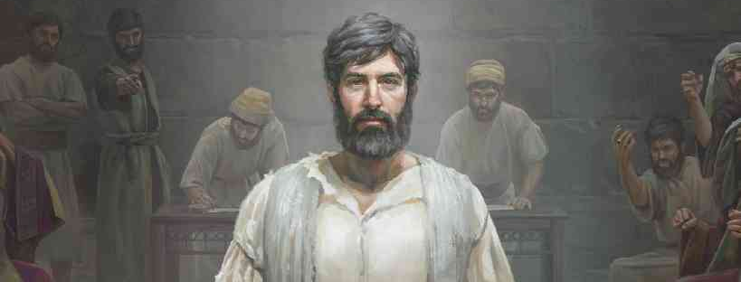
Stephen Defends the Faith
Acts 7:1-60

Slide 2
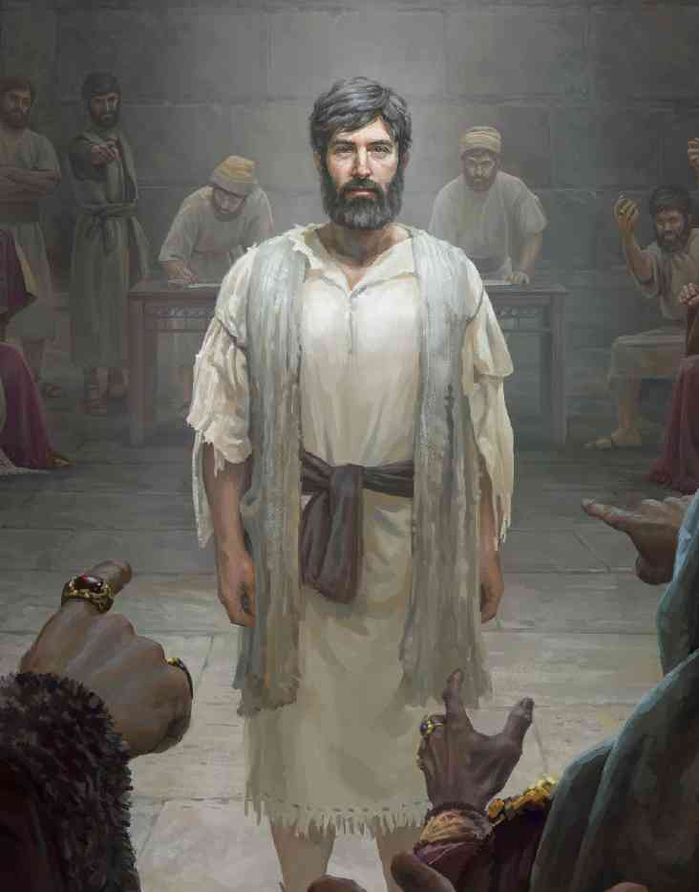
Stephen before the Court 7:1
Acts 7:1 Then the high priest said, “Are these things so?”
Blasphemed Moses and God? The temple, Law?
Christ’s words .. Luke 21:12-18
Stephen’s full sermon .. 7:2-53
Purpose: to answer the charges with truth
Establish three facts..
God’s ultimate purpose is not the temple, but Christ
God has faithfully blessed Israel, regardless of temple
Israel has long history of resisting God’s plan

Slide 3
Abraham 7:2-8
Stephen is respectful .. “Brethren and fathers”
God began the relationship when he chose Abraham
Abraham left Ur, traveled to Haran, then to Canaan
Didn’t give the land to Abraham, but in promise
Established circumcision as token of the covenant
Abraham begot Isaac (circumcised 8th day)
Isaac begot Jacob, Jacob begot twelve patriarchs

Slide 4
Joseph 7:9-16
Ten of the patriarchs sold their brother into slavery
Joseph waited on God to deliver him
God used the evil of Joseph’s brothers
Raised Joseph to prime minister of Egypt
Used Joseph to provide for his people in famine
For 400 years Israel grew in a fertile region
God fulfilled His covenant in spite of their rebellion

Slide 5
Moses 7:17-35
God blessed the Israelites.. Egyptians enslaved them
God raised up a deliverer named Moses
God used the Egyptians to equip him for leadership
Moses attempted to lead his own way.. they rejected him
Moses fled Egypt, dwelt in Midian forty years
God appeared to Moses.. “I am the God of your father”
God sent His ruler back whom they had rejected

Slide 6
The Exodus 7:36-45
God used Moses to free and lead them to promised land
Moses promised God would raise up a prophet like Him
Moses received the Law on Mt Sinai
Our father again rejected Moses, rebelled.. “make us gods”
Made a golden calf.. Offered sacrifices, rejoiced in own doing
God’s grace despite the sin of the majority

Slide 7
David and Solomon 7:46-50
Israel’s glory peaked with King David and Solomon
Israel worshiped at tabernacle until Solomon
Permanent temple built in Jerusalem
But Israel’s disobedience led to destruction, captivity
Stephen’s indictment.. 7:51-53
Council responds with rage.. 7:54
Stephen’s calm, faithful behavior.. 7:55-60

Slide 8
Stephen Defends the Faith
Acts 7:1-60

