Slide 1
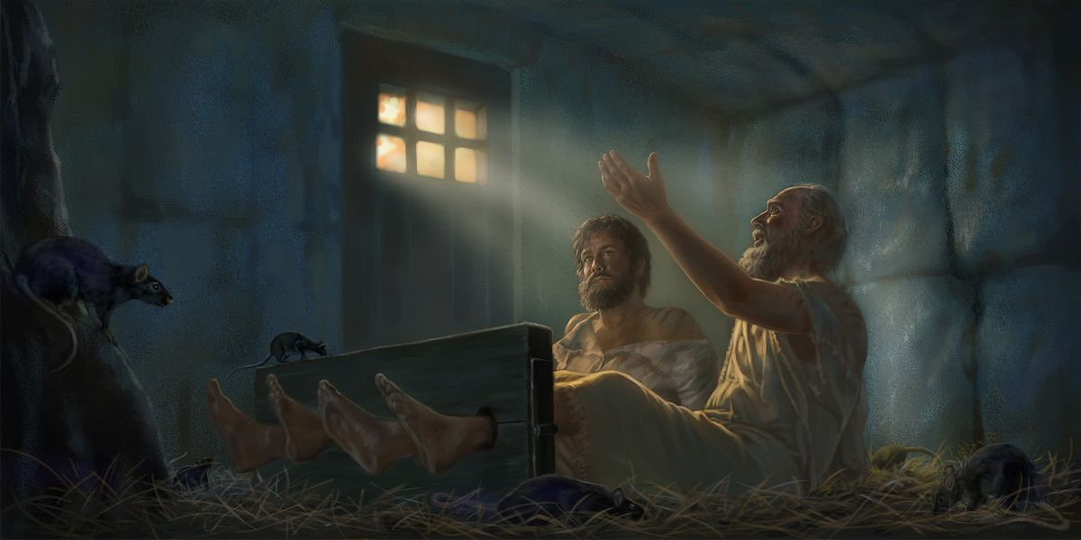
Singing in our Struggles
Acts 16:1-40

Slide 2
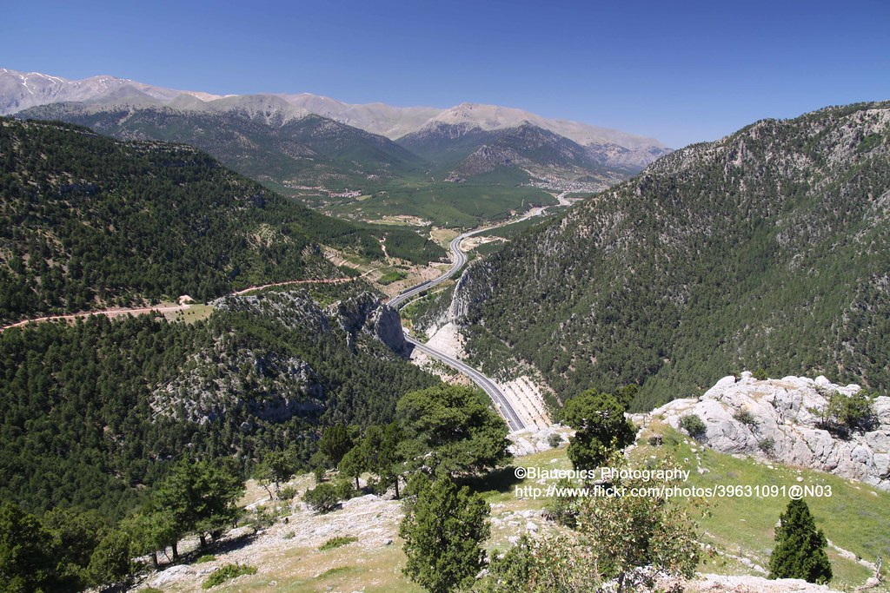
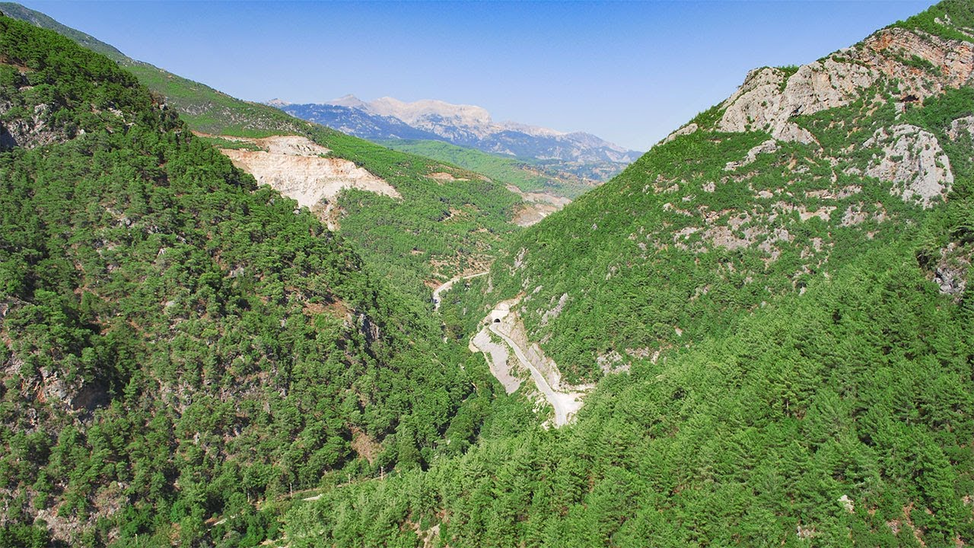

Slide 3
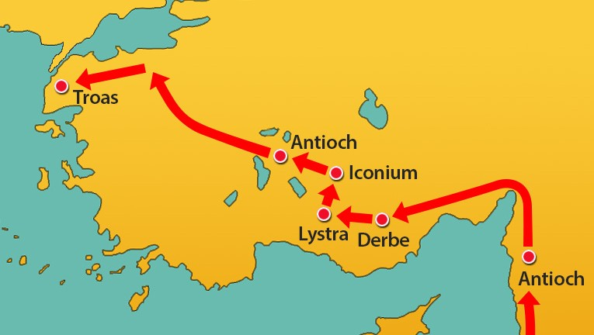
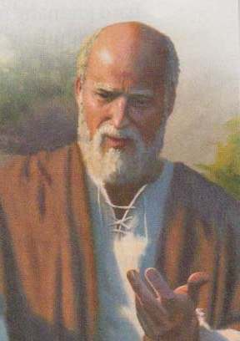
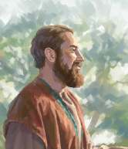
Paul
Silas

Slide 4
Allowing God to Lead 1-10
Paul and Silas return to Lystra 1-3
Young disciple Timothy
Timothy chosen to join them
Strengthening the churches 4-5
Reading the letter
Edifying with the word

Slide 5
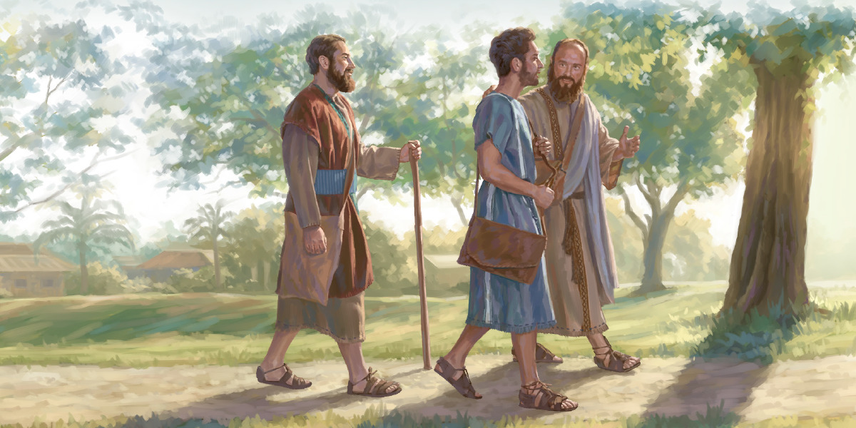

Slide 6
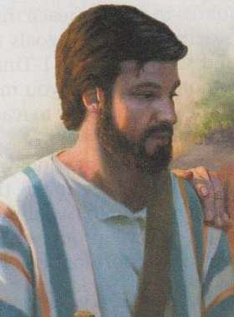
Paul
Silas
Timothy

Slide 7
Allowing God to Lead 1-10
The Holy Spirit closes doors 6-7
Forbidden to Asia
Not permitted to Bithynia
At Troas.. a Vision in the night 8-10
Come help us in Macedonia
The Lord had called us

Slide 8
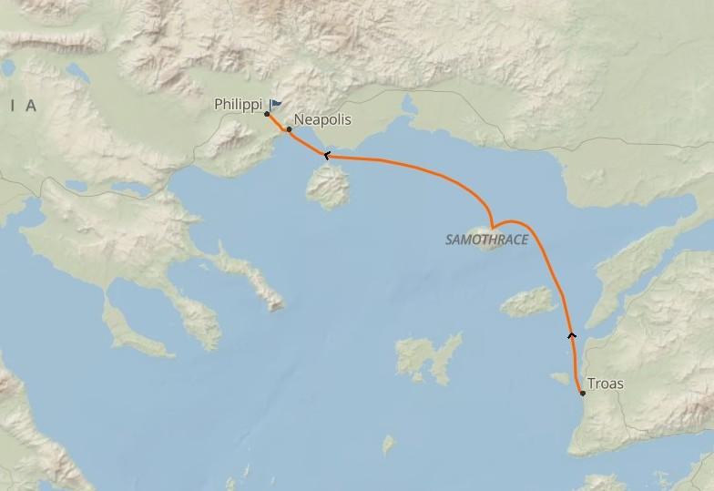
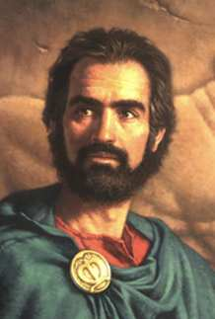
Paul
Silas
Timothy
Luke

Slide 9
The Gospel Begins in Europe 11-24
Initial impact..evangelism 11-15
Group of women by riverside
Lydia’s heart opens to the gospel

Slide 10
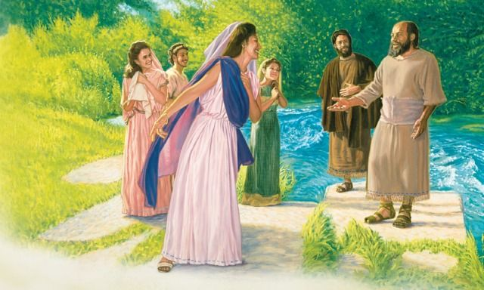

Slide 11
The Gospel Begins in Europe 11-24
Initial impact..evangelism 11-15
Group of women by riverside
Lydia’s heart opens to the gospel
Opposition.. Demonism 16-24
Slave girl with evil spirit
Her master’s lost profits

Slide 12
Pain and Mistreatment 25-34
Paul and Silas beaten and imprisoned
Prayer and praise
Deliverance and salvation
Conversion of the jailer
Remarkable release.. Encouragement
City leaders realize their mistake
Paul calls for public apology

Slide 13
Singing in our Struggles
Acts 16:1-40

