Slide 1
The Gospel for All
Acts 17:1-34

Slide 3
Three types of people
Religious beliefs (resistant to change)
Seeking truth (respectful of scripture)
Highly educated (inner spiritual hunger)

Slide 4
Inner essential quality
Paul’s enthusiasm (“En-theos”)
Apostles driven out of Philippi
Divine fire glowing within
Are you fanning the flame?

Slide 5
At Thessalonica 1-9 (How the Gospel should be preached)
Paul’s message 1-3
Reasoned from the Scriptures
Explaining these passages
Demonstrating (proving)
(Conclusion: This Jesus I am preaching is the Christ)
Response and opposition (4-9)

Slide 6
At Berea 10-15 (How the Gospel should be received)
Much different atmosphere 10-12
Fair minded (noble)
Received word with readiness
Searched scriptures daily
Response and opposition 13-15

Slide 7
At Athens 16-34 (How the Gospel should be related)
Paul sees the needs 16-21
The city given over to idols
Synagogue (Jews and Gentile worshipers)
Marketplace (Epicurean and Stoic philosophers)
Response: Paul taken to the Areopagus

Slide 8
At Athens 16-34 (How the Gospel should be related)
Relating the Gospel 22-31
He started where they were 22-23
He used the familiar to introduce the true God 24-25
He developed his theme clearly 25-27
God is the Creator of all
God is in Control but Close to us
God created us to be in fellowship with Him
He kept their attention 28
He applied the message 29-31

Slide 9
The Gospel for All
Acts 17:1-34

Slide 10
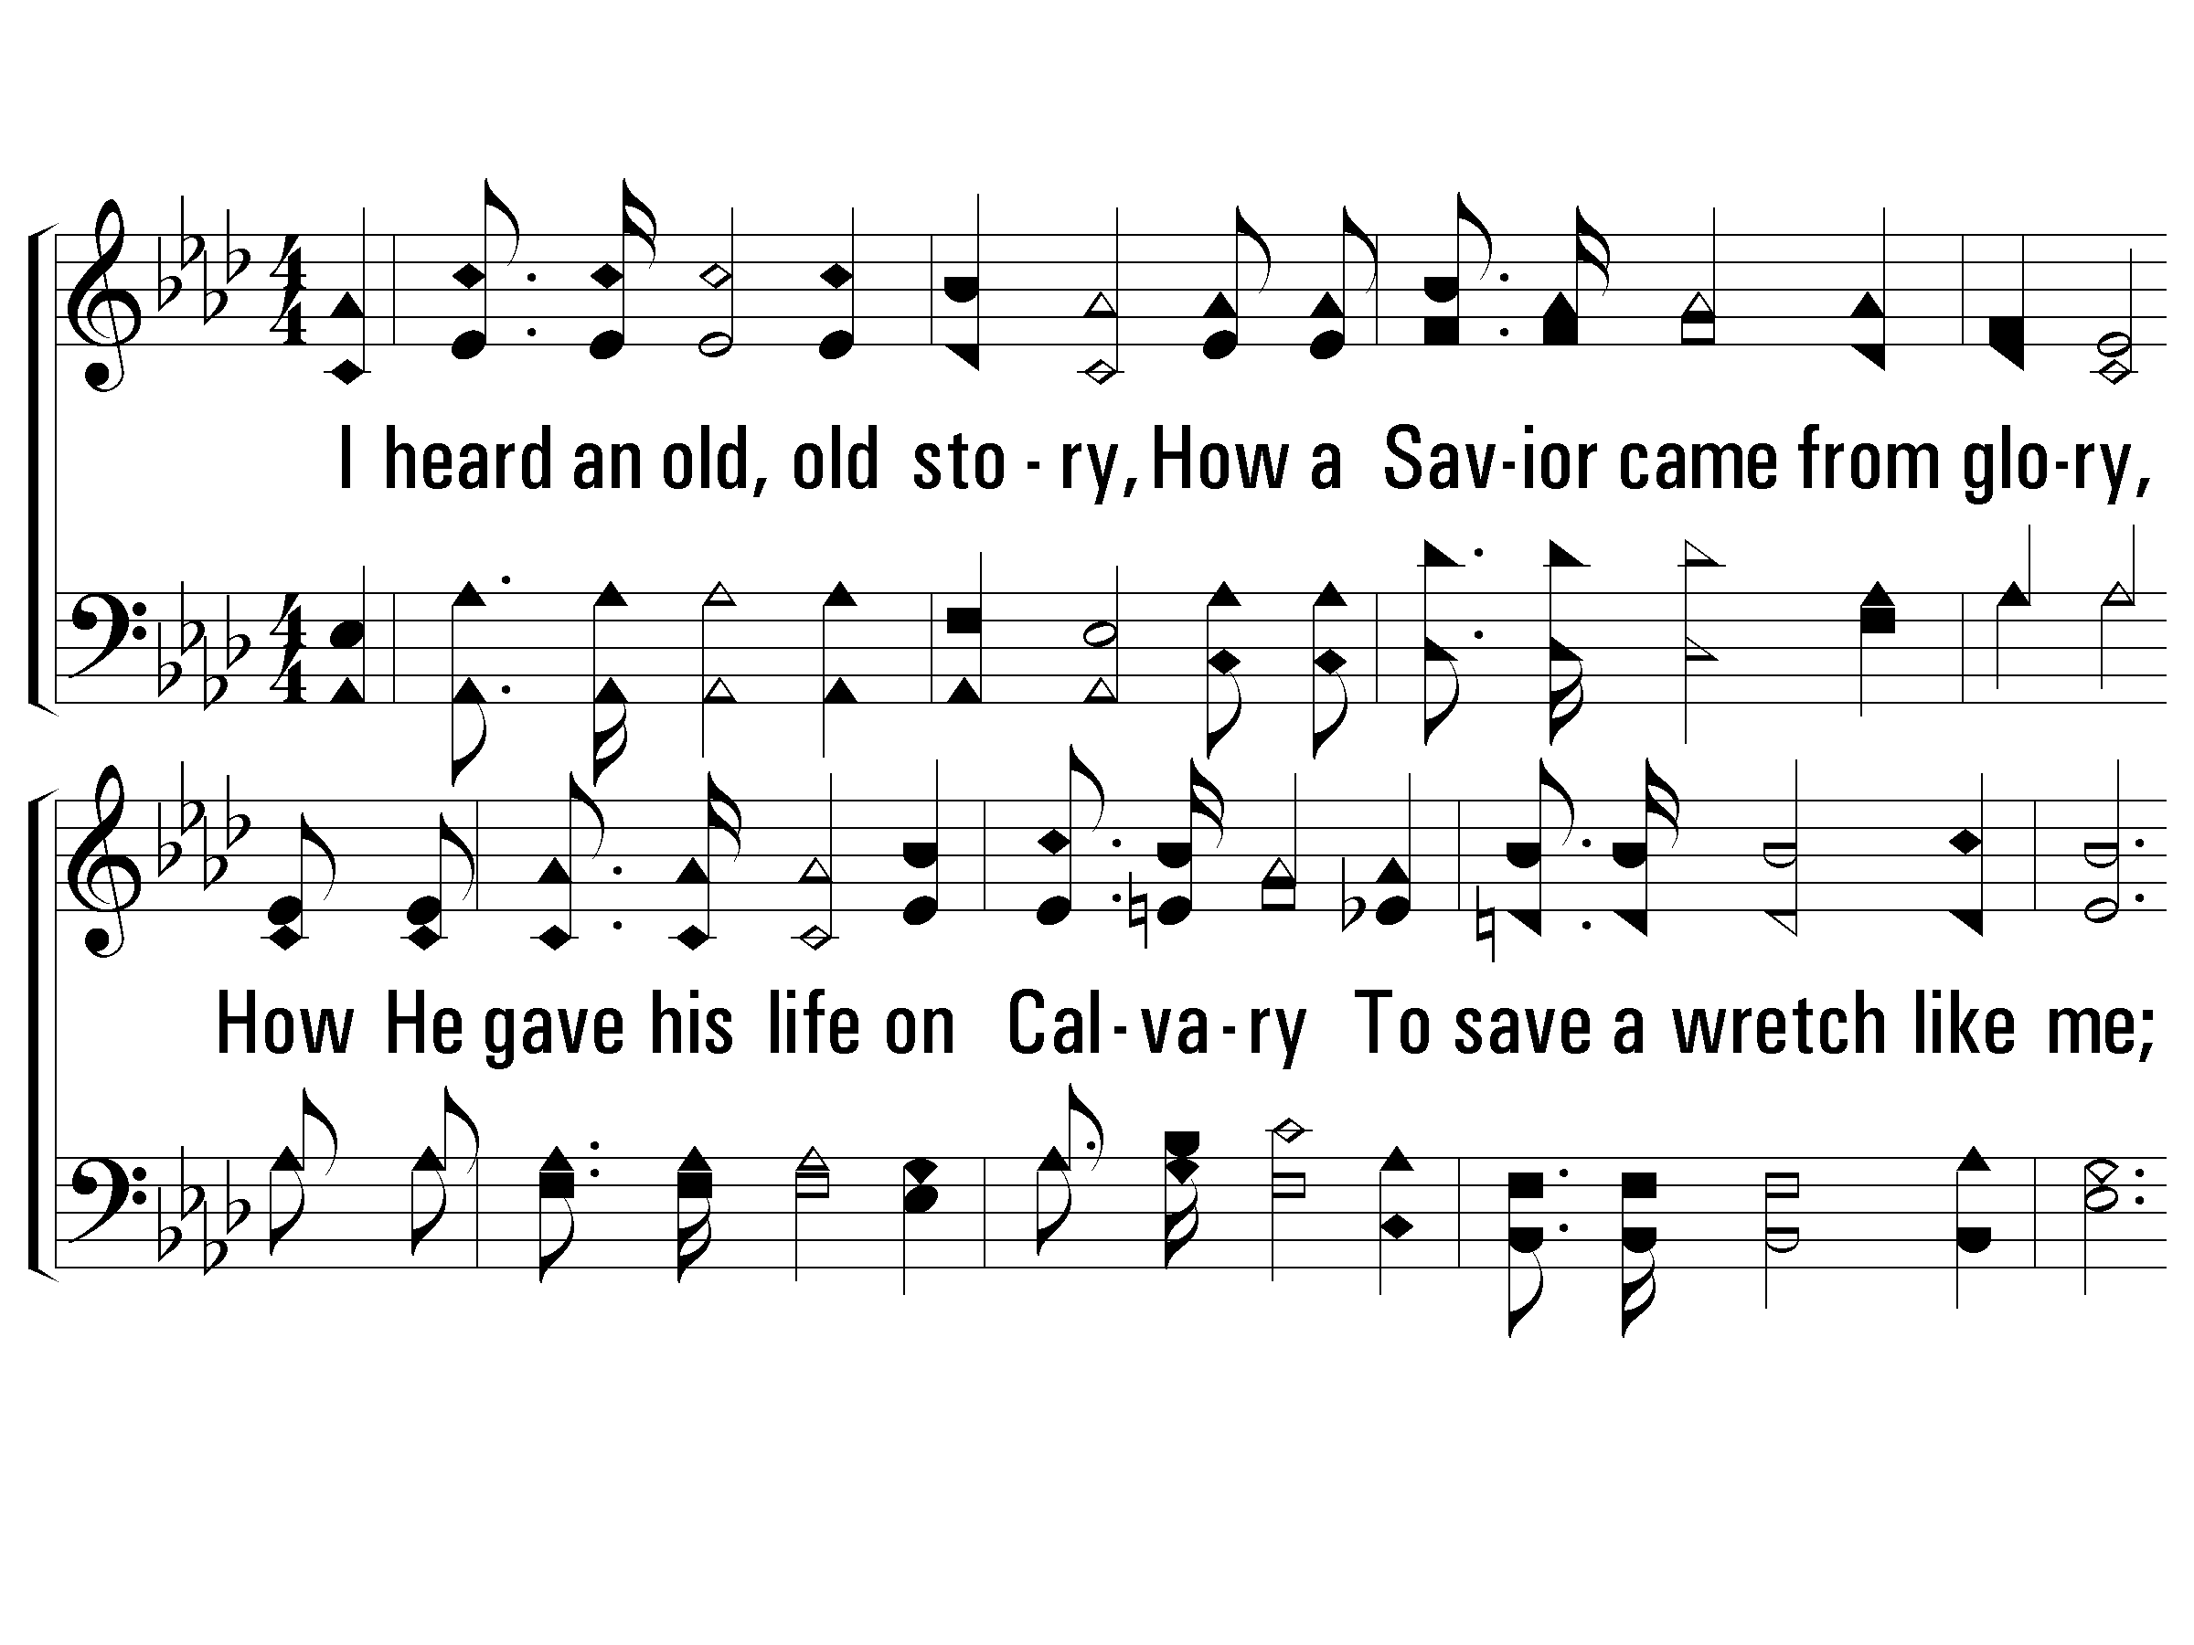
1 – Victory in Jesus
717
1.
I heard an old, old story, How a Savior came from glory,
How He gave his life on Calvary To save a wretch like me;
I heard about His groaning, Of His precious blood's atoning,
Then I repented of my sins And won the victory.
Words and Music by: E. M. Bartlett
Copyright © 1939 by E.M. Bartlett. Copyright 1967 by Mrs. E.M. Bartlett, renewal.
Assigned to Albert E. Brumley & Sons/SESAC (admin. By ICG).
All rights reserved. Used by permission.
© 2001 The Paperless Hymnal™

Slide 11
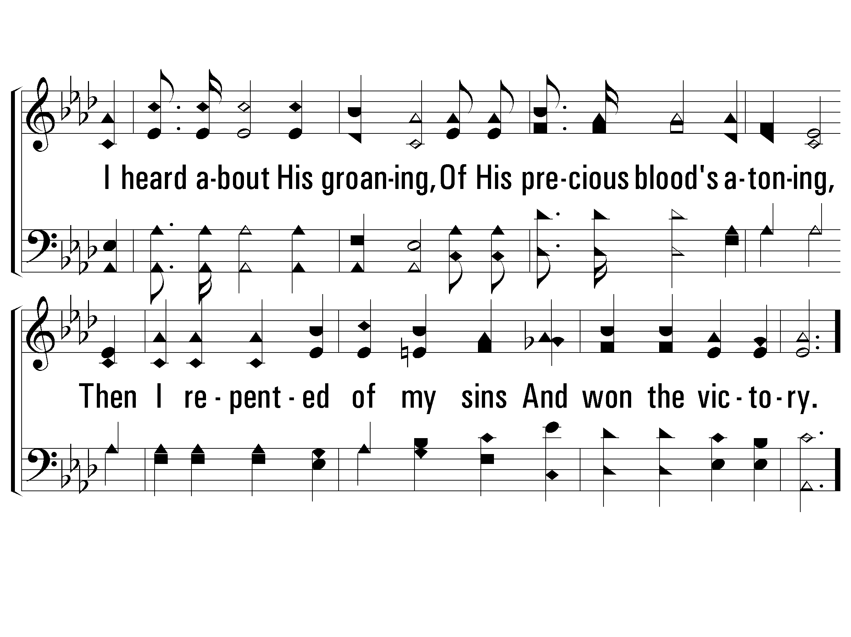
1 – Victory in Jesus
717
© 2001 The Paperless Hymnal™

Slide 12
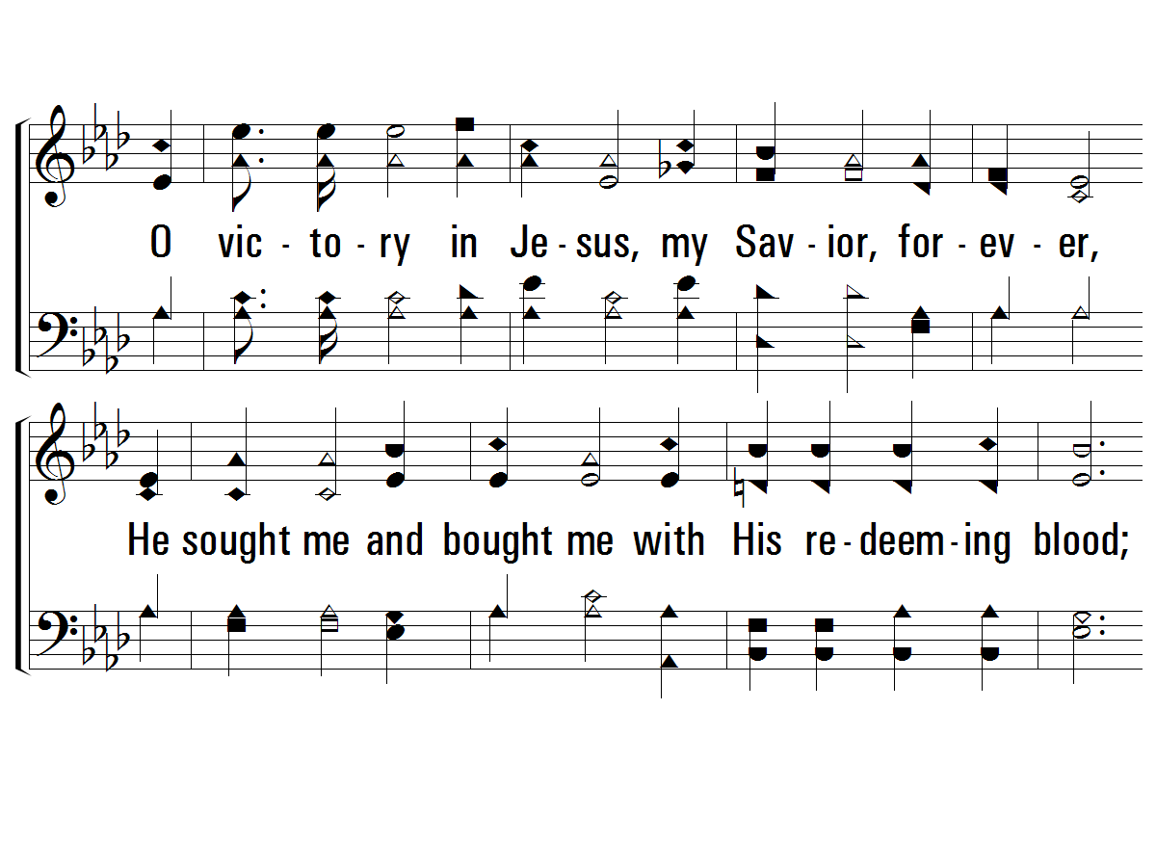
c – Victory in Jesus
717
O victory in Jesus, my Savior, forever,
He sought me and bought me with His redeeming blood;
He loved me ere I knew Him, and all my love is due Him,
He plunged me to victory, beneath the cleansing flood.
© 2001 The Paperless Hymnal™

Slide 13
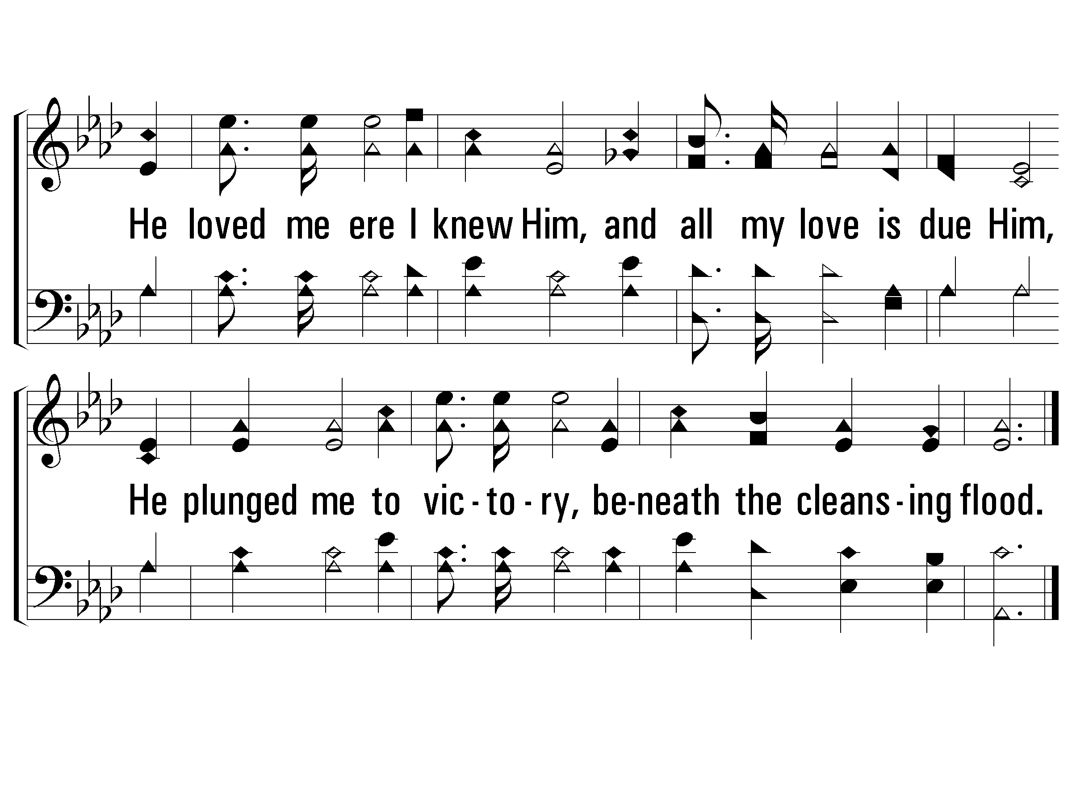
c – Victory in Jesus
717
© 2001 The Paperless Hymnal™

Slide 14
2 – Victory in Jesus
717
2.
I heard about His healing, Of His cleansing power revealing,
How He made the lame to walk again And caused the blind to see;
And then, I cried, "Dear Jesus, Come and heal my broken spirit,"
I then obeyed His blest commands And gained the victory.
Words and Music by: E. M. Bartlett
Copyright © 1939 by E.M. Bartlett. Copyright 1967 by Mrs. E.M. Bartlett, renewal.
Assigned to Albert E. Brumley & Sons/SESAC (admin. By ICG).
All rights reserved. Used by permission.
© 2001 The Paperless Hymnal™

Slide 15
2 – Victory in Jesus
717
© 2001 The Paperless Hymnal™

Slide 16
c – Victory in Jesus
717
O victory in Jesus, my Savior, forever,
He sought me and bought me with His redeeming blood;
He loved me ere I knew Him, and all my love is due Him,
He plunged me to victory, beneath the cleansing flood.
© 2001 The Paperless Hymnal™

Slide 17
c – Victory in Jesus
717
© 2001 The Paperless Hymnal™

Slide 18
3 – Victory in Jesus
717
3.
I heard about a mansion He has built for me in glory,
And I heard about the streets of gold Beyond the crystal sea;
About the angels singing, And the old redemption story,
And some sweet day I'll sing up there The song of victory.
Words and Music by: E. M. Bartlett
Copyright © 1939 by E.M. Bartlett. Copyright 1967 by Mrs. E.M. Bartlett, renewal.
Assigned to Albert E. Brumley & Sons/SESAC (admin. By ICG).
All rights reserved. Used by permission.
© 2001 The Paperless Hymnal™

Slide 19
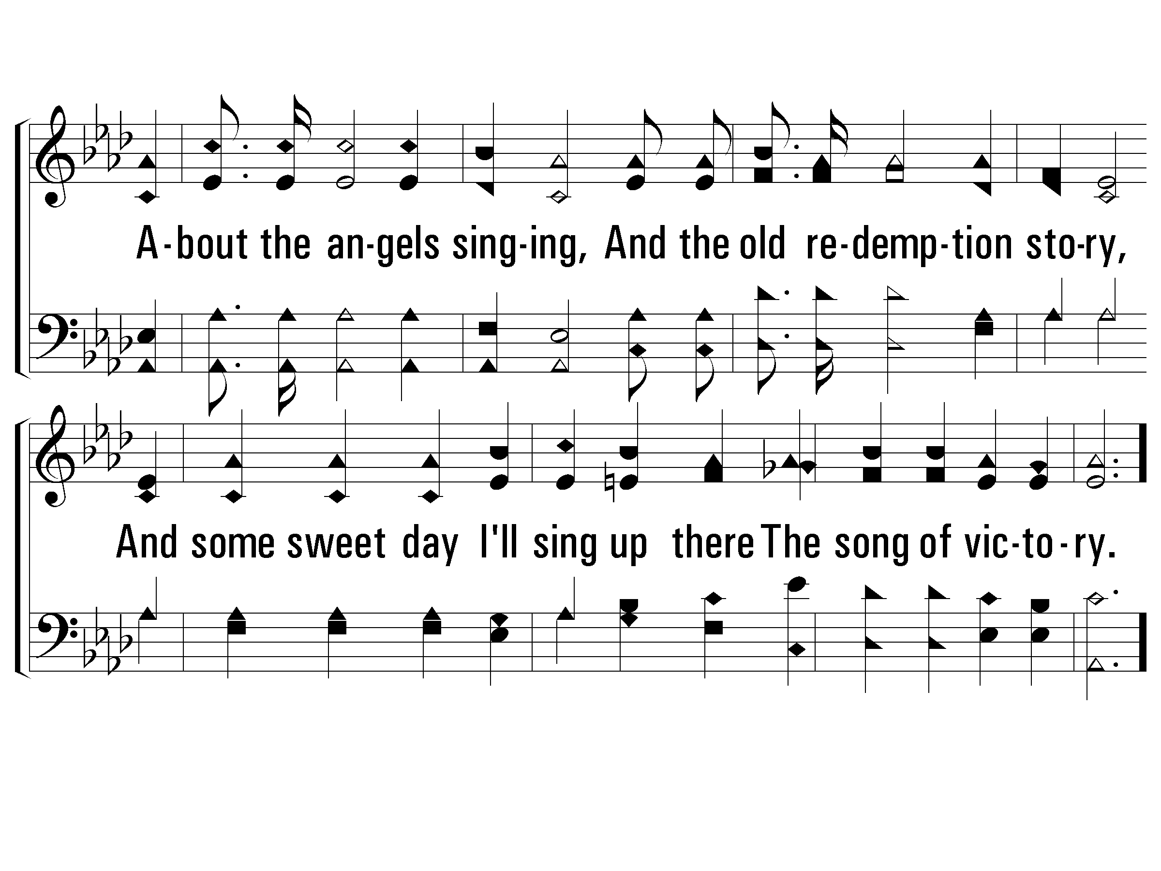
3 – Victory in Jesus
717
© 2001 The Paperless Hymnal™

Slide 20
c – Victory in Jesus
717
O victory in Jesus, my Savior, forever,
He sought me and bought me with His redeeming blood;
He loved me ere I knew Him, and all my love is due Him,
He plunged me to victory, beneath the cleansing flood.
© 2001 The Paperless Hymnal™

Slide 21
c – Victory in Jesus
717
© 2001 The Paperless Hymnal™

Slide 22
The Gospel for All
Acts 17:1-34

