Slide 1
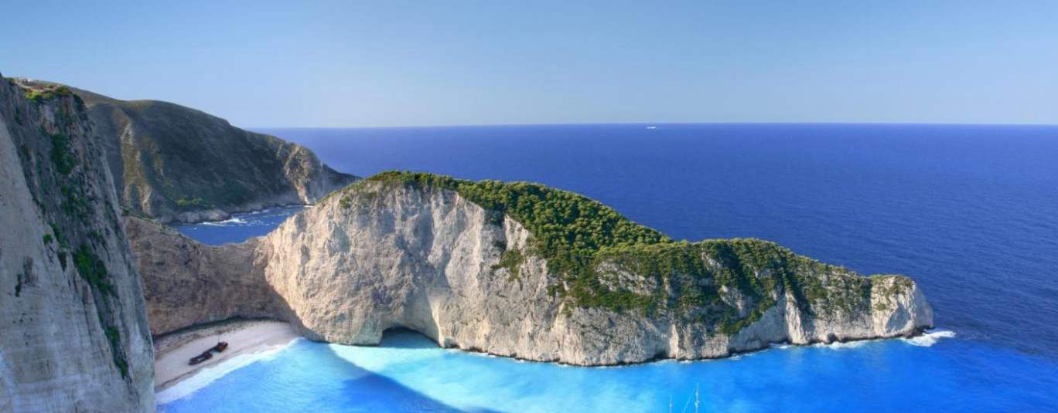
Mission Possible The Gospel in New Territory
Acts 13:1-52

Slide 2
Selected for the Mission 1-3
Church in Antioch
Strong foundation: Acts 11:26
Godly leadership: The Antioch Five
Call of the Holy Spirit
Total commitment: Luke 10:1-2

Slide 3
First Stop: Cyprus 4-12
Sailed for Cyprus (implement the plan)
Salamis: preach the word to the Jews
Paphos: summoned by the proconsul
Opposed by Elymas: boldness of “Paul”
The Proconsul believed: 1st convert

Slide 4
North to Mainland 13-15
Defection of John Mark
More difficult region ahead
Rugged climb through mountains
Antioch of Pisidia: Roman colony
Welcomed in the synagogue

Slide 5
Paul’s Sermon 16-41
History of Israel: God’s promises
God always kept His word
Promises to Abraham, David
God has sent His promised Savior
Jerusalem rejected/Jesus fulfilled all
Promise of forgiveness – all who believe
Warning: Don’t you also be scoffers (Habakkuk 1:5)

Slide 6
Immediate Aftermath 42-52
Positive initial response: hear more
Next sabbath: standing room only
Jealousy of the Jews
Paul and Barnabas: bold response
God’s command: turn to the Gentiles
Unworthy of eternal life
Joy of Gentiles/Jews stir up more trouble

Slide 7
Mission Possible The Gospel in New Territory
Acts 13:1-52

