Slide 1
Christians in a Secular Culture
John 17:11-17

Slide 2
Building a Biblical Faith
Jude 20-21 But you, beloved, building yourselves up on your most holy faith, praying in the Holy Spirit, ²¹ keep yourselves in the love of God, looking for the mercy of our Lord Jesus Christ unto eternal life.
Three key areas of faith
What we should believe
How we should think
How we live out our faith

Slide 3
2020 - “The New Normal”
2020 a pivotal year – Cultural Shift
Year of the pandemic
Racial protests/Social Justice movement
Need for Biblical discernment
Phil 1:9-11 And this I pray, that your love may abound still more and more in knowledge and all discernment, ¹⁰ that you may approve the things that are excellent, that you may be sincere and without offense till the day of Christ, ¹¹ being filled with the fruits of righteousness which are by Jesus Christ, to the glory and praise of God.

Slide 4
Our View of Scripture
2 Timothy 3:15-17 from childhood you have known the Holy Scriptures, which are able to make you wise for salvation through faith which is in Christ Jesus.
¹⁶ All Scripture is given by inspiration of God, and is profitable for doctrine, for reproof, for correction, for instruction in righteousness, ¹⁷ that the man of God may be complete, thoroughly equipped for every good work.

Slide 5
We are in a Cultural Minority
Social media pressure (comments)
“Listen to your inner self”
“Live your best life”
“You’re so strong”
“Be accepting of all views”
All roads lead to the summit
Follow your own heart
The only things “real” are proved scientifically

Slide 6
Culture is not a new problem
Romans 12:2 And do not be conformed to this world, but be transformed by the renewing of your mind, that you may prove what is that good and acceptable and perfect will of God.
Colossians 2:8 Beware lest anyone ^{[a]}cheat you through philosophy and empty deceit, according to the tradition of men, according to the basic principles of the world, and not according to Christ.
1 Peter 2:11-12 Beloved, I beg you as sojourners and pilgrims, abstain from fleshly lusts which war against the soul, ¹² having your conduct honorable among the Gentiles, that when they speak against you as evildoers, they may, by your good works which they observe, glorify God in the day of visitation.

Slide 7
Secular culture is our Moment
Matt 5:13-16“You are the salt of the earth; but if the salt loses its flavor, how shall it be seasoned? It is then good for nothing but to be thrown out and trampled underfoot by men. ¹⁴ “You are the light of the world. A city that is set on a hill cannot be hidden. ¹⁶ Let your light so shine before men, that they may see your good works and glorify your Father in heaven.
The Bible is totally accurate/absolute truth exists
Jesus lived a sinless life on earth
God is the Creator who still rules the earth

Slide 8
What is Secularism?
Secular (latin) the age, generation..
The world as opposed to the church
Irreligious, attitudes, activities with no religious basis
Jesus foretold this
John 15:18-25“If the world hates you, you know that it hated Me before it hated you. ¹⁹ If you were of the world, the world would love its own. Yet because you are not of the world, but I chose you out of the world, therefore the world hates you.

Slide 9
America is Secular for a Reason
Founding fathers wanted to protect Religious liberty
Constitution: Congress shall make no law..
Respecting an establishment of religion
Or prohibiting the free exercise thereof
John Adams: Our constitution was for a moral people. It is wholly inadequate to govern any other.
James Madison: Our constitution requires sufficient virtue among men for self government. Otherwise nothing less than the chains of despotism can restrain them from destroying and devouring one another.

Slide 10
Secular culture is never neutral
What rights should its citizens have?
Who should be protected?
When one person’s rights conflict with another person?
How far should parental rights extend?
What is criminal behavior?
What should be taught in public education?
(If God doesn’t exist, what authority is the basis for deciding these values?) … The new authority: the self

Slide 11
Why Secular Culture is appealing
Eph 2:1-3 And you He made alive, who were dead in trespasses and sins, ² in which you once walked according to the course of this world, according to the prince of the power of the air, the spirit who now works in the sons of disobedience, ³ among whom also we all once conducted ourselves in the lusts of our flesh, fulfilling the desires of the flesh and of the mind, and were by nature children of wrath, just as the others.

Slide 12
Christians in a Secular Culture
John 17:11-17

Slide 13
1 – When the Roll Is Called Up Yonder
755
1.
When the trumpet of the Lord shall sound
and time shall be no more,
And the morning breaks eternal, bright and fair;
When the saved of earth shall gather over on the other shore,
And the roll is called up yonder, I'll be there.
Words & Music: James M. Black
© 2005 The Paperless Hymnal™

Slide 14
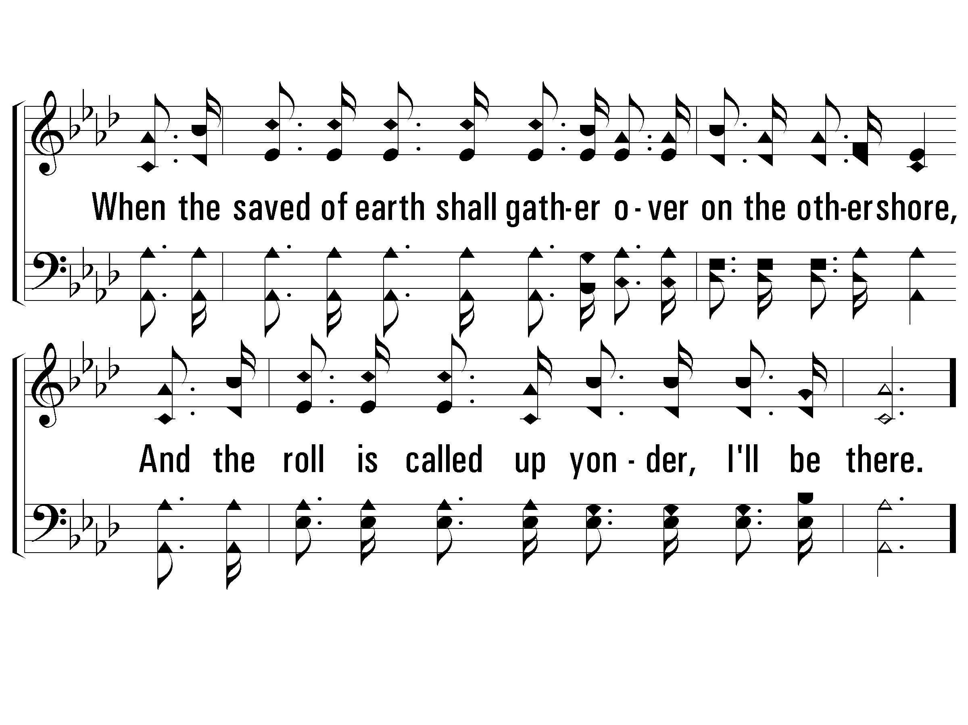
1 – When the Roll Is Called Up Yonder
755
© 2005 The Paperless Hymnal™

Slide 15
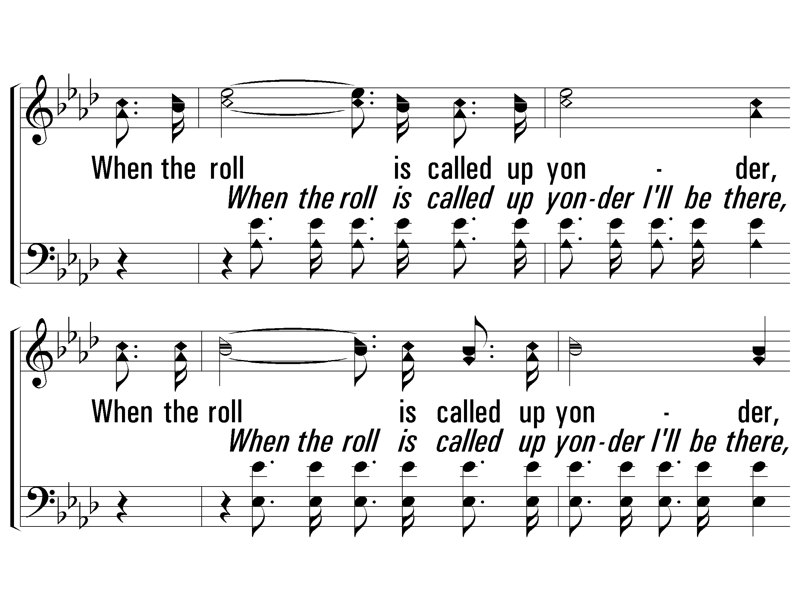
c – When the Roll Is Called Up Yonder
755
When the roll is called up yonder,
When the roll is called up yonder,
When the roll is called up yonder,
When the roll is called up yonder, I'll be there.
© 2005 The Paperless Hymnal™

Slide 16
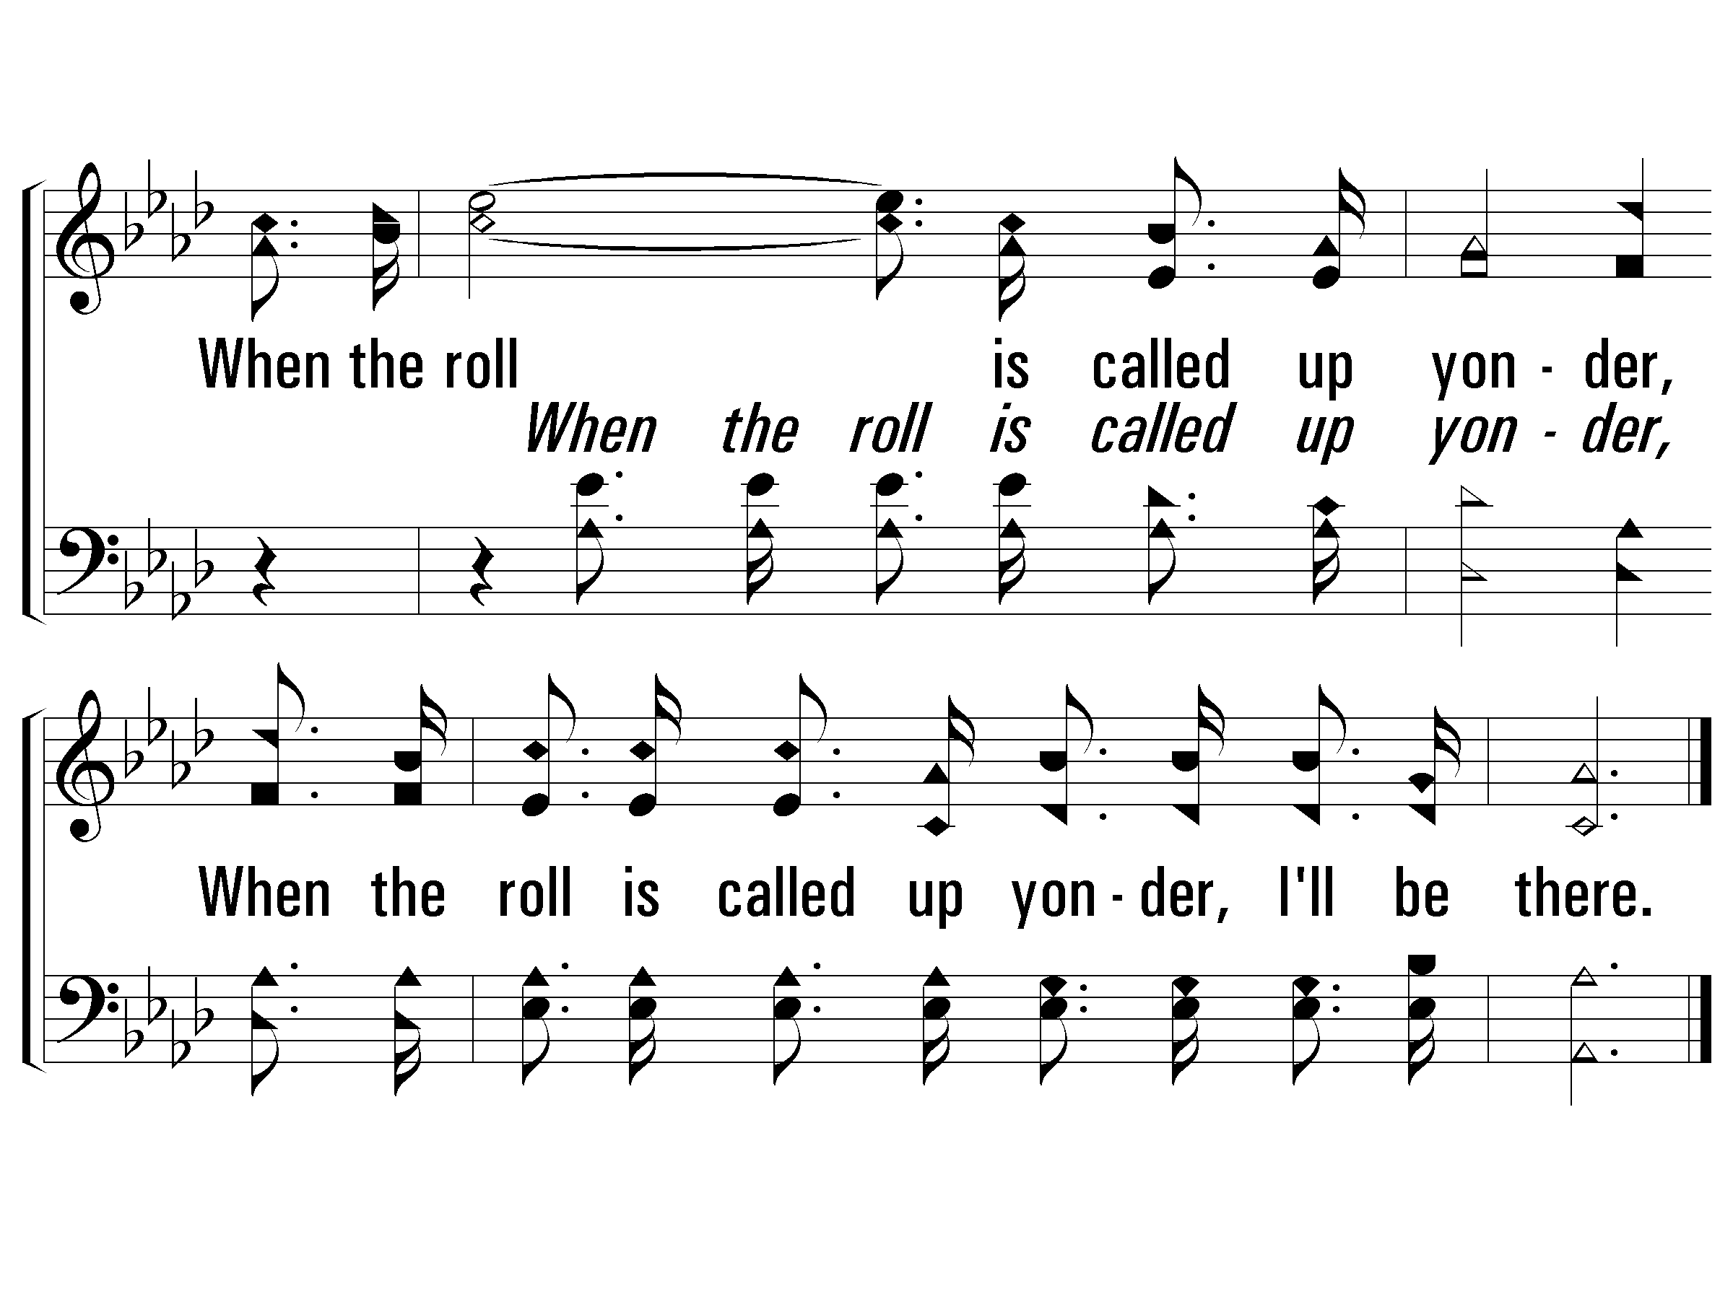
c – When the Roll Is Called Up Yonder
755
© 2005 The Paperless Hymnal™

Slide 17
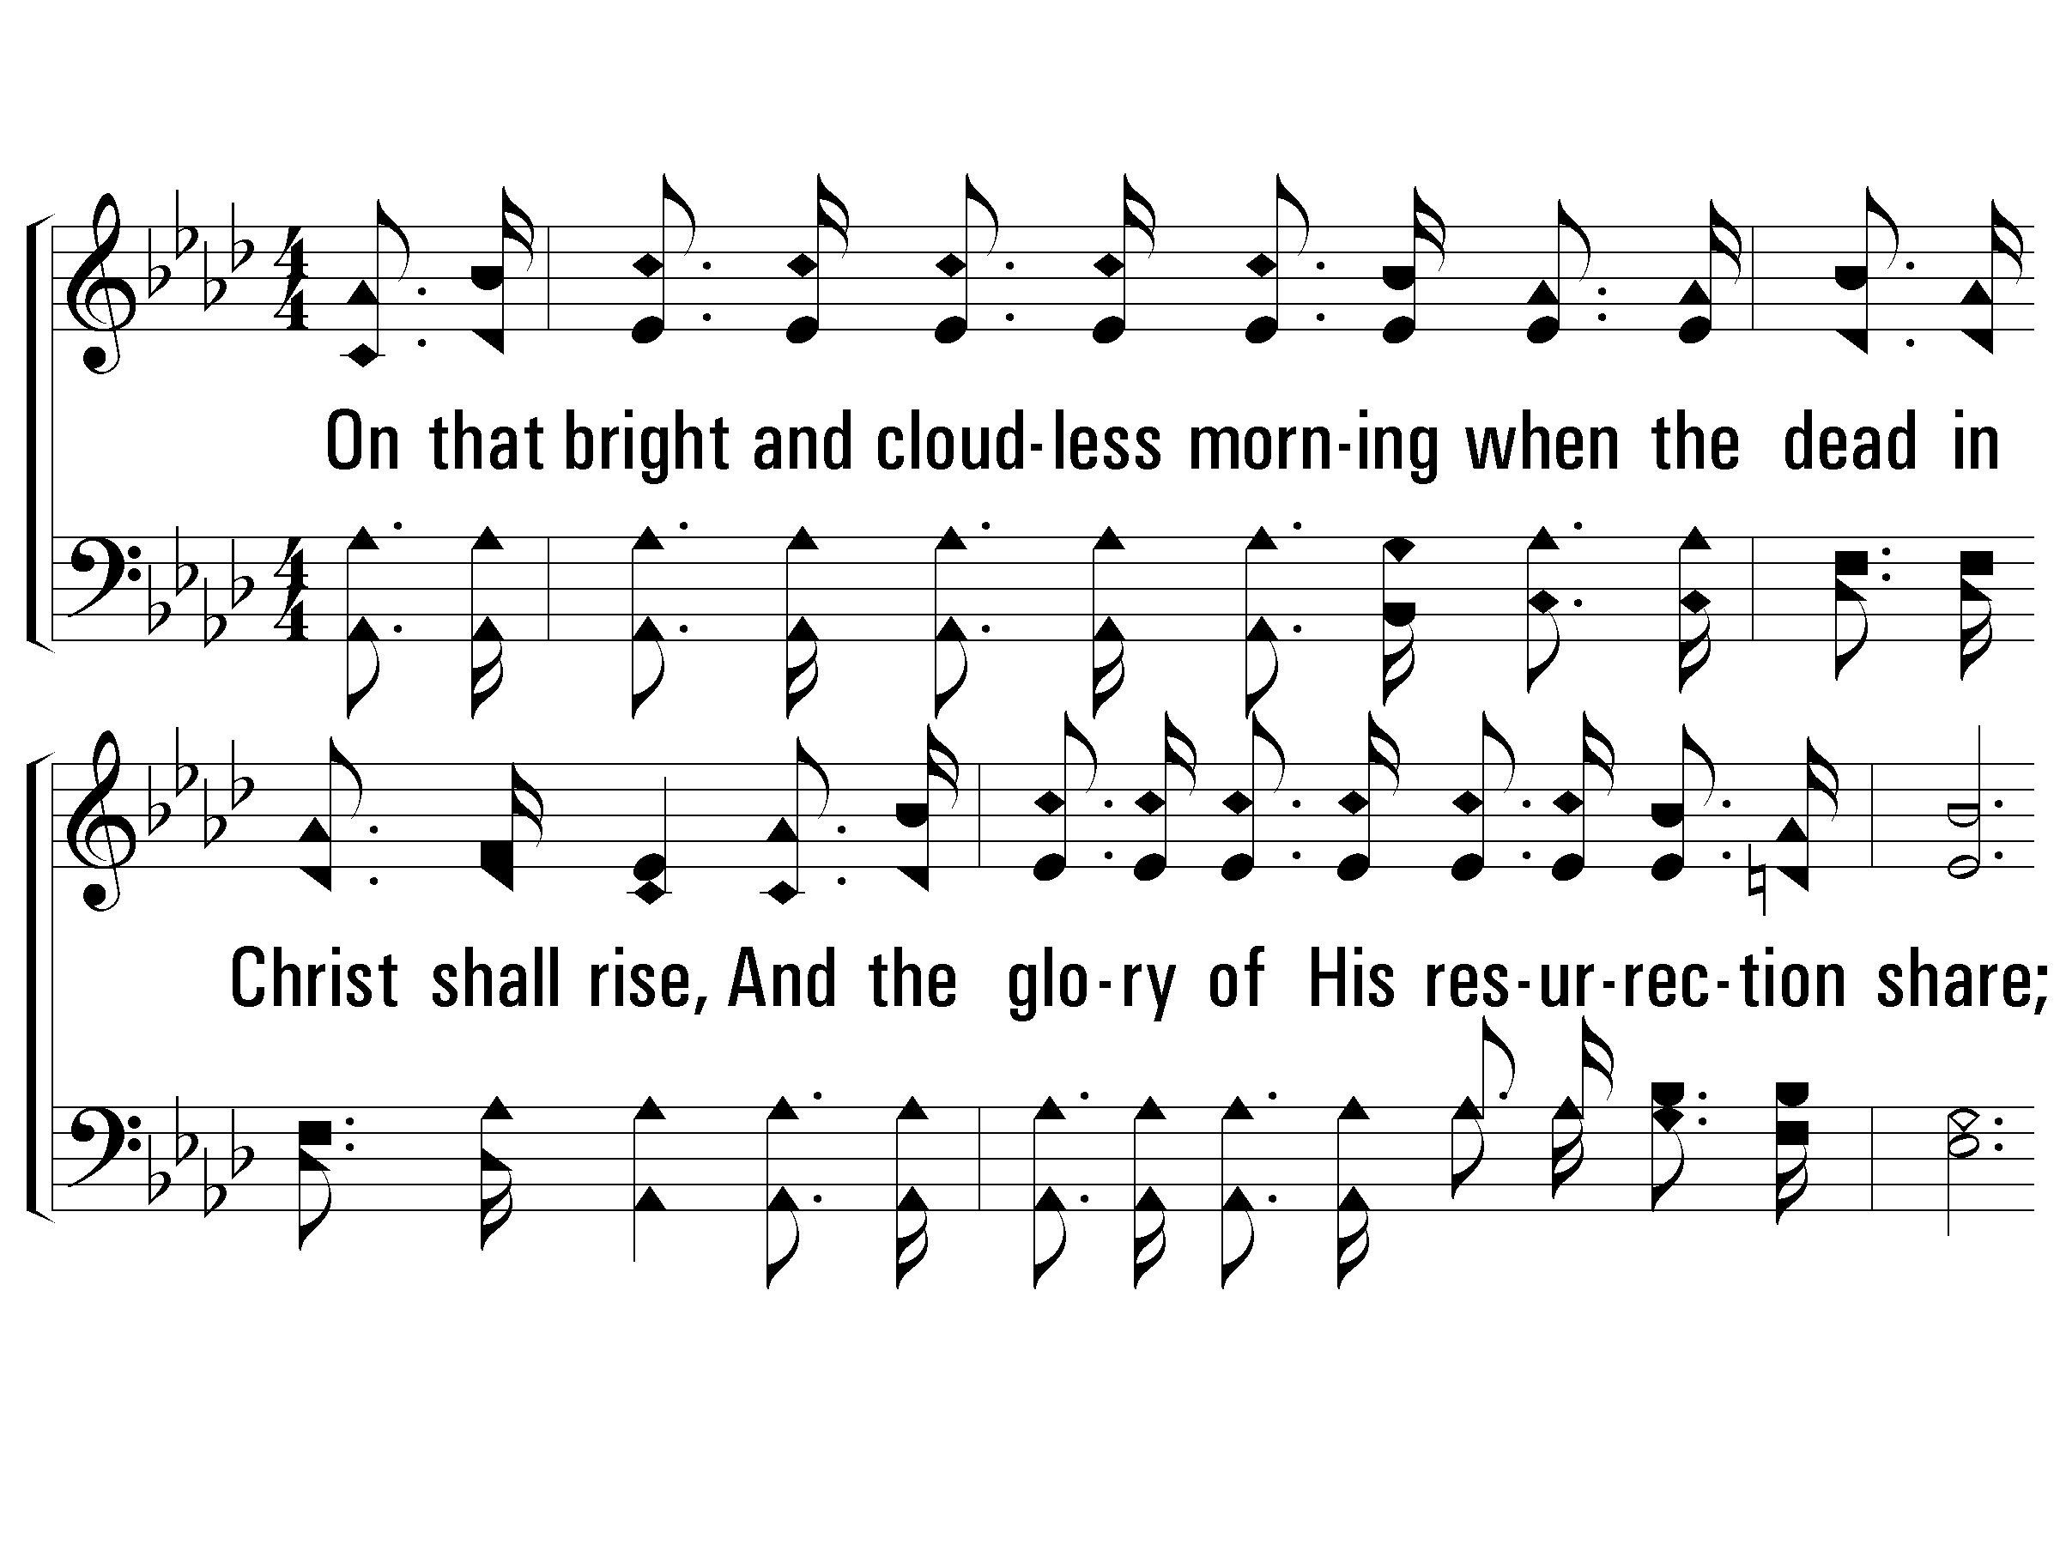
2 – When the Roll Is Called Up Yonder
755
2.
On that bright and cloudless morning
when the dead in Christ shall rise,
And the glory of His resurrection share;
When His chosen ones shall gather to their home beyond the skies,
And the roll is called up yonder, I'll be there.
Words & Music: James M. Black
© 2005 The Paperless Hymnal™

Slide 18
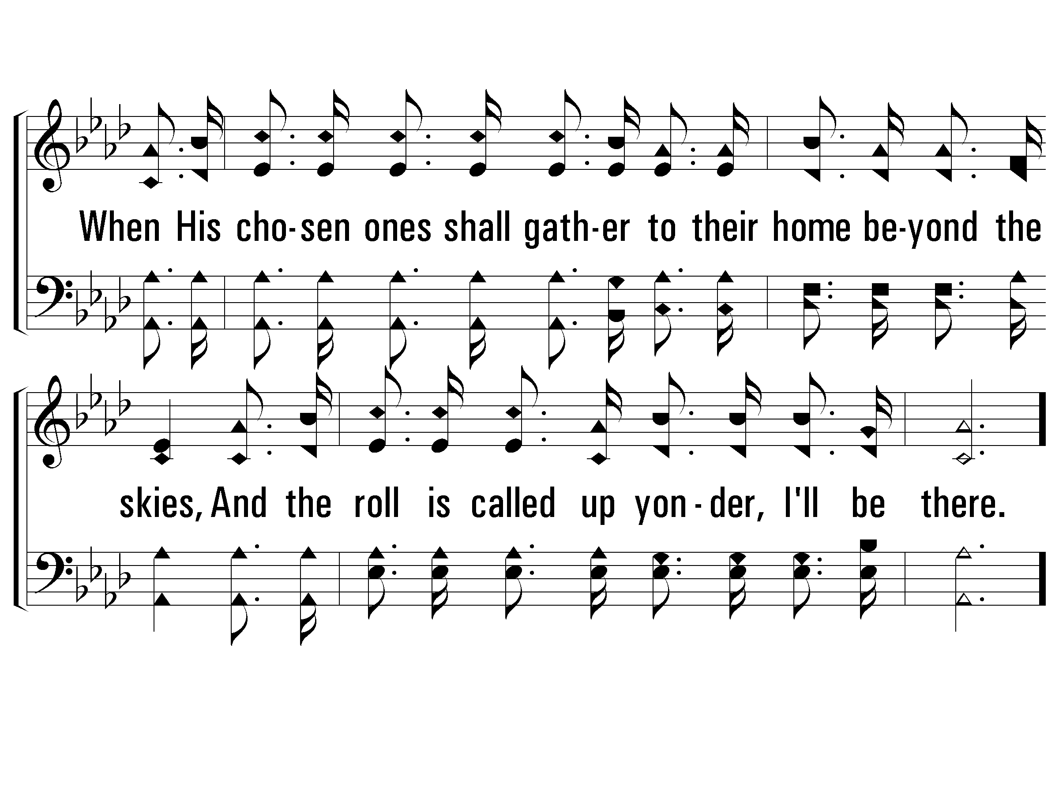
2 – When the Roll Is Called Up Yonder
755
© 2005 The Paperless Hymnal™

Slide 19
c – When the Roll Is Called Up Yonder
755
When the roll is called up yonder,
When the roll is called up yonder,
When the roll is called up yonder,
When the roll is called up yonder, I'll be there.
© 2005 The Paperless Hymnal™

Slide 20
c – When the Roll Is Called Up Yonder
755
© 2005 The Paperless Hymnal™

Slide 21
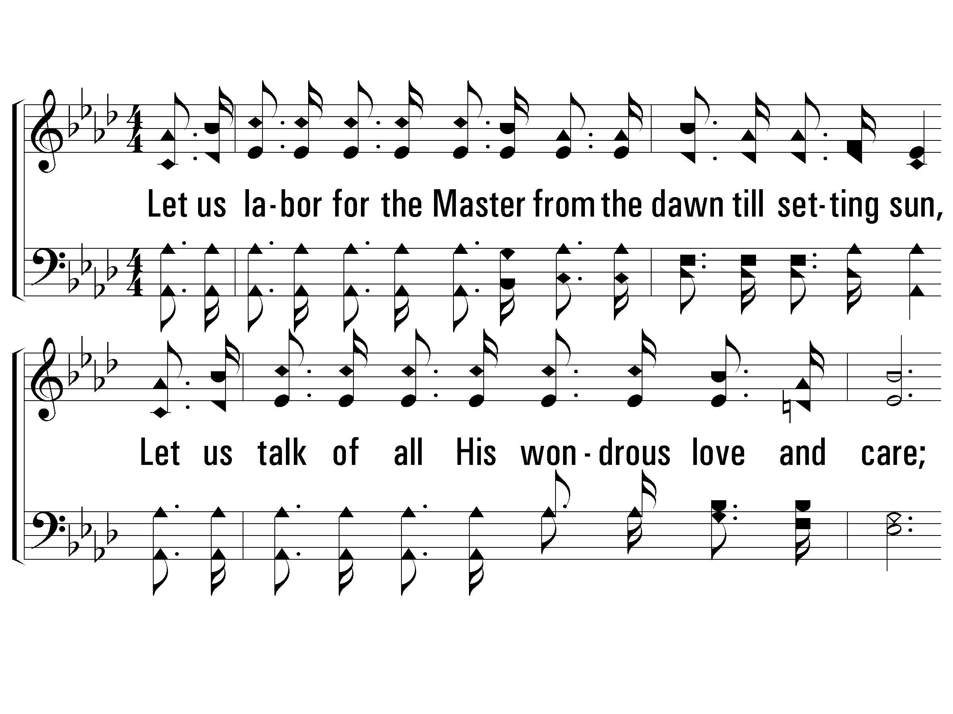
3 – When the Roll Is Called Up Yonder
755
3.
Let us labor for the Master from the dawn till setting sun,
Let us talk of all His wondrous love and care;
Then when all of life is over and our work on earth is done,
And the roll is called up yonder, I'll be there.
Words & Music: James M. Black
© 2005 The Paperless Hymnal™

Slide 22
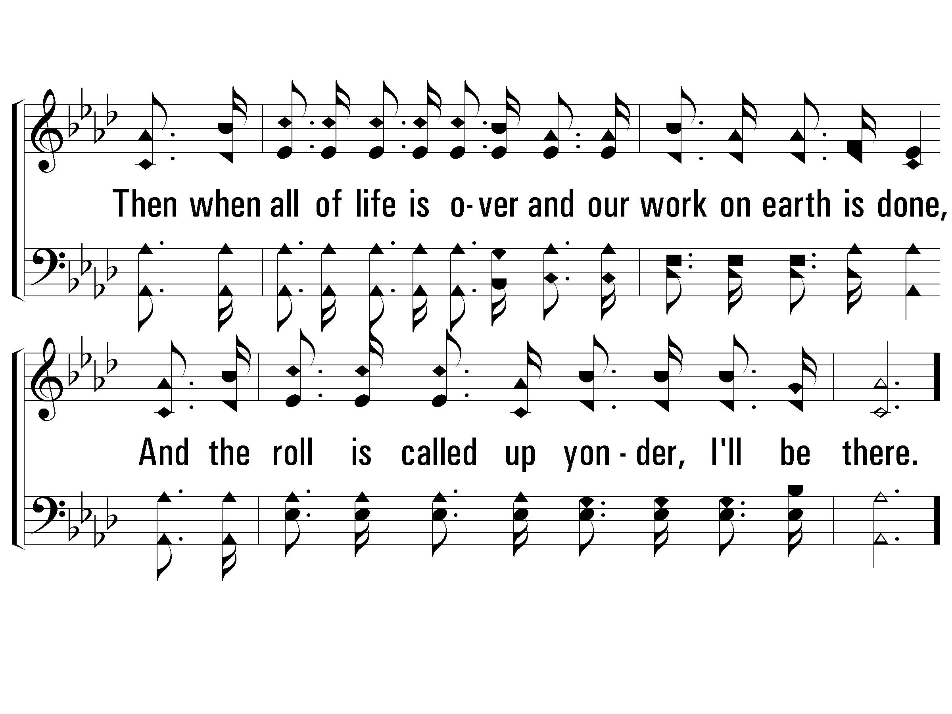
3 – When the Roll Is Called Up Yonder
755
© 2005 The Paperless Hymnal™

Slide 23
c – When the Roll Is Called Up Yonder
755
When the roll is called up yonder,
When the roll is called up yonder,
When the roll is called up yonder,
When the roll is called up yonder, I'll be there.
© 2005 The Paperless Hymnal™

Slide 24
c – When the Roll Is Called Up Yonder
755
© 2005 The Paperless Hymnal™

Slide 25
Christians in a Secular Culture
John 17:11-17

