Slide 1
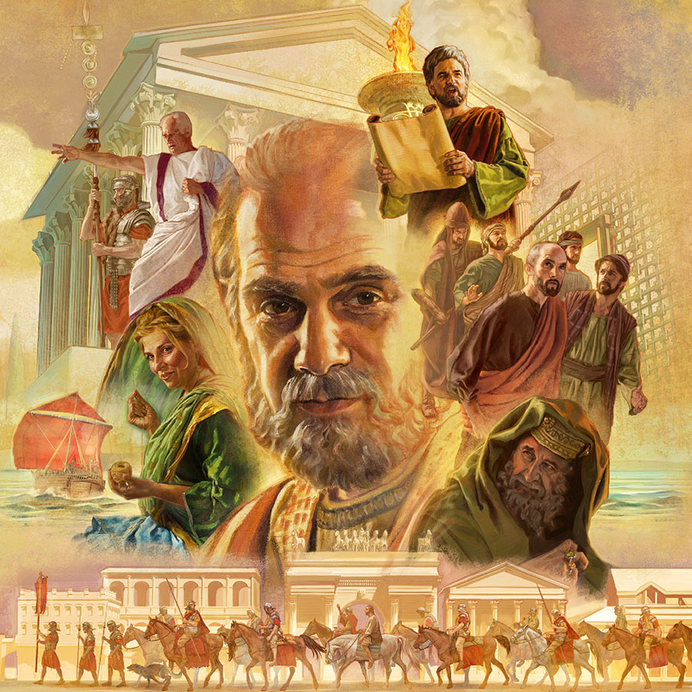
The Lord’s Protection in Paul’s Life
Acts 23:1-35

Slide 2
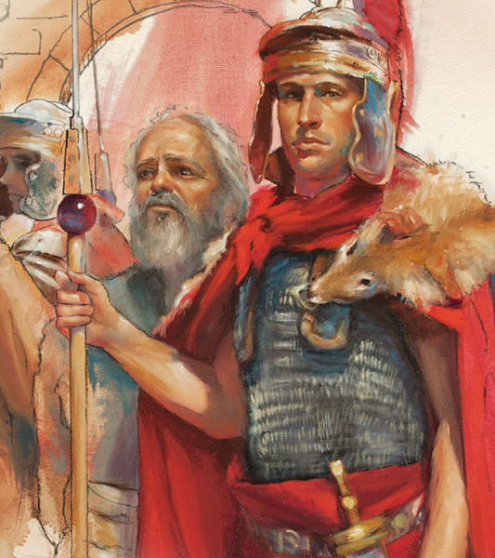
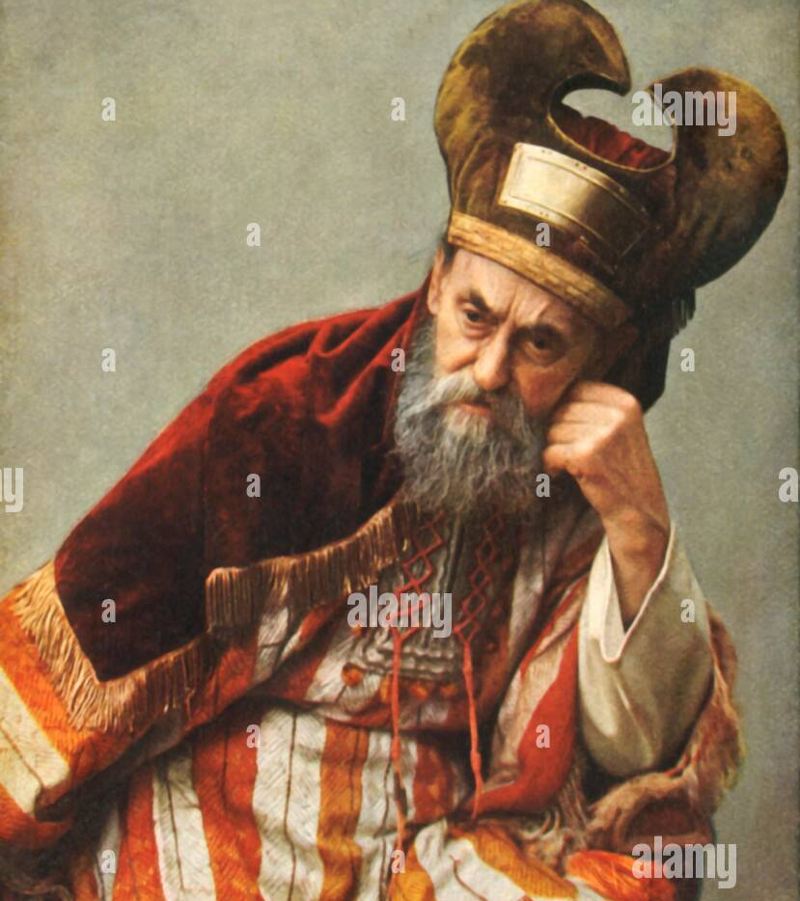

Slide 3
Setting from previously
22:30 The next day, because he wanted to know for certain why he was accused by the Jews, he released him from his bonds, and commanded the chief priests and all their council to appear, and brought Paul down and set him before them.

Slide 4
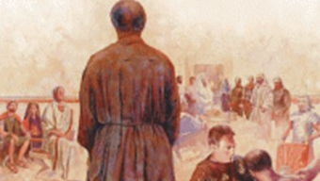

Slide 5
Paul before the Council
23:1-5 Then Paul, looking earnestly at the council, said, “Men and brethren, I have lived in all good conscience before God until this day.” ² And the high priest Ananias commanded those who stood by him to strike him on the mouth. ³ Then Paul said to him, “God will strike you, you whitewashed wall! For you sit to judge me according to the law, and do you command me to be struck contrary to the law?”
⁴ And those who stood by said, “Do you revile God’s high priest?”
⁵ Then Paul said, “I did not know, brethren, that he was the high priest; for it is written, ‘You shall not speak evil of a ruler of your people.’ ”

Slide 7
Paul before the Council
23:1-5 Then Paul, looking earnestly at the council, said, “Men and brethren, I have lived in all good conscience before God until this day.” ² And the high priest Ananias commanded those who stood by him to strike him on the mouth. ³ Then Paul said to him, “God will strike you, you whitewashed wall! For you sit to judge me according to the law, and do you command me to be struck contrary to the law?”
Deut 19:15 “One witness shall not rise against a man concerning any iniquity or any sin that he commits; by the mouth of two or three witnesses the matter shall be established.

Slide 8
Paul before the Council
23:1-5 ⁴ And those who stood by said, “Do you revile God’s high priest?”
⁵ Then Paul said, “I did not know, brethren, that he was the high priest; for it is written, ‘You shall not speak evil of a ruler of your people.’ ”
Exodus 22:28 “You shall not revile God, nor curse a ruler of your people.

Slide 9
Disorder in the Court
6-9 But when Paul perceived that one part were Sadducees and the other Pharisees, he cried out in the council, “Men and brethren, I am a Pharisee, the son of a Pharisee; concerning the hope and resurrection of the dead I am being judged!”
⁷ And when he had said this, a dissension arose between the Pharisees and the Sadducees; and the assembly was divided. ⁸ For Sadducees say that there is no resurrection—and no angel or spirit; but the Pharisees confess both. ⁹ Then there arose a loud outcry. And the scribes of the Pharisees’ party arose and protested, saying, “We find no evil in this man; but if a spirit or an angel has spoken to him, let us not fight against God.”

Slide 10
The Lord encourages Paul
10-11 Now when there arose a great dissension, the commander, fearing lest Paul might be pulled to pieces by them, commanded the soldiers to go down and take him by force from among them, and bring him into the barracks.
¹¹ But the following night the Lord stood by him and said, “Be of good cheer, Paul; for as you have testified for Me in Jerusalem, so you must also bear witness at Rome.”

Slide 11
Treachery of the Jews
12-15 And when it was day, some of the Jews banded together and bound themselves under an oath, saying that they would neither eat nor drink till they had killed Paul. ¹³ Now there were more than forty who had formed this conspiracy.
¹⁴ They came to the chief priests and elders, and said, “We have bound ourselves under a great oath that we will eat nothing until we have killed Paul. ¹⁵ Now you, therefore, together with the council, suggest to the commander that he be brought down to you tomorrow, as though you were going to make further inquiries concerning him; but we are ready to kill him before he comes near.”

Slide 12
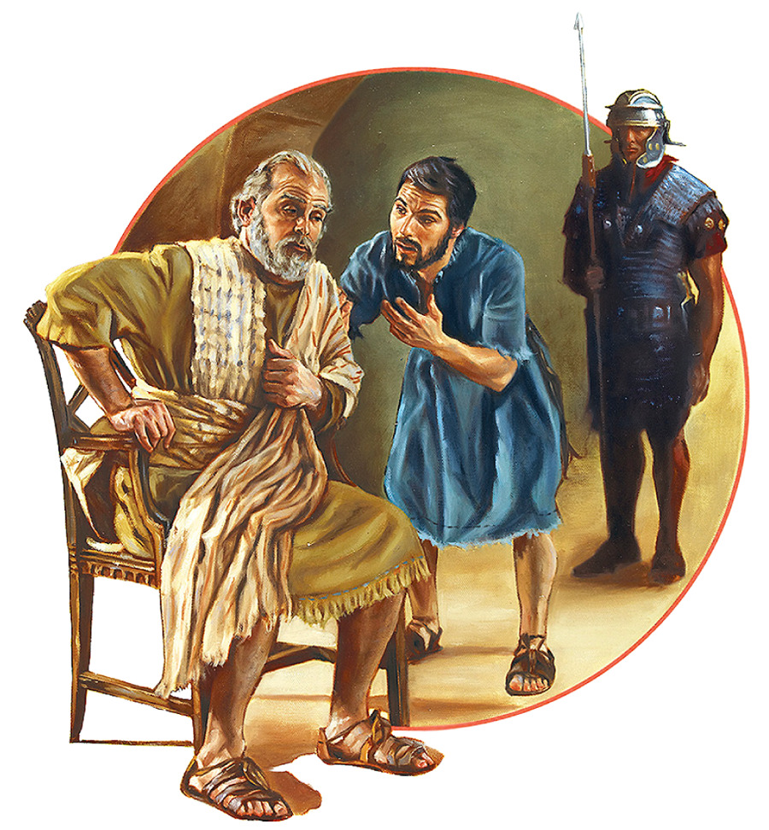

Slide 13
Paul’s Nephew
16-19 So when Paul’s sister’s son heard of their ambush, he went and entered the barracks and told Paul. ¹⁷ Then Paul called one of the centurions to him and said, “Take this young man to the commander, for he has something to tell him.”
¹⁸ So he took him and brought him to the commander and said, “Paul the prisoner called me to him and asked me to bring this young man to you. He has something to say to you.”
¹⁹ Then the commander took him by the hand, went aside, and asked privately, “What is it that you have to tell me?”

Slide 15
The Commander’s Response
20-24 And he said, “The Jews have agreed to ask that you bring Paul down to the council tomorrow, as though they were going to inquire more fully about him. ²¹ But do not yield to them, for more than forty of them lie in wait for him, men who have bound themselves by an oath that they will neither eat nor drink till they have killed him; and now they are ready, waiting for the promise from you.”
²² So the commander let the young man depart, and commanded him, “Tell no one that you have revealed these things to me.”
²³ And he called for two centurions, saying, “Prepare two hundred soldiers, seventy horsemen, and two hundred spearmen to go to Caesarea at the third hour of the night; ²⁴ and provide mounts to set Paul on, and bring him safely to Felix the governor.”

Slide 16
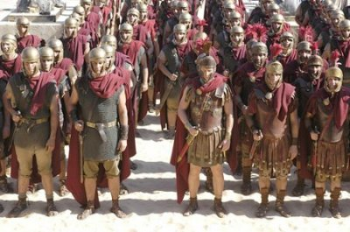

Slide 17
His Letter to His Superior
25-30 He wrote a letter in the following manner:
²⁶ Claudius Lysias, To the most excellent governor Felix: Greetings.
²⁷ This man was seized by the Jews and was about to be killed by them. Coming with the troops I rescued him, having learned that he was a Roman. ²⁸ And when I wanted to know the reason they accused him, I brought him before their council. ²⁹ I found out that he was accused concerning questions of their law, but had nothing charged against him deserving of death or chains. ³⁰ And when it was told me that the Jews lay in wait for the man, I sent him immediately to you, and also commanded his accusers to state before you the charges against him.
Farewell.

Slide 18
Paul’s safe transfer
31-35 Then the soldiers, as they were commanded, took Paul and brought him by night to Antipatris. ³² The next day they left the horsemen to go on with him, and returned to the barracks.
³³ When they came to Caesarea and had delivered the letter to the governor, they also presented Paul to him. ³⁴ And when the governor had read it, he asked what province he was from. And when he understood that he was from Cilicia, ³⁵ he said, “I will hear you when your accusers also have come.” And he commanded him to be kept in Herod’s Praetorium.

Slide 19
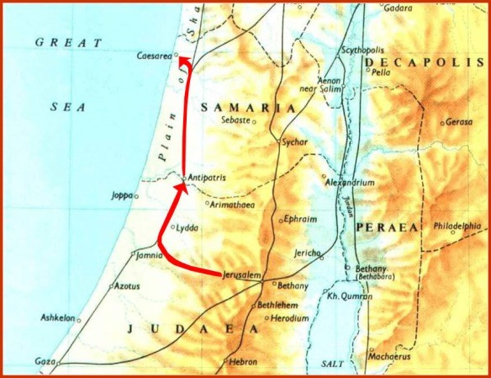

Slide 20
The Lord’s Presence for us
The Lord is always faithful to His people..
1 Cor 1:9 God is faithful, by whom you were called into the fellowship of His Son, Jesus Christ our Lord.
1 Cor 10:13 No temptation has overtaken you except such as is common to man; but God is faithful, who will not allow you to be tempted beyond what you are able, but with the temptation will also make the way of escape, that you may be able to bear it.
How easy to take God’s faithfulness for granted..

Slide 21
The Lord’s Protection in Paul’s Life
Acts 23:1-35

