Slide 1
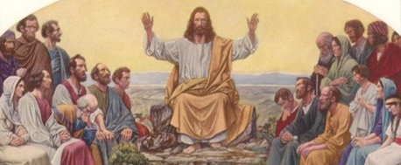
The Preaching of Jesus
Matthew 6 True Righteousness

Slide 2
Jesus began preaching..
Matthew 4 “Repent, for the kingdom of heaven is at hand”
Matthew 5 Attitudes of the Kingdom
Blessed.. are those who know they are not righteous
Righteousness that exceeds that of the Pharisees
Matthew 6 True Righteousness..
In our religious life (our motives)
In our daily life (our possessions)

Slide 3
True Righteousness..
In Religious life (watch our motives).. 1-18
Charitable deeds 1-4
Seeking glory from men, they have their reward
Do kind deeds in secret, your Father will reward you
Prayer 5-14
Praying to be heard by others
Praying empty repetitions
Praying with sin in heart
Fasting 16-18
Sad appearance
Dress as usual

Slide 4
True Righteousness..
In Daily life (weigh our values).. 19-34
Don’t lay up treasures on earth 19-24
Living for material things is foolish (they don’t last)
Treasure for God’s glory lasts eternally
Don’t worry about the things of life 25-32
Worry about material things is foolish (accomplishes nothing)
God’s care of nature (Flowers, birds).. You are of more value
Seek first the Kingdom of God and His righteousness 33-34
God will provide our material needs when we put Him first
Don’t let worries for tomorrow affect serving God today

Slide 5
Jesus’ advice for a Happy Life
Live one day at a time with God and for God
Put God first in each day (time for prayer, His word)
Put God first in your week (worship faithfully 1st day)
Put God first in our choices (no decisions that leave Him out)
Planning for tomorrow is time well spent
Worrying about tomorrow is time wasted
We should not be fascinated with our possessions
God alone deserves to be our Master
Focus your eyes on Him

Slide 6
The Preaching of Jesus
Matthew 6 True Righteousness

