Slide 1
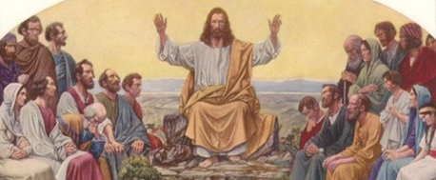
The Preaching of Jesus
Matthew 7 - Two Choices in Life

Slide 2
Two lifestyles
Judgmental
Prayerful
(1-11)
Matt 7:1-5 “Judge not, that you be not judged. ² For with what judgment you judge, you will be judged; and with the measure you use, it will be measured back to you.
7:7-11 “Ask, and it will be given to you; seek, and you will find; knock, and it will be opened to you. ⁸ For everyone who asks receives, and he who seeks finds, and to him who knocks it will be opened.

Slide 3
Two pathways
Narrow way
Broad way
(13-19)
13-14 “Enter by the narrow gate; for wide is the gate and broad is the way that leads to destruction, and there are many who go in by it. ¹⁴ Because narrow is the gate and difficult is the way which leads to life, and there are few who find it.
16-19 “Beware of false prophets.. A good tree cannot bear bad fruit, nor can a bad tree bear good fruit. ¹⁹ Every tree that does not bear good fruit is cut down and thrown into the fire. ²⁰ Therefore by their fruits you will know them.

Slide 4
Two destinies
Wise builder
Foolish builder
(21-29)
21-23 “Not everyone who says to Me, ‘Lord, Lord,’ shall enter the kingdom of heaven, but he who does the will of My Father in heaven.
24-29 “Therefore whoever hears these sayings of Mine, and does them, I will liken him to a wise man who built his house on the rock.. but everyone who hears these sayings of Mine, and does not do them, will be like a foolish man who built his house on the sand..

Slide 5
Two destinies
Wise builder
Foolish builder
(21-29)
27 and the rain descended, the floods came, and the winds blew and beat on that house; and it fell. And great was its fall.”
28-29 And so it was, when Jesus had ended these sayings, that the people were astonished at His teaching, ²⁹ for He taught them as one having authority, and not as the scribes.

Slide 6
The Preaching of Jesus
Matthew 7 – Two Choices in Life

