Slide 1
A Popular Saying
Acts 17:11

Slide 3
Old Testament examples
King Hezekiah (2 Chron 32:1-8)
And he strengthened himself, built up all the wall that was broken, raised it up to the towers, and built another wall outside; also he repaired the Millo in the City of David, and made weapons and shields in abundance. ⁶ Then he set military captains over the people, gathered them together to him in the open square of the city gate, and gave them encouragement, saying, ⁷ “Be strong and courageous; do not be afraid nor dismayed before the king of Assyria, nor before all the multitude that is with him; for there are more with us than with him. ⁸ With him is an arm of flesh; but with us is the Lord our God, to help us and to fight our battles.” And the people were strengthened by the words of Hezekiah king of Judah.

Slide 4
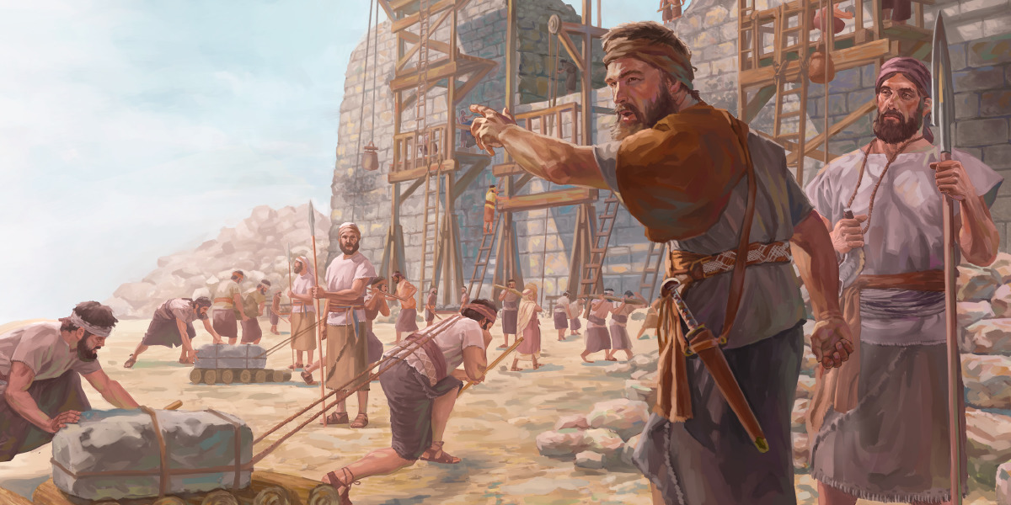

Slide 5
Hezekiah’s Tunnel

Slide 6
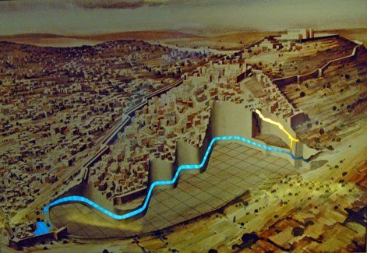
Hezekiah’s Tunnel

Slide 7
Old Testament examples
Proverbs 6:10-12 Go to the ant, you sluggard! Consider her ways and be wise, ⁷ Which, having no captain, Overseer or ruler, ⁸ Provides her supplies in the summer, And gathers her food in the harvest. ⁹ How long will you slumber, O sluggard? When will you rise from your sleep? ¹⁰ A little sleep, a little slumber, A little folding of the hands to sleep—¹¹ So shall your poverty come on you like a prowler, And your need like an armed man.
Proverbs 13:4 The soul of a lazy man desires, and has nothing; But the soul of the diligent shall be made rich.

Slide 9
Practical Examples for Today
Praying for food
Matthew 6:11 Give us this day our daily bread.
2 Thess 3:7-10 For you yourselves know how you ought to follow us, for we were not disorderly among you; ⁸ nor did we eat anyone’s bread free of charge, but worked with labor and toil night and day, that we might not be a burden to any of you, ⁹ not because we do not have authority, but to make ourselves an example of how you should follow us. ¹⁰ For even when we were with you, we commanded you this: If anyone will not work, neither shall he eat.
1 Timothy 6:8 And having food and clothing, with these we shall be content.

Slide 10
Gaining Wisdom
James 1:5 If any of you lacks wisdom, let him ask of God, who gives to all liberally and without reproach, and it will be given to him.
6-8 But let him ask in faith, with no doubting, for he who doubts is like a wave of the sea driven and tossed by the wind. ⁷ For let not that man suppose that he will receive anything from the Lord; ⁸ he is a double-minded man, unstable in all his ways.
Colossians 1:9 For this reason we also, since the day we heard it, do not cease to pray for you, and to ask that you may be filled with the knowledge of His will in all wisdom and spiritual understanding;
Hebrews 5:14 But solid food belongs to those who are of full age, that is, those who by reason of use have their senses exercised to discern both good and evil.

Slide 11
Salvation and Forgiveness
Ephesians 2:4-5 But God, who is rich in mercy, because of His great love with which He loved us, ⁵ even when we were dead in trespasses, made us alive together with Christ (by grace you have been saved),
Romans 5:6-8 For when we were still without strength, in due time Christ died for the ungodly. ⁷ For scarcely for a righteous man will one die; yet perhaps for a good man someone would even dare to die. ⁸ But God demonstrates His own love toward us, in that while we were still sinners, Christ died for us.
2 Peter 3:9 The Lord is not slack concerning His promise, as some count slackness, but is longsuffering toward us, not willing that any should perish but that all should come to repentance.

Slide 12
Salvation and Forgiveness
For the Non-Christian
For the Christian
Hearing the Gospel Rom 10:17
Believing in Christ Mark 16:16
Repenting of sins Acts 2:38
Confessing our faith Rom10:9-10
Baptized into Christ Acts 22:16
Repentance Acts 8:22
Prayer 1 John 1:9

Slide 13
Growing in Strength
Philippians 4:13 I can do all things through Christ who strengthens me.
Through the word of God
Acts 20:32 I commend you to God and to the word of His grace, which is able to build you up and give you an inheritance among all those who are sanctified.
The example of Christ
Hebrews 12:2-3 looking unto Jesus, the author and finisher of our faith, who for the joy that was set before Him endured the cross, despising the shame, and has sat down at the right hand of the throne of God.

Slide 14
Growing in Strength
The encouragement of brethren
Hebrews 3:12-13 Beware, brethren, lest there be in any of you an evil heart of unbelief in departing from the living God; ¹³ but exhort one another daily, while it is called “Today,” lest any of you be hardened through the deceitfulness of sin.

Slide 16
A Popular Saying
Acts 17:11

