Slide 1
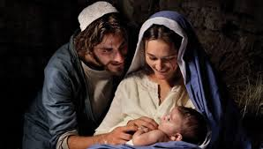
Joseph of Bethlehem
Matthew 1:18-25

Slide 2
Two angelic visits
Luke 1:26-29 Mary’s visit
Now in the sixth month the angel Gabriel was sent by God to a city of Galilee named Nazareth, ²⁷ to a virgin betrothed to a man whose name was Joseph, of the house of David…when she saw him, she was troubled at his saying, and considered what manner of greeting this was.
Matthew 1:18-25 Joseph’s dream
After His mother Mary was betrothed to Joseph, before they came together, she was found with child of the Holy Spirit… an angel of the Lord appeared to him in a dream, saying, “Joseph, son of David, do not be afraid to take to you Mary your wife, for that which is conceived in her is of the Holy Spirit.

Slide 3
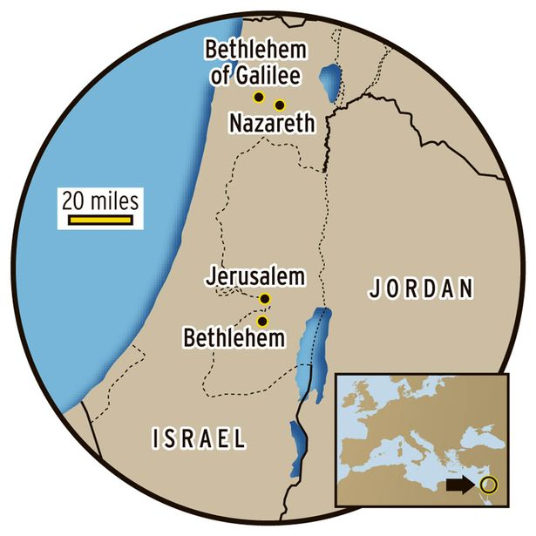

Slide 4
Bethlehem city of Joseph
Matthew’s city of Bethlehem
Luke 2:1-3 a decree went out from Caesar Augustus that all the world should be registered…So all went to be registered, everyone to his own city. Joseph also went up from Galilee, out of the city of Nazareth, into Judea, to the city of David, which is called Bethlehem, because he was of the house and lineage of David..
Matthew 2:23 And he came and dwelt in a city called Nazareth, that it might be fulfilled which was spoken by the prophets, “He shall be called a Nazarene.”

Slide 5
Bethlehem city of Joseph
Mary’s visit to Elizabeth
Luke 1:39-56 Now Mary arose in those days and went into the hill country with haste, to a city of Judah, ⁴⁰ and entered the house of Zacharias and greeted Elizabeth. ⁵⁶ And Mary remained with her about three months, and returned to her house.
Joseph learns Mary is pregnant
Matt 1:18-19 After His mother Mary was betrothed to Joseph, before they came together, she was found with child of the Holy Spirit. ¹⁹ Then Joseph her husband, being a just man, and not wanting to make her a public example, was minded to put her away secretly.

Slide 6
Bethlehem’s importance
“House of Bread” 6 mi from Jerusalem
Gen 35:19-20 Rachel’s grave
So Rachel died and was buried on the way to Ephrath (that is, Bethlehem). ²⁰ And Jacob set a pillar on her grave, which is the pillar of Rachel’s grave to this day.
Setting of book of Ruth (1:22)
Ruth’s grandson David “City of David”
Prophecy of Micah 5:2
But you, Bethlehem Ephrathah, Though you are little among the thousands of Judah, Yet out of you shall come forth to Me the One to be Ruler in Israel, Whose goings forth are from of old, From everlasting.”

Slide 7
Humility of Joseph
No recorded words in NT
Only few times after birth narratives
Luke 2:40-52 Jesus 12 yrs old
Matthew 13:55-56 Is this not the carpenter’s son?
Mark 6:3 Is this not the carpenter?
We see a humble, hard working man

Slide 8
His decision to show compassion
Matt 1:18-19 Now the birth of Jesus Christ was as follows: After His mother Mary was betrothed to Joseph, before they came together, she was found with child of the Holy Spirit. ¹⁹ Then Joseph her husband, being a just man, and not wanting to make her a public example, was minded to put her away secretly.
1st reacation Did not believe Mary’s story, felt hurt
Being a just man.. He showed compassion, mercy
Deut 22:23-24 she could be stoned to death

Slide 9
His dream in the night
Matt 1:20-21 But while he thought about these things, behold, an angel of the Lord appeared to him in a dream, saying, “Joseph, son of David, do not be afraid to take to you Mary your wife, for that which is conceived in her is of the Holy Spirit. ²¹ And she will bring forth a Son, and you shall call His name Jesus, for He will save His people from their sins.”
Next day Joseph agreed to marry Mary
Quickly completed legal process to marry her
His willingness to do honorable thing

Slide 10
The prophecy of Isaiah
Matt 1:22-23 So all this was done that it might be fulfilled which was spoken by the Lord through the prophet, saying: ²³ “Behold, the virgin shall be with child, and bear a Son, and they shall call His name Immanuel,” which is translated, “God with us.”
Context of Isaiah 7 – threat of Israel/Syria attack
The Lord’s sign – virgin’s child before knowing right/wrong
First fulfillment – Isaiah 8 Isaiah and his wife have child
Matthew’s fulfillment – Jesus is Immanuel (God with us)

Slide 11
Joseph willing to be the earthly father of Jesus
His impact on Jesus’ life
Jesus’ use of “Father in heaven” (Heb ‘Abba’)
Father of prodigal son showed mercy/patience with sons
Little said in NT
Willing to be earthly father with little notice

Slide 12
Joseph of Bethlehem
Matthew 1:18-25

