Slide 1
Will 2023 Be a Year of Growth?
2 Peter 3:10-18

Slide 2
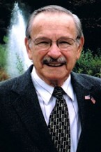
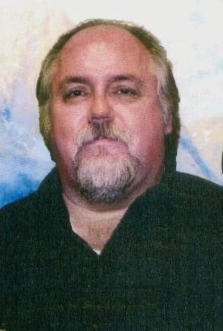
John William Castle
September 28, 1926 – October 8, 2022
Ronald Dean Robbins
December 15, 1955 -
November 28, 2022

Slide 3
2023 a year of growth?
2 Peter 3:18 but grow in the grace and knowledge of our Lord and Savior Jesus Christ. To Him be the glory both now and forever. Amen.

Slide 4
2023 a year of growth?
Warnings
Coming of the Day of Lord
False teachers distort truth
Exhortation
3:17 You therefore, beloved, since you know this beforehand, beware lest you also fall from your own steadfastness, being led away with the error of the wicked..
3:18 but grow in the grace and knowledge of our Lord and Savior Jesus Christ. To Him be the glory both now and forever. Amen.

Slide 5
Grow in grace and knowledge
God blesses His people (the righteous)
1 Peter 3:10-12 For the eyes of the Lord are on the righteous, and His ears are open to their prayers; But the face of the Lord is against those who do evil.”

Slide 6
Grow in..
Grace
Knowledge
Deeper remorse
1 Tim 1:12-15
Strong prayer life
1 John 5:14-15
Peace/contentment
Phil 4:6/11-13
Sharing the light
Matthew 5:16
Diligent study
Scriptural knowledge
2 Tim 2:15
Personal application
Spiritual wisdom
Acts 17:11

Slide 7
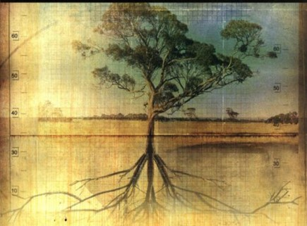
A Test: Do We Really want this church to grow?

Slide 8
Will 2023 Be a Year of Growth?
2 Peter 3:10-18

