Slide 1
The Church’s Identity and Purpose
1 Timothy 3:14-16

Slide 2
The purpose of his letter
I am writing these things to you..
I hope to come to you shortly
But if I am delayed
I write so you may know how you ought to conduct yourself in the house of God
(personal note to Timothy)

Slide 3
The purpose of his letter 14-15a
I am writing these things to you..
I hope to come to you shortly
But if I am delayed
I write so you may know how you ought to conduct yourself in the house of God
(personal note to Timothy)

Slide 4
The identity of the church 15
..how you may conduct yourself in
The house of God (household)
The church of the living God
The pillar and ground of the truth

Slide 5
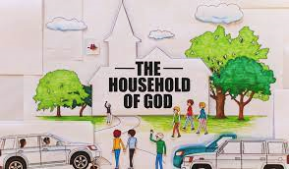
The house of God
House (oikos) house or household (vs 4-5 elder’s household)
We are part of God’s family (God is our father, we are brethren)
How to conduct ourselves in the family

Slide 6
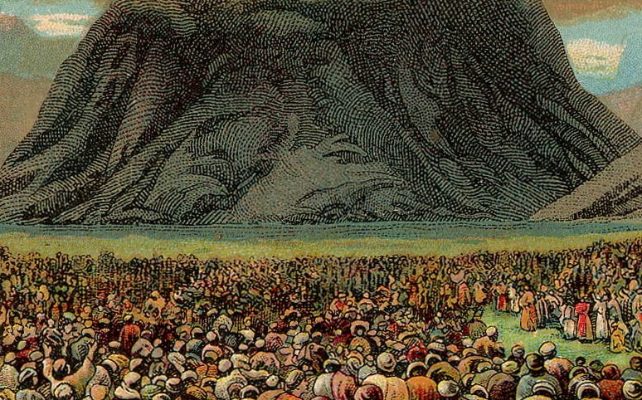
The church of the living God
Church (assembly – ekklesia)
God’s people assembled together (as at Mt Sinai Acts 7:38)
Church of the living God (Josh 3:10 1 Sam 17:26 Psa 42:2 Dan 6:26)

Slide 7
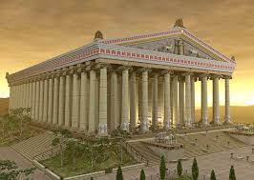
The pillar and ground of the truth
Ephesus worshipped the temple of Diana
The Ephesus church was the pillar of God’s truth (foundation, mainstay, bulwark, buttress)
The truth is found in God’s revealed word (Bible) (Luke 24:27,44 1 Cor 3:11, Eph 2:20, 3:1-11)

Slide 8
The great message 16
Great is the mystery of godliness..
He who was manifested in the flesh John 1:1,14
Justified in the Spirit Romans 1:3
Seen by angels Luke 24:23
Preached among the nations Acts 2:5-11
Believed on in the world John 1:12
Received up in glory Acts 1:9-11

Slide 9
The Church’s Identity and Purpose
1 Timothy 3:14-16

