Slide 2
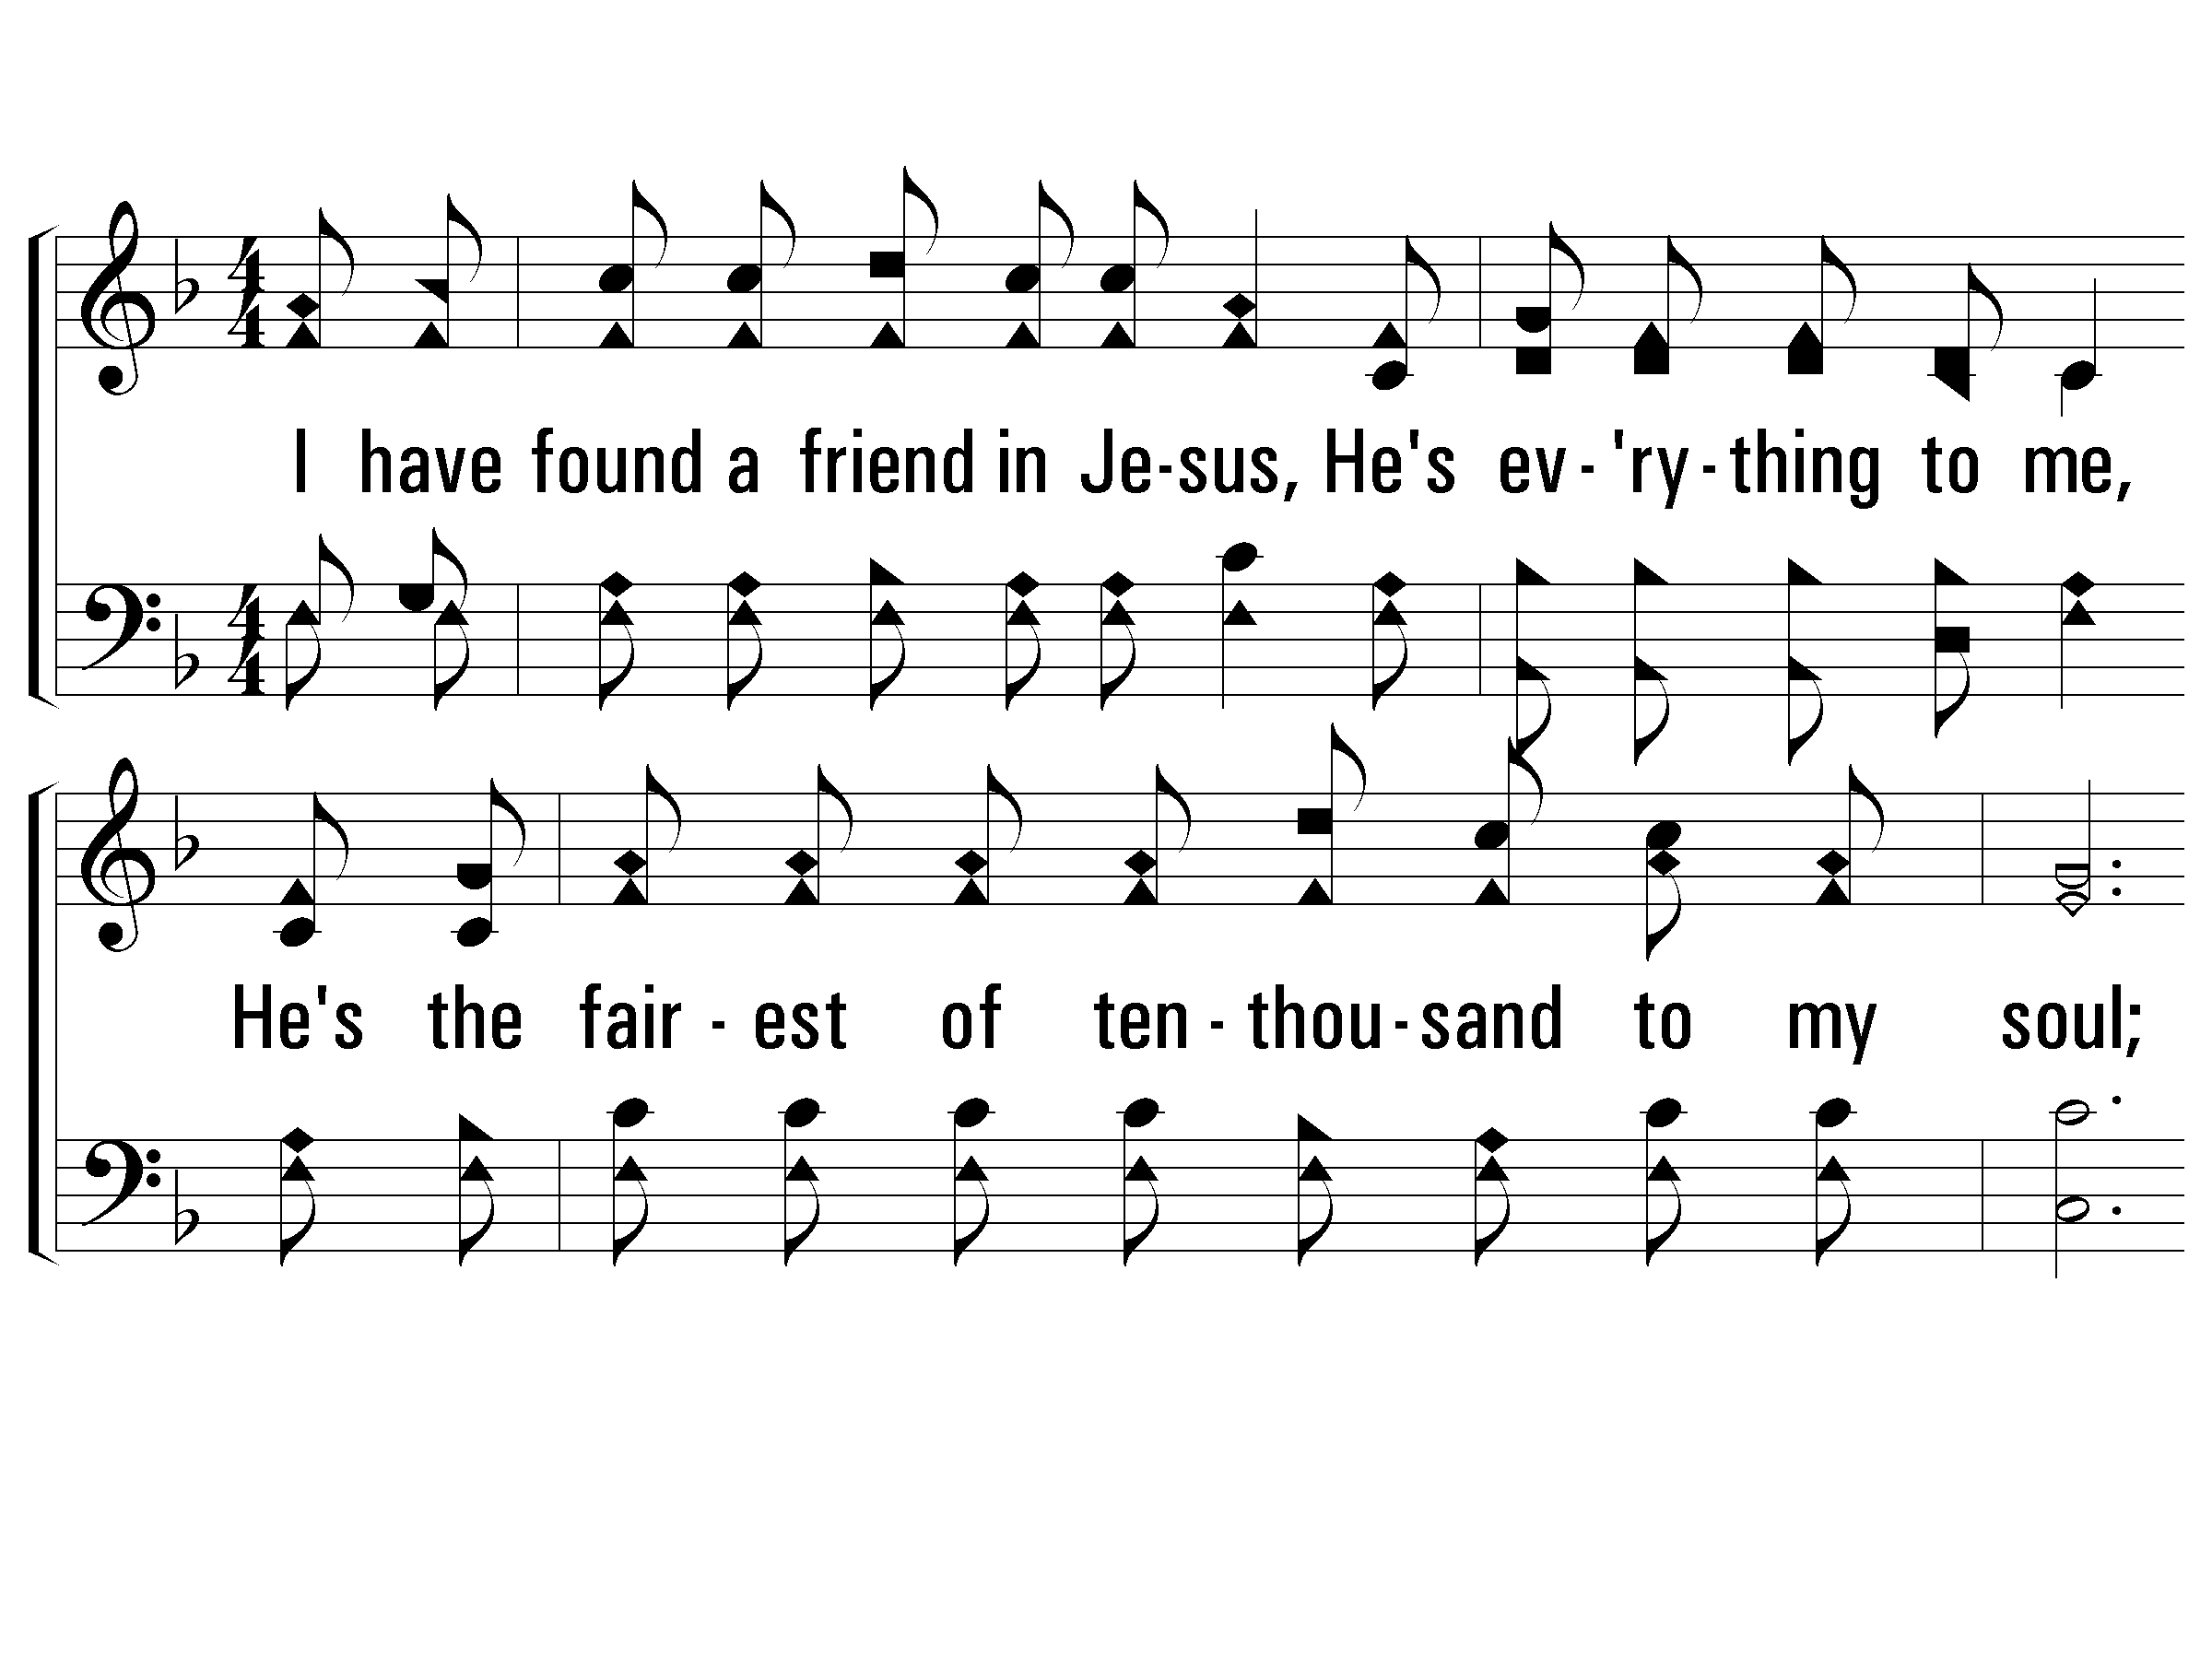
1 – I Have Found a Friend in Jesus
274
1.
I have found a friend in Jesus,
He's everything to me,
He's the fairest of ten-thousand to my soul;
The Lily of the Valley, in Him alone I see
All I need to cleanse and make me fully whole.
In sorrow He's my comfort, in trouble He's my stay,
He tells me every care on Him to roll.
Words: Charles W. Fry
Music: William S. Hays / Arr.: Charles W. Fry
© 2002 The Paperless Hymnal™

Slide 3
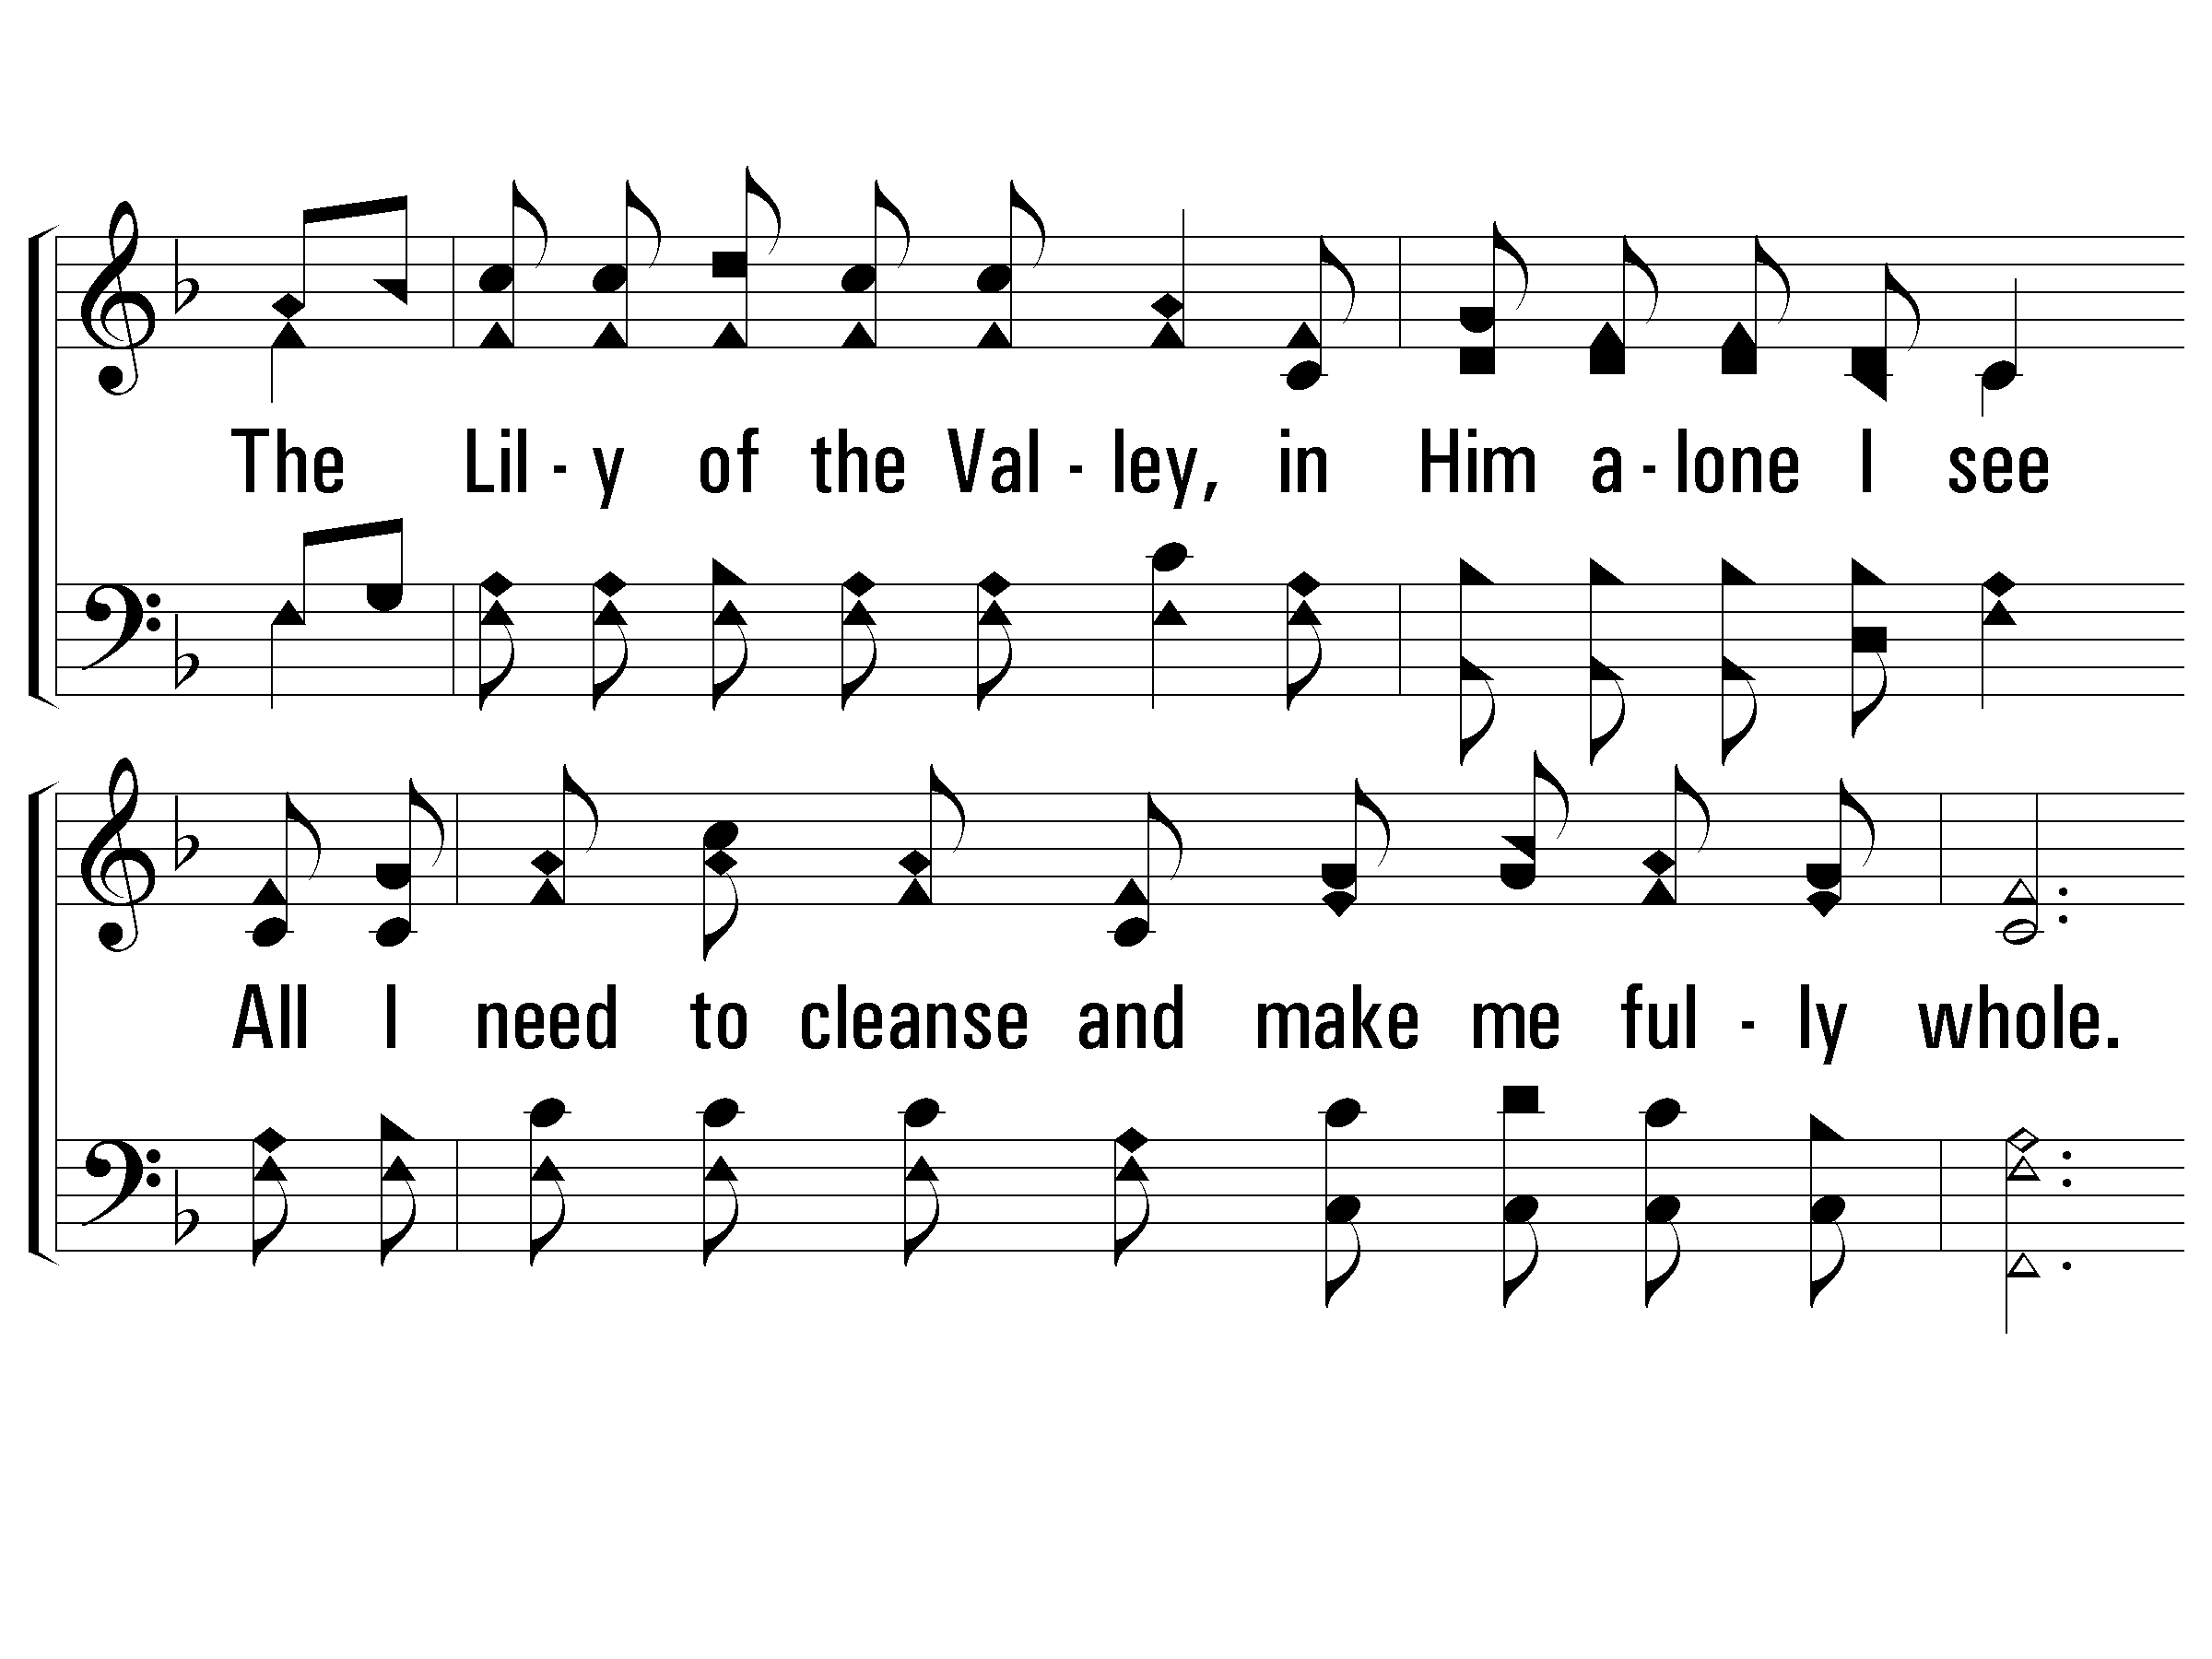
1 – I Have Found a Friend in Jesus
274
© 2002 The Paperless Hymnal™

Slide 4
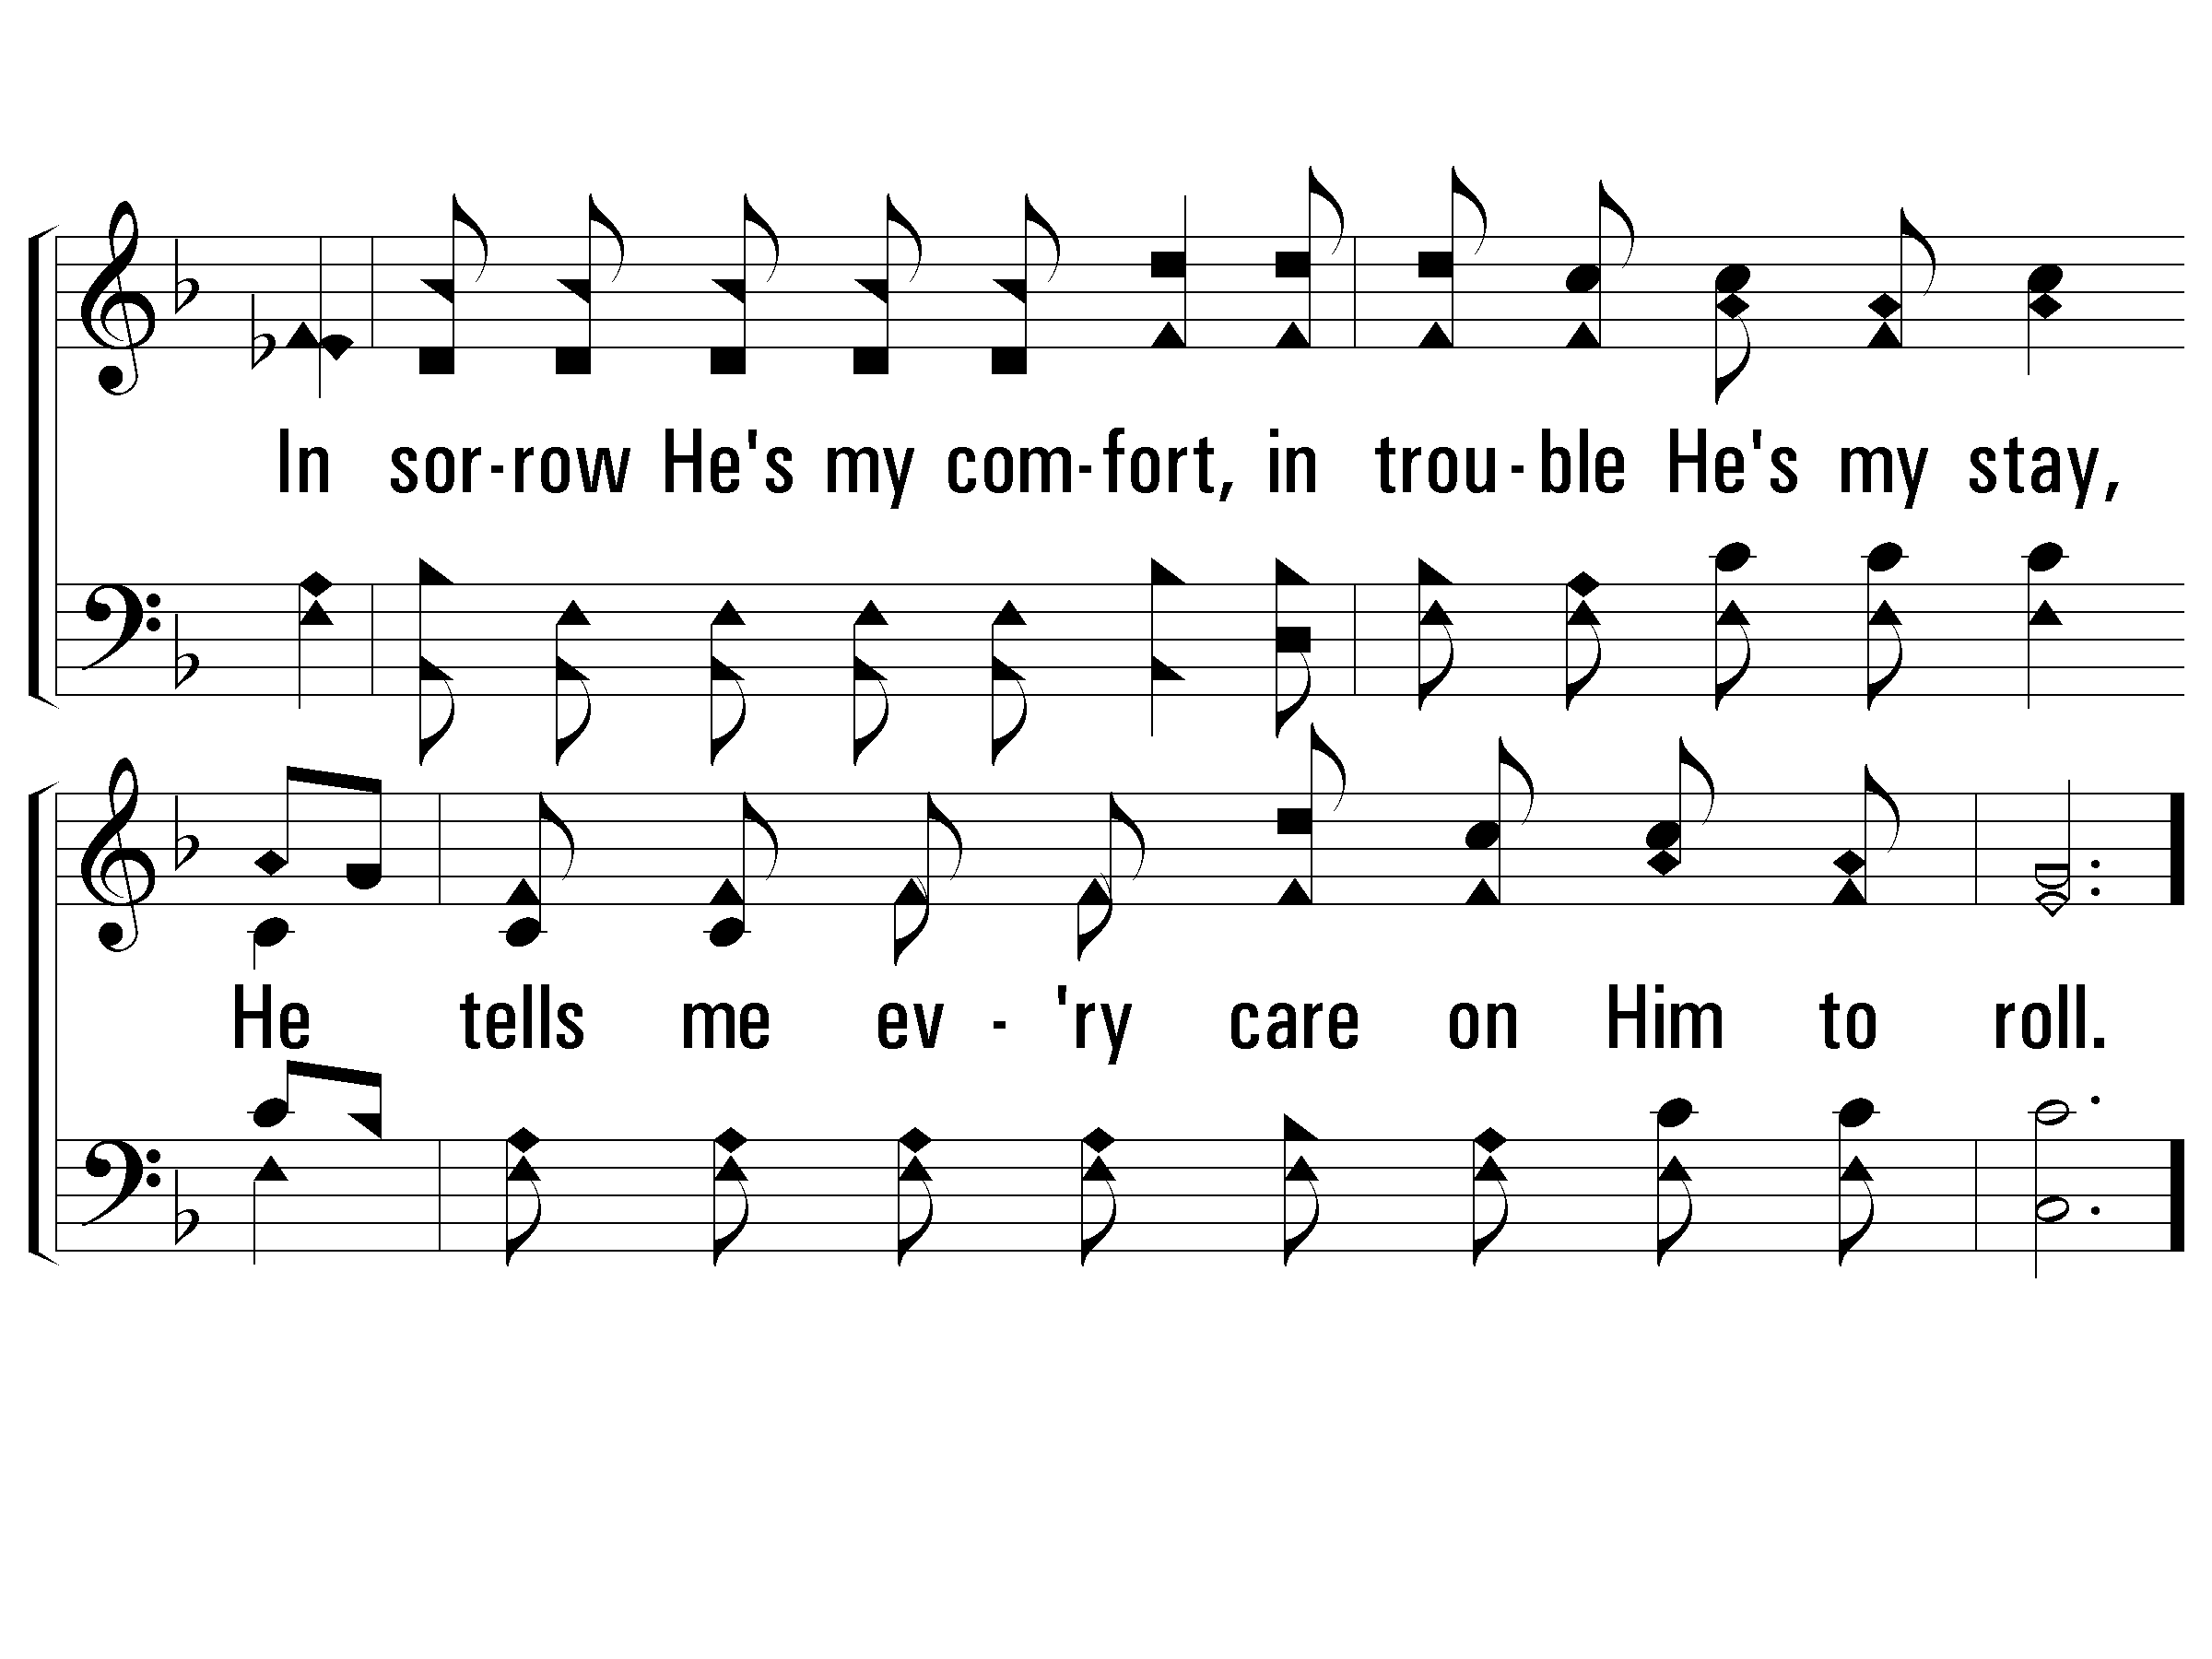
1 – I Have Found a Friend in Jesus
274
© 2002 The Paperless Hymnal™

Slide 5
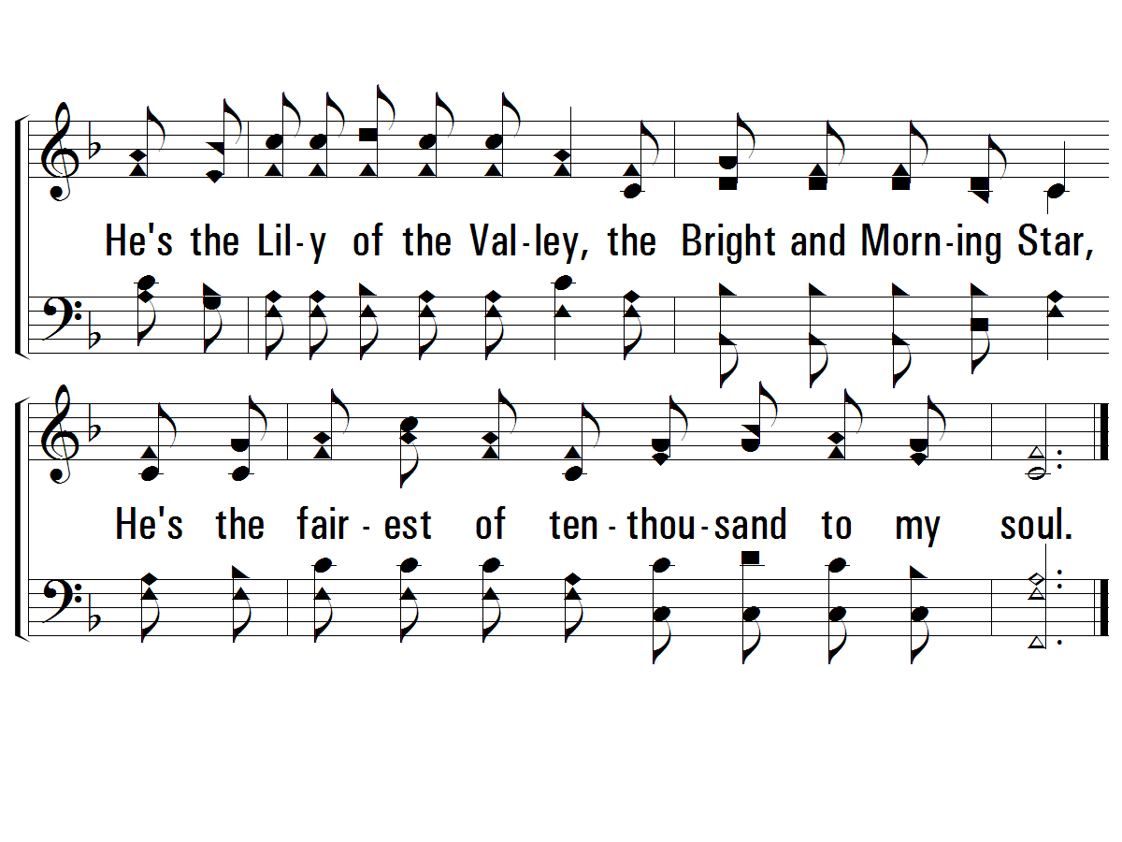
c – I Have Found a Friend in Jesus
274
He's the Lily of the Valley,
the Bright and Morning Star,
He's the fairest of ten-thousand to my soul.
© 2002 The Paperless Hymnal™

Slide 6
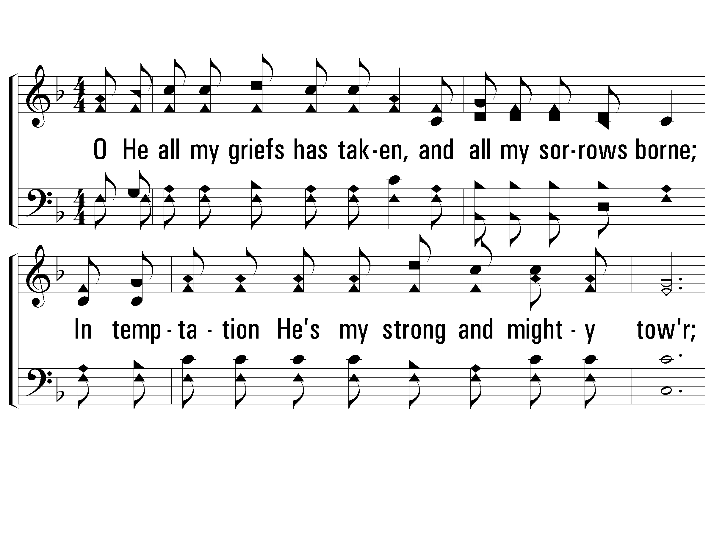
2 – I Have Found a Friend in Jesus
274
2.
O He all my griefs has taken,
and all my sorrows borne;
In temptation He's my strong and mighty tower;
I have all for Him forsaken, and all my idols torn
From my heart, and now He keeps me by His power.
Though all the world forsake me, and Satan tempt me sore,
Through Jesus I shall safely reach the goal.
Words: Charles W. Fry
Music: William S. Hays / Arr.: Charles W. Fry
© 2002 The Paperless Hymnal™

Slide 7
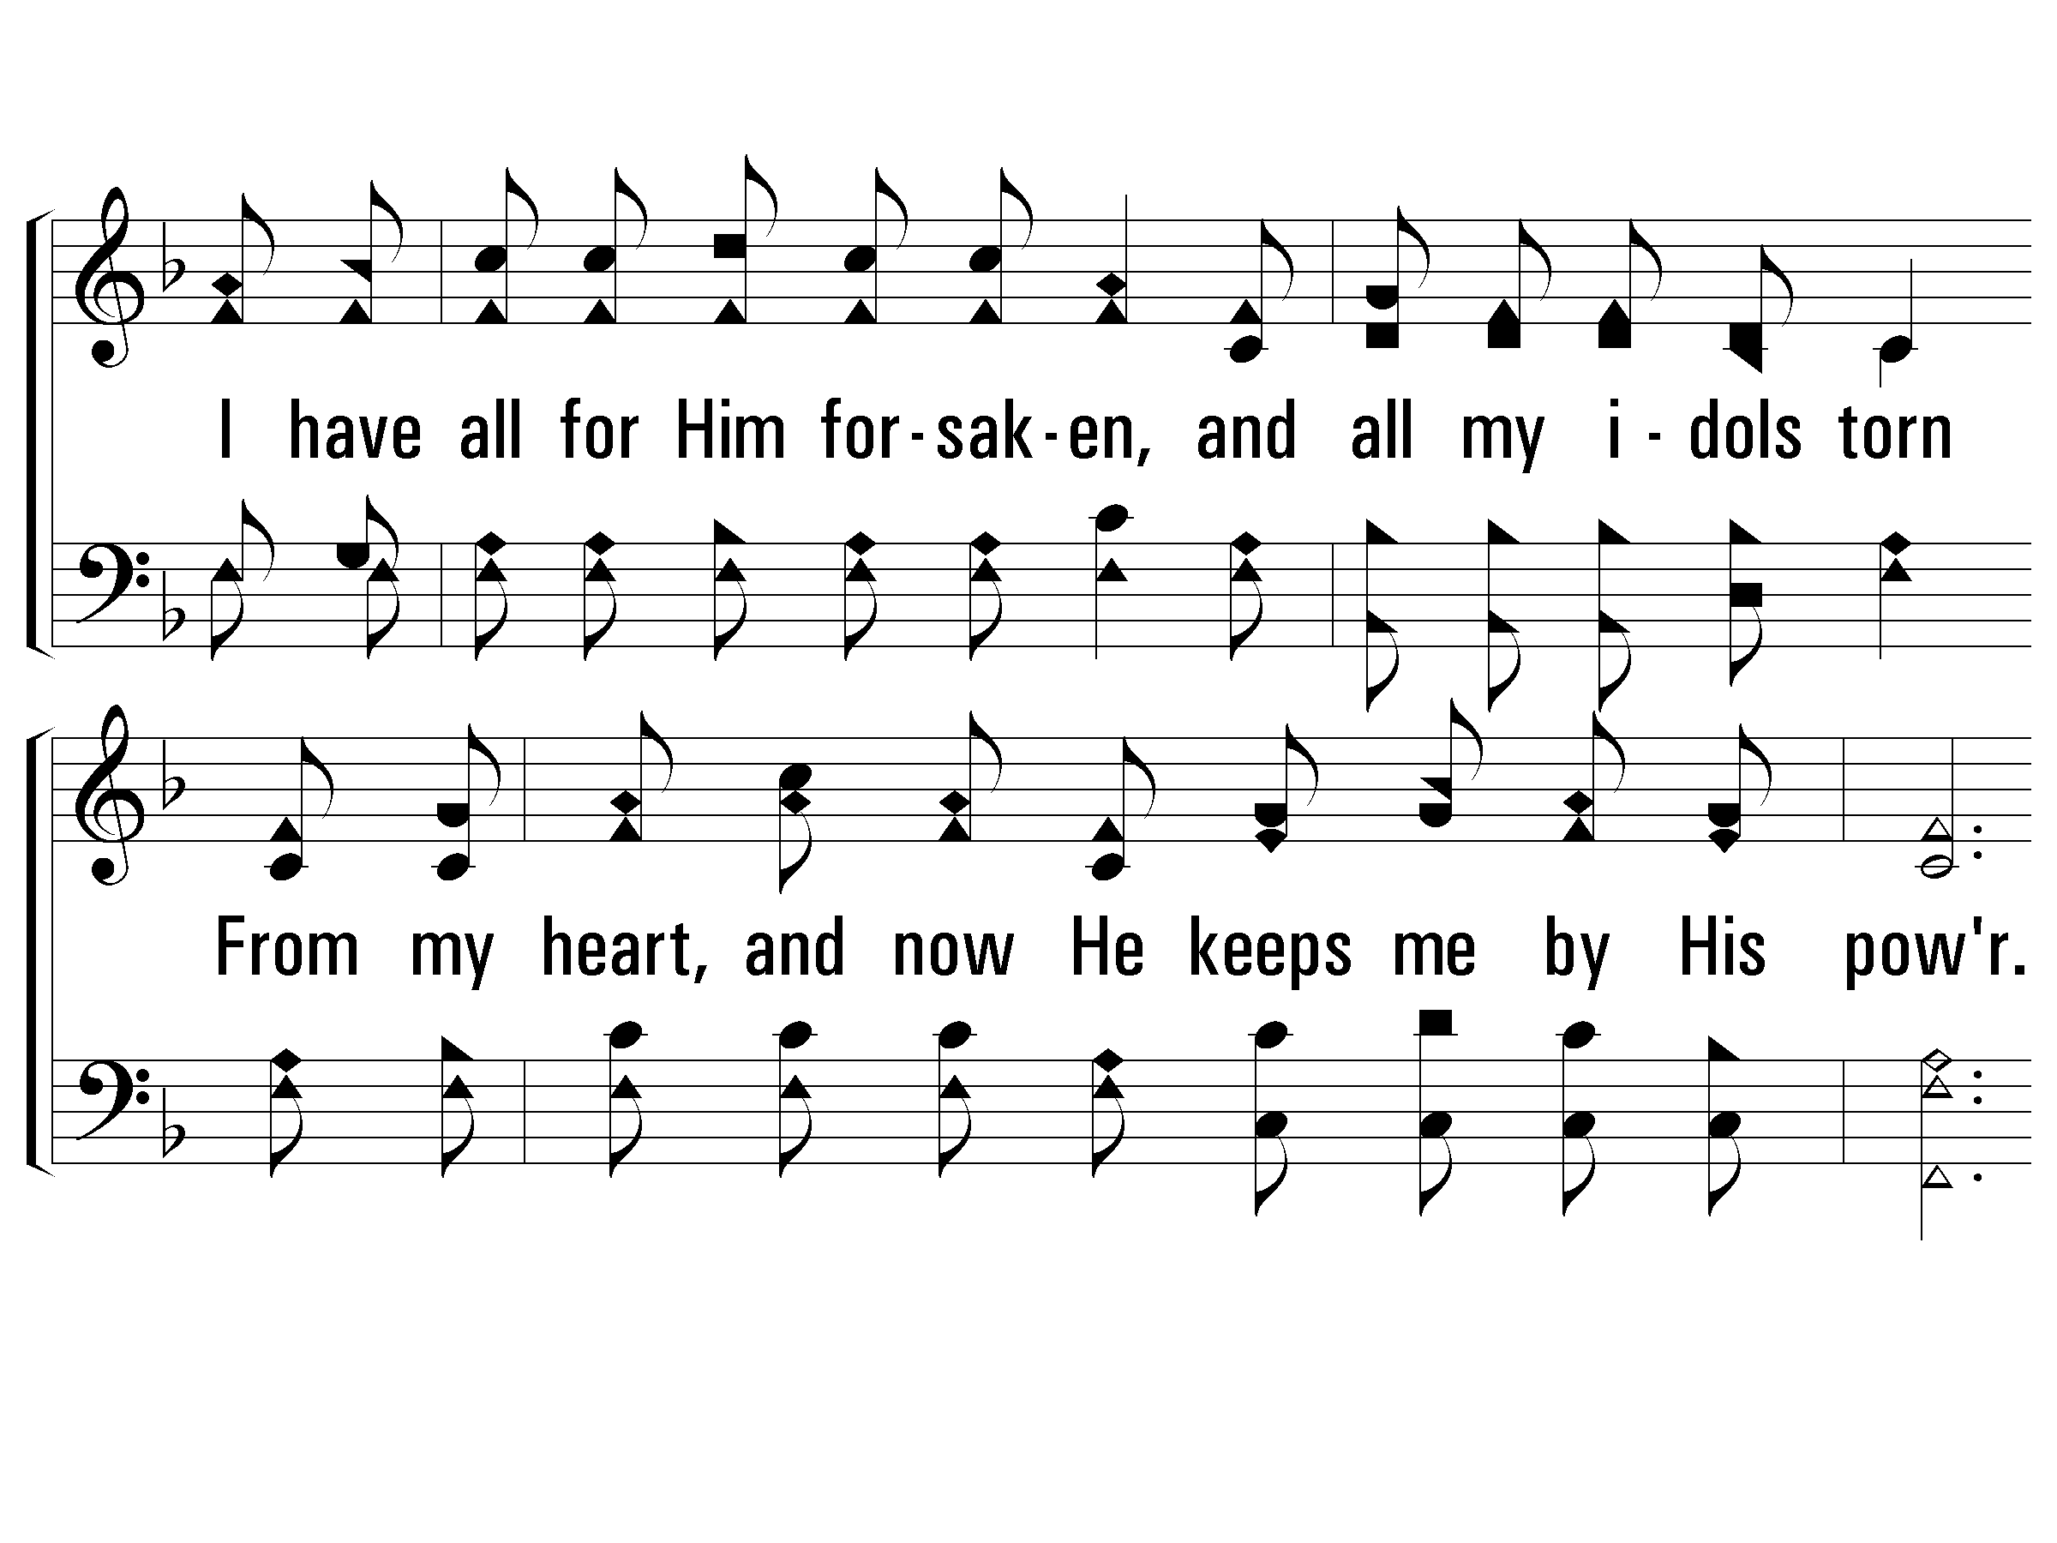
2 – I Have Found a Friend in Jesus
274
© 2002 The Paperless Hymnal™

Slide 8
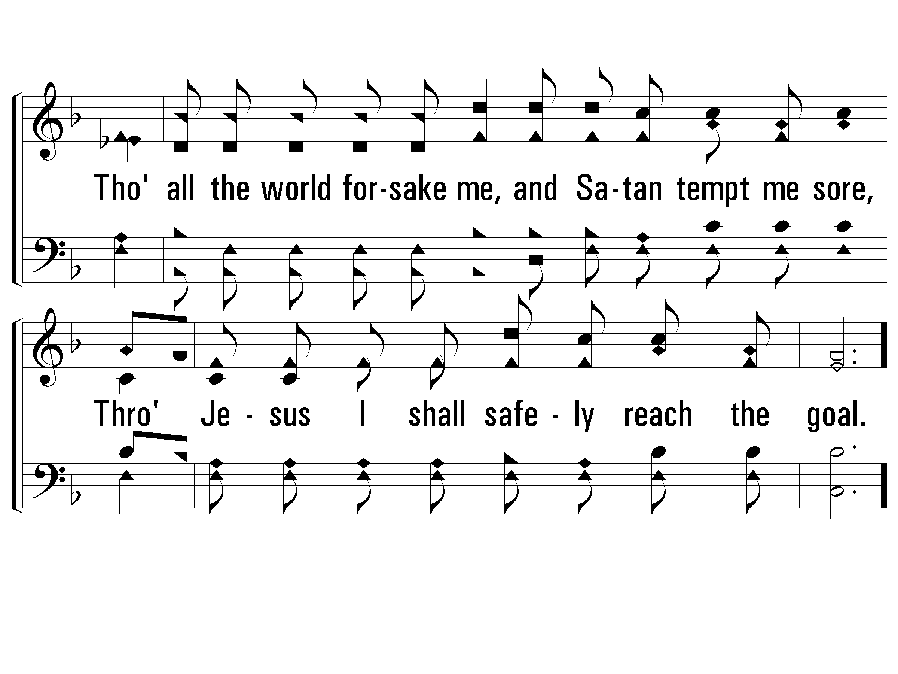
2 – I Have Found a Friend in Jesus
274
© 2002 The Paperless Hymnal™

Slide 9
c – I Have Found a Friend in Jesus
274
He's the Lily of the Valley,
the Bright and Morning Star,
He's the fairest of ten-thousand to my soul.
© 2002 The Paperless Hymnal™

Slide 10
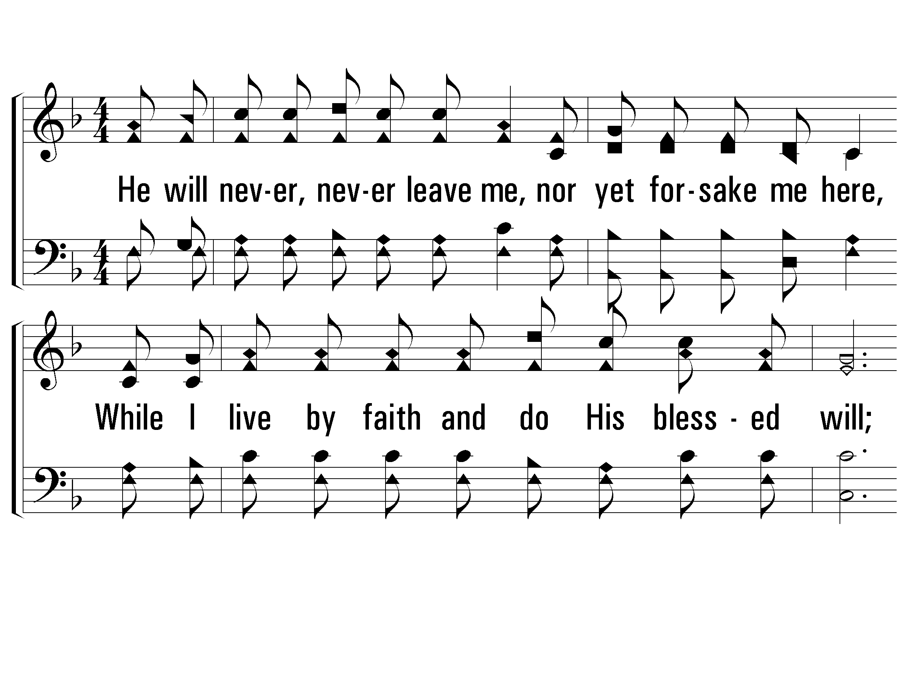
3 – I Have Found a Friend in Jesus
274
3.
He will never, never leave me,
nor yet forsake me here,
While I live by faith and do His blessed will;
A wall of fire about me,
I've nothing now to fear,
With His manna He my hungry soul shall fill.
Then sweeping up to glory to see His bless-ed face,
Where rivers of delight shall ever roll.
Words: Charles W. Fry
Music: William S. Hays / Arr.: Charles W. Fry
© 2002 The Paperless Hymnal™

Slide 11
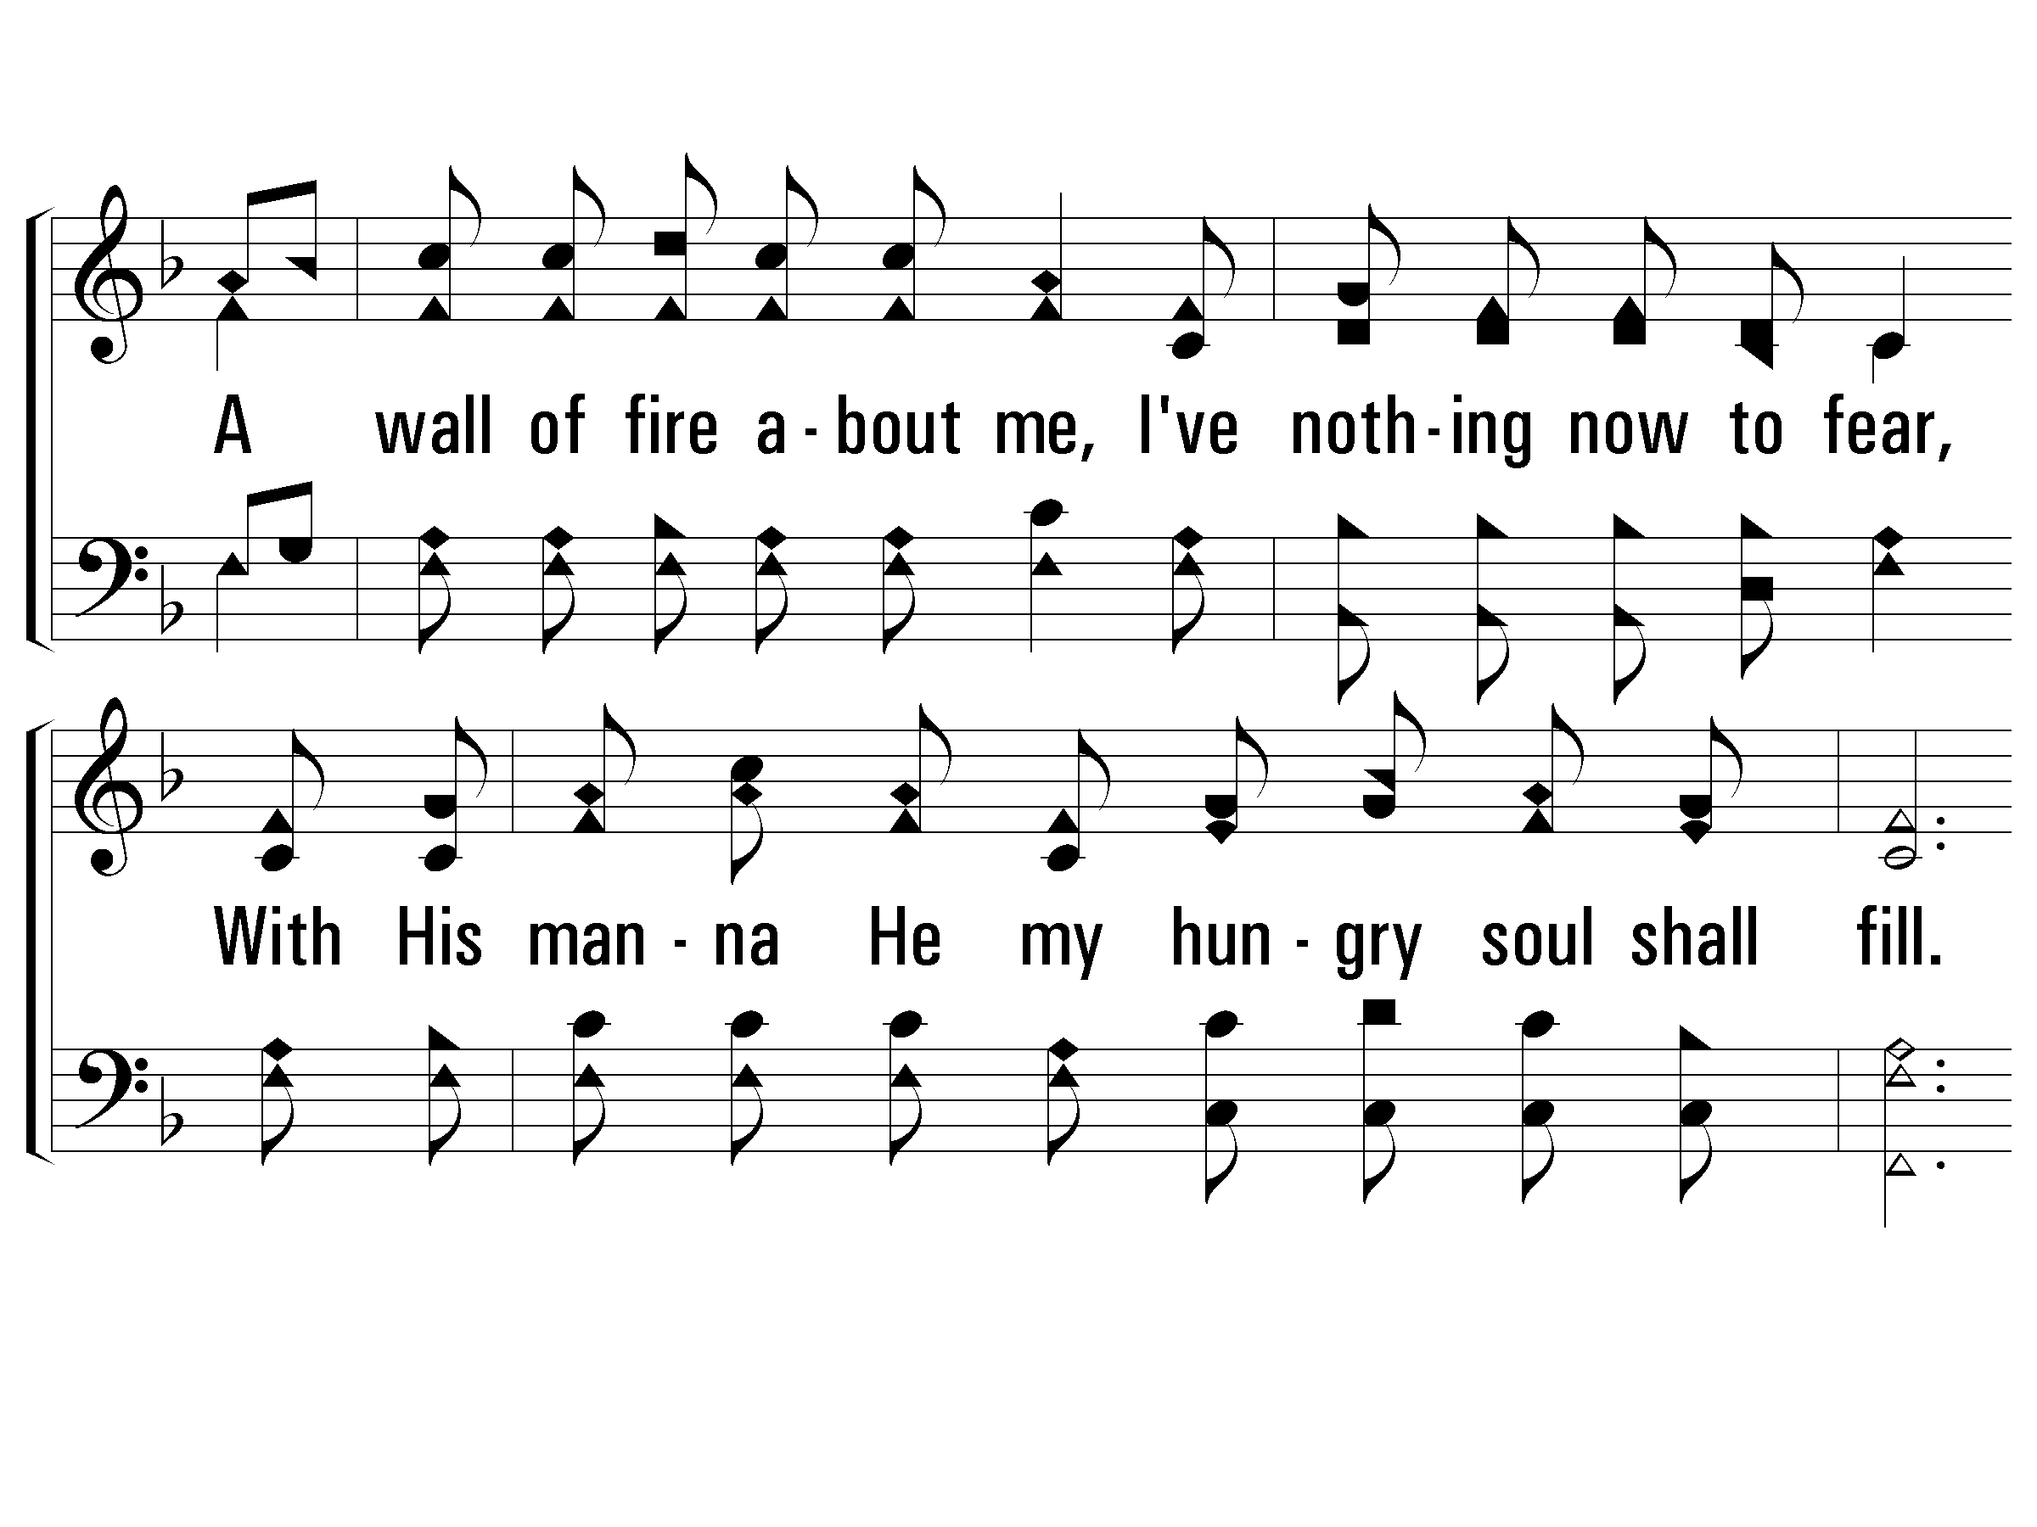
3 – I Have Found a Friend in Jesus
274
© 2002 The Paperless Hymnal™

Slide 12
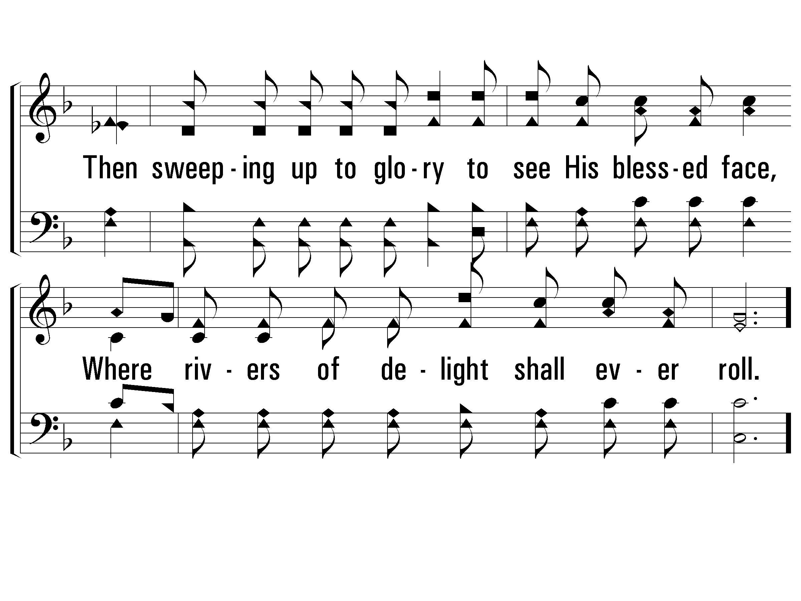
3 – I Have Found a Friend in Jesus
274
© 2002 The Paperless Hymnal™

Slide 13
c – I Have Found a Friend in Jesus
274
He's the Lily of the Valley,
the Bright and Morning Star,
He's the fairest of ten-thousand to my soul.
© 2002 The Paperless Hymnal™

Slide 15
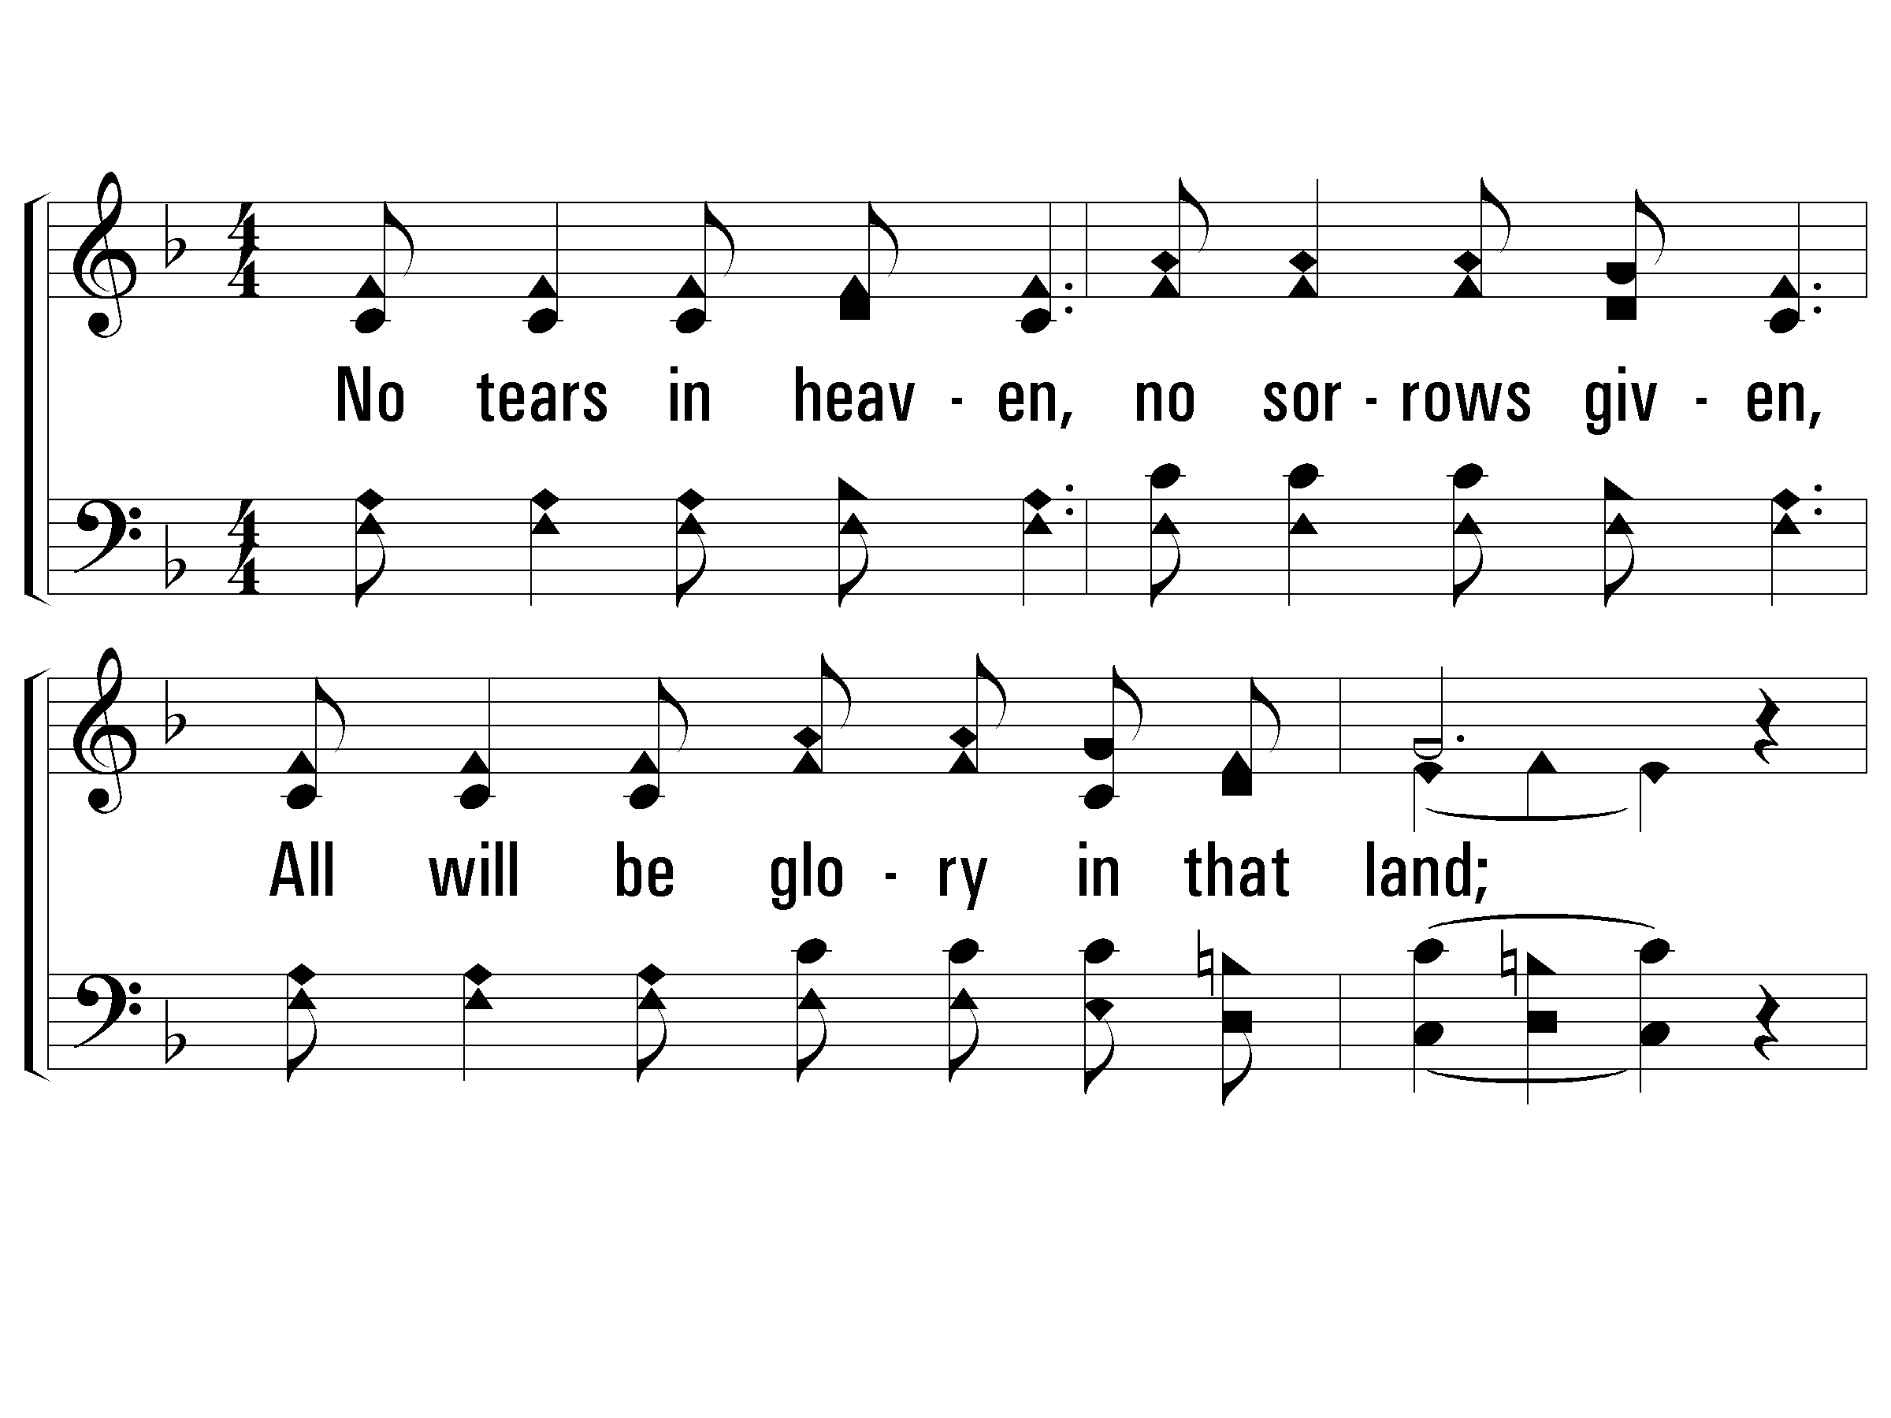
1 - No Tears in Heaven
456
1.
No tears in heaven, no sorrows given,
All will be glory in that land;
There'll be no sadness, all will be gladness,
When we shall join that happy band.
Words and Music by: Robert S. Arnold
Copyright © 1935 by Stamps-Baxter Co. Renewed 1963 National Music Co.
© 2001 The Paperless Hymnal™

Slide 16
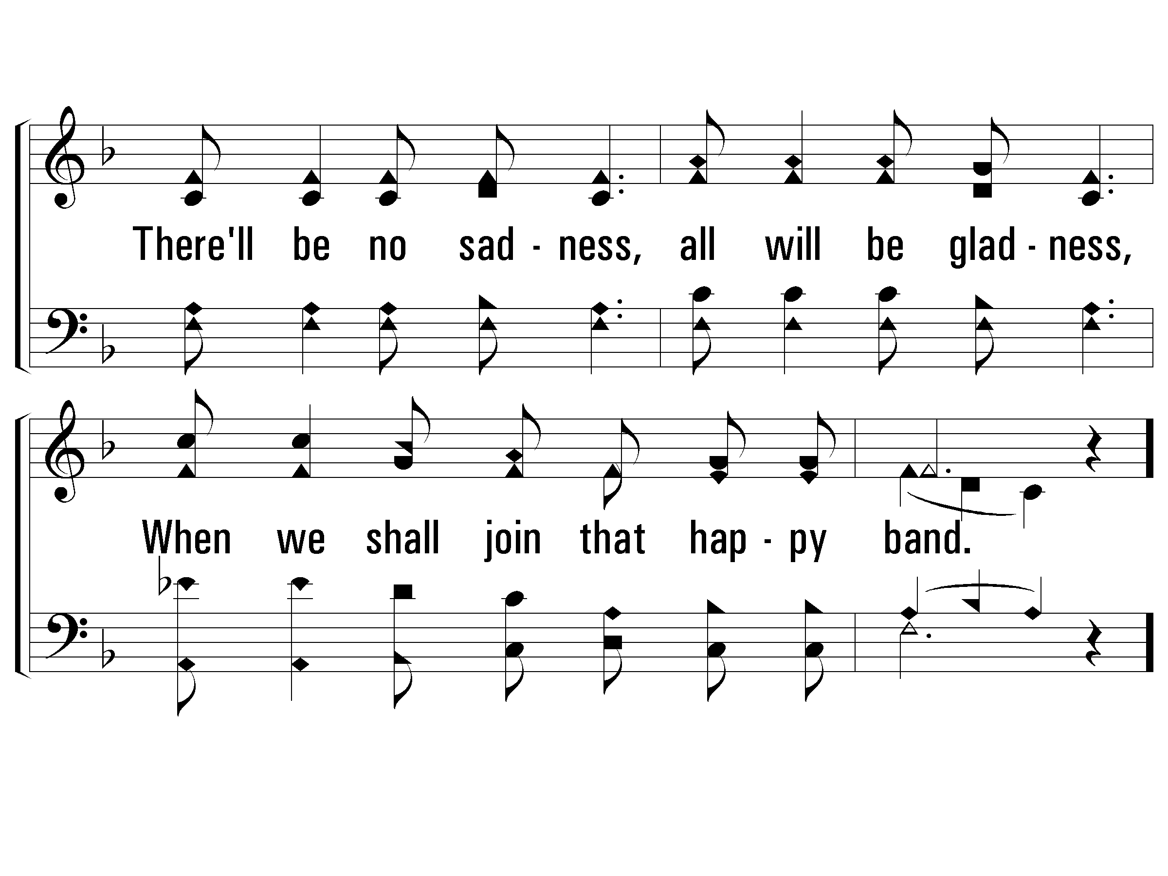
1 - No Tears in Heaven
456
© 2001 The Paperless Hymnal™

Slide 17
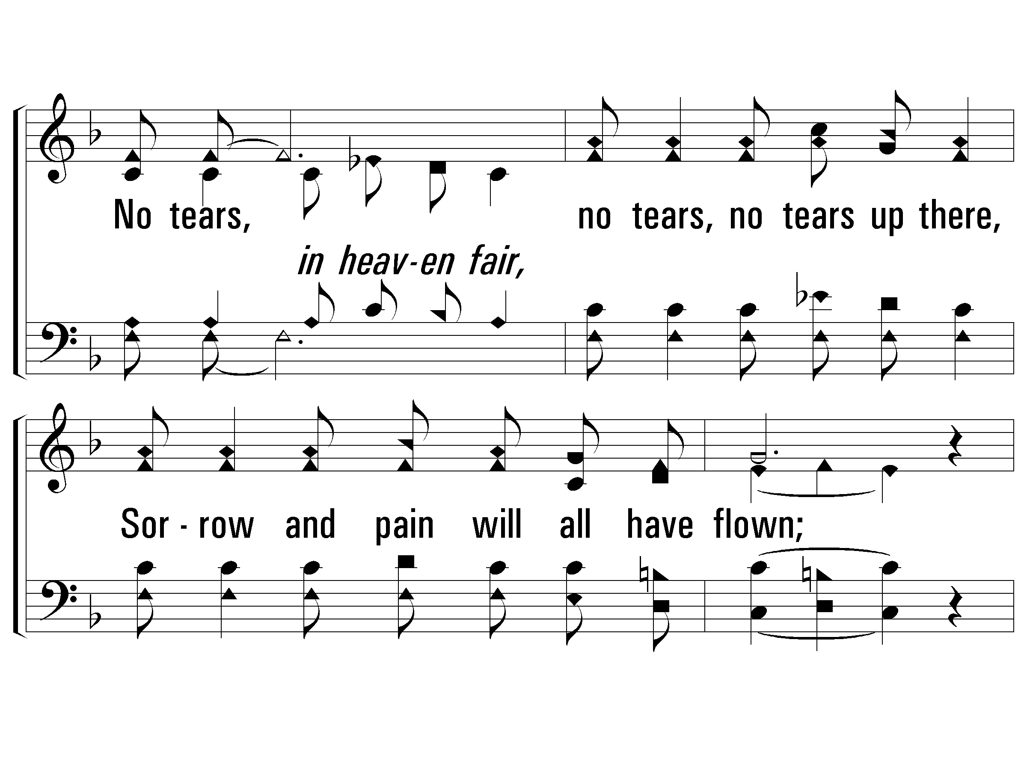
c - No Tears in Heaven
456
No tears, no tears, no tears up there,
Sorrow and pain will all have flown;
No tears, no tears, no tears up there,
No tears in heaven will be known.
© 2001 The Paperless Hymnal™

Slide 18
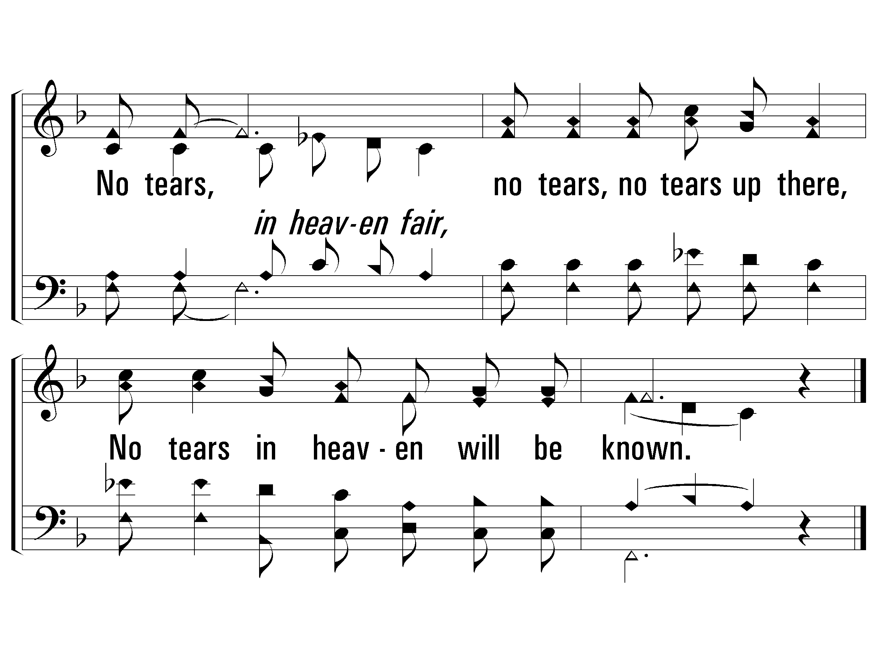
c - No Tears in Heaven
456
© 2001 The Paperless Hymnal™

Slide 19
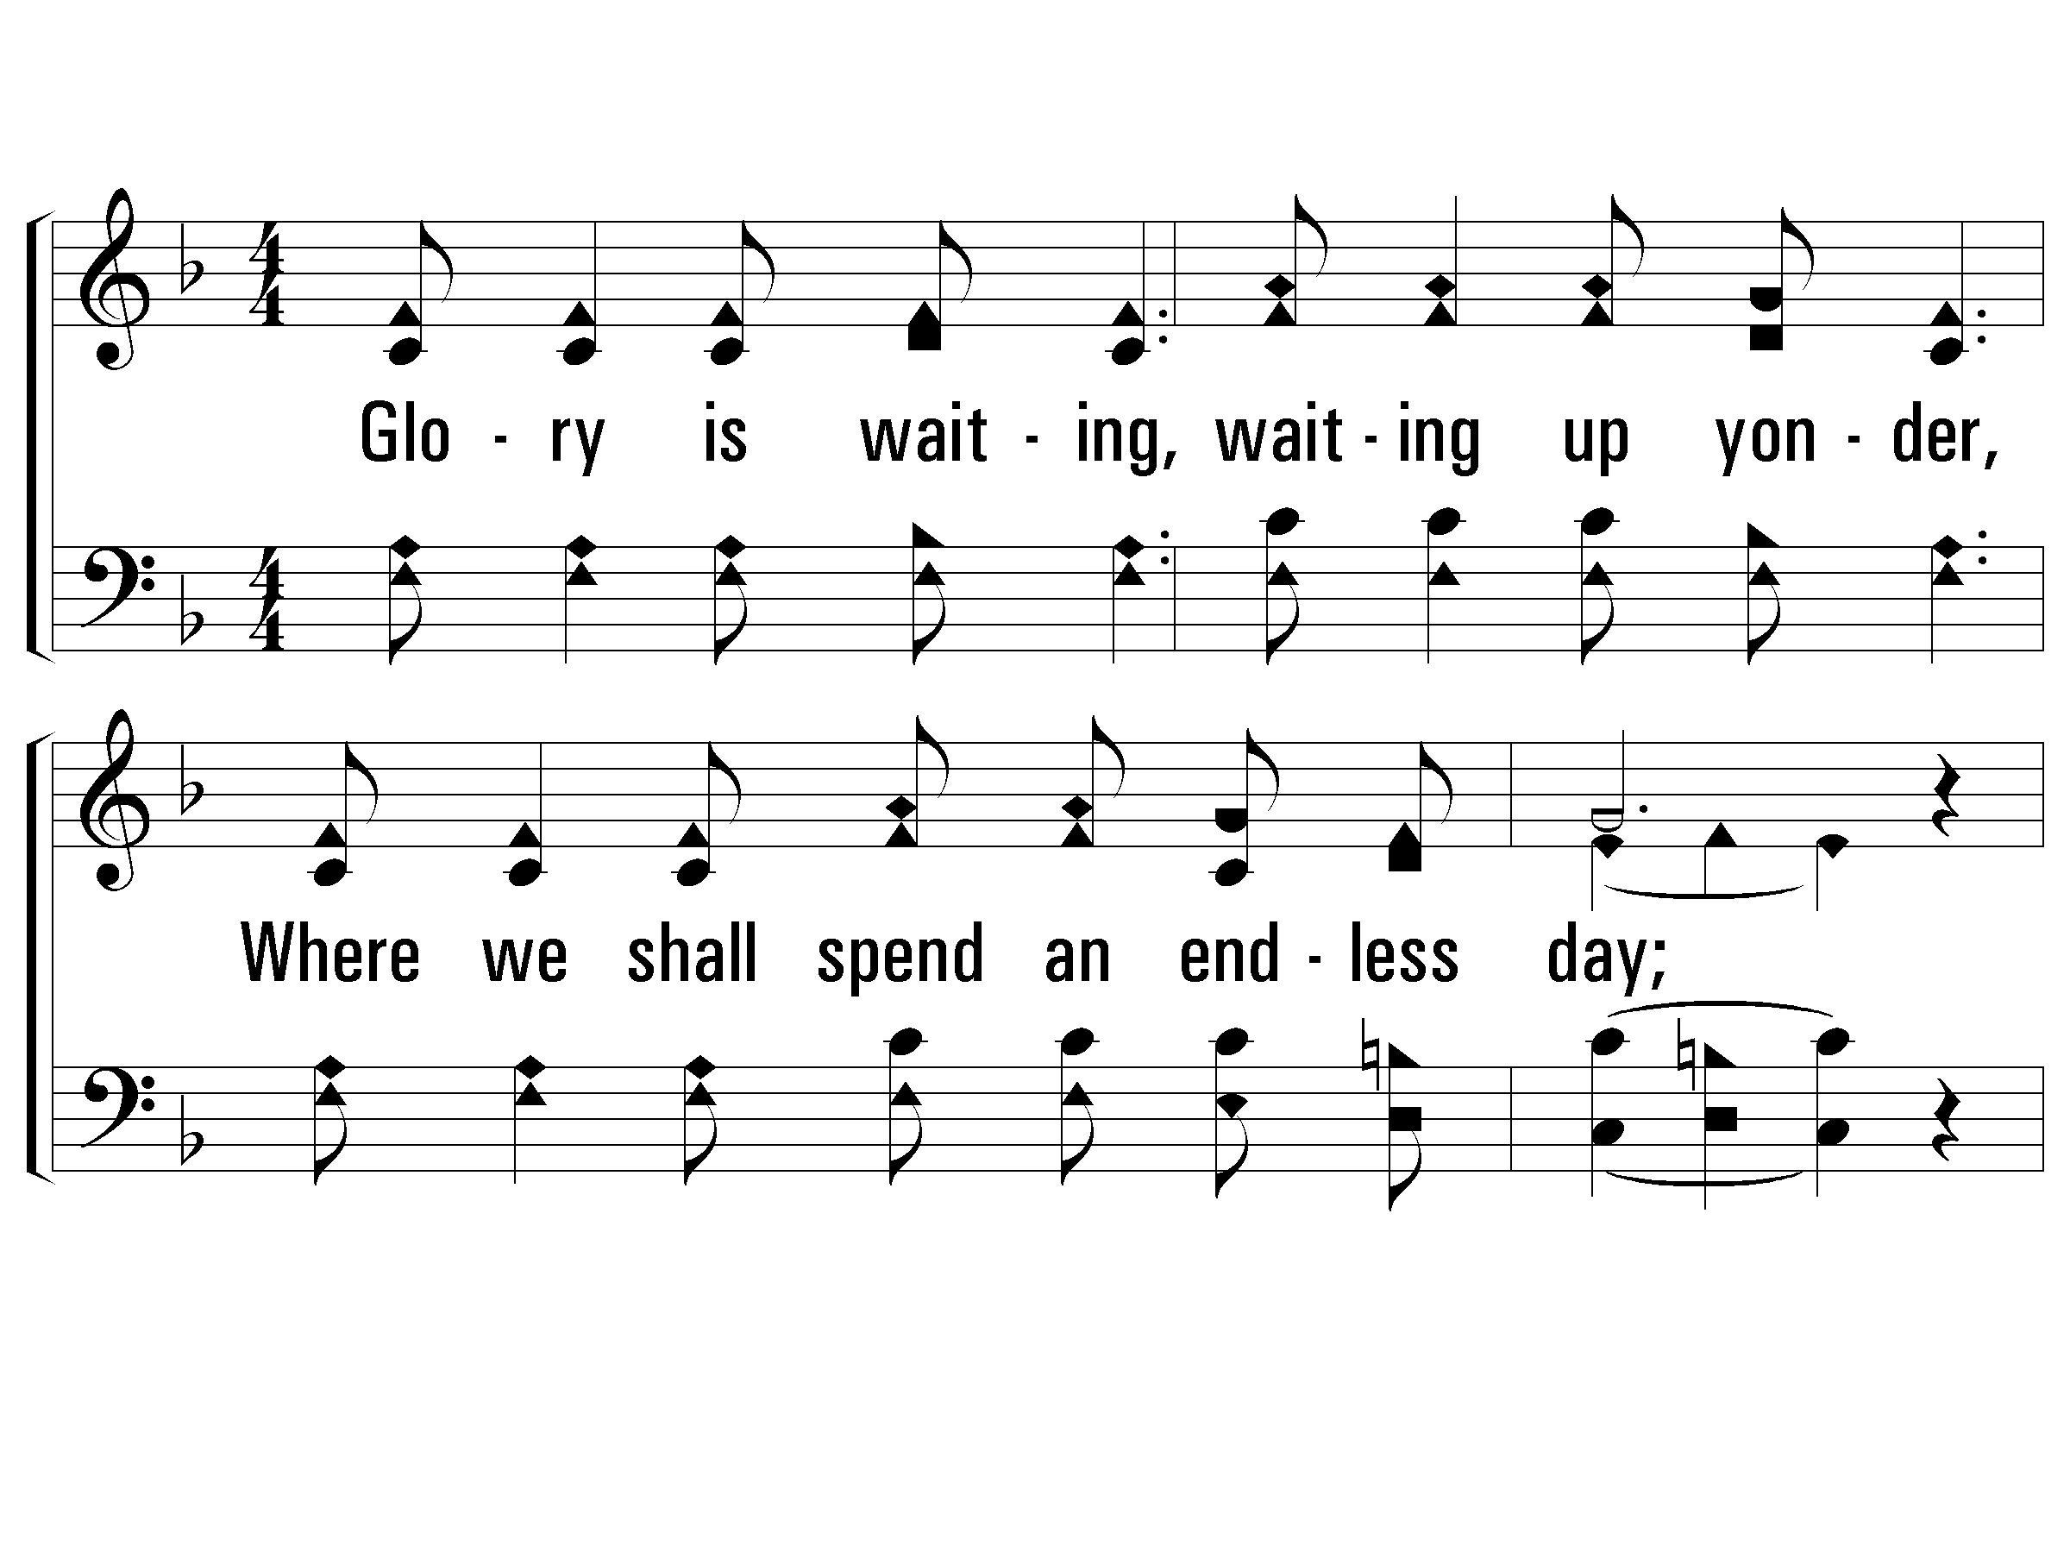
2 - No Tears in Heaven
456
2.
Glory is waiting, waiting up yonder,
Where we shall spend an endless day;
There with our Savior, we'll be forever,
Where no more sorrow can dismay.
Words and Music by: Robert S. Arnold
Copyright © 1935 by Stamps-Baxter Co. Renewed 1963 National Music Co.
© 2001 The Paperless Hymnal™

Slide 20
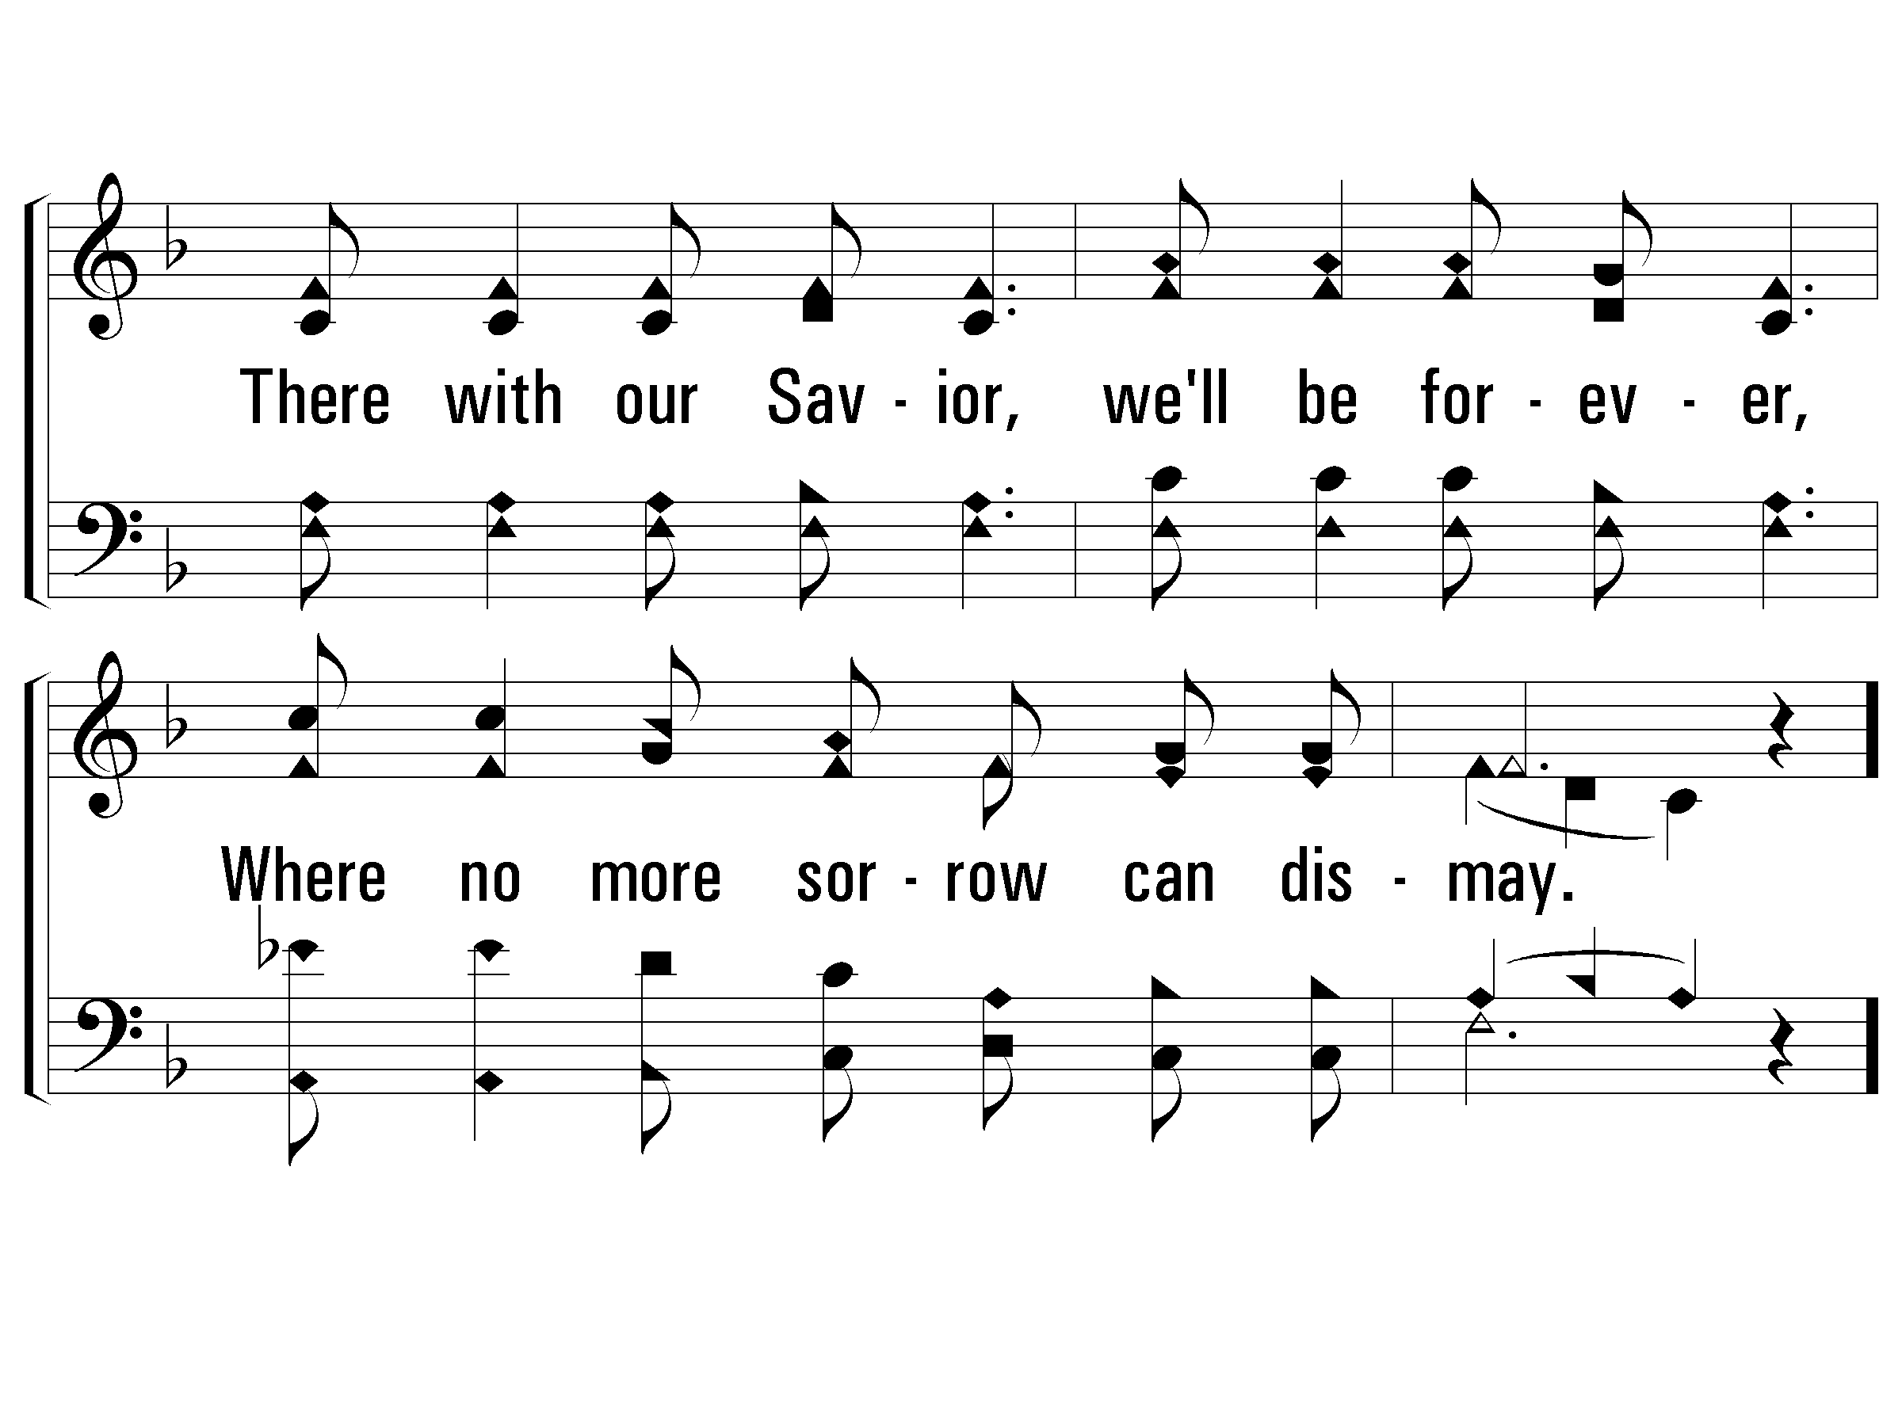
2 - No Tears in Heaven
456
© 2001 The Paperless Hymnal™

Slide 21
c - No Tears in Heaven
456
No tears, no tears, no tears up there,
Sorrow and pain will all have flown;
No tears, no tears, no tears up there,
No tears in heaven will be known.
© 2001 The Paperless Hymnal™

Slide 22
c - No Tears in Heaven
456
© 2001 The Paperless Hymnal™

Slide 23
3 - No Tears in Heaven
456
3.
Some morning yonder, we'll cease to ponder
O'er things this life has brought to view;
All will be clearer, loved ones be dearer,
In heaven where all will be made new.
Words and Music by: Robert S. Arnold
Copyright © 1935 by Stamps-Baxter Co. Renewed 1963 National Music Co.
© 2001 The Paperless Hymnal™

Slide 24
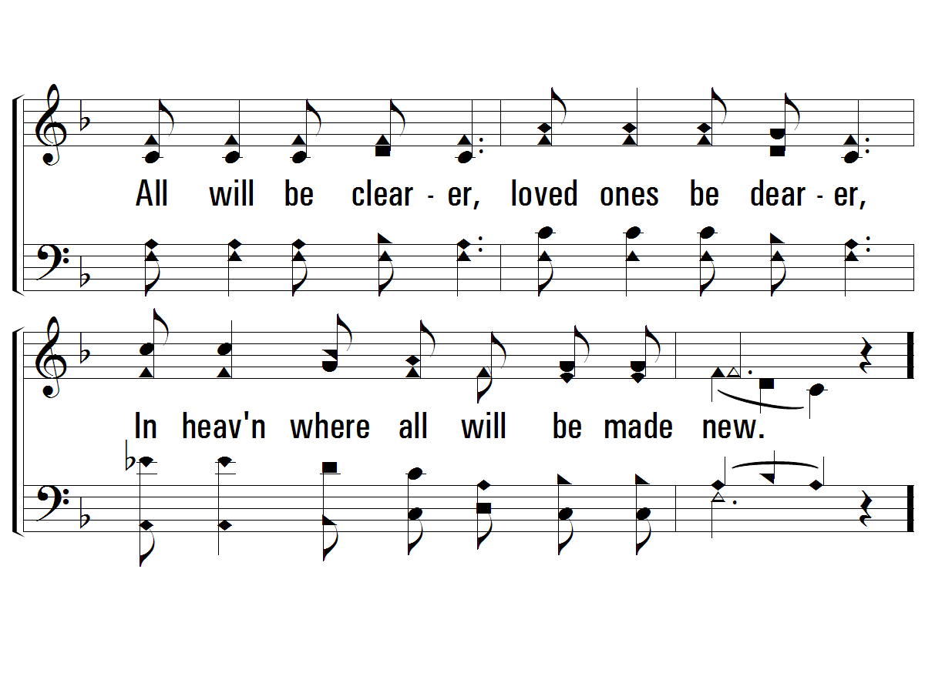
3 - No Tears in Heaven
456
© 2001 The Paperless Hymnal™

Slide 25
c - No Tears in Heaven
456
No tears, no tears, no tears up there,
Sorrow and pain will all have flown;
No tears, no tears, no tears up there,
No tears in heaven will be known.
© 2001 The Paperless Hymnal™

Slide 26
c - No Tears in Heaven
456
© 2001 The Paperless Hymnal™

Slide 28
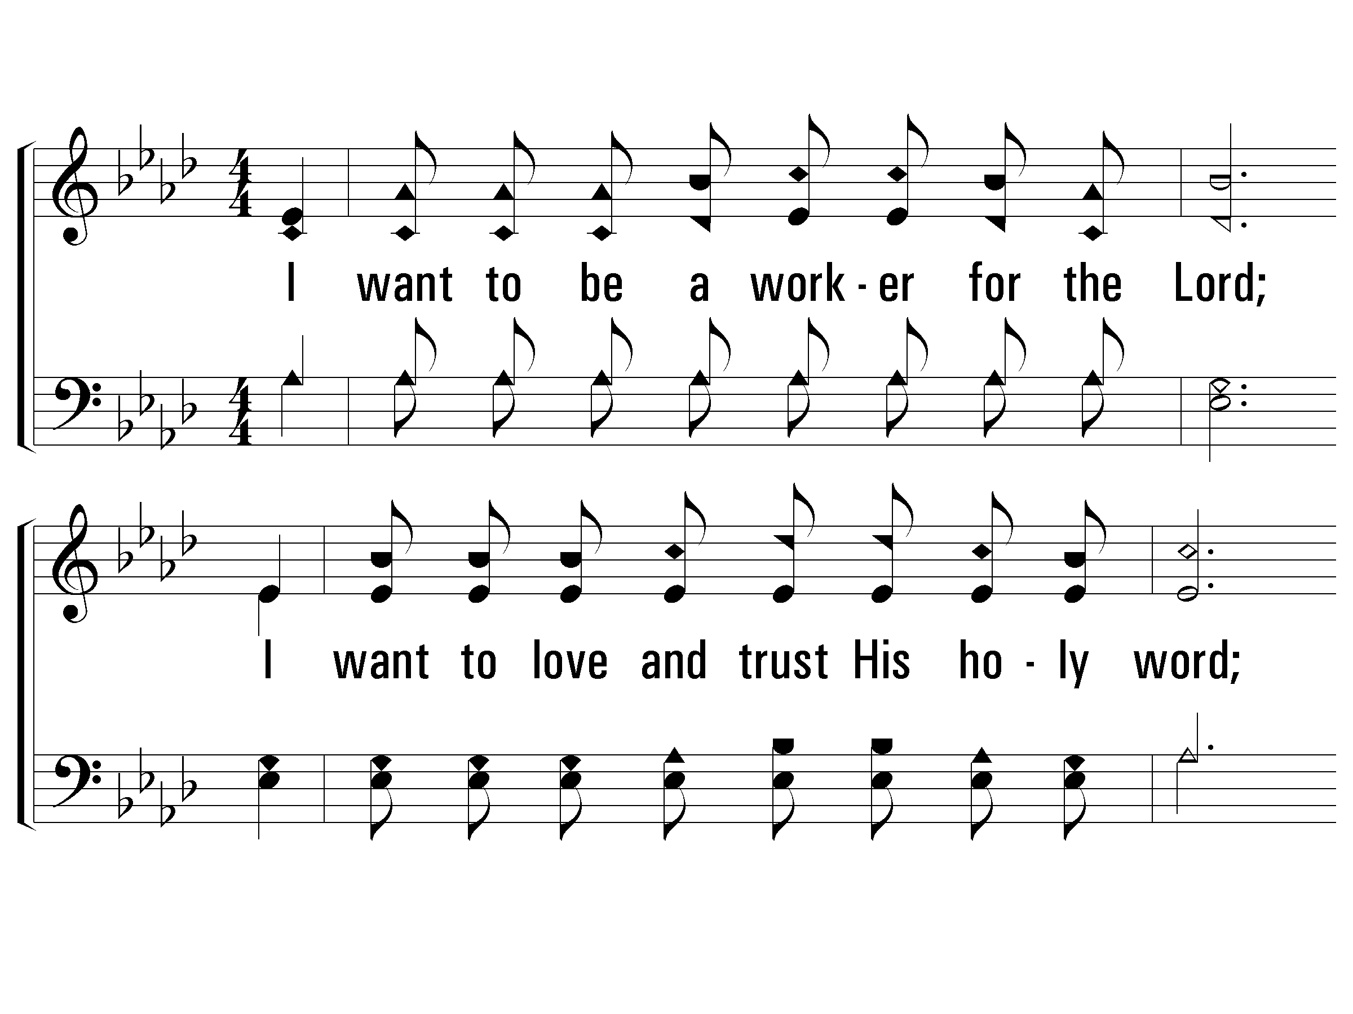
1 - I Want to Be a Worker
297
1.
I want to be a worker for the Lord;
I want to love and trust His holy word;
I want to sing and pray, and be busy every day,
In the vineyard of the Lord.
Words & Music: Isaiah Baltzell
© 2008 The Paperless Hymnal®

Slide 29
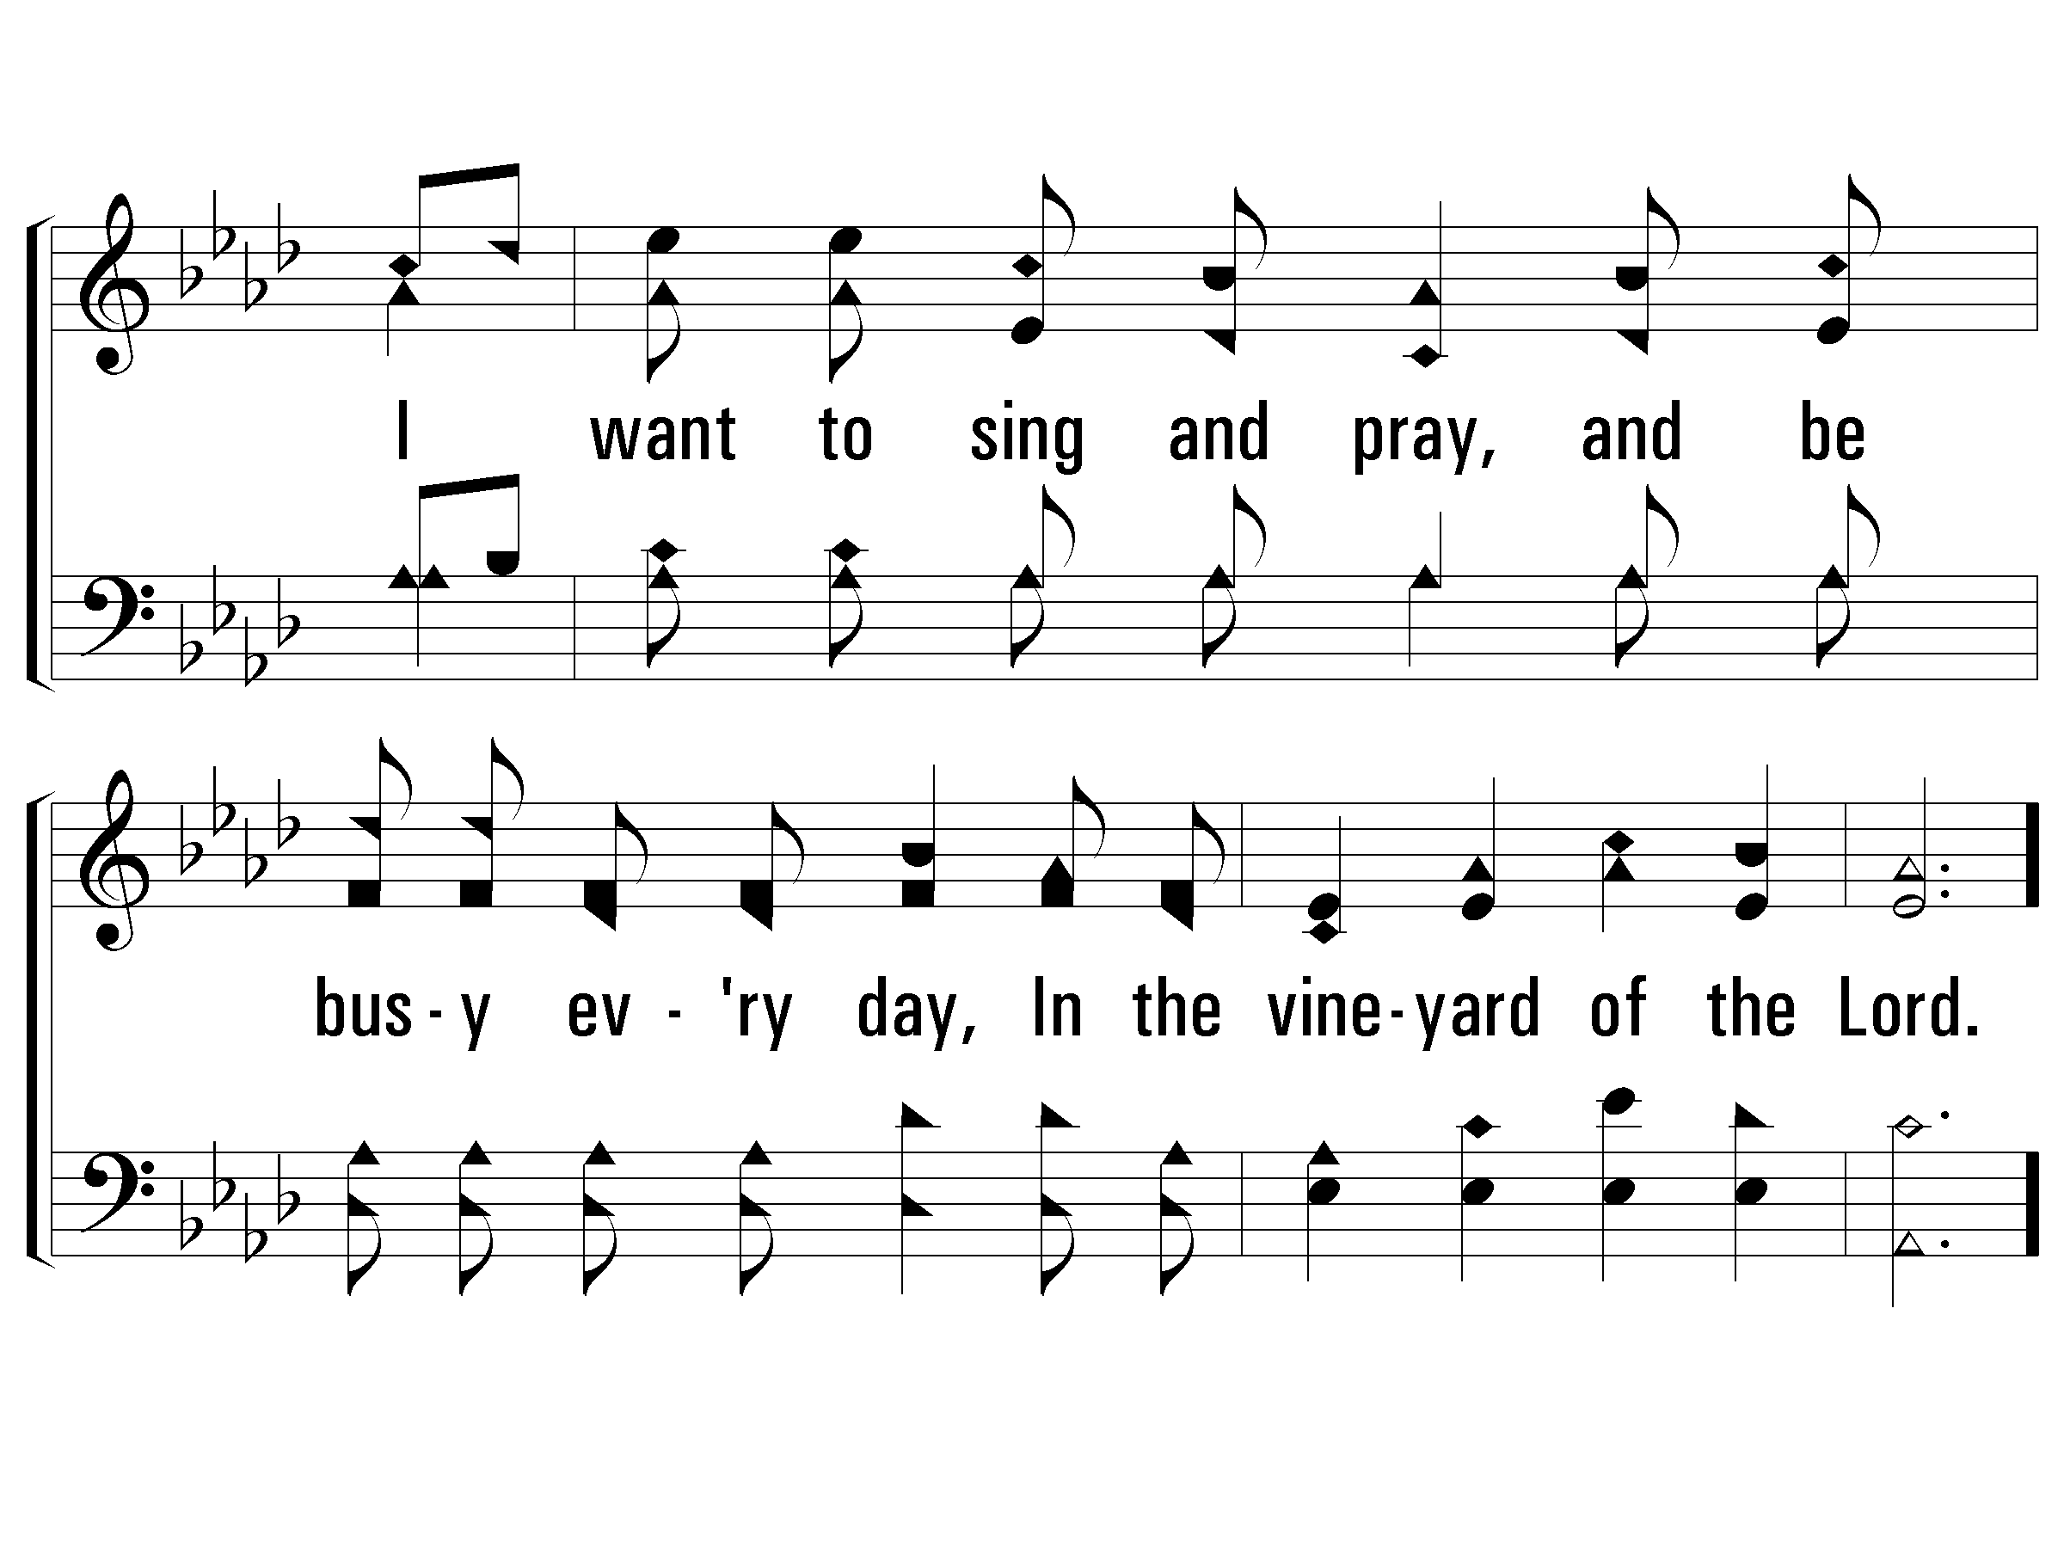
1 - I Want to Be a Worker
297
© 2008 The Paperless Hymnal®

Slide 30
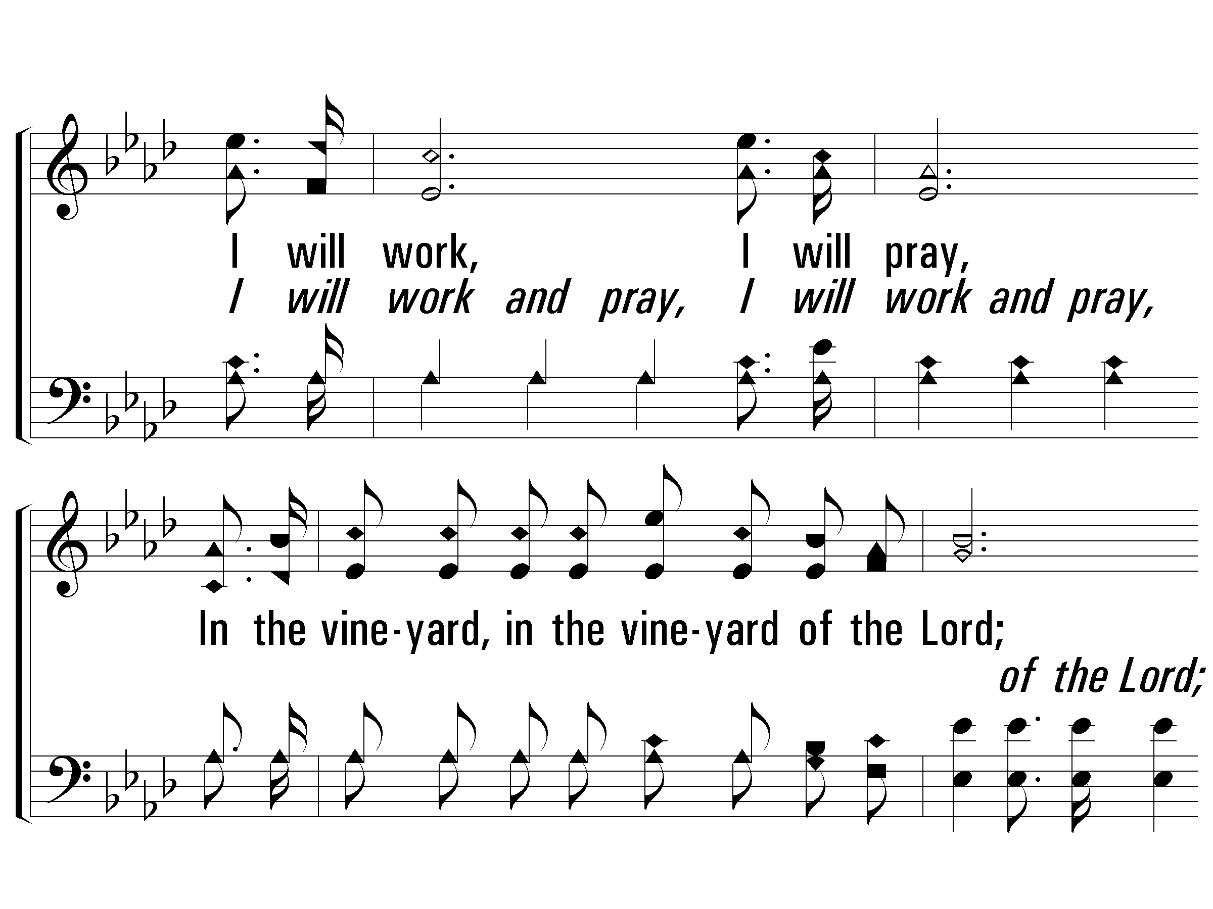
c - I Want to Be a Worker
297
I will work, I will pray,
In the vineyard, in the vineyard of the Lord;
I will work, I will pray, I will labor every day,
In the vineyard of the Lord.
© 2008 The Paperless Hymnal®

Slide 31
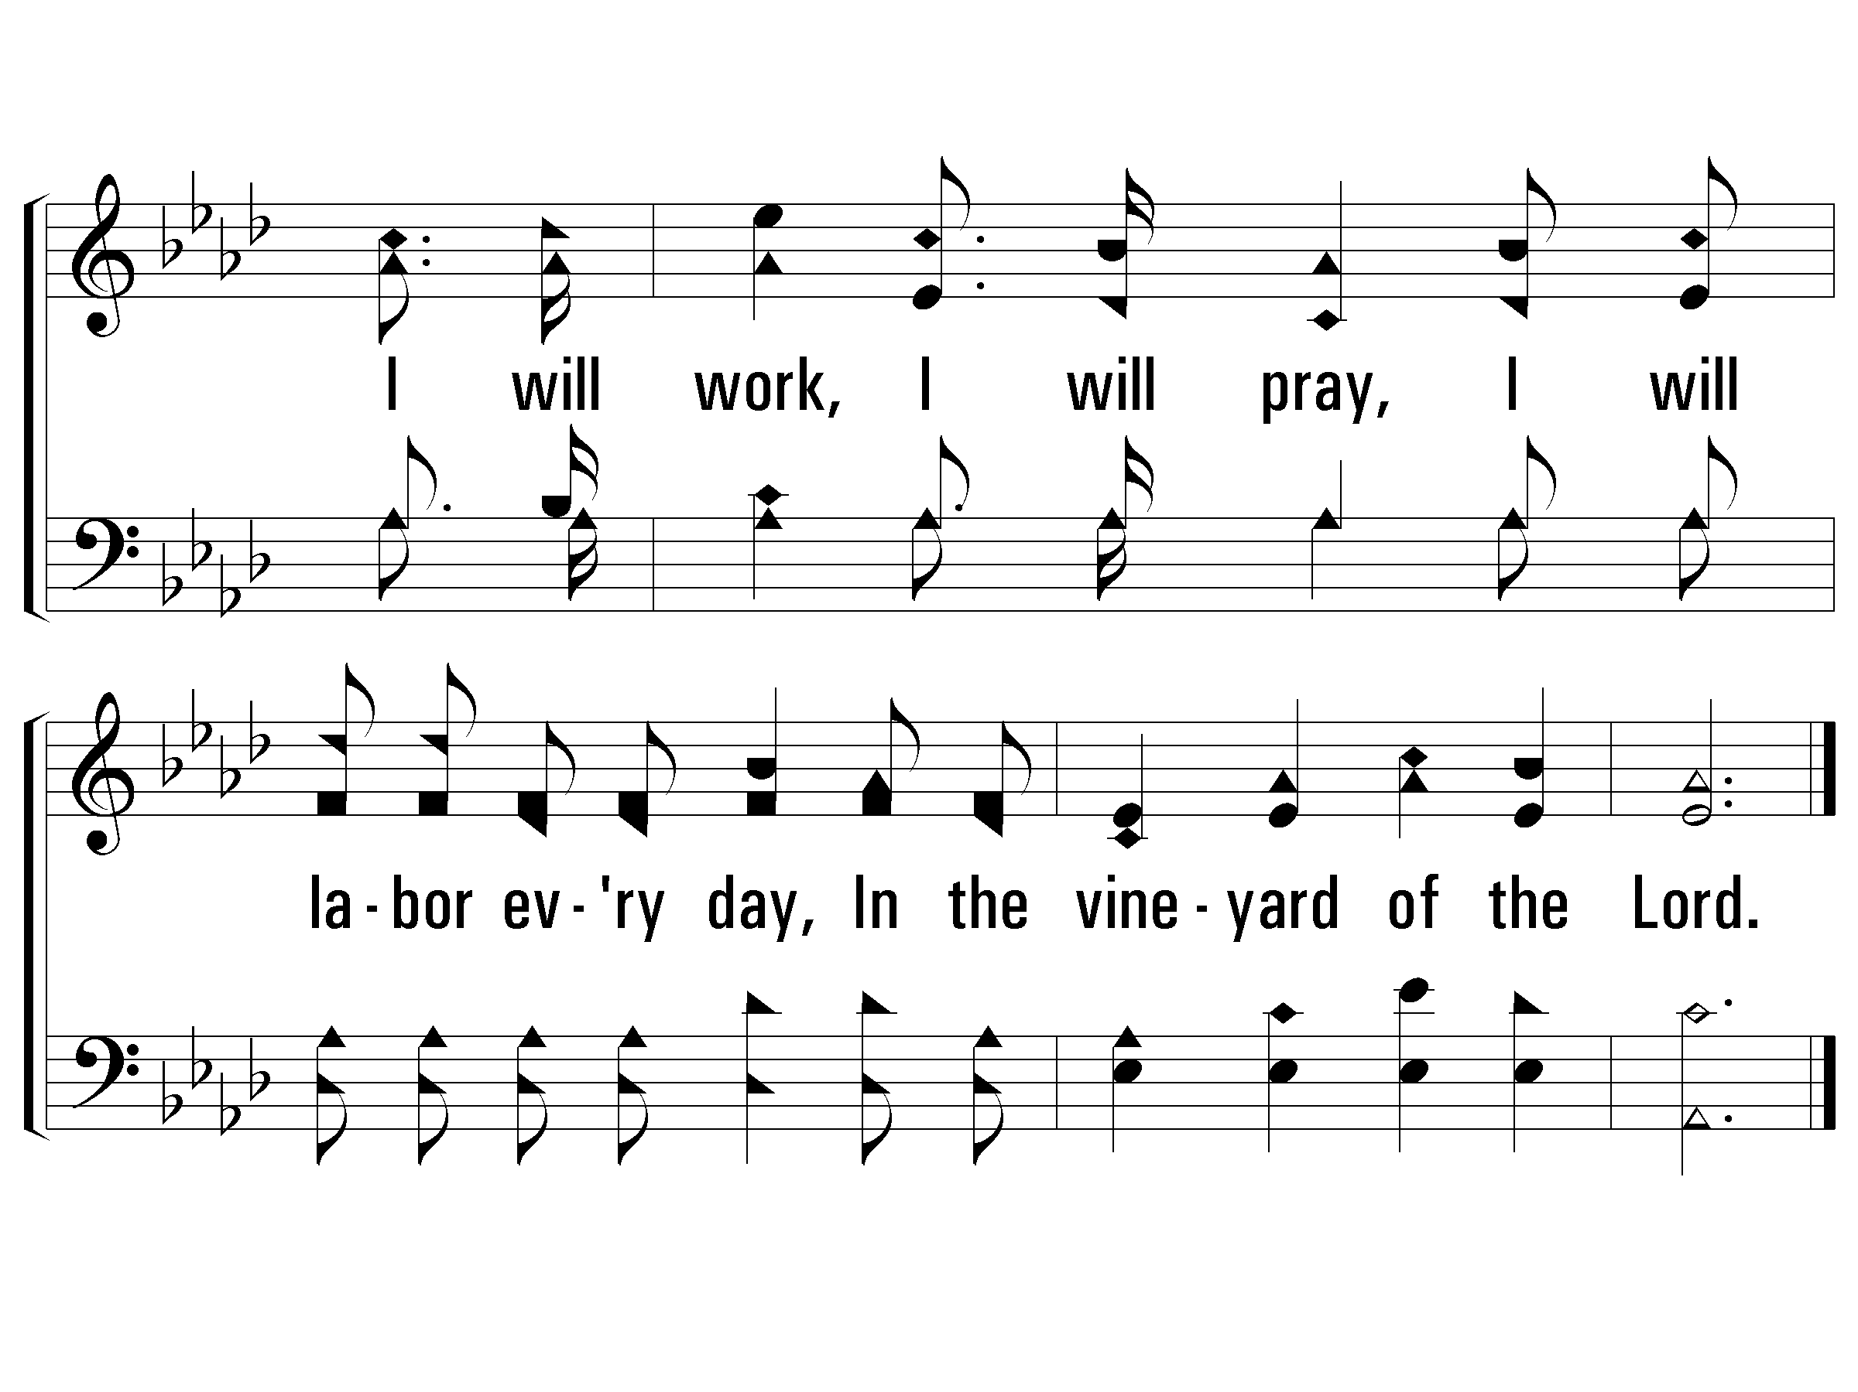
c - I Want to Be a Worker
297
© 2008 The Paperless Hymnal®

Slide 32
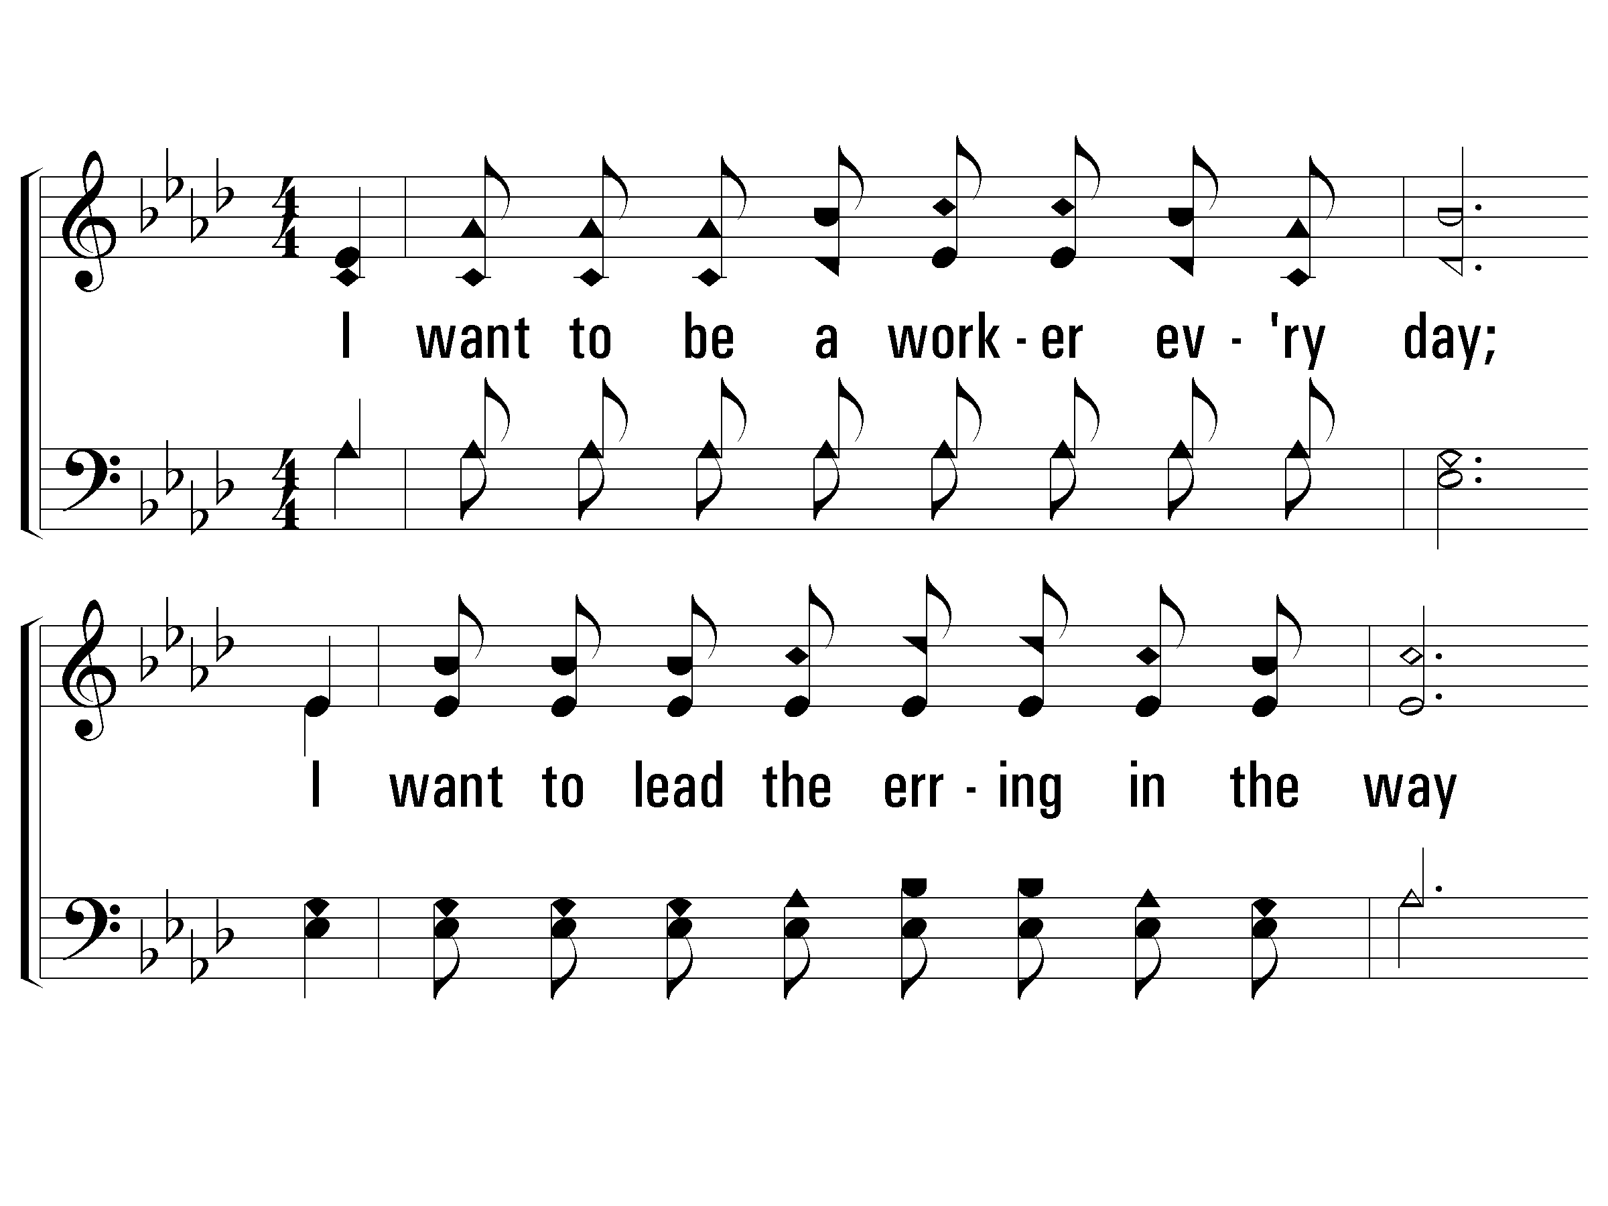
2 - I Want to Be a Worker
297
2.
I want to be a worker every day;
I want to lead the erring in the way
That leads to heaven above, where all is peace and love,
In the kingdom of the Lord.
Words & Music: Isaiah Baltzell
© 2008 The Paperless Hymnal®

Slide 33
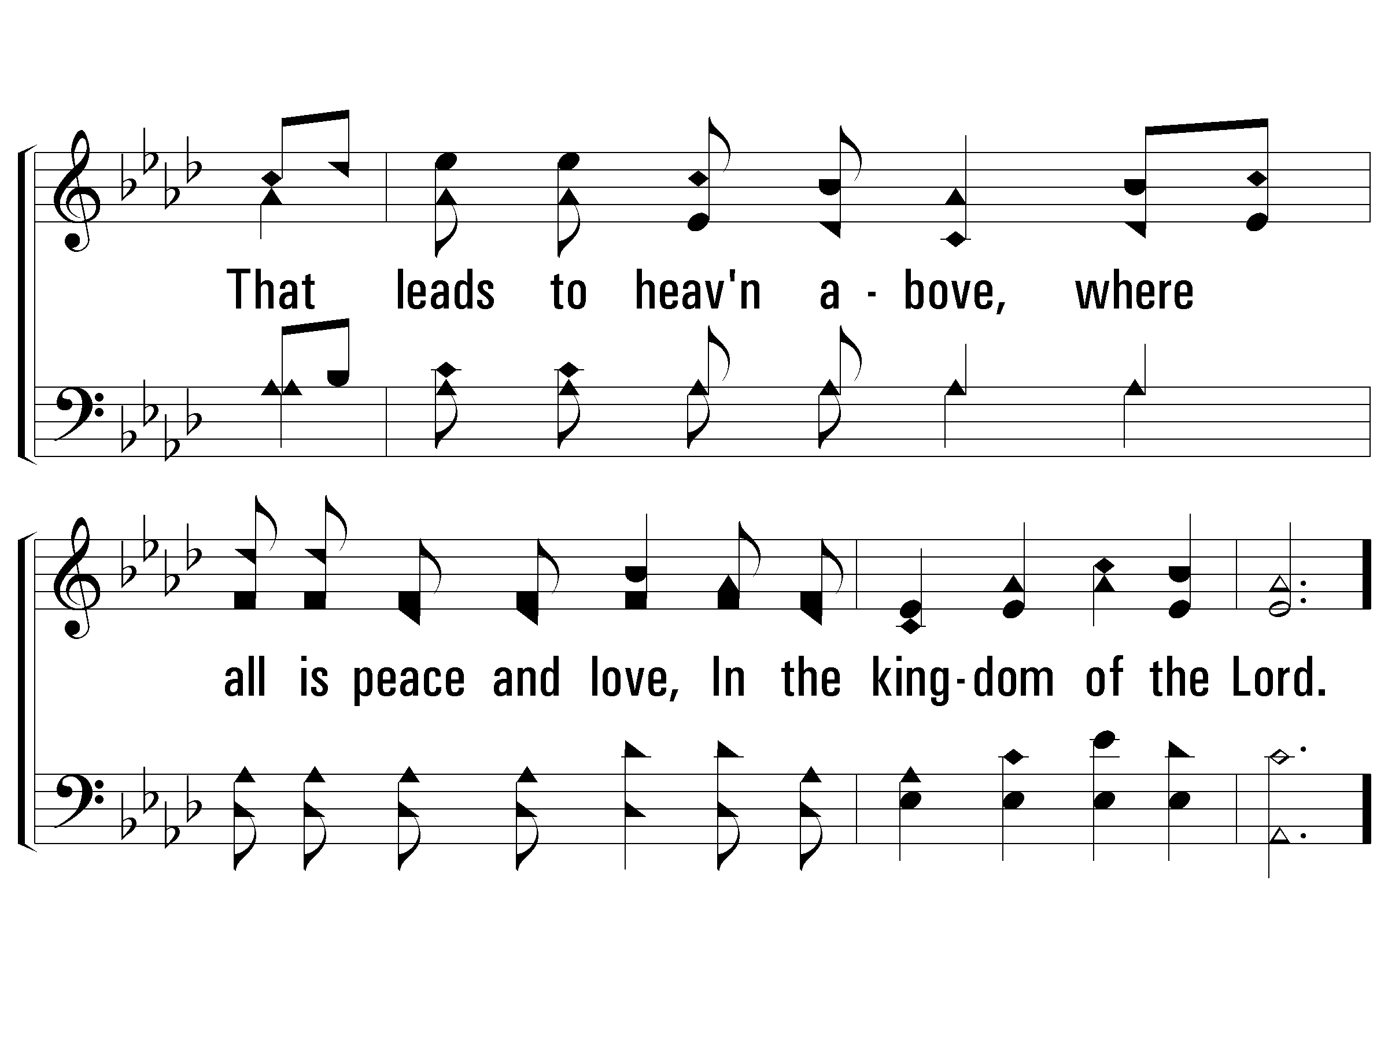
2 - I Want to Be a Worker
297
© 2008 The Paperless Hymnal®

Slide 34
c - I Want to Be a Worker
297
I will work, I will pray,
In the vineyard, in the vineyard of the Lord;
I will work, I will pray, I will labor every day,
In the vineyard of the Lord.
© 2008 The Paperless Hymnal®

Slide 35
c - I Want to Be a Worker
297
© 2008 The Paperless Hymnal®

Slide 36
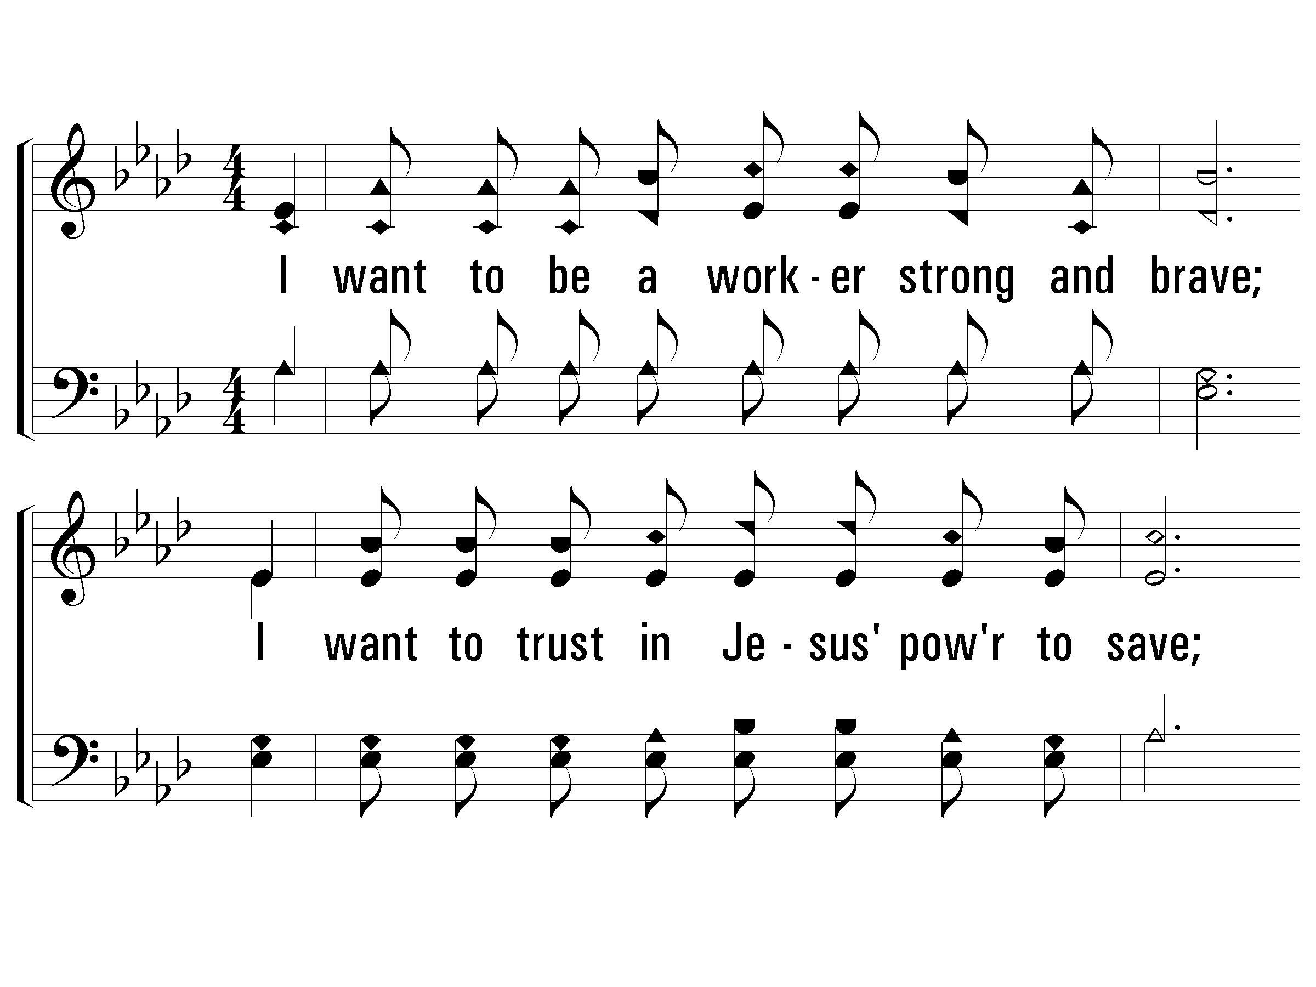
3 - I Want to Be a Worker
297
3.
I want to be a worker strong and brave;
I want to trust in Jesus' power to save;
All who will truly come shall find a happy home,
In the kingdom of the Lord.
Words & Music: Isaiah Baltzell
© 2008 The Paperless Hymnal®

Slide 37
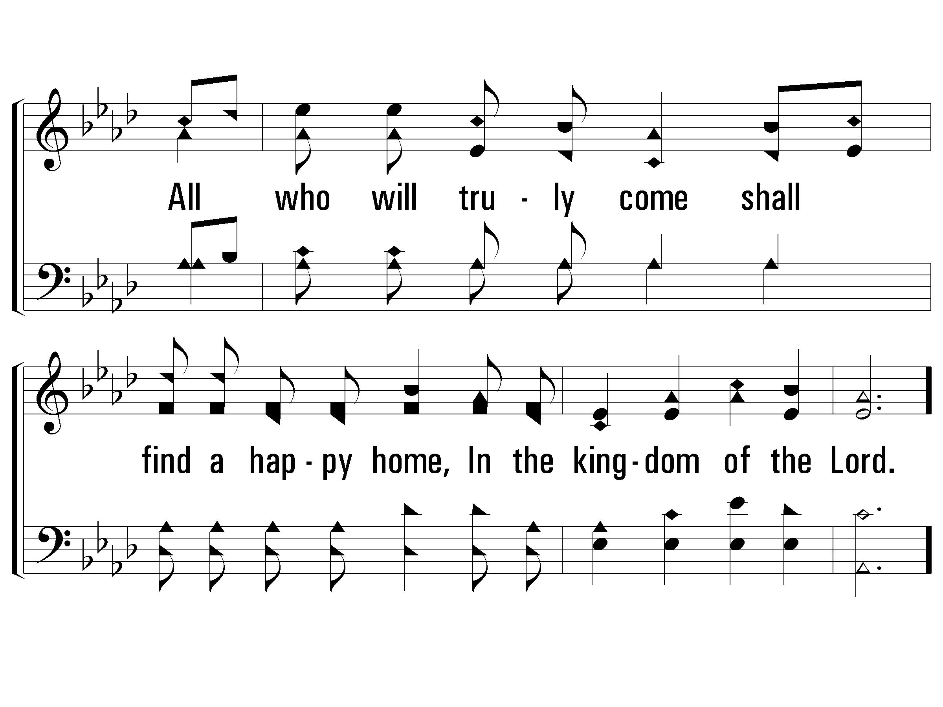
3 - I Want to Be a Worker
297
© 2008 The Paperless Hymnal®

Slide 38
c - I Want to Be a Worker
297
I will work, I will pray,
In the vineyard, in the vineyard of the Lord;
I will work, I will pray, I will labor every day,
In the vineyard of the Lord.
© 2008 The Paperless Hymnal®

Slide 39
c - I Want to Be a Worker
297
© 2008 The Paperless Hymnal®

Slide 41
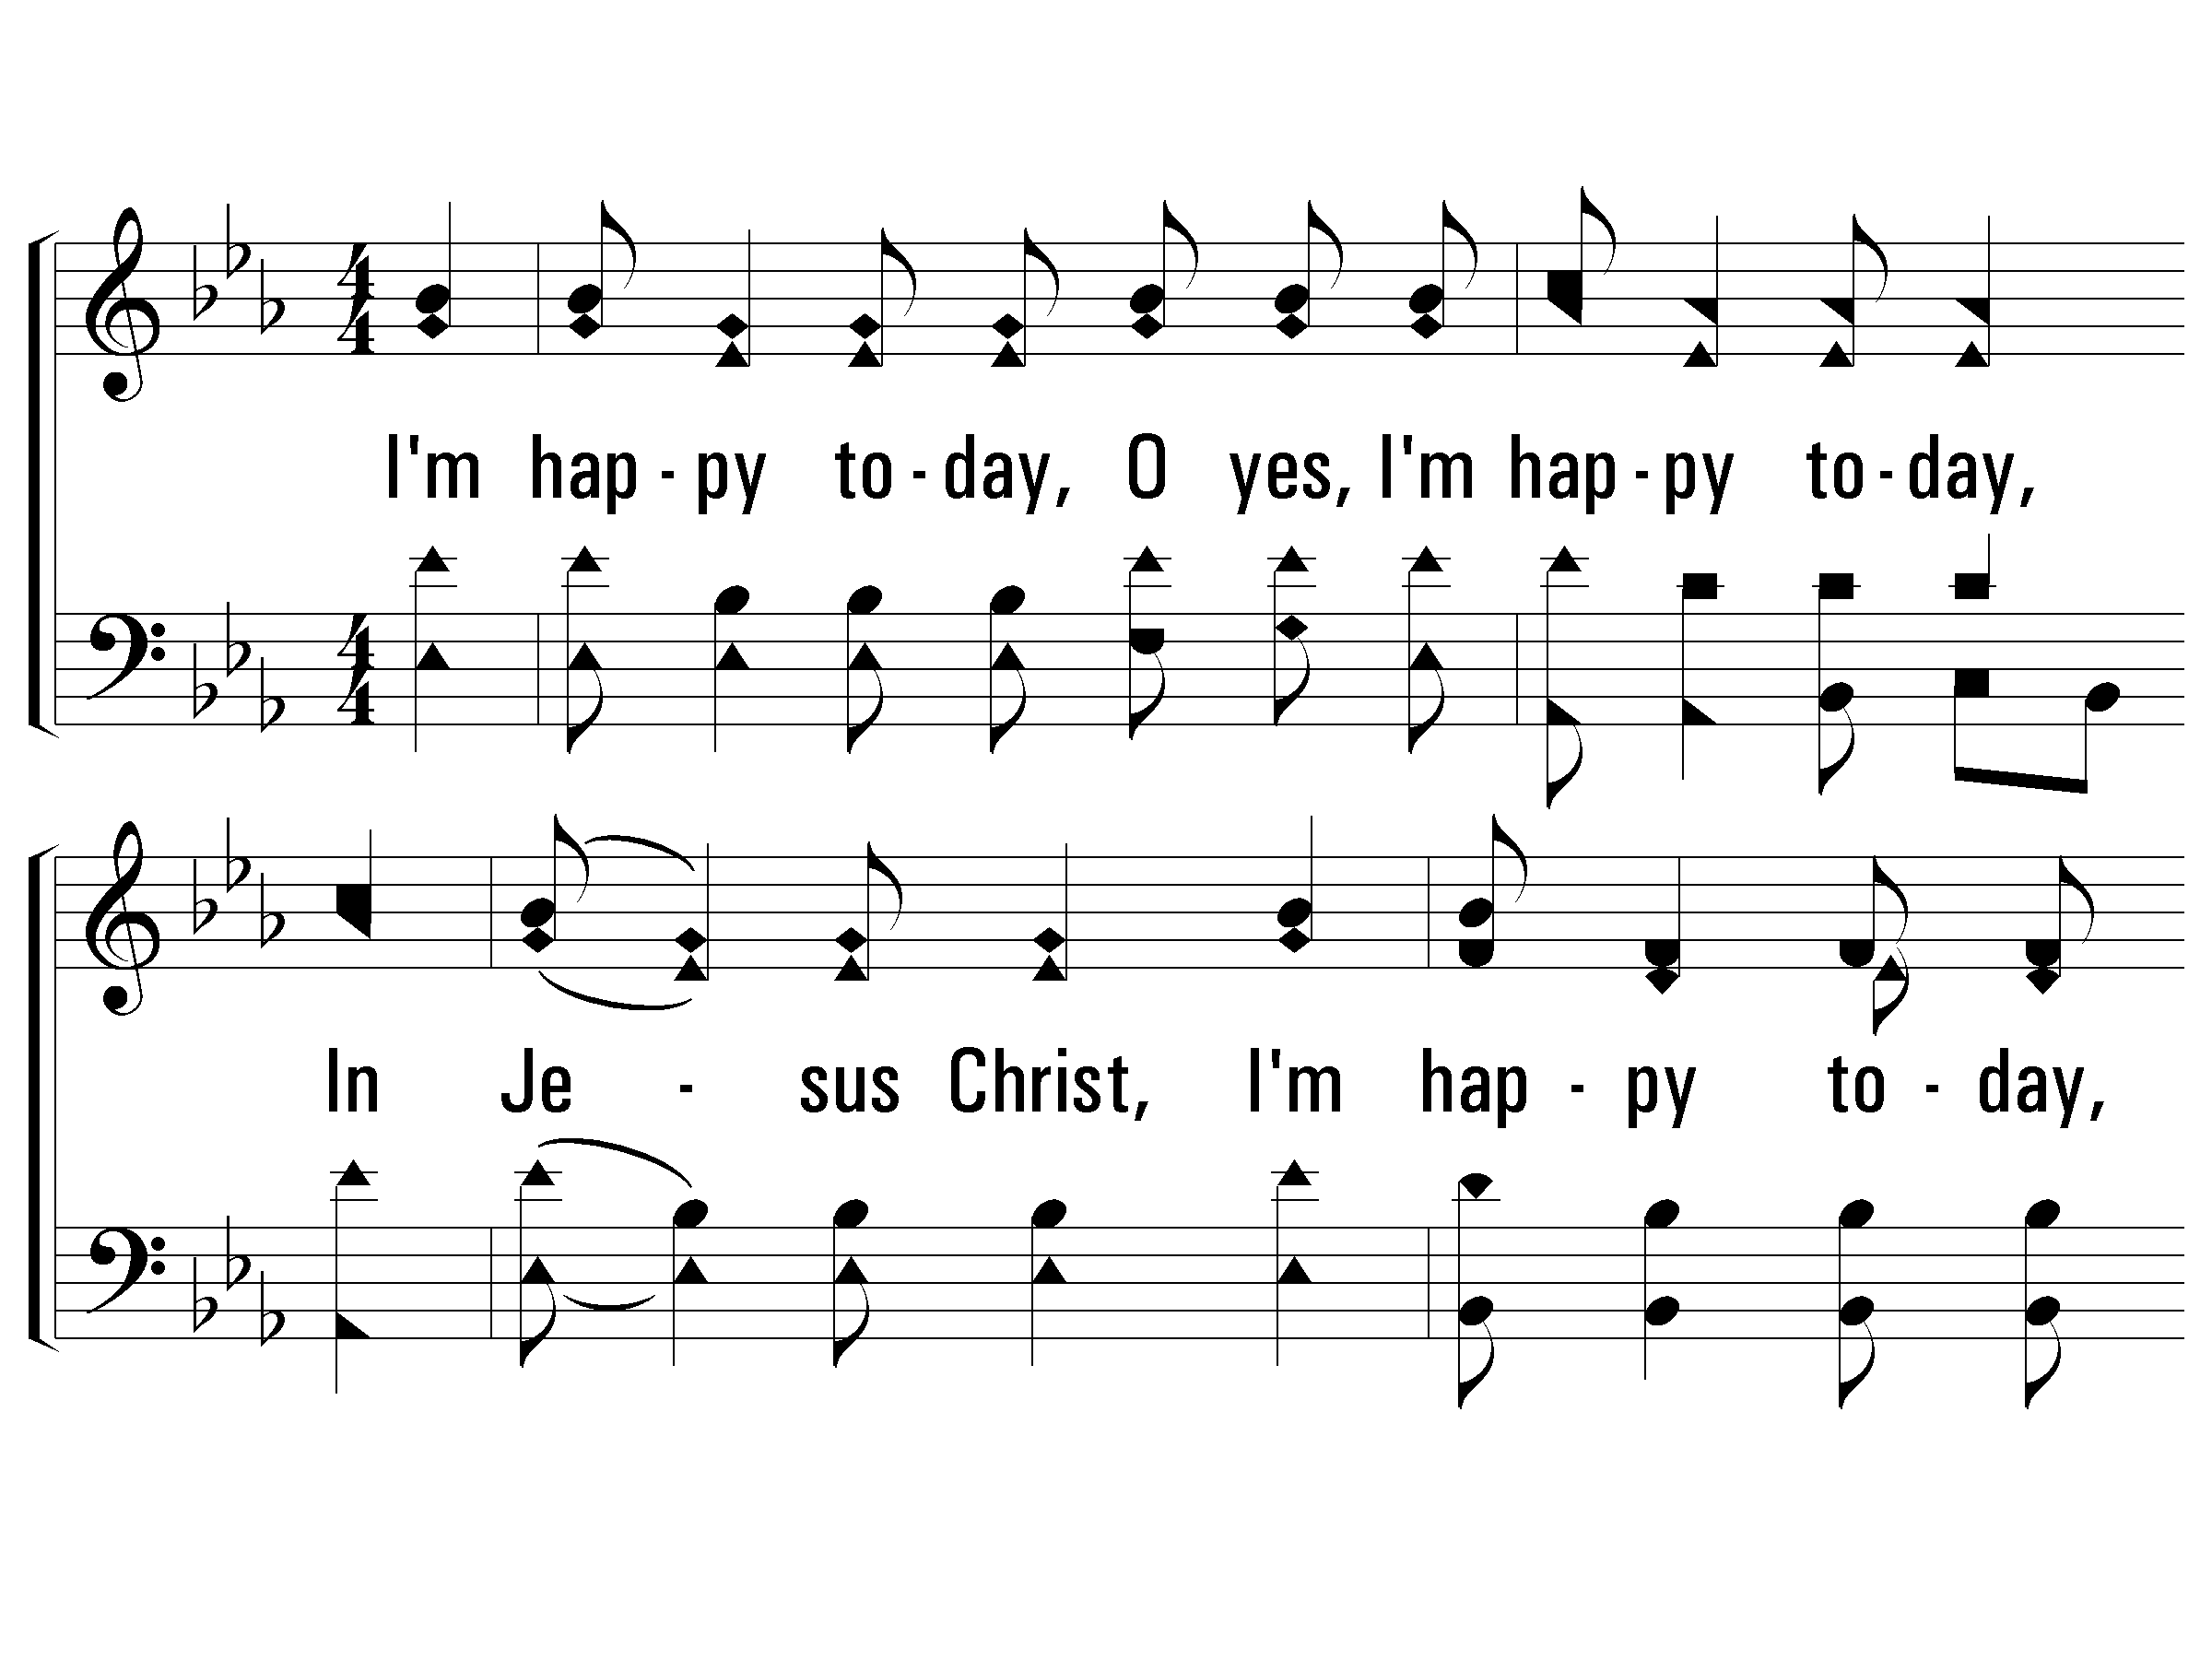
1 - I’m Happy Today
870
1.
I'm happy today, O yes, I'm happy today,
In Jesus Christ, I'm happy today,
Because He's taken all my sins away,
And that's why I'm happy today!
Words & Music: American Folk Hymn
Arrangement copyright © 1992 by Song Supplements, Inc., in Praise for the Lord. Used by permission.
© 2010 The Paperless Hymnal®

Slide 42
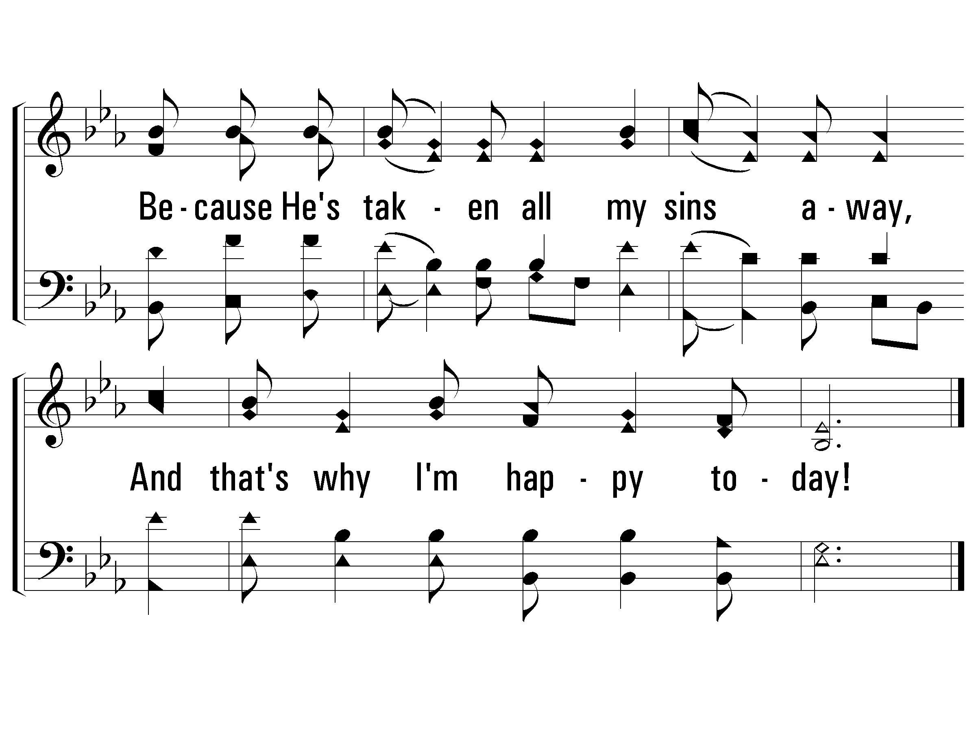
1 - I’m Happy Today
870
© 2010 The Paperless Hymnal®

Slide 43
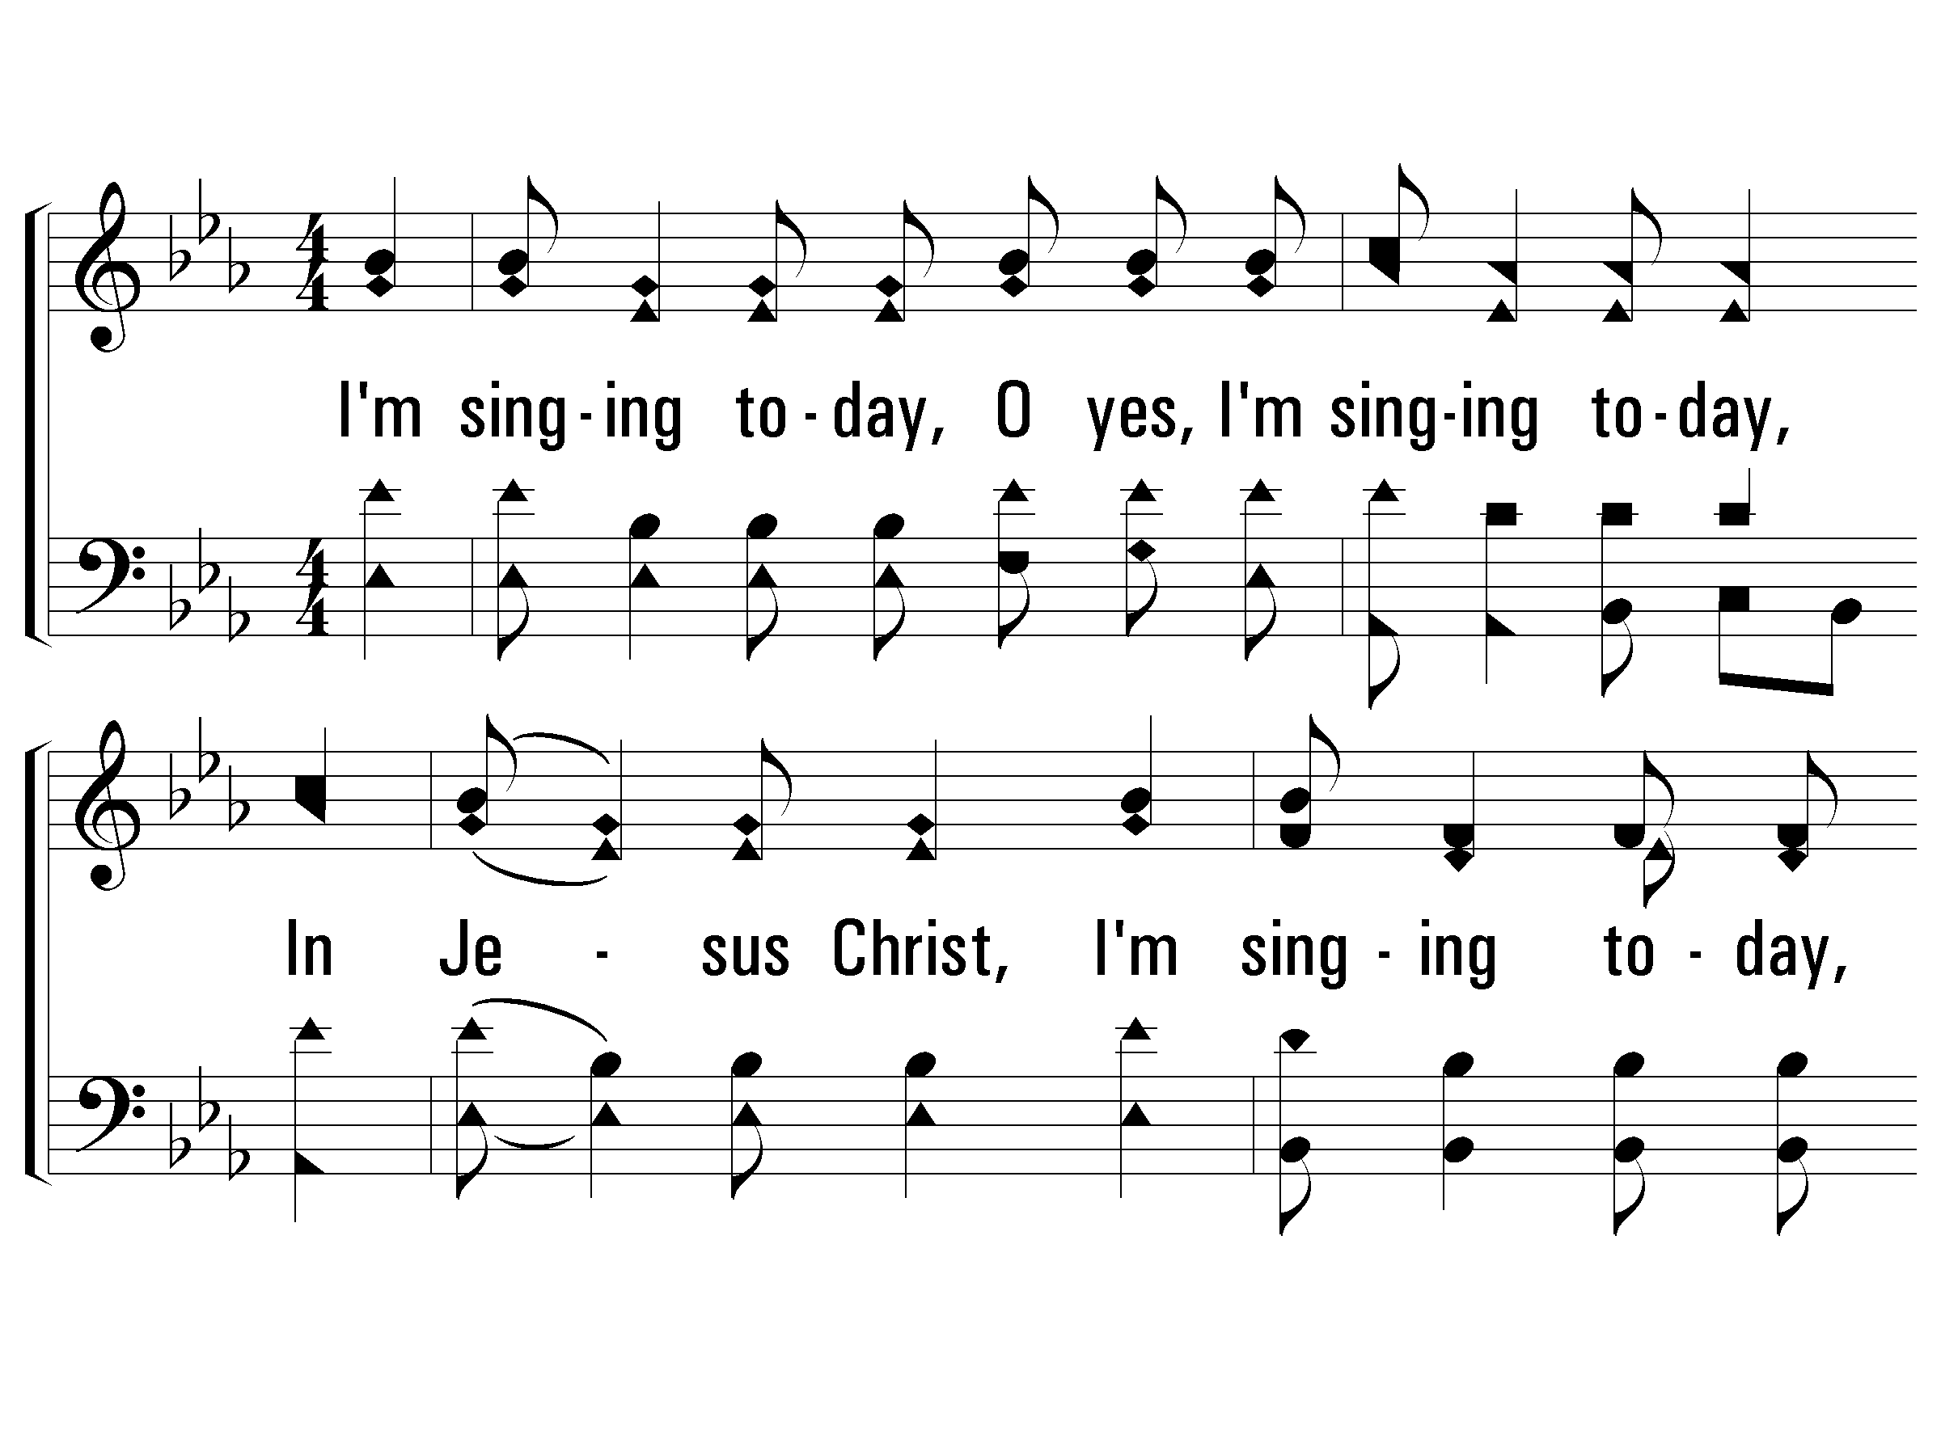
2 - I’m Happy Today
870
2.
I'm singing today, O yes, I'm singing today,
In Jesus Christ, I'm singing today,
Because He's taken all my sins away,
And that's why I'm singing today!
Words & Music: American Folk Hymn
Arrangement copyright © 1992 by Song Supplements, Inc., in Praise for the Lord. Used by permission.
© 2010 The Paperless Hymnal®

Slide 44
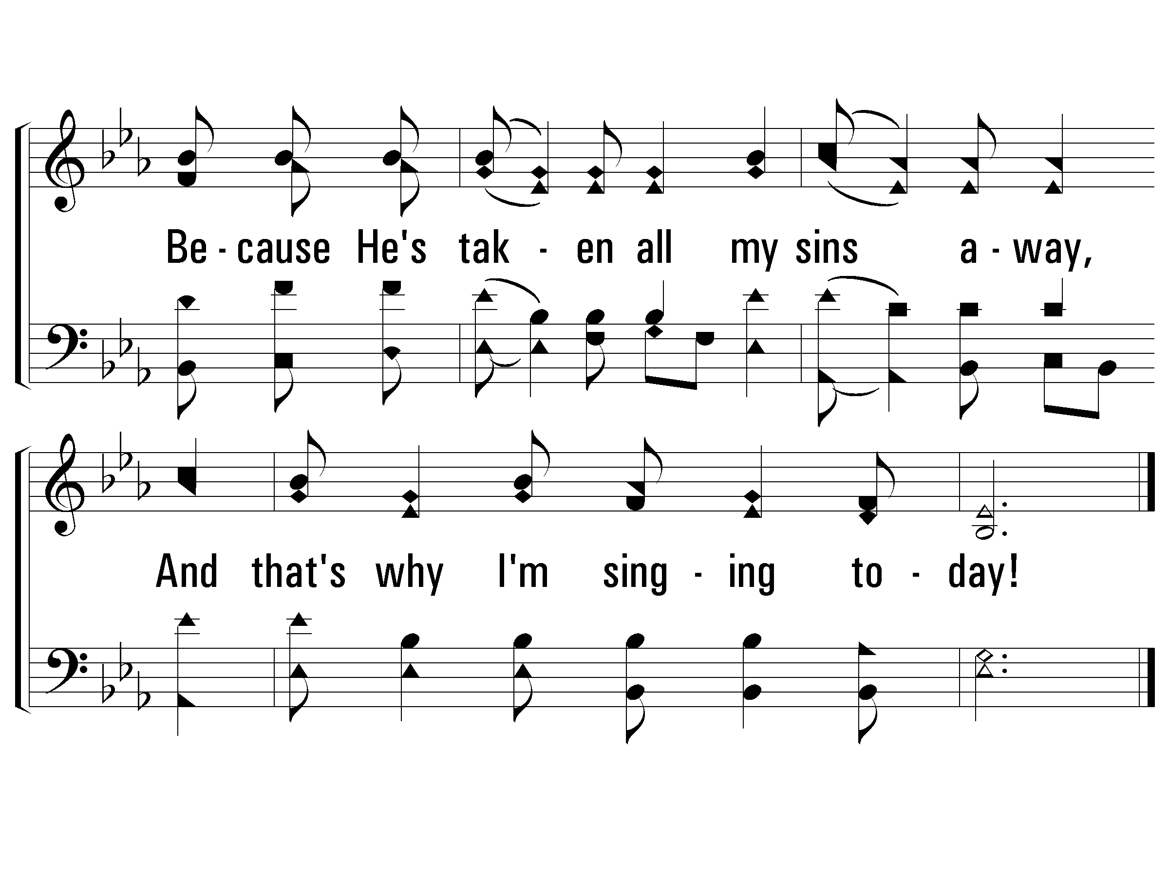
2 - I’m Happy Today
870
© 2010 The Paperless Hymnal®

Slide 45
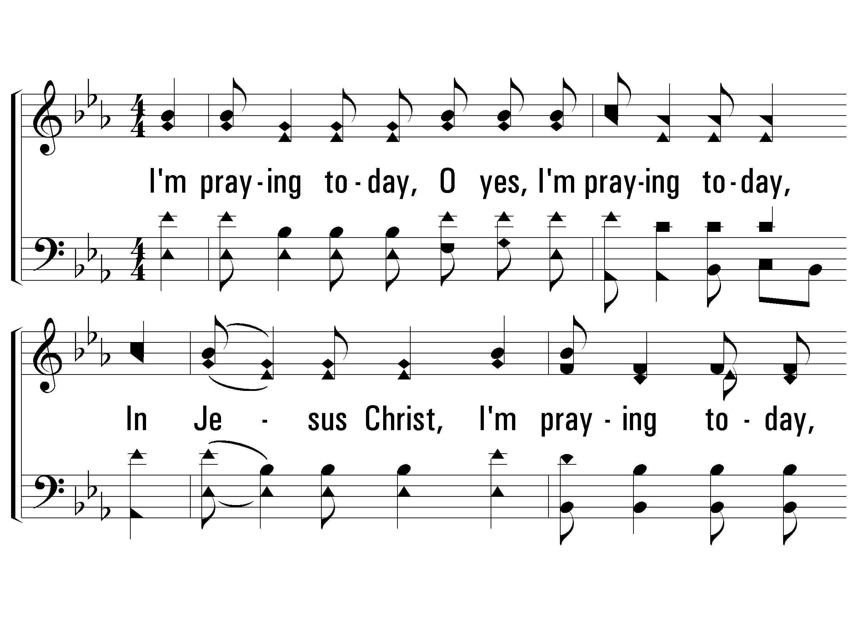
3 - I’m Happy Today
870
3.
I'm praying today, O yes, I'm praying today,
In Jesus Christ, I'm praying today,
Because He's taken all my sins away,
And that's why I'm praying today!
Words & Music: American Folk Hymn
Arrangement copyright © 1992 by Song Supplements, Inc., in Praise for the Lord. Used by permission.
© 2010 The Paperless Hymnal®

Slide 46
3 - I’m Happy Today
870
© 2010 The Paperless Hymnal®

Slide 47
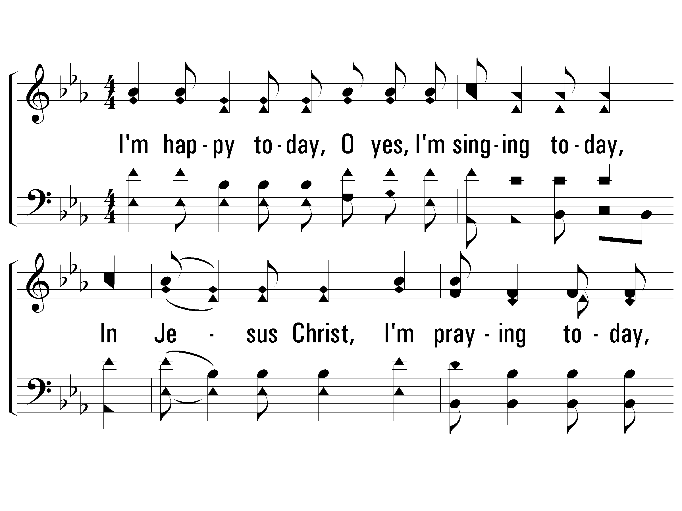
4 - I’m Happy Today
870
4.
I'm happy today, O yes, I'm singing today,
In Jesus Christ, I'm praying today,
Because He's taken all my sins away,
And that's why I'm sharing today!
Words & Music: American Folk Hymn
Arrangement copyright © 1992 by Song Supplements, Inc., in Praise for the Lord. Used by permission.
© 2010 The Paperless Hymnal®

Slide 48
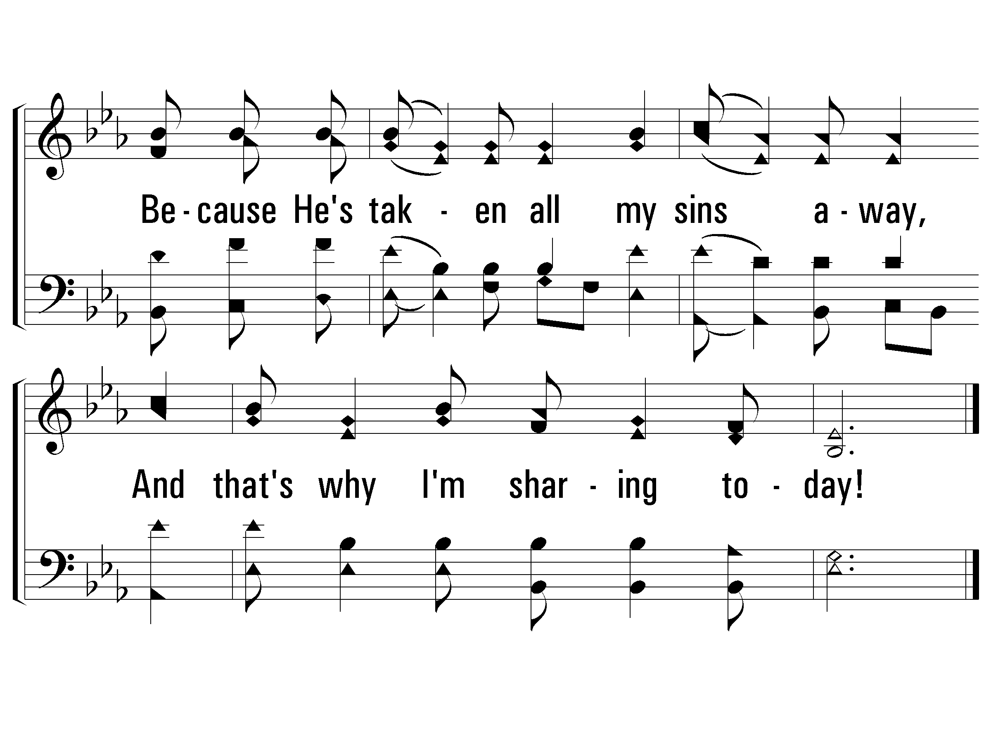
4 - I’m Happy Today
870
© 2010 The Paperless Hymnal®

Slide 50
Sound Doctrine and Right Living
1 Timothy 6:1-10

Slide 51
Paul’s instructions in this letter
Ch 1 False teaching
Ch 2 Order in worship
Ch 3 Qualified leadership
Ch 4 Work of evangelist
Ch 5 Special groups (widows)
Sound Doctrine
(godliness)
Right Living

Slide 52
Advice to Slaves 1-2
All slaves – Count masters worthy of all honor
The name of God
His doctrine
With believing masters – Not despise them
Proper attitude – serve more fervently
Those “benefitted” are beloved
Principle: what we believe directly affects our behavior

Slide 53
Advice about False Teachers 3-5
If any teach otherwise (not consent sound words)
Words of Lord Jesus Christ
Doctrine accord with godliness
Their character and motives
Conceited, understands nothing
Obsessed with disputes, arguments
Results will be constant strife, abusive language
Want attention, godliness a means of gain

Slide 54
Advice to the Rich 6-10
True Godliness actually is a means of great gain
Qualifier – when accompanied with contentment
Satisfied with what they have in Christ
Some worldly goods are necessary – how much?
Ok to have nice things (only for this short life)
Be happy and grateful if have basic necessities

Slide 55
Advice to the Rich 6-10
Those who desire to be rich fall into..
Temptation
Snare
Many foolish lusts (sink into destruction)
The love of money..
Root of (all kinds) evil
Causes Christians to wander from the faith
Final result.. pierce selves many sorrows
Paul: not one good thing about craving for money

Slide 56
Sound Doctrine and Right Living
1 Timothy 6:1-10

Slide 57
Sound Doctrine and Right Living
1 Timothy 6:1-10

