Slide 1
Endure Hardship for Christ
2 Timothy 2:1-13

Slide 2
Endure Hardship for Christ
2nd Timothy
2 Timothy 2:1-13

Slide 3
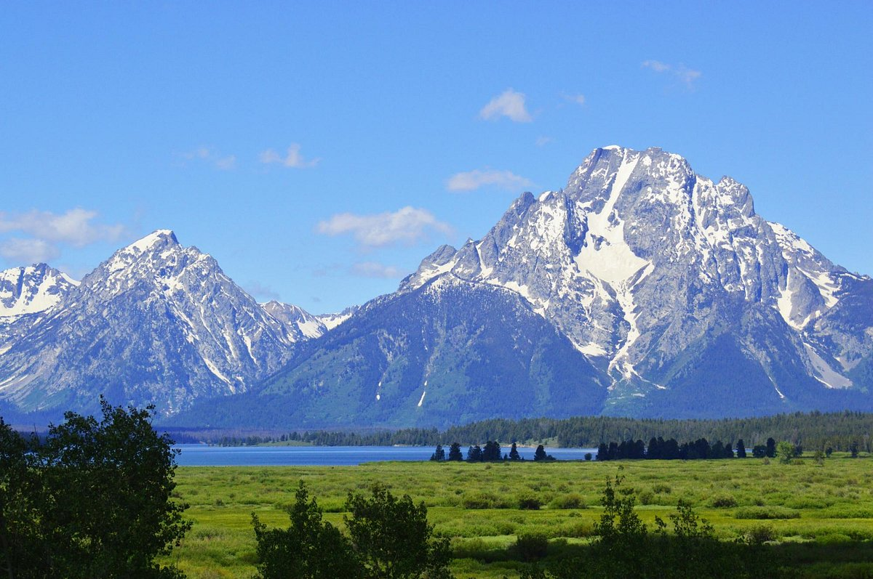
Grand Teton National Park, Wyoming

Slide 5
2 Timothy 2
1-7 The Christian life is really hard..
8-13 .. and it is really worth it !!
The Gospel is worthy of Hardships

Slide 6
Be Strong in His Grace
2:1-2 ¹ You therefore, my son, be strong in the grace that is in Christ Jesus.

Slide 7
Be Strong in His Grace
2:1-2 ² And the things that you have heard from me among many witnesses, commit these to faithful men who will be able to teach others also.
Paul’s Gospel
Timothy
Faithful men
Others

Slide 8
Be Prepared for Hardships
2:3-4 ³ You therefore must endure hardship as a good soldier of Jesus Christ. ⁴ No one engaged in warfare entangles himself with the affairs of this life, that he may please him who enlisted him as a soldier.

Slide 9
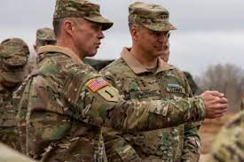

Slide 10
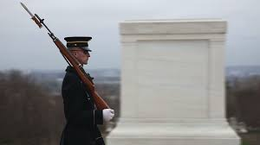

Slide 11
Be Prepared for Hardships
2:3-6 ⁵ And also if anyone competes in athletics, he is not crowned unless he competes according to the rules.

Slide 12
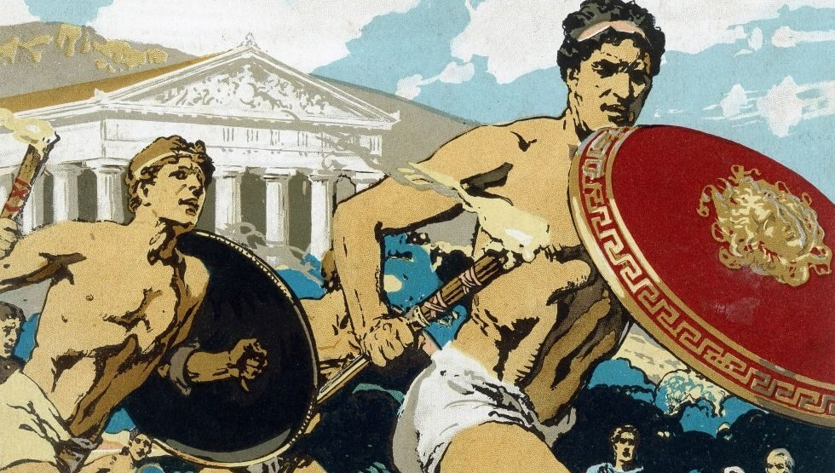

Slide 13
Be Prepared for Hardships
2:3-6 ⁶ The hardworking farmer must be first to partake of the crops. ⁷ Consider what I say, and may the Lord give you understanding in all things.

Slide 15
God Will Reward Endurance
2:8-10 ⁸ Remember that Jesus Christ, of the seed of David, was raised from the dead according to my gospel, ⁹ for which I suffer trouble as an evildoer, even to the point of chains; but the word of God is not chained.

Slide 16
God Will Reward Endurance
2:8-10 ¹⁰ Therefore I endure all things for the sake of the elect, that they also may obtain the salvation which is in Christ Jesus with eternal glory.

Slide 17
God Will Reward Endurance
2:8-10 ¹⁰ Therefore I endure all things for the sake of the elect, that they also may obtain the salvation which is in Christ Jesus with eternal glory.

Slide 19
Endure Hardship for Christ
2 Timothy 2:1-13

Slide 20
Endure Hardship for Christ
2 Timothy 2:1-13

Slide 22
Endure Hardship for Christ
2 Timothy 2:1-13

Slide 23
Endure Hardship for Christ
2nd Timothy
2 Timothy 2:1-13

