Slide 1
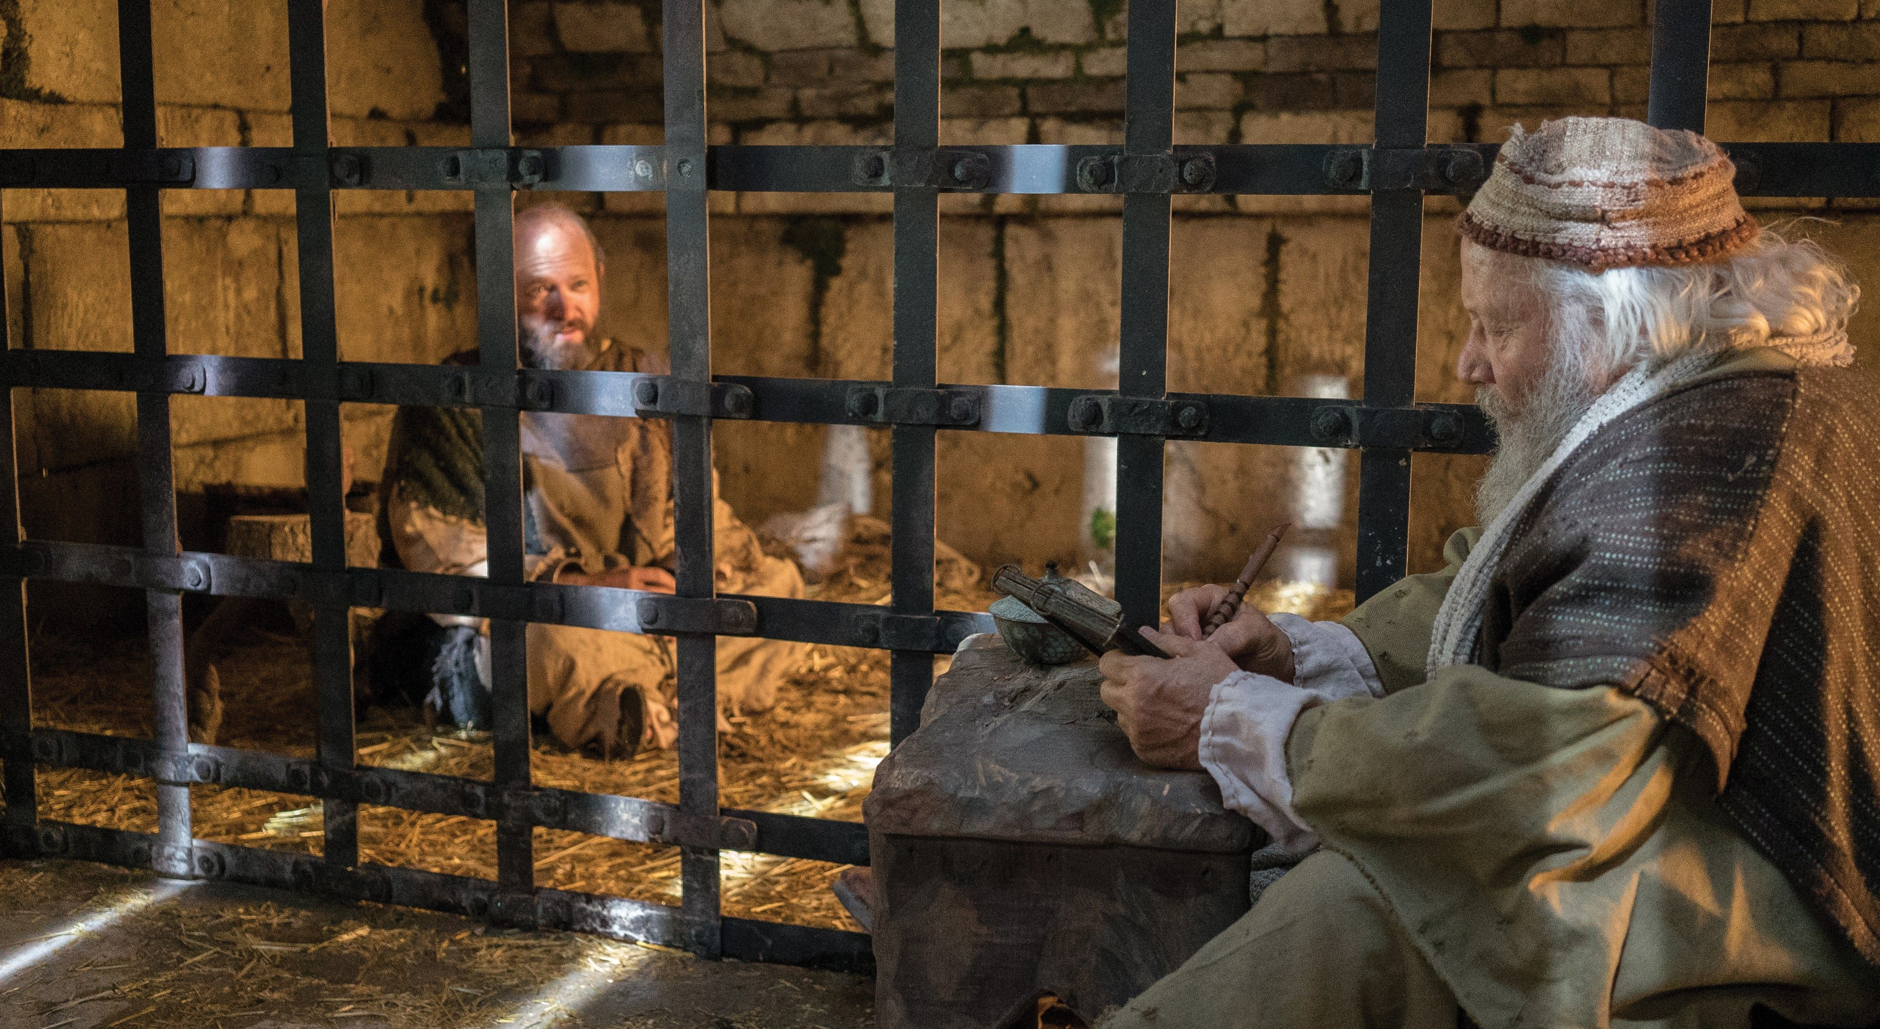
The Lord Stands at our Side
2 Timothy 4:9-22

Slide 2
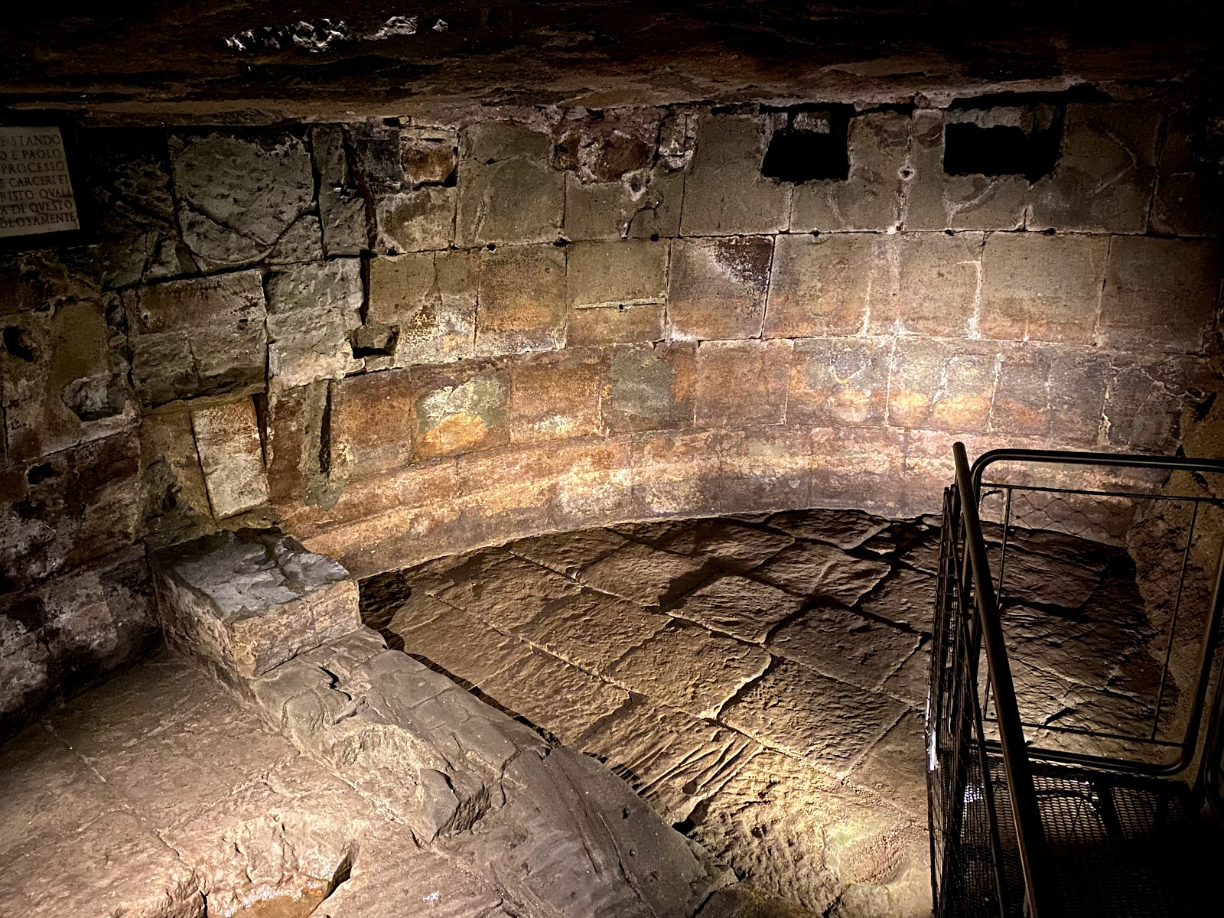

Slide 3
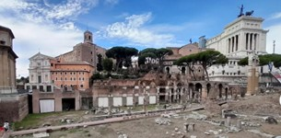

Slide 4
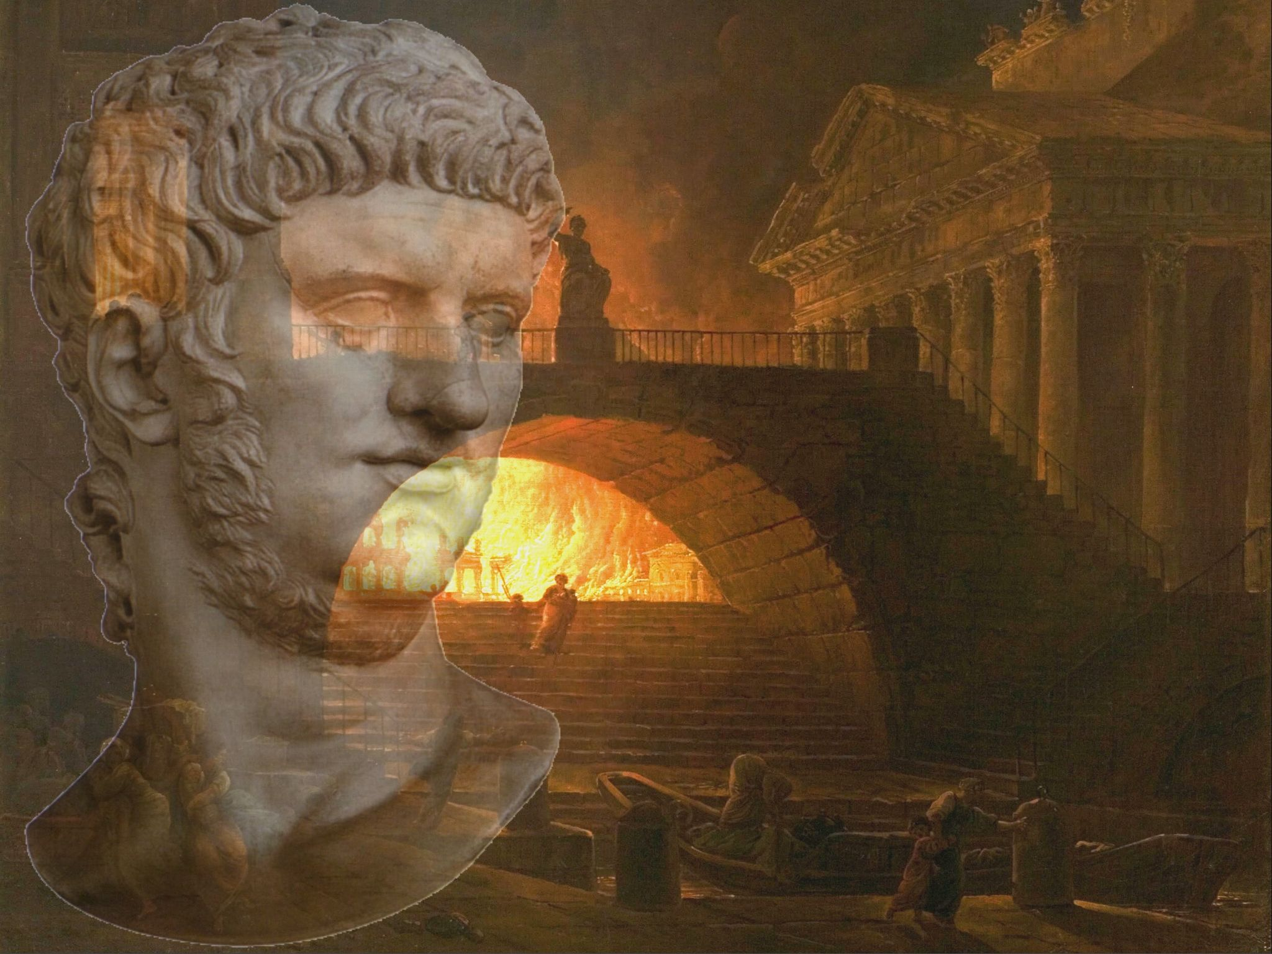

Slide 5
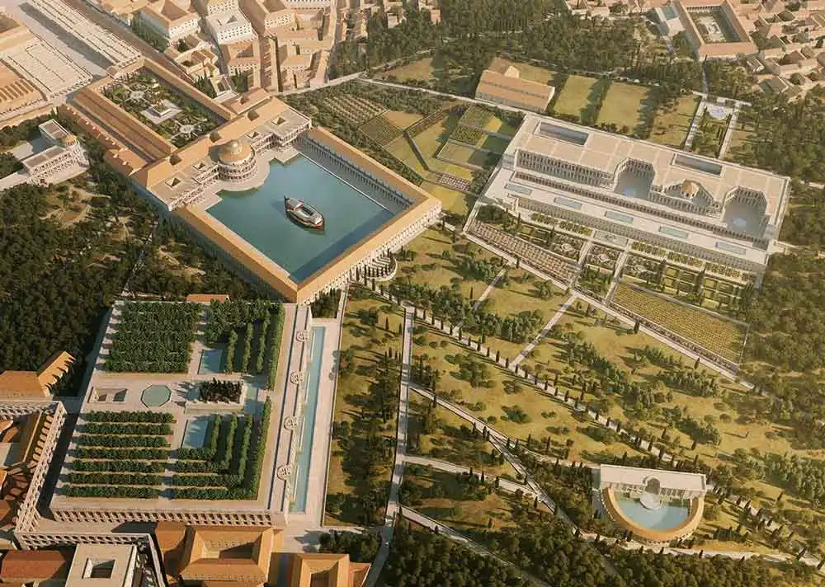

Slide 6
Paul’s requests 9-11a
2 Tim 4:9-11a Be diligent to come to me quickly; ¹⁰ for Demas has forsaken me, having loved this present world, and has departed for Thessa-lonica—Crescens for Galatia, Titus for Dalmatia. ¹¹ Only Luke is with me.
Timothy to Come quickly (before winter v 21)

Slide 7
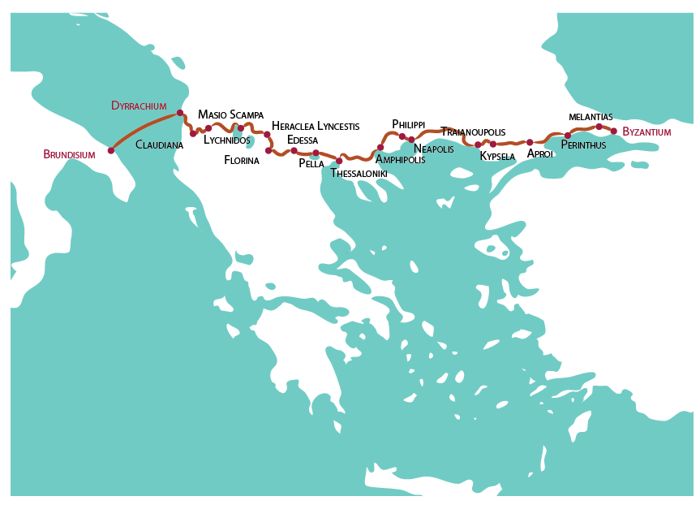
Troas
Ephesus

Slide 8
Bring with You 11b-13
4:11b-12 Get Mark and bring him with you, for he is useful to me for ministry. ¹² And Tychicus I have sent to Ephesus. Bring the cloak that I left with Carpus at Troas when you come—and the books, especially the parchments.
Bring Mark with him
Bring his cloak, books, parchments

Slide 9
Trials Paul endured 14-15
4:14-15 Alexander the coppersmith did me much harm. May the Lord repay him according to his works. ¹⁵ You also must beware of him, for he has greatly resisted our words. At my first defense no one stood with me, but all forsook me. May it not be charged against them.
Demas had forsaken him
Only Luke was with him (other local brethren v 21)

Slide 10
Alone at his first defense 16-17
4:16 At my first defense no one stood with me, but all forsook me. May it not be charged against them.
He had been forsaken at his trial
Alexander did him much harm

Slide 11
Paul’s faithfulness 17-18
4:17-18 But the Lord stood with me and strengthened me, so that the message might be preached fully through me, and that all the Gentiles might hear. Also I was delivered out of the mouth of the lion. ¹⁸ And the Lord will deliver me from every evil work and preserve me for His heavenly kingdom. To Him be glory forever and ever. Amen!
Still confident in the Lord
The Lord stood with him, did deliver him

Slide 12
His thoughts for others 19-21
4:19-22 Greet Prisca and Aquila, and the household of Onesiphorus. ²⁰ Erastus stayed in Corinth, but Trophimus I have left in Miletus sick. 21 Do your utmost to come before winter. Eubulus greets you, as well as Pudens, Linus, Claudia, and all the brethren. 22 The Lord Jesus Christ be with your spirit. Grace be with you. Amen.
Sends greetings to old friends
The Lord be with you and strengthen you

Slide 13
The Lord Stands at our Side
2 Timothy 4:9-22

Slide 14
The Lord Stands at our Side
2nd Timothy
2 Timothy 4:9-22

