Slide 1
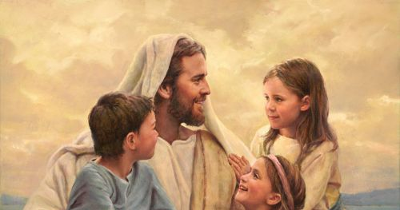
Jesus Loves the Children
Mark 10:13-16

Slide 3
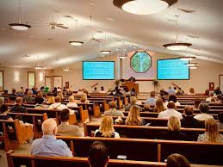

Slide 4
Willing to take time for them
Mark 10:13-16 Then they brought little children to Him, that He might touch them; but the disciples rebuked those who brought them.
¹⁴ But when Jesus saw it, He was greatly displeased and said to them, “Let the little children come to Me, and do not forbid them; for of such is the kingdom of God. ¹⁵ Assuredly, I say to you, whoever does not receive the kingdom of God as a little child will by no means enter it.” ¹⁶ And He took them up in His arms, laid His hands on them, and blessed them.

Slide 5
Recognizing their Value
Matthew 18:1-5 At that time the disciples came to Jesus, saying, “Who then is greatest in the kingdom of heaven?”
² Then Jesus called a little child to Him, set him in the midst of them, ³ and said, “Assuredly, I say to you, unless you are converted and become as little children, you will by no means enter the kingdom of heaven. ⁴ Therefore whoever humbles himself as this little child is the greatest in the kingdom of heaven. ⁵ Whoever receives one little child like this in My name receives Me.

Slide 6
Recognizing their Value
Leaders who put service above own status
Matt 25:31-46 Then the King will say to those on His right hand, ‘Come, you blessed of My Father, inherit the kingdom prepared for you from the foundation of the world: ³⁵ for I was hungry and you gave Me food; I was thirsty and you gave Me drink; I was a stranger and you took Me in; ³⁶ I was naked and you clothed Me; I was sick and you visited Me; I was in prison and you came to Me.’

Slide 7
Zeal Protecting their Innocence
Matt 18:6-10 “But whoever causes one of these little ones who believe in Me to sin, it would be better for him if a millstone were hung around his neck, and he were drowned in the depth of the sea.
⁸ “If your hand or foot causes you to sin, cut it off and cast it from you. It is better for you to enter into life lame or maimed, rather than having two hands or two feet, to be cast into the everlasting fire. ¹⁰ “Take heed that you do not despise one of these little ones, for I say to you that in heaven their angels always see the face of My Father who is in heaven.

Slide 8
The Tender Heart of God for them
Matt 9:18-26 “But whoever causes one of these little ones who believe in Me to sin, it would be better for him if a millstone were hung around his neck, and he were drowned in the depth of the sea.
⁸ “If your hand or foot causes you to sin, cut it off and cast it from you. It is better for you to enter into life lame or maimed, rather than having two hands or two feet, to be cast into the everlasting fire. ¹⁰ “Take heed that you do not despise one of these little ones, for I say to you that in heaven their angels always see the face of My Father who is in heaven.

Slide 9
Instill Godly Values in them
God gave this responsibility to families
Eph 6:4 And you, fathers, do not provoke your children to wrath, but bring them up in the training and admonition of the Lord.
Deut 6:5-7 You shall love the Lord your God with all your heart, with all your soul, and with all your strength.⁶ “And these words which I command you today shall be in your heart. ⁷ You shall teach them diligently to your children, and shall talk of them when you sit in your house, when you walk by the way, when you lie down, and when you rise up.

Slide 10
Instill Godly Values in them
God gave this responsibility to families
Proverbs 22:6 Train up a child in the way he should go, And when he is old he will not depart from it.
Proverbs 6:20-23 My son, keep your father’s command, And do not forsake the law of your mother. ²¹ Bind them continually upon your heart; Tie them around your neck. ²² When you roam, ^{[a]}they will lead you; When you sleep, they will keep you; And when you awake, they will speak with you. ²³ For the commandment is a lamp, And the law a light; Reproofs of instruction are the way of life,

Slide 11
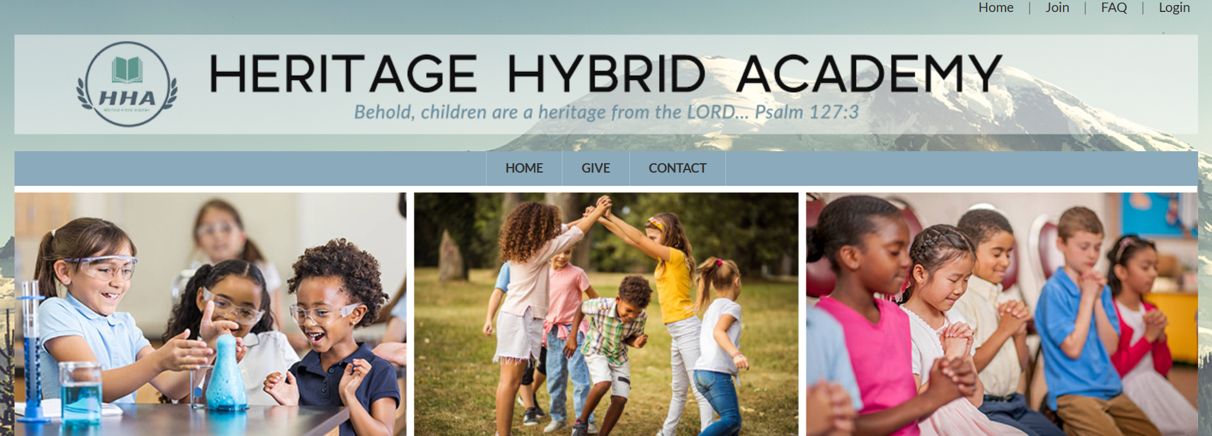

Slide 12
Jesus Loves the Children
Mark 10:13-16

