Slide 1
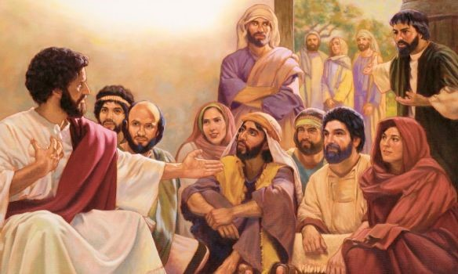
The Family of Jesus
Mark 3:21-35

Slide 2
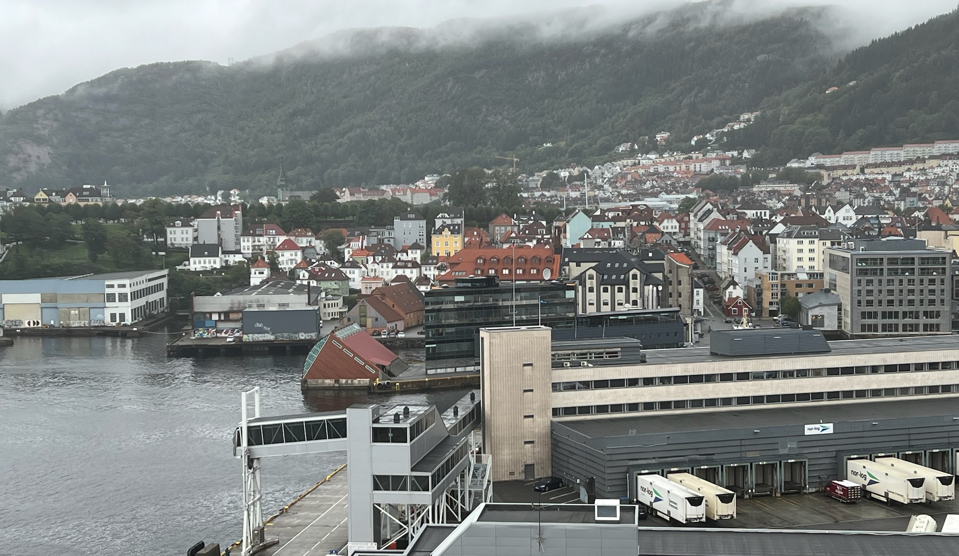
Bergen, Norway

Slide 3
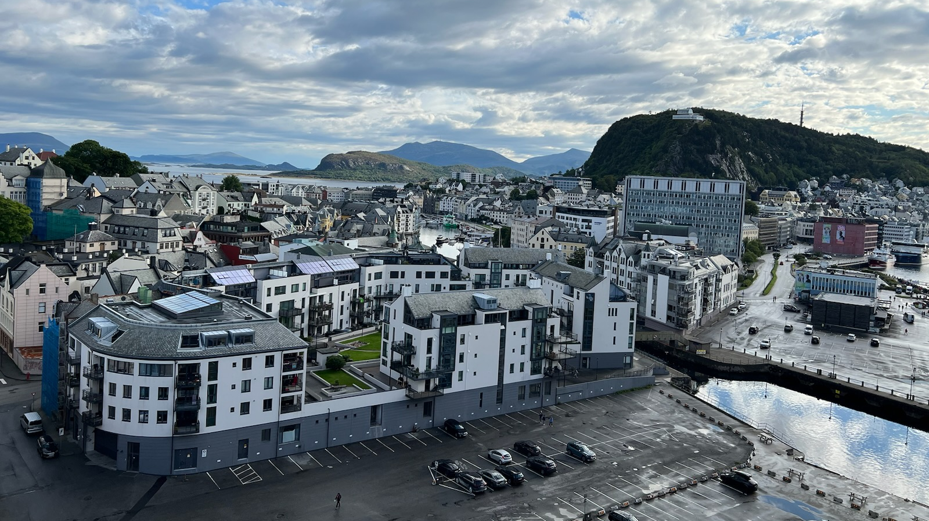
Alesand, Norway

Slide 4
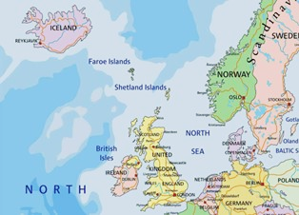

Slide 5
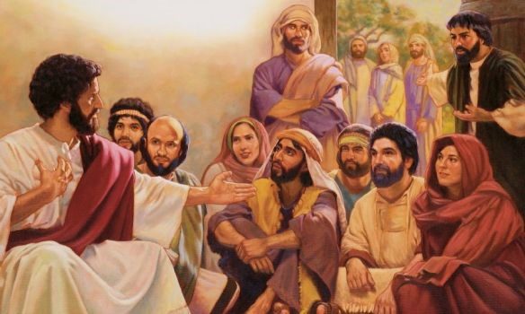
The Family of Jesus
Mark 3:21-35

Slide 6
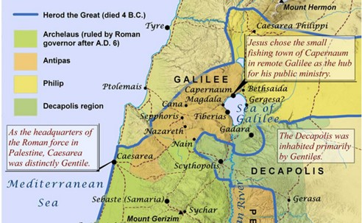

Slide 7
Jesus’ family tree had some skeletons

Slide 8
You don’t have to repeat same tendencies in your family past
Joshua 24:14-15 “Now therefore, fear the Lord, serve Him in sincerity and in truth, and put away the gods which your fathers served on the other side of the River and in Egypt. Serve the Lord! ¹⁵ And if it seems evil to you to serve the Lord, choose for yourselves this day whom you will serve, whether the gods which your fathers served that were on the other side of the River, or the gods of the Amorites, in whose land you dwell. But as for me and my house, we will serve the Lord.”

Slide 9
The one who chooses righteousness will not bear guilt of the past
Ezekiel 18:14-17 “If, however, he begets a son who sees all the sins which his father has done, and considers but does not do likewise; ¹⁵ Who has not eaten on the mountains, nor lifted his eyes to the idols of the house of Israel, nor defiled his neighbor’s wife; ¹⁶ Has not oppressed anyone, nor withheld a pledge, nor robbed by violence, But has given his bread to the hungry and covered the naked with clothing; ¹⁷ — He shall not die for the iniquity of his father; He shall surely live!

Slide 10
Jesus came from a marred family but he chose the path of His Father
Hebrews 4:14-15 Seeing then that we have a great High Priest who has passed through the heavens, Jesus the Son of God, let us hold fast our confession. ¹⁵ For we do not have a High Priest who cannot sympathize with our weaknesses, but was in all points tempted as we are, yet without sin.

Slide 11
Jesus dealt with unbelief in his own biological family
Mark 3:20-21 Then Jesus entered a house, and again a crowd gathered, so that he and his disciples were not even able to eat. ²¹ When his family heard about this, they went to take charge of him, for they said, “He is out of his mind.”

Slide 12
His own brothers did not believe in Him
John 7:1-5 After these things Jesus walked in Galilee; for He did not want to walk in Judea, because the Jews sought to kill Him. ² Now the Jews’ Feast of Tabernacles was at hand. ³ His brothers therefore said to Him, “Depart from here and go into Judea, that Your disciples also may see the works that You are doing. ⁴ For no one does anything in secret while he himself seeks to be known openly. If You do these things, show Yourself to the world.” ⁵ For even His brothers did not believe in Him.

Slide 13
As Jesus kept focused on his mission the unbelief within his family changed
Acts 1:14 These all continued with one accord in prayer and supplication, with the women and Mary the mother of Jesus, and with His brothers.

Slide 14
What mattered most to Jesus was not his physical but his spiritual family
Mark 3:31-35 Then His brothers and His mother came, and standing outside they sent to Him, calling Him. ³² And a multitude was sitting around Him; and they said to Him, “Look, Your mother and Your brothers are outside seeking You.”
³³ But He answered them, saying, “Who is My mother, or My brothers?” ³⁴ And He looked around in a circle at those who sat about Him, and said, “Here are My mother and My brothers! ³⁵ For whoever does the will of God is My brother and My sister and mother.”

Slide 15
Jesus identified his true family and you can be part of it
1 John 3:1-2 Behold what manner of love the Father has bestowed on us, that we should be called children of God! Therefore the world does not know us, because it did not know Him. ² Beloved, now we are children of God; and it has not yet been revealed what we shall be, but we know that when He is revealed, we shall be like Him, for we shall see Him as He is.

Slide 16
Jesus acknowledges those in his spiritual family
Hebrew 2:11 For both He who sanctifies and those who are being sanctified are all of one, for which reason He is not ashamed to call them brethren..

Slide 17
The Family of Jesus
Mark 3:21-35

