Slide 1
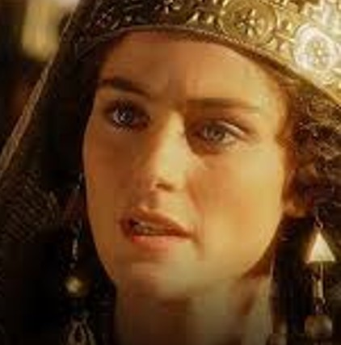
Trusting God When it Counts
Joseph and Esther

Slide 2
Joseph
Esther
Both Young people living in a foreign land
Both kept their identities a secret
Both maintained their faith in God
God used them to save His people

Slide 3
Joseph
Esther
Genesis 50:20
Do not be afraid, for am I in theplace of God? But as for you, you meant evil against me; but God meant it for good, in order to bring it about as it is this day, to save many people alive.
Esther 4:14
For if you remain completely silent at this time, relief and deliverance will arise for the Jews from another place, but you and your father’s house will perish. Yet who knows whether you have come to the kingdom for such a time as this?”

Slide 4
Joseph trusted God in Egypt
Refused to sin with Potiphar’s wife
Gen 39:9-12 How then can I do this great wickedness, and sin against God?”¹⁰ So it was, as she spoke to Joseph day by day, that he did not heed her, to lie with her or to be with her.
Faithfully served God while in jail
Gen 39:21-23 But the Lord was with Joseph and showed him mercy, and He gave him favor in the sight of the keeper of the prison… and whatever he did, the Lord made it prosper.

Slide 5
How Joseph trusted God
He gave God credit for interpreting dreams
Gen 41:16 So Joseph answered Pharaoh, saying, “It is not in me; God will give Pharaoh an answer of peace.”
He followed God’s plan in preparing for famine
Gen 41:48 So he gathered up all the food of the seven years which were in the land of Egypt, and laid up the food in the cities; he laid up in every city the food of the fields which surrounded them.

Slide 6
Esther trusted God to save her people
She recognized the opportunity to help her people
Esther 4:14 if you remain completely silent at this time, relief and deliverance will arise for the Jews from another place, but you and your father’s house will perish. Yet who knows whether you have come to the kingdom for such a time as this?”
She fasted and trusted God to risk her life
4:16 Go, gather all the Jews who are present in Shushan, and fast for me; neither eat nor drink for three days, night or day. My maids and I will fast likewise. And so I will go to the king, which is against the law; and if I perish, I perish!”

Slide 7
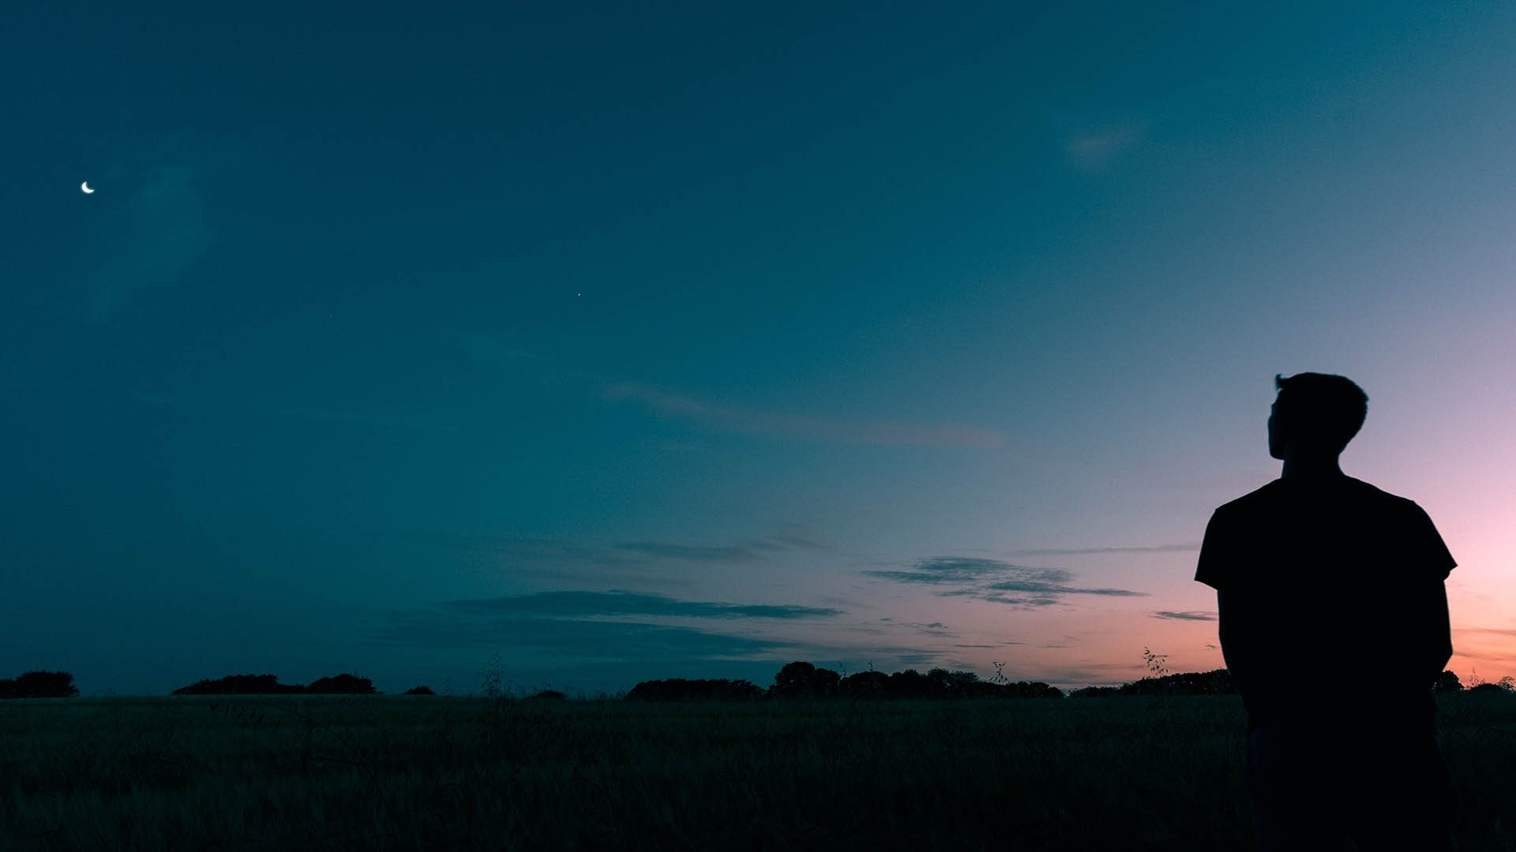
How we show our trust in God
When others tempt us to sin
1 Cor 10:13 No temptation has overtaken you except such as is common to man; but God is faithful, who will not allow you to be tempted beyond what you are able, but with the temptation will also make the way of escape, that you may be able to bear it.
When among those who do not believe
Phil 2:15-16 that you may become blameless and harmless, children of God without fault in the midst of a crooked and perverse generation, among whom you shine as lights in the world, ¹⁶ holding fast the word of life, so that I may rejoice in the day of Christ that I have not run in vain or labored in vain.

Slide 8
How we show our trust in God
Willing to help others when opportunities arise
Galatians 6:10 Therefore, as we have opportunity, let us do good to all, especially to those who are of the household of faith.
Willing to make sacrifices to fulfill God’s mission
Luke 9:23 “If anyone desires to come after Me, let him deny himself, and take up his cross ^{[a]}daily, and follow Me.

Slide 9
Trusting God When it Counts
Joseph and Esther

