Slide 1
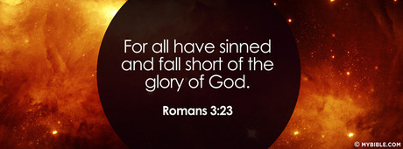
Redemption Needed
Romans 3.9-12

Slide 2
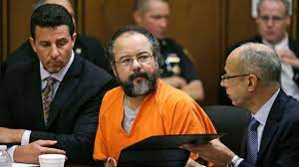
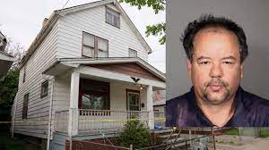
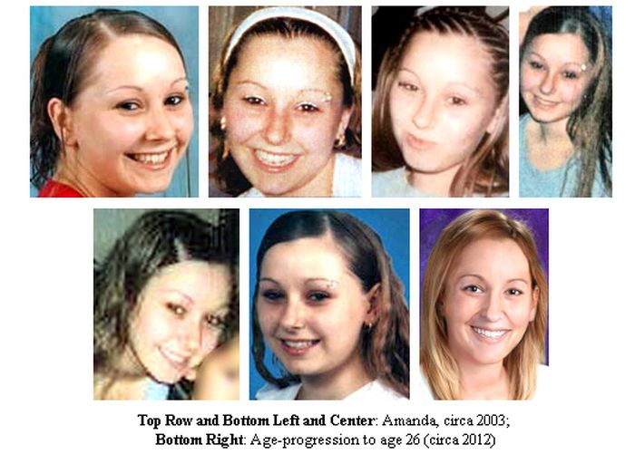

Slide 3
“I am basically a good person”
Romans 1:18–3:20 man’s lost condition (condemned)
God’s righteous standard 1:18,25 2:2,8-11
To Gentiles – thru moral law 2:14-15
To Jews – through Moses’ law 2:17-24
Conclusion all men are under sin 3:9-20,23
Cannot be made righteous by law (moral or Mosaic)
all men’s need for a Savior

Slide 4
All are lost.. All need Christ
Acts 17:30
John 14:6
All men are lost (even those who have never heard)
Romans 3:23; 6:23; 8:2
Man stands condemned, unable to save himself
To be redeemed, God must step in to redeem him
Romans 3:23-24 for all have sinned and fall short of the glory of God, ²⁴ being justified freely by His grace through the redemption that is in Christ Jesus..

Slide 5
Man is not justified by Law
The nature of law – given to restrain sin
1 Tim 1:9 not made for righteous man but for lawless
Psalm 19:7 God’s law is perfect (truth, righteousness)
Galatians 3:10-12 requires strict obedience
For as many as are of the works of the law are under the curse; for it is written, “Cursed is everyone who does not continue in all things which are written in the book of the law, to do them.” ¹¹ But that no one is ^{[a]}justified by the law in the sight of God is evident, for “the just shall live by faith.” ¹² Yet the law is not of faith, but “the man who does them shall live by them.”

Slide 6
In Christ, God justifies the sinner
Law condemns the sinner, but cannot justify the violator Gal 3:10-12, 2 Cor 3:7,9
The law of Moses a legal law (ministry of death)
Justification is the act of God declaring or accounting one as righteous Romans 4:2-5
Christianity is a law of liberty (blesses) James 1:25
Romans 3:27; Romans 6:14, 8:1-2

Slide 8
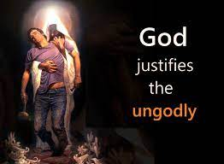

Slide 9
Redemption Needed
Romans 3.9-12

