Slide 1
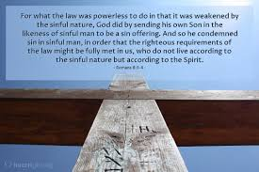
Redemption Provided
Romans 8:1-4

Slide 2
God provided His own Son
Rom 8:1-2 There is therefore now no condemnation for those who are in Christ Jesus. For the law of the Spirit of life in Christ Jesus has made me free from the law of sin and death.
³ For what the law could not do in that it was weak through the flesh, God did by sending His own Son in the likeness of sinful flesh, on account of sin: He condemned sin in the flesh..
(an offering for sin, a sin-offering)

Slide 3
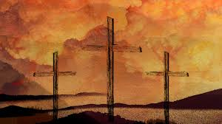
The Work of Christ at Calvary
Man is unable to be righteous through self effort due to the law of sin and death
Gen 2:17 tree of knowledge of good and evil you shall not eat, in the day that you eat of it you shall surely die.”
Eph 2:1 And you He made alive, who were dead in trespasses and sins, ² in which you once walked according to the course of this world,

Slide 4
Satan had the power of death
Romans 3:23/6:23 for all have sinned and fall short of the glory of God.. the wages of sin is death, but the gift of God is eternal life in Christ Jesus our Lord.
Heb 2:14-15 as the children have partaken of flesh and blood, He Himself shared in the same, that through death He might destroy him who had the power of death, that is, the devil, ¹⁵ and release those who through fear of death were all their lifetime subject to bondage.

Slide 5
Christ our Sin Offering
Isaiah 53:5-8 But He was wounded for our trans-gressions, He was bruised for our iniquities; The chas-tisement for our peace was upon Him, And by His stripes we are healed. ⁶ All we like sheep have gone astray; And the Lord has laid on Him the iniquity of us all.
Rom 5:8 But God demonstrates His own love toward us, in that while we were still sinners, Christ died for us.

Slide 6
He Died “for” us
Rom 8:32 He who did not spare His own Son, but delivered Him up for us all, how shall He not with Him give us all things?
1 Cor 15:3 Christ died for our sins according to the Scriptures
2 Cor 5:14 For the love of Christ compels us, because we judge thus: that if One died for all, then all died
Gal 2:20 I have been crucified with Christ; it is no longer I who live, but Christ lives in me; and the life which I now live in the flesh I live by faith in the Son of God, who loved me and gave Himself for me.
Eph 5:2 walk in love, as Christ also has loved us and given Himself for us, an offering and a sacrifice to God for a sweet-smelling aroma.

Slide 7
He Became Sin for Us
2 Cor 5:21 For He made Him who knew no sin to be sin for us, that we might become the righteousness of God in Him.
Matt 27:46 about the ninth hour Jesus cried out with a loud voice, saying, “Eli, Eli, lama sabachthani?” that is, “My God, My God, why have You forsaken Me?”
Isaiah 53:6 All we like sheep have gone astray; And the Lord has laid on Him the iniquity of us all. 10 Yet it pleased the Lord to bruise Him; He has put Him to grief. When You make His soul an offering for sin, He shall see His seed, He shall prolong His days, And the pleasure of the Lord shall prosper in His hand.

Slide 8
Jesus blotted out the bond we owed
Colossians 2:11-14 In Him you buried with Him in baptism, in which you also were raised with Him through faith in the working of God, who raised Him from the dead. ¹³ And you, being dead in your trespasses and the uncircumcision of your flesh, He has made alive together with Him, having forgiven you all trespasses, ¹⁴ having wiped out the handwriting of requirements that was against us, which was contrary to us. And He has taken it out of the way, having nailed it to the cross.

Slide 9
Jesus is our continual offering
Isaiah 53:12 He poured out His soul unto death, And He was numbered with the transgressors, And He bore the sin of many, And made intercession for the transgressors.
Heb 9:26-28 He then would have had to suffer often since the foundation of the world; but now, once at the end of the ages, He has appeared to put away sin by the sacrifice of Himself. ²⁷ And as it is appointed for men to die once, but after this the judgment, ²⁸ so Christ was offered once to bear the sins of many. To those who eagerly wait for Him He will appear a second time, apart from sin, for salvation.

Slide 10
He is our High Priest
Hebrews 2:17-18 Therefore, in all things He had to be made like His brethren, that He might be a merciful and faithful High Priest in things pertaining to God, to make propitiation for the sins of the people. ¹⁸ For in that He Himself has suffered, being tempted, He is able to aid those who are tempted.
Heb 4:14-16 Seeing then that we have a great High Priest who has passed through the heavens, Jesus the Son of God, let us hold fast our confession. ¹⁵ For we do not have a High Priest who cannot sympathize with our weaknesses, but was in all points tempted as we are, yet without sin. ¹⁶ Let us therefore come boldly to the throne of grace, that we may obtain mercy and find grace to help in time of need.

Slide 11
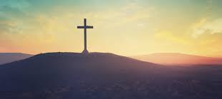
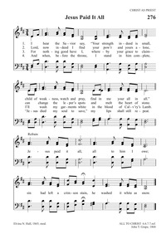
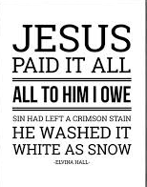

Slide 12
Redemption Provided
Romans 8:1-4

