Slide 1
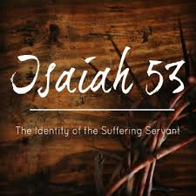
Redemption Satisfied
Isaiah 53:10-12
He shall see the labor of His soul, and be satisfied. By His knowledge My righteous Servant shall justify many, for He shall bear their iniquities.

Slide 2
The Suffering Servant context of Isaiah
Isaiah 40-66 – Comfort to the people of God
“My Servant” 42:1-13 49:1-13 50:4-11 52:13-53:12
Cyrus my anointed – deliver from captivity
Jesus my servant – spiritual deliverance

Slide 3
Exaltation of the Servant
52:13-15 Behold, My Servant shall deal prudently; He shall be exalted and extolled and be very high. ¹⁴ Just as many were astonished at you, So His visage was marred more than any man, And His form more than the sons of men; ¹⁵ So shall He sprinkle many nations. Kings shall shut their mouths at Him; For what had not been told them they shall see, And what they had not heard they shall consider.

Slide 4
Suffering of the Servant
53:1-3 Who has believed our report? And to whom has the arm of the Lord been revealed? ² For He shall grow up before Him as a tender plant, And as a root out of dry ground. He has no form or comeliness; And when we see Him, There is no beauty that we should desire Him. ³ He is despised and rejected by men, A Man of sorrows and acquainted with grief. And we hid, as it were, our faces from Him; He was despised, and we did not esteem Him.

Slide 5
Significance of His Suffering
53:4-6 Surely He has borne our griefs And carried our sorrows; Yet we esteemed Him stricken, Smitten by God, and afflicted. ⁵ But He was wounded for our transgressions, He was bruised for our iniquities; The chastisement for our peace was upon Him, And by His stripes we are healed. ⁶ All we like sheep have gone astray; We have turned, every one, to his own way; And the Lord has laid on Him the iniquity of us all.

Slide 6
Patience of the Servant
53:7-9 He was oppressed and He was afflicted, Yet He opened not His mouth; He was led as a lamb to the slaughter, And as a sheep before its shearers is silent, So He opened not His mouth. ⁸ He was taken from prison and from judgment, And who will declare His generation? For He was cut off from the land of the living; For the transgressions of My people He was stricken. ⁹ And they made His grave with the wicked— But with the rich at His death, Because He had done no violence, Nor was any deceit in His mouth.

Slide 7
Satisfying Results of the Servant
53:10-12 Yet it pleased the Lord to bruise Him; He has put Him to grief. When You make His soul an offering for sin, He shall see His seed, He shall prolong His days, And the pleasure of the Lord shall prosper in His hand. ¹¹ He shall see the labor of His soul, and be satisfied. By His knowledge My righteous Servant shall justify many, For He shall bear their iniquities. ¹² Therefore I will divide Him a portion with the great, And He shall divide the spoil with the strong, Because He poured out His soul unto death, And He was numbered with the transgressors, And He bore the sin of many, And made intercession for the transgressors.

Slide 8
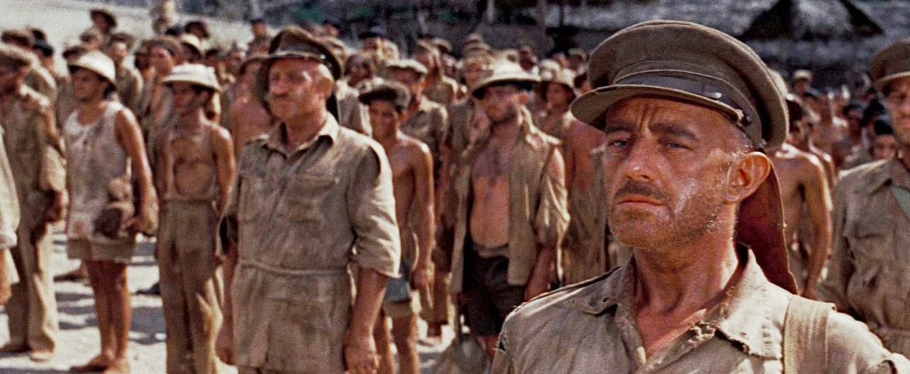
The Bridge on the River Kwai

Slide 9
Applying to us
God exalts the humble
Appearance is not the key
Jesus suffered our punishment
God brings victory out of defeat

Slide 10
Redemption Satisfied
Isaiah 53:10-12
He shall see the labor of His soul, and be satisfied. By His knowledge My righteous Servant shall justify many, for He shall bear their iniquities.

