Slide 1
The Moment Your Destiny Changed
Ephesians 2:11-16

Slide 2
Where do we stand with God?
In Christ? … or without Christ?
Separated? .. or reconciled to God?
Condemnation? …. or righteousness?
Our response to Jesus

Slide 3
Your previous destiny
Eph 2:11-13 Therefore remember…¹² that at that time you were without Christ, being aliens .. and strangers from the covenants of promise, having no hope and without God in the world..
Eph 2:1-5 And you He made alive, who were dead in trespasses and sins.. But God, ⁵ even when we were dead in trespasses, made us alive together with Christ..

Slide 4
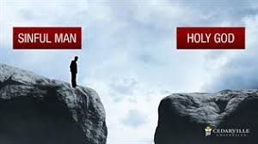
SIN

Slide 5
Your previous path
Matthew 7:13-14 Enter by the narrow gate; for wide is the gate and broad is the way that leads to destruction, and there are many who go in by it.
2 Thessalonians 1:9 These shall be punished with ever-lasting destruction from the presence of the Lord and from the glory of His power,

Slide 6
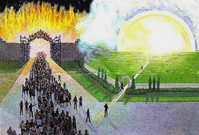

Slide 7
God calls us
Romans 5:6-8 For when we were still without strength, in due time Christ died for the ungodly. ⁷ For scarcely for a righteous man will one die; yet perhaps for a good man someone would even dare to die. ⁸ But God demonstrates His own love toward us, in that while we were still sinners, Christ died for us.
Mark 16:15-16 And He said to them, “Go into all the world and preach the gospel to every creature. ¹⁶ He who believes and is baptized will be saved; but he who does not believe will be condemned.

Slide 9
In Christ.. Place of blessing
Romans 6:17-18 But God be thanked that though you were slaves of sin, yet you obeyed from the heart that form of doctrine to which you were delivered. ¹⁸ And having been set free from sin, you became slaves of righteousness.
Our Positive response leads to a new relationship

Slide 10
Baptism into Christ
Galatians 3:27 For as many of you as were baptized into Christ have put on Christ.
Romans 6:3-5 Or do you not know that as many of us as were baptized into Christ Jesus were baptized into His death? ⁴ Therefore we were buried with Him through baptism into death, that just as Christ was raised from the dead by the glory of the Father, even so we also should walk in newness of life.

Slide 11
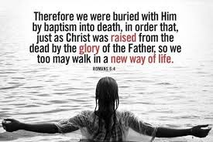

Slide 12
Birth of the new man
Romans 6:5-7 For if we have been united together in the likeness of His death, certainly we also shall be in the likeness of His resurrection, ⁶ knowing this, that our old man was crucified with Him, that the body of sin might be done away with, that we should no longer be slaves of sin. ⁷ For he who has died has been freed from sin.

Slide 13
Your new position
Ephesians 1:3-7 Blessed be the God and Father of our Lord Jesus Christ, who has blessed us with every spiritual blessing in the heavenly places in Christ, ⁴ just as He chose us in Him before the foundation of the world, that we should be holy and without blame before Him in love..
5 having predestined us to adoption as sons by Jesus Christ to Himself, according to the good pleasure of His will, ⁶ to the praise of the glory of His grace, by which He made us accepted in the Beloved.
7 In Him we have redemption through His blood, the forgiveness of sins, according to the riches of His grace

Slide 14
Your new destiny
Ephesians 2:4-7 But God, who is rich in mercy, because of His great love with which He loved us, ⁵ even when we were dead in trespasses, made us alive together with Christ (by grace you have been saved), ⁶ and raised us up together, and made us sit together in the heavenly places in Christ Jesus, ⁷ that in the ages to come He might show the exceeding riches of His grace in His kindness toward us in Christ Jesus.

Slide 15
Your new destiny
New Lord and Master .. Rom 6:16 you are that one’s slave whom you obey.. sin leading to death or obedience leading to righteousness
New family .. John 1:11-12 But as many as received Him, to them He gave the right to become children of God, to those who believe in His name
New home .. 1 Peter 2:11-12, Phil 3:20-21 For our citizenship is in heaven, from which we also eagerly wait for the Savior, the Lord Jesus Christ, ²¹ who will transform our lowly body that it may be conformed to His glorious body..

Slide 16
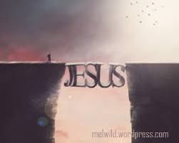

Slide 18
The Moment Your Destiny Changed
Ephesians 2:11-16

