Slide 1
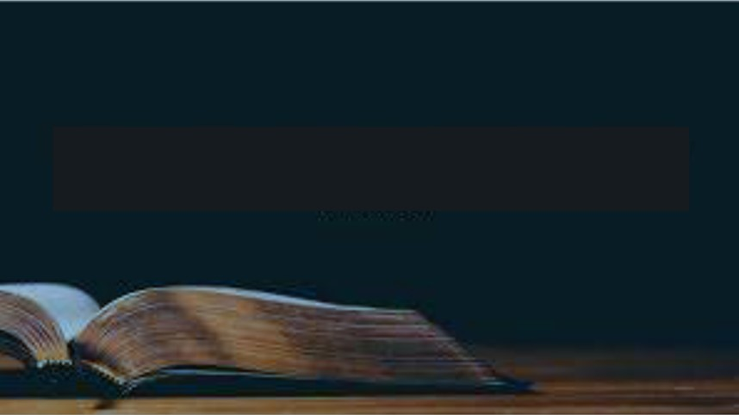
Not Seeing our Own Faults
2 Samuel 12:1-15

Slide 2
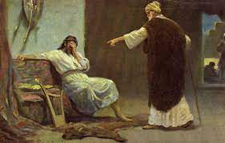
We are good at pointing out others’ faults ..
Why can’t we see our own?

Slide 3
1 We Aren’t Looking for them
James 1:22-25 But be doers of the word, and not hearers only, deceiving yourselves. ²³ For if anyone is a hearer of the word and not a doer, he is like a man observing his natural face in a mirror; ²⁴ for he observes himself, goes away, and immediately forgets what kind of man he was.
²⁵ But he who looks into the perfect law of liberty and continues in it, and is not a forgetful hearer but a doer of the work, this one will be blessed in what he does.

Slide 4
2 We Try to Excuse them
Genesis 3:8-13 Then the man said, “The woman whom You gave to be with me, she gave me of the tree, and I ate.”¹³ And the Lord God said to the woman, “What is this you have done?” The woman said, “The serpent deceived me, and I ate.”
Exodus 32:22-24 You know the people, that they are set on evil. ²³ For they said to me, ‘Make us gods that shall go before us; as for this Moses, the man who brought us out of the land of Egypt, we do not know what has become of him.’ ²⁴ And I said to them, ‘Whoever has any gold, let them break it off.’ So they gave it to me, and I cast it into the fire, and this calf came out.”

Slide 5
Don’t forget..God will hold you accountable
2 Samuel 12:7-12 Then Nathan said to David, “You are the man! Thus says the Lord God of Israel: ‘I anointed you king over Israel, and I delivered you from the hand of Saul. ⁸ I gave you your master’s house and your master’s wives into your keeping, and gave you the house of Israel and Judah. And if that had been too little, I also would have given you much more!

Slide 6
3 We don’t like to hear it
Amos 5:10 They hate the one who rebukes in the gate, And they abhor the one who speaks uprightly.
Amos 7:12-13 Then Amaziah said to Amos: “Go, you seer! Flee to the land of Judah. There eat bread, And there prophesy. ¹³ But never again prophesy at Bethel, For it is the king’s sanctuary, And it is the royal residence.”
Ezekiel 33:31-32 So they come to you as people do, they sit before you as My people, and they hear your words, but they do not do them; for with their mouth they show much love, but their hearts pursue their own gain.

Slide 7
David didn’t have this attitude
2 Samuel 12:13 So David said to Nathan, “I have sinned against the Lord.”
James 5:16 Confess your trespasses to one another, and pray for one another, that you may be healed. The effective, fervent prayer of a righteous man avails much.

Slide 8
4 We try to hide them
2 Samuel 12:9-12 Why have you despised the commandment of the Lord, to do evil in His sight? You have killed Uriah the Hittite with the sword; you have taken his wife to be your wife, and have killed him with the sword of the people of Ammon…For you did it secretly, but I will do this thing before all Israel, before the sun.’ ”
Isaiah 29:15 Woe to those who seek deep to hide their counsel far from the Lord, And their works are in the dark; They say, “Who sees us?” and, “Who knows us?”

Slide 9
How does it end?
2 Samuel 12:13-14 So David said to Nathan, “I have sinned against the Lord.”
And Nathan said to David, “The Lord also has put away your sin; you shall not die. ¹⁴ However, because by this deed you have given great occasion to the enemies of the Lord to blaspheme, the child also who is born to you shall surely die.”

Slide 10
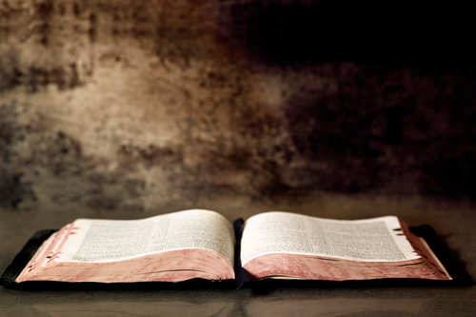
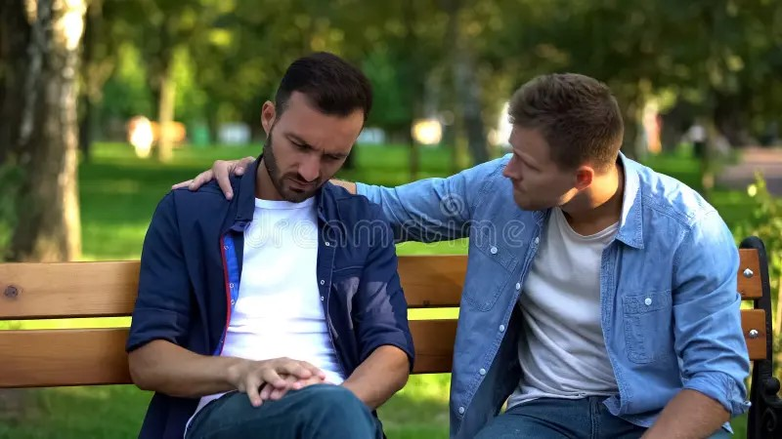
Despise not the correction of the Lord..

Slide 11
Not Seeing our Own Faults
2 Samuel 12:1-15

