Slide 1
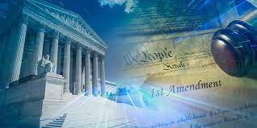
freedom
John 8.32-36
The Healing of America

Slide 2
True Freedom..
John 8:32 And you shall know the truth, and the truth shall make you free.”
³³ They answered Him, “We are Abraham’s descendants, and have never been in bondage to anyone. How can You say, ‘You will be made free’?” ³⁴ Jesus answered them, “Most assuredly, I say to you, whoever commits sin is a slave of sin. ³⁵ And a slave does not abide in the house forever, but a son abides forever.
³⁶ Therefore if the Son makes you free, you shall be free indeed.

Slide 3
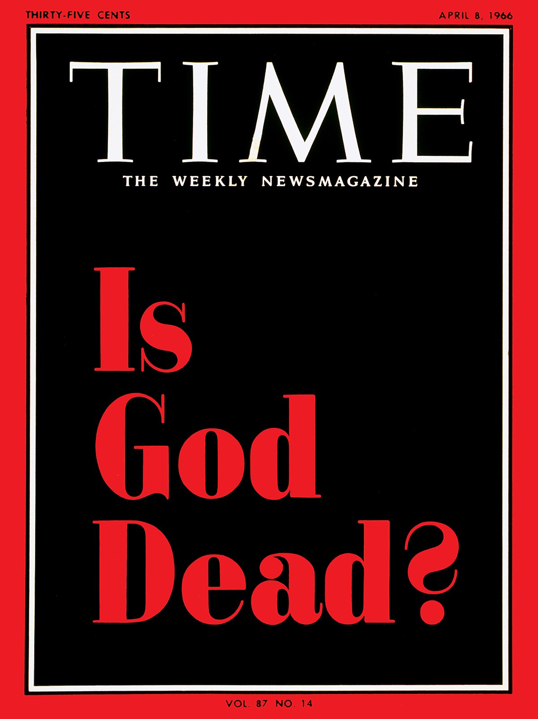
False Freedom (from God)
Genesis 3:4-5 the serpent said to the woman, “You will not surely die. ⁵ For God knows that in the day you eat of it your eyes will be opened, and you will be like God, knowing good and evil.”
2 Peter 2:19 While they promise them liberty, they themselves are slaves of corruption; for by whom a person is overcome, by him also he is brought into bondage.

Slide 4
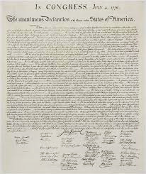
Founders’ View of Freedom
Declaration of Independence July 4, 1776
We hold these truths to be self-evident, that all men are created equal, that they are endowed by their Creator with certain unalienable Rights, that among these are Life, Liberty and the pursuit of Happiness.--That to secure these rights, Governments are instituted among Men, deriving their just powers from the consent of the governed, --That whenever any Form of Government becomes destructive of these ends, it is the Right of the People to alter or to abolish it, and to institute new Government, laying its foundation on such principles and organizing its powers in such form, as to them shall seem most likely to effect their Safety and Happiness.

Slide 5
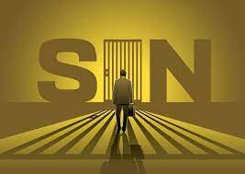

Slide 6
The Bible’s Vision of Living
Christ has set us free (we need to live out this freedom in living as He created us)
God is working through us, including the freeing of others to experience life with God
Our inner freedom should lead to outer freedom (religious, economic, political)

Slide 7
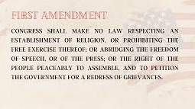

Slide 8
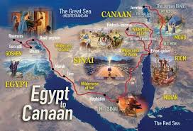
Biblical Freedom

Slide 9
Biblical Perspective on Freedom
Know the truth – the truth will set us free
Throwing off the bondage of sin
Becoming a servant of Christ
Rejecting lies which hold us captive
Relativism – no absolute truth
Freedom from moral restraint

Slide 10
Freedom in Old Testament
God delivered them from slavery in Egypt
Exodus 20:2 Exod 21:2 Deut 7:8 Deut 15:12
Pattern: generation that didn’t follow God lost freedom
Message of the Prophets
Isaiah 61:1 The Lord has sent me to proclaim liberty to the captives
2 Chron 7:14 if My people who are called by My name will humble them-selves, and pray and seek My face, and turn from their wicked ways, then I will hear from heaven, and will forgive their sin and heal their land.

Slide 11
Freedom in New Testament
Main focus: freedom in Christ from sin
John 3:19-20 John 8:31-32 Romans 1:20-25
Old Self – away from God (My will be done)
In Christ – toward God (Thy will be done)
Paradox (How can “serving God” be freedom?)
To live to fullest as we are designed by God to function

Slide 12
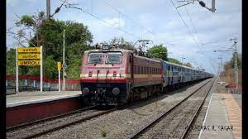

Slide 13
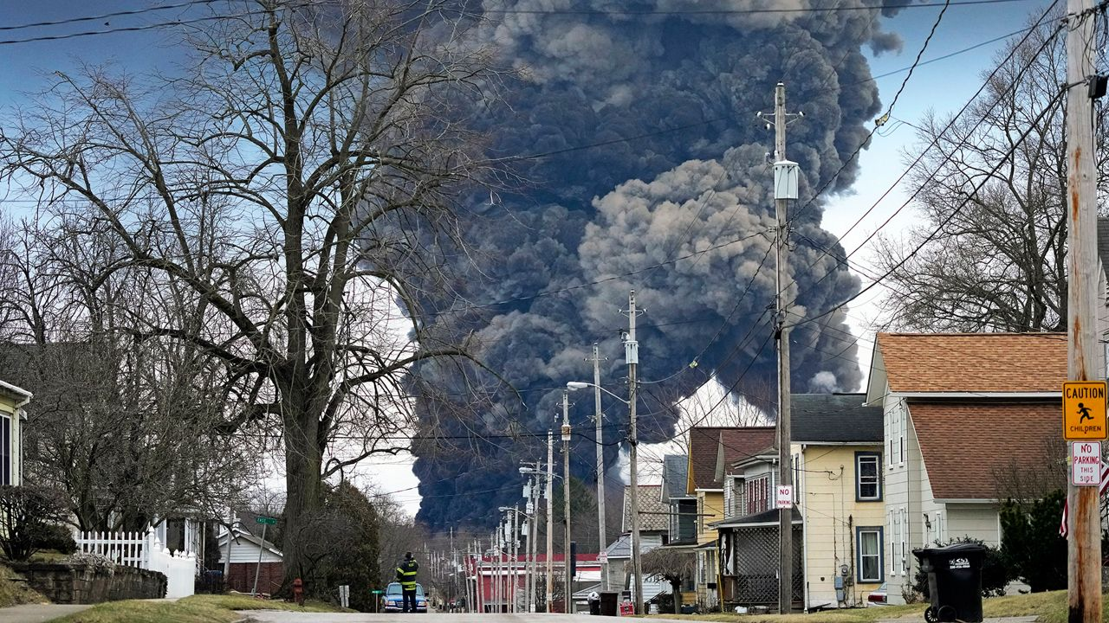

Slide 14
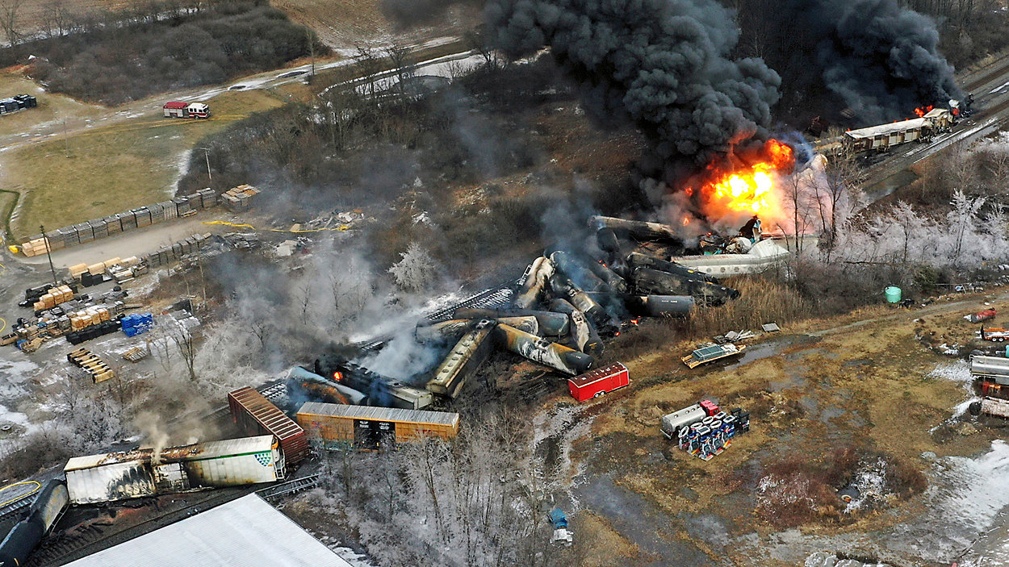

Slide 15
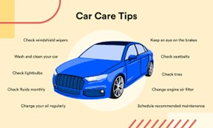

Slide 16
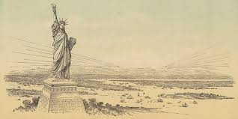

Slide 19
freedom
John 8.32-36
The Healing of America

