Slide 1
law
Deuteronomy 4:1-9
The Healing of America

Slide 2
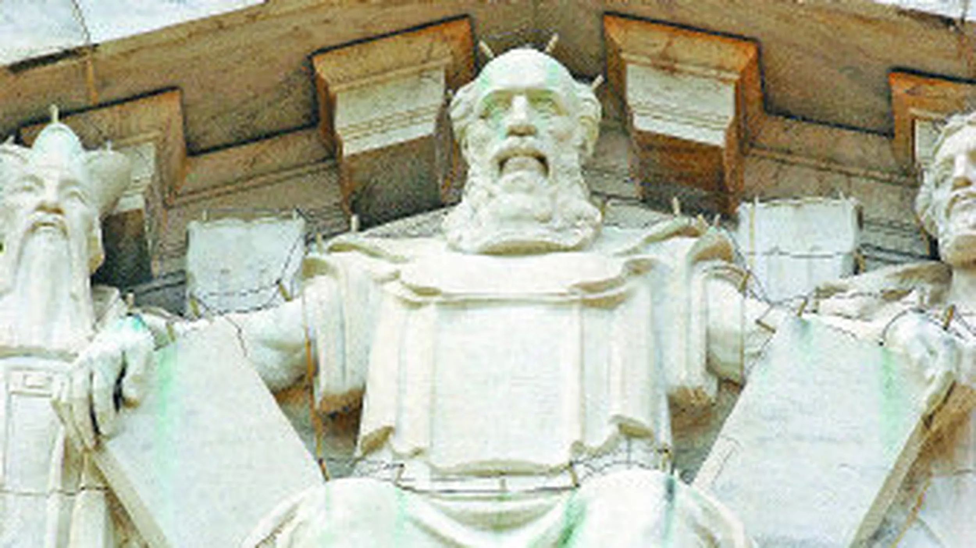
U.S. Supreme Court Building

Slide 3
America’s Legal System
Based in God’s Word
All men created equal
Man’s sinful corruption
Religious freedom
Limited government
OT Hebrew commonwealth
7th Day/1st Day govt rest

Slide 4
Losing our godly heritage
Human tendency to wander
History of human governments
Only one kingdom stands forever
Daniel 2:31-34 earthly empires
Dan 2:44 God of heaven kingdom
Matt 16:18 Built on the Rock

Slide 5
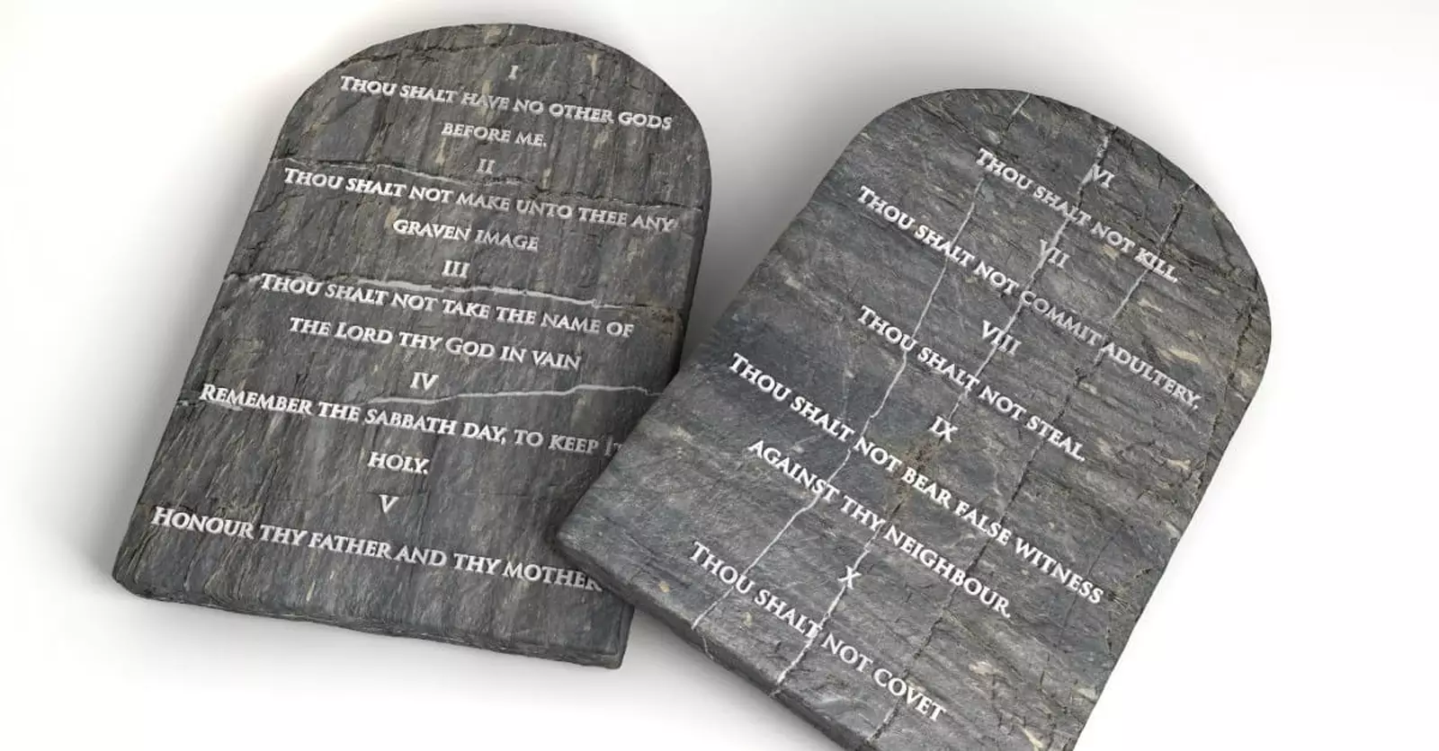
God created us in relationship
Live in relationship (God/man)
Man’s difficulty from the beginning
God freed his people/gave Law (torah)
Ten simple laws written on stone
Honor God alone
Respect your parents
Don’t kill/steal/lie
Don’t cheat on wife
Exodus 20:1-17
Galatians 3:24

Slide 6
The Perfect source of Law
Proverbs 6:20-23 My son, keep your father’s com-mand, And do not forsake the law of your mother. ²¹ Bind them continually upon your heart; Tie them around your neck. ²² When you roam, they will lead you; When you sleep, they will keep you; And when you awake, they will speak with you. ²³ For the commandment is a lamp, And the law a light; Reproofs of instruction are the way of life..

Slide 7
Law written on their hearts
Romans 2:14-15 for when Gentiles, who do not have the law, by nature do the things in the law, these, although not having the law, are a law to themselves, ¹⁵ who show the work of the law written in their hearts, their conscience also bearing witness, and between themselves their thoughts accusing or else excusing them)

Slide 8
Guiding us to Love
Romans 13:8-10 Owe no one anything except to love one another, for he who loves another has fulfilled the law. ⁹ For the commandments, “You shall not commit adultery,” “You shall not murder,” “You shall not steal,” ^{[a]}“You shall not bear false witness,” “You shall not covet,” and if there is any other commandment, are all summed up in this saying, namely, “You shall love your neighbor as yourself.” ¹⁰ Love does no harm to a neighbor; therefore love is the fulfillment of the law.

Slide 9
Moving the lines of morality
God is dead
Truth is relative
God did not create life
Sex is for self gratification
Moral Laws can be ignored
Church should be separate
Christians should keep quiet
We can return to God if we recognize these lies and return to the truths of the Almighty

Slide 10
The Ultimate Truth
John 3:16 For God so loved the world that He gave His only begotten Son, that whoever believes in Him should not perish but have everlasting life.
Luke 10:25-37 The Good Samaritan
Lawyer asks how may I inherit eternal life?
Jesus – what do the scriptures say?
Love Lord your God/Love your neighbor
Who is my neighbor?

Slide 11
law
Deuteronomy 4:1-9
The Healing of America

